Slide 1
Unit Three- Early Republic

Slide 2
Growing Pains
Population after 1789
US heavily in debt!
Rest of the world interested in our outcome…

Slide 3
Con’t…
How to pay off debt?
  Impose tariff
  Excise tax: mainly on whiskey tax

Slide 4
Hamilton vs T. Jefferson on National Bank
Hamilton
  Gov’t main stockholder
  “Necessary and Proper” clause (AKA- Elastic Clause)
  Loose interpretation
Jefferson
  Tool of the rich!
  State control over banks is best
  Strict interpretation

Slide 5
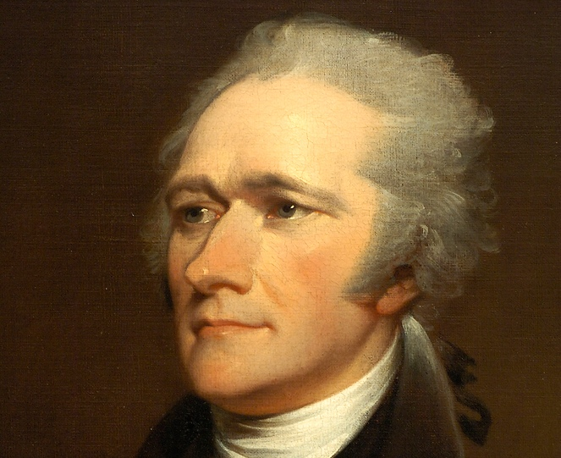
Result?
Hamilton won!
  Bank of US created in 1791
  Lasted 20 years
Alexander Hamilton

Slide 6
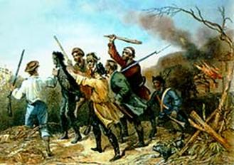
Whiskey Rebellion (1794)
Farmers in W. PA disagreed with Hamilton's excise tax
Washington sent troops to quell rebellion
Proved new gov’t was STRONG

Slide 7
Emergence of Political Parties
Rivalry b/t Jefferson and Hamilton
Anti-Federalists become Democratic-Republicans (Jefferson and Madison)
  Weak national gov’t
  No fed. Taxes
  Location/occupations
Federalists
  Hamilton and John Adams
  Strong national gov’t
  Location/occupations
  Will later become known as the Whigs
    Yes fed. Taxes

Slide 8
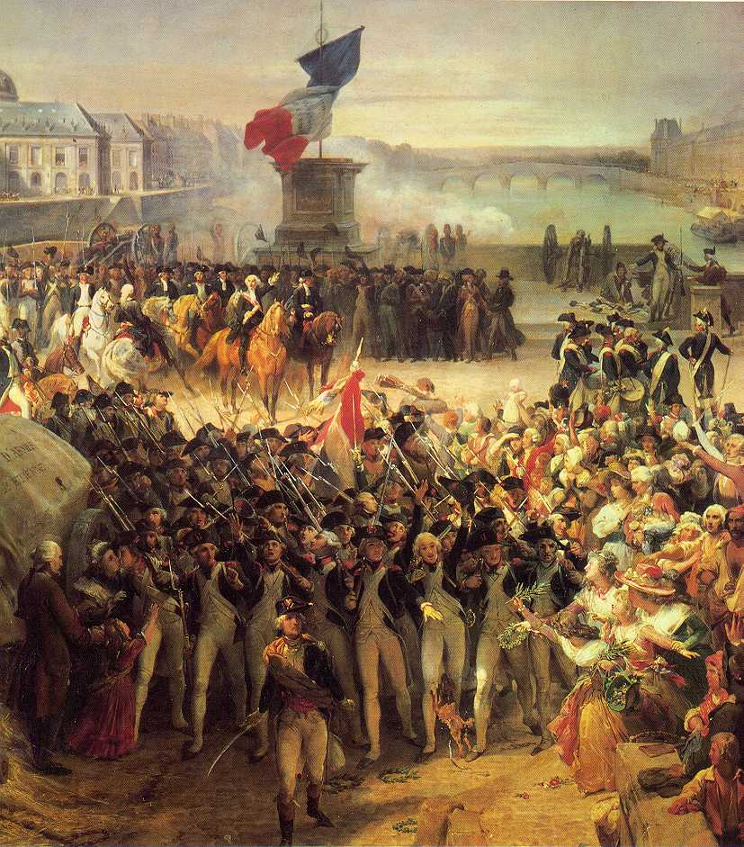
French Revolution (1789)
Huge impact on US
Mobocracy?
France declares war on G.B. and war starts again in Europe

Slide 9
Neutrality Proclamation
JDR’s (Jeffersonian Democratic-Republicans) support France
Hamilton supports England
Washington proclaims neutrality
Britain ignores proclamation
  impressment

Slide 10
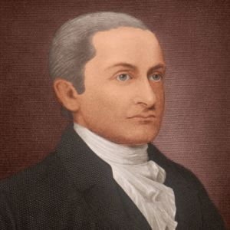
Jay’s Treaty
John Jay
  Negotiated with England to prevent war
  South is furious
John Jay

Slide 11
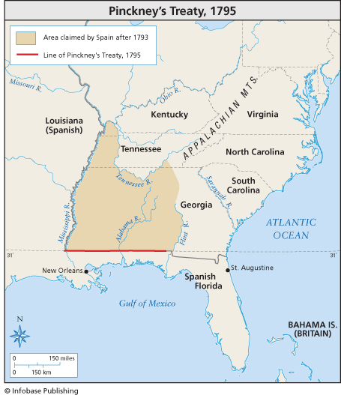
Treaty with Spain
  Pinckney Treaty of 1795

Slide 12
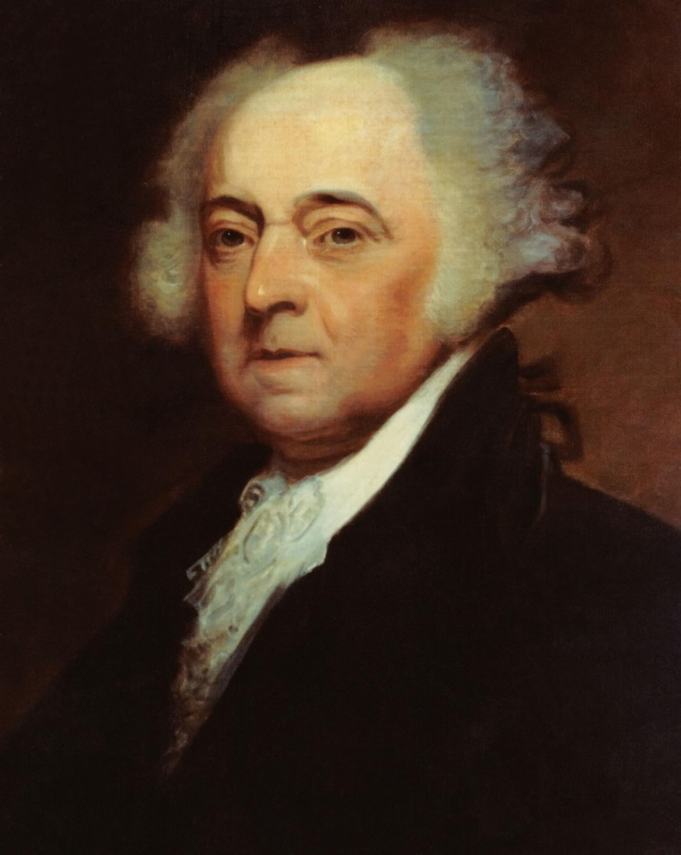
Washington Says Farewell
2-term precedent
Farewell Address
John Adams new President
John Adams

Slide 13
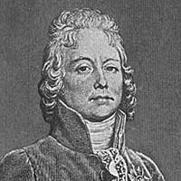
XYZ Affair (1798-1800)
France mad about Jay’s Treaty
Talleyrand
“Quasi-War”
Marquis de Talleyrand

Slide 14
Alien Laws
New residence requirements
Deportation easier

Slide 15
Sedition Act
Punished “violators” of gov’t policy
Aimed at JDR’s
1st amendment anyone??

Slide 16
Virginia and Kentucky Resolutions
Virginia Resolution
  Madison
Kentucky Resolution
  Jefferson
States made federal gov’t so they should be able to nullify federal laws
End Federalist abuses!

Slide 17
Federalists vs Democratic-Republicans
Federalists
  Pro-British
  Educated, wealthy northerners
  SOME DEBT IS OKAY
Democratic-Republicans
  Pro-French
  Farmers
  DEBT IS SUPER DUPER BAD

Slide 18
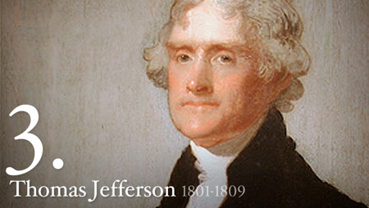
Election of 1800
Federalists put country in debt w. Navy
  Jefferson attacked by Federalists
Aaron Burr and Jefferson TIE
Revolution of 1800
Thomas Jefferson

Slide 19
Jefferson’s Presidency
President in the new capital of DC
Pardoned some accused under Sedition Act
Albert Gallatin

Slide 20
Judiciary Act of 1789
1789- Gave Congress the authority to create federal court system. Also stated an executive official would have to carry out judicial appointments

Slide 21
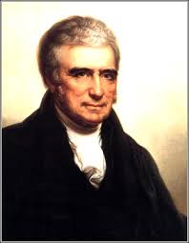
Marbury v Madison (1803)
“Midnight Judges”
Marbury v Madison (1803)
  William Marbury and James Madison
  Chief Justice John Marshall
  Stated J. Act of 1789 was unconstitutional
  “Doctrine of Judicial Review”
Marshall

Slide 22
Louisiana Purchase
Spain sells land to France
Jefferson buys it from France for $15 million- 1803
Unconstitutional?
  180° turn of philosophical beliefs
Doubles size of US

Slide 23
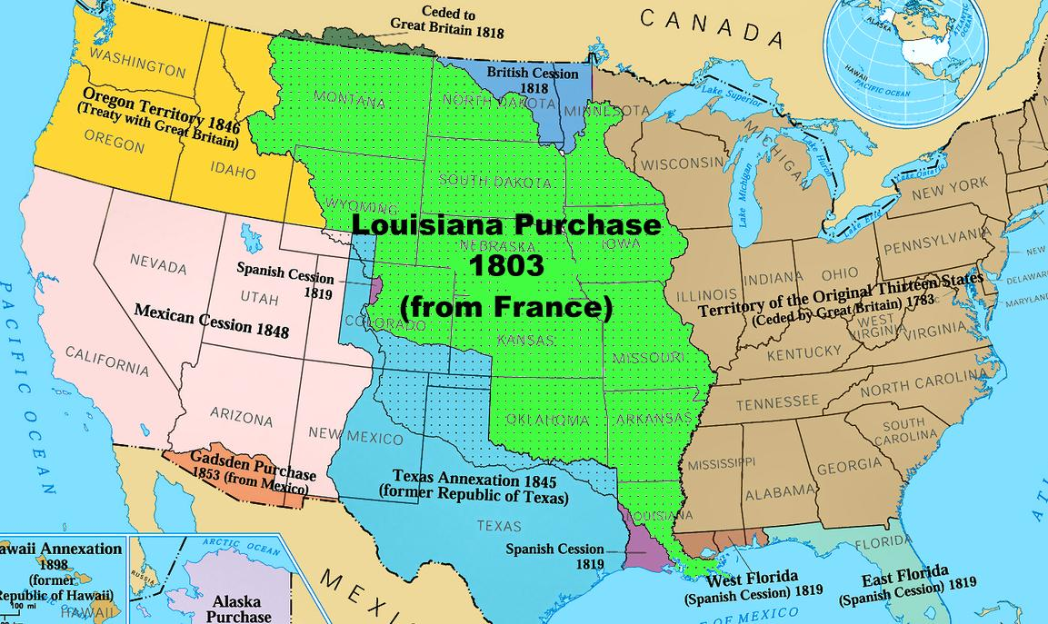

Slide 24
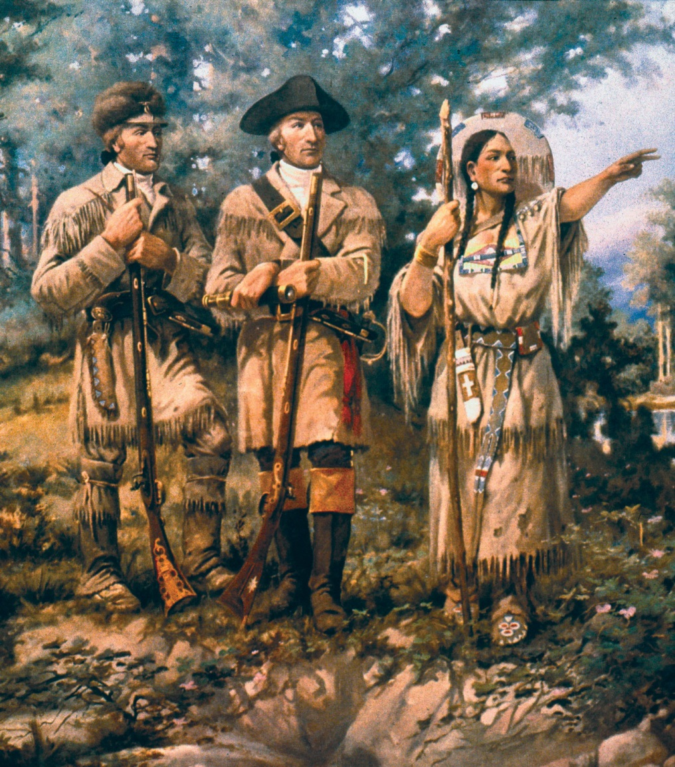
Con’t…
William Clark and Meriwether Lewis
Sacajawea

Slide 25
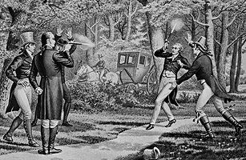
Aaron Burr Conspiracies
Burr vs Hamilton
Arrested for murder and later, treason

Slide 26
Leading up to War of 1812
Jefferson wins 1804 election
War b/t France and Britain affects US
Embargo Act 1807
  Prohibition of commerce/trade with a particular country

Slide 27
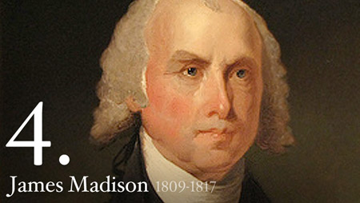
James Madison
4th president- 1809
Macon’s Bill #2
Madison

Slide 28
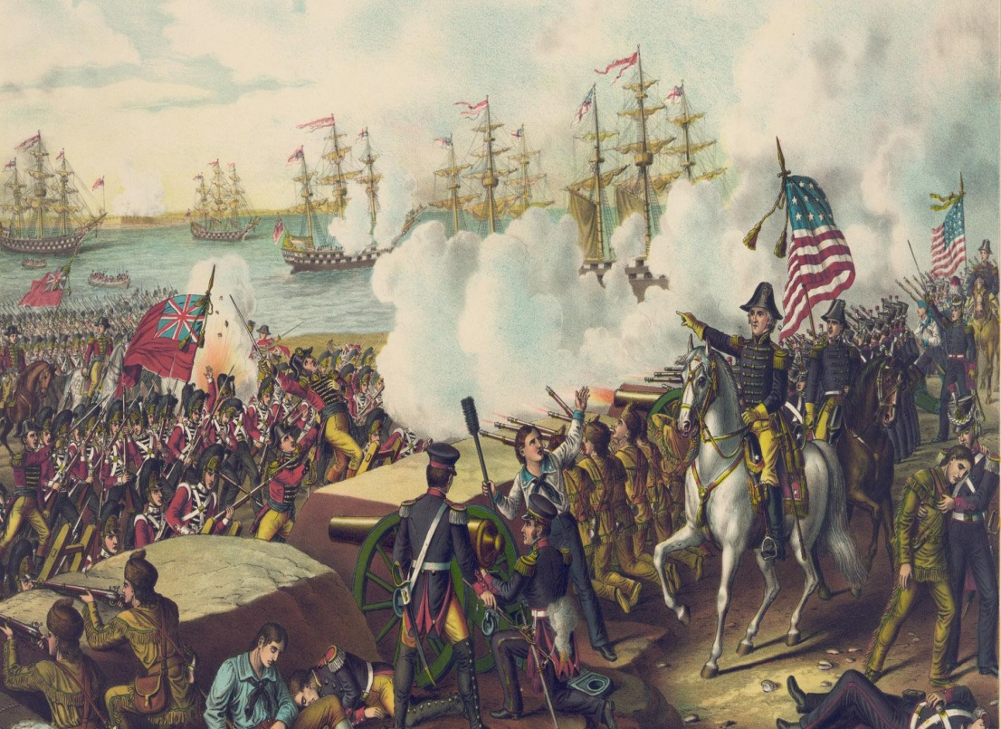
War of 1812
US vs Great Britain
Why Britain?
  Freedom of Seas
  Native American issues
  Canada!
Federalists opposed war

Slide 29
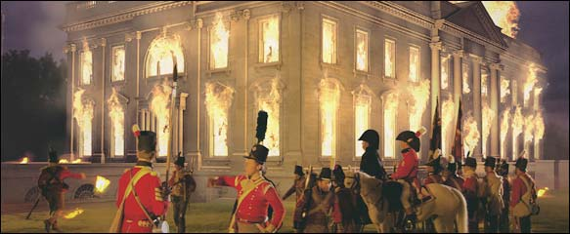
Con’t
Brits burn down Capitol and Whitehouse

Slide 30
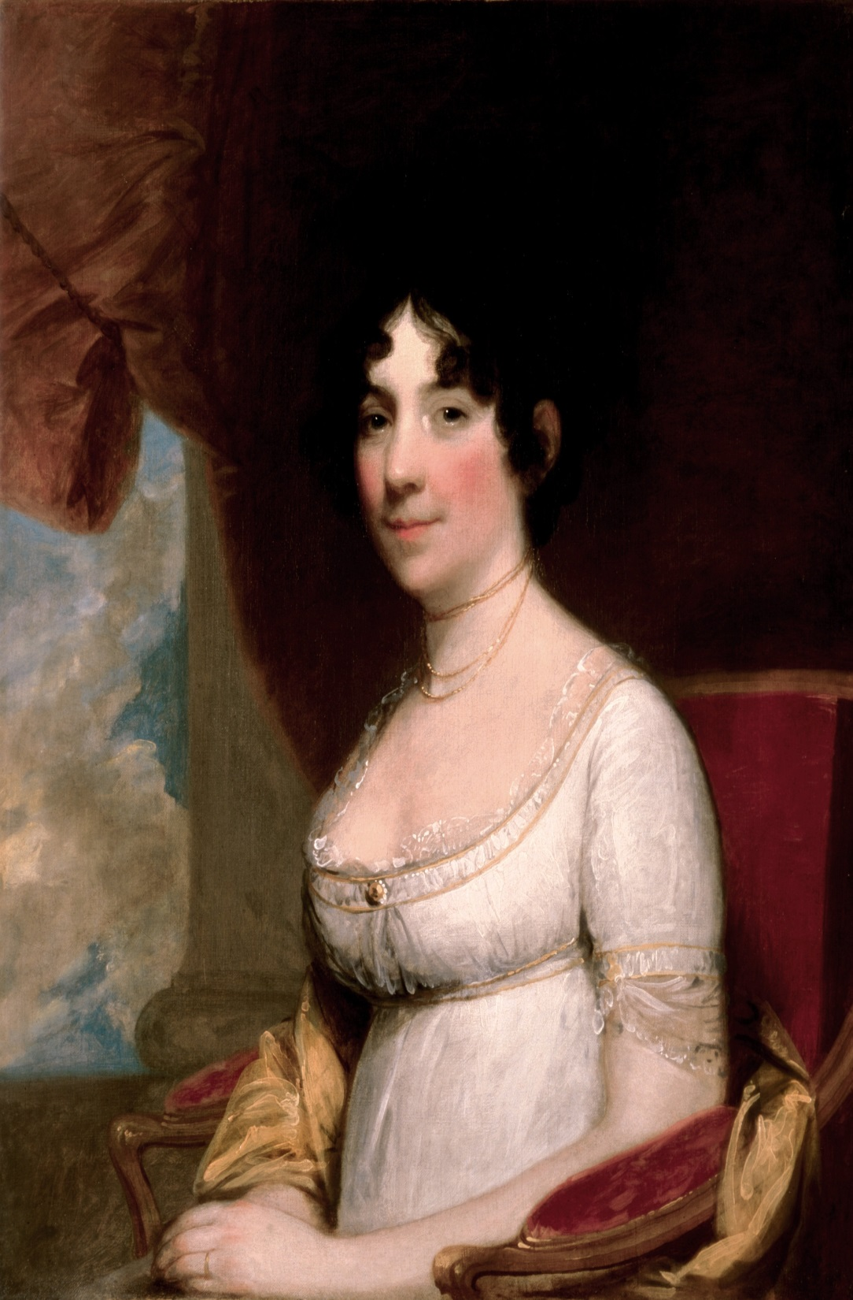
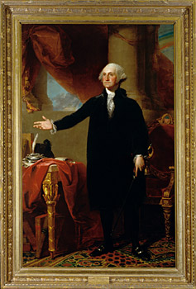

Slide 31
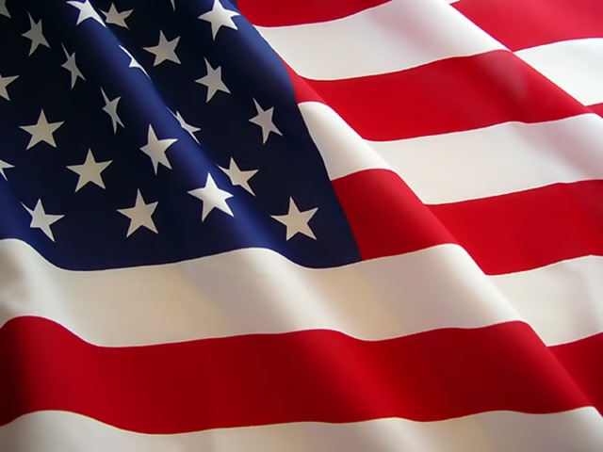
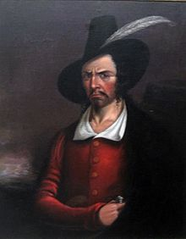
Con’t
Francis Scott Key and the Star Spangled Banner
Battle in New Orleans
  Jean Lafitte
Lafitte

Slide 32
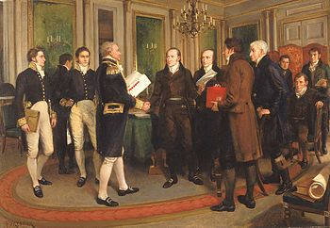
Treaty of Ghent
Tsar Alexander I
Signed Christmas Eve 1814

Slide 33
Hartford Convention
Federalist grievances
Wanted to abolish 3/5s clause
Federalists never have successful presidential campaign again

Slide 34
Effects of War of 1812
America gets respect
War heroes: Andrew Jackson and William Henry Harrison
Canadians felt betrayed by Britain

Slide 35
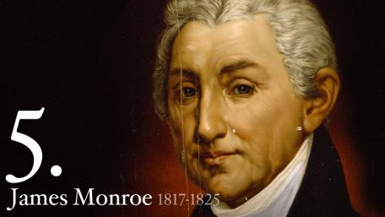
Era of Good Feelings
James Monroe- 5th president (1816)
Chartered the 2nd federal bank
Name is a misnomer
Monroe

Slide 36
Missouri Compromise (1820)
  Missouri Compromise created
    Missouri entered as a slave state
    East-west line through LA Purchase with slavery prohibited above the line and allowed below

Slide 37
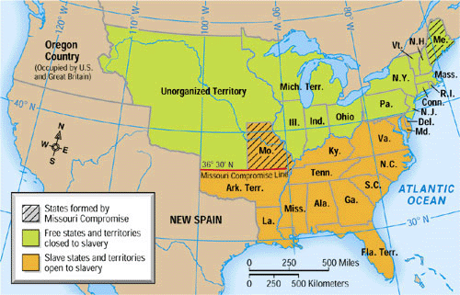

Slide 38
John Marshall and Judicial Nationalism
McCulloch vs Maryland
  Doctrine of implied powers
  Gibbons vs Ogden
    States can’t control interstate commerce
    Marbury, McCulloch, and Ogden are the foundation blocks of the Supreme Courts authority to mediate b/t Branches of gov’t as decided during J. Marshalls tenure as chief justice of the Supreme Court

Slide 39
Oregon and Florida
Monroe and John Quincy Adams
Anglo-American convention of 1818
  Canada and US share Oregon territory for 10 years
  Spain still controls FL
    Andrew Jackson went to FL and disobeyed D.C.
    Adams-Onis Treaty ($5 million to purchase FL)

Slide 40
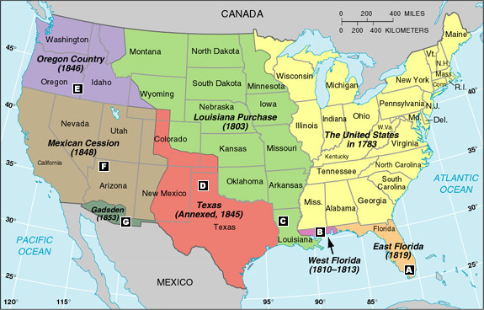

Slide 41
Monroe Doctrine
European fear of democracy
American fear of Europe
British propose alliance
Monroe Doctrine created in 1823
  America NOT opened for colonization
  W. Hemisphere is a Republic, not a monarchy
  US won’t get involved in Europe
  Europe tries to get involved in US- threat!

Slide 42
Con’t
Europe enraged
Self-defense policy

