Slide 1
Unit Eight
Great Depression, Interwar, World War II

Slide 2
The Onset of the Great Depression
1929-1932

Slide 3
Causes and Consequences
Business was booming, but investments were made with borrowed money
“Black Tuesday”
Long-standing weaknesses exposed in economy
Causes of the Great Depression: The stock market crash of 1929 and collapse of stock prices
Banks and businesses fail
12 million people are now out of work

Slide 4
Con’t…
Foreign markets began to rely on US help but with the depression we could no longer afford to do so
  This disrupts European financial system
Hawley-Smoot Tariff of 1930 raised high protective tariffs to all-time highs, European governments retaliated by imposing their own trade restrictions.
This is going to strangle world trade

Slide 5
Con’t…
European demand for US agriculture products came to almost stand-still
No one is spending any money!
This combined with the crash in 1929 brings on global depression

Slide 6
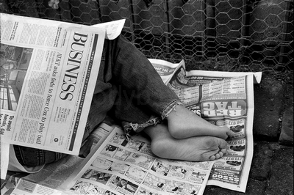
Rising Discontent
Hoovervilles appear
Farm Holiday Association
Labor strikes on the rise
“Hoover blankets”

Slide 7
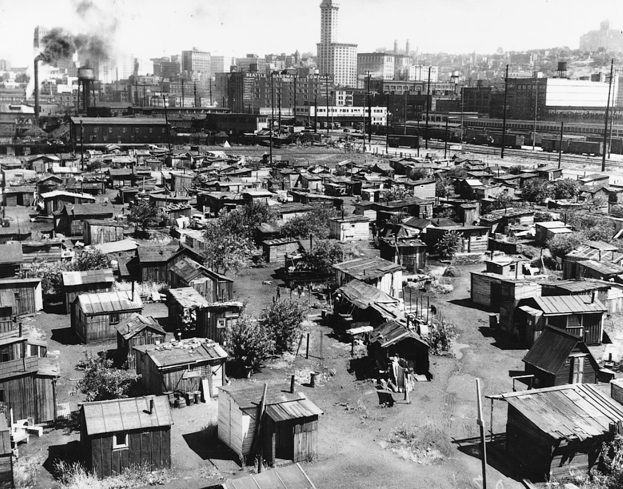
In the early years of the depression,
desperate, homeless people
constructed shacks out of scavenged
materials. These shantytowns
sprang up in cities across
the country.

Slide 8
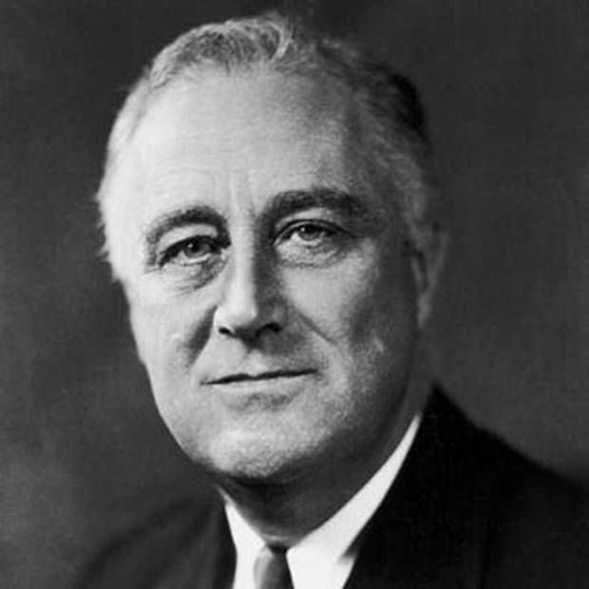
1932 Election
Rep. Herbert Hoover vs. Dem. Franklin Delano Roosevelt
Roosevelt a victim of polio
Roosevelt is victorious
FDR

Slide 9
The New Deal
1933-1939

Slide 10
The New Deal Takes Over
Roosevelt proposes “New Deal” as a response to the nations suffering
This program changed the role of the government to a more active participant in solving problems.
Roosevelt rallied a frightened nation in which one in four workers was unemployed.
“We have nothing to fear, but fear itself.”

Slide 11
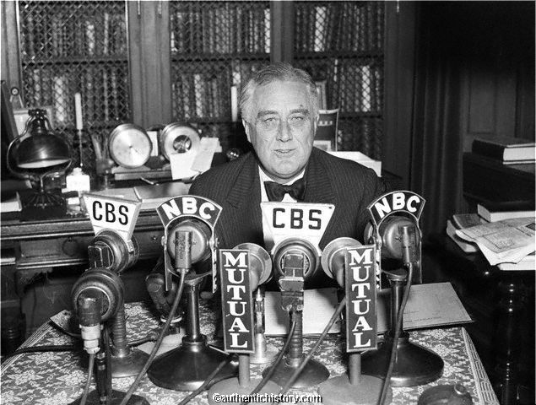
Roosevelt's Leadership
FDR popular b/c he is willing to experiment with new ideas
“fireside chats”
Willing to seek advice for help on New Deal tactics

Slide 12
The Hundred Days
FDR declared a national “bank holiday”
The Emergency Banking Act
Federal Deposit Insurance Corporation (FDIC) is created
  This is a reform measure to correct unsound banking and investment practices

Slide 13
Time for some alphabet soup…
Civilian Conservation Corps (CCC)
Tennessee Valley Authority (TVA)
Agricultural Adjustment Administration (AAA)
Civil Works Administration (CWA)

Slide 14
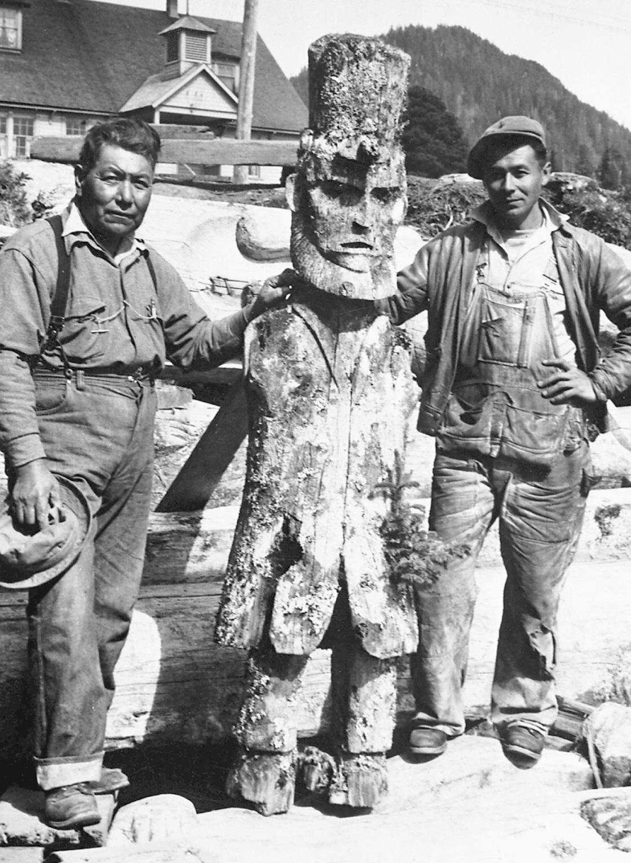
These Tlingit carvers in Alaska’s southeastern panhandle were part of a CCC project to restore totem poles. Here they stand with a pole carved in the likeness of Abraham Lincoln

Slide 15
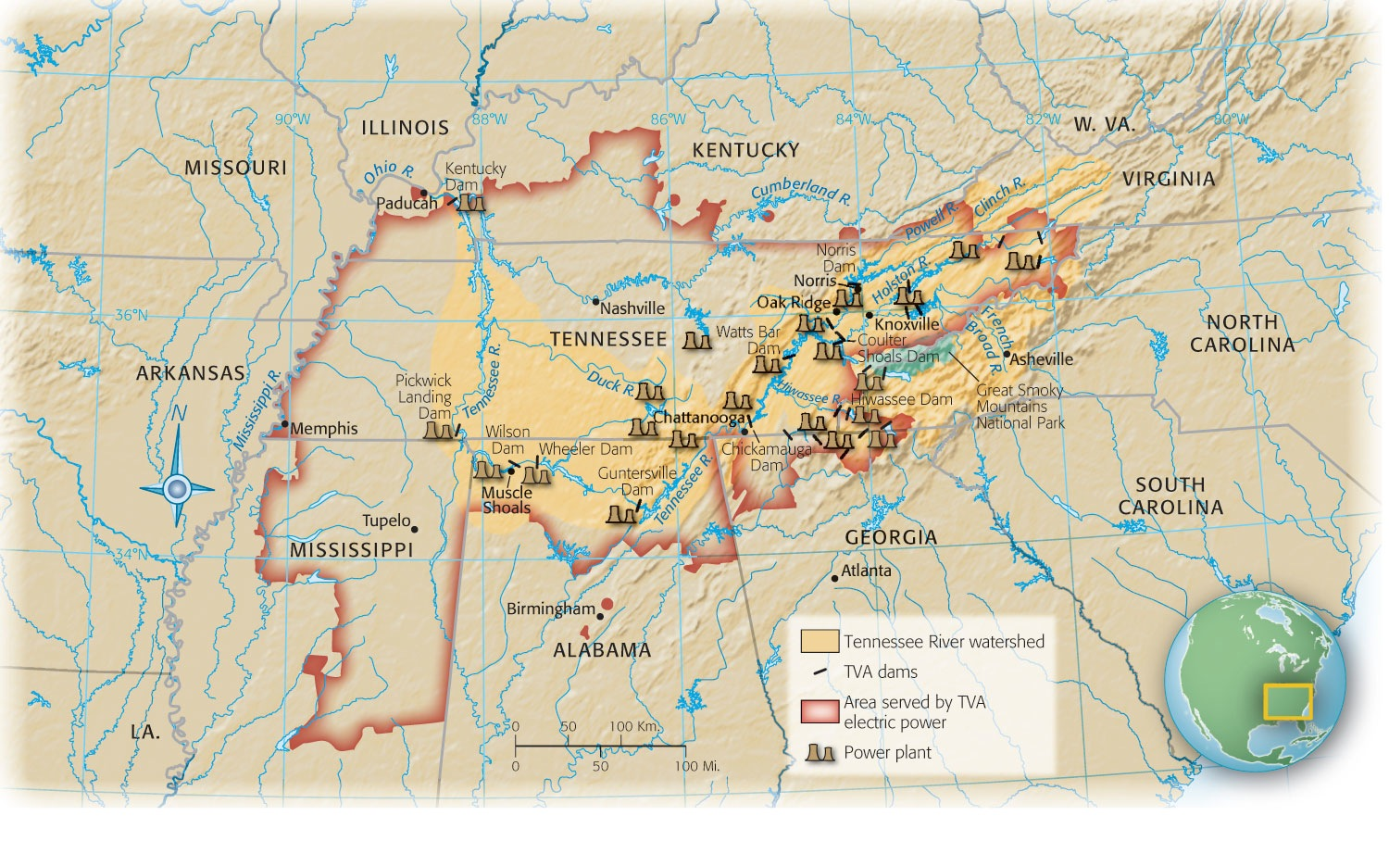
20 dams built on TN River

Slide 16
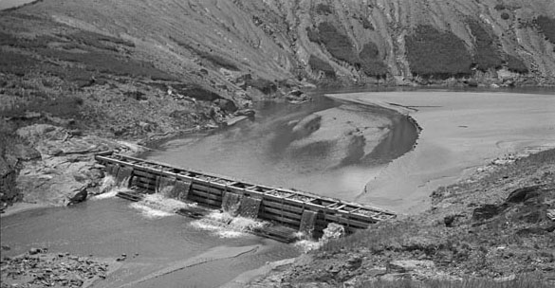

Slide 17
Federal Reserve
  The Federal Reserve is the part of the national gov’t that controls the supply of money in the economy

Slide 18
Second New Deal

Slide 19
Legislative Accomplishments
Roosevelt has his eye on the next election- looks to broaden scope of relief efforts
Social Security Act of 1935
  This is acting as a safeguard for workers
The legacy of the New Deal influenced the public’s belief in the responsibility of government to deliver public services, to intervene in the economy, and to act in ways that promote the general welfare.
Works Progress Administration (WPA) became the main federal relief agency and provided direct payment to people for immediate help

Slide 20
1936 Election
FDR had support of new Democrats AND progressive Republicans
FDR vs R. Alfred M. Landon
Roosevelt’s victory is one of the biggest landslides in American history

Slide 21
New Deal’s Impact on Society

Slide 22
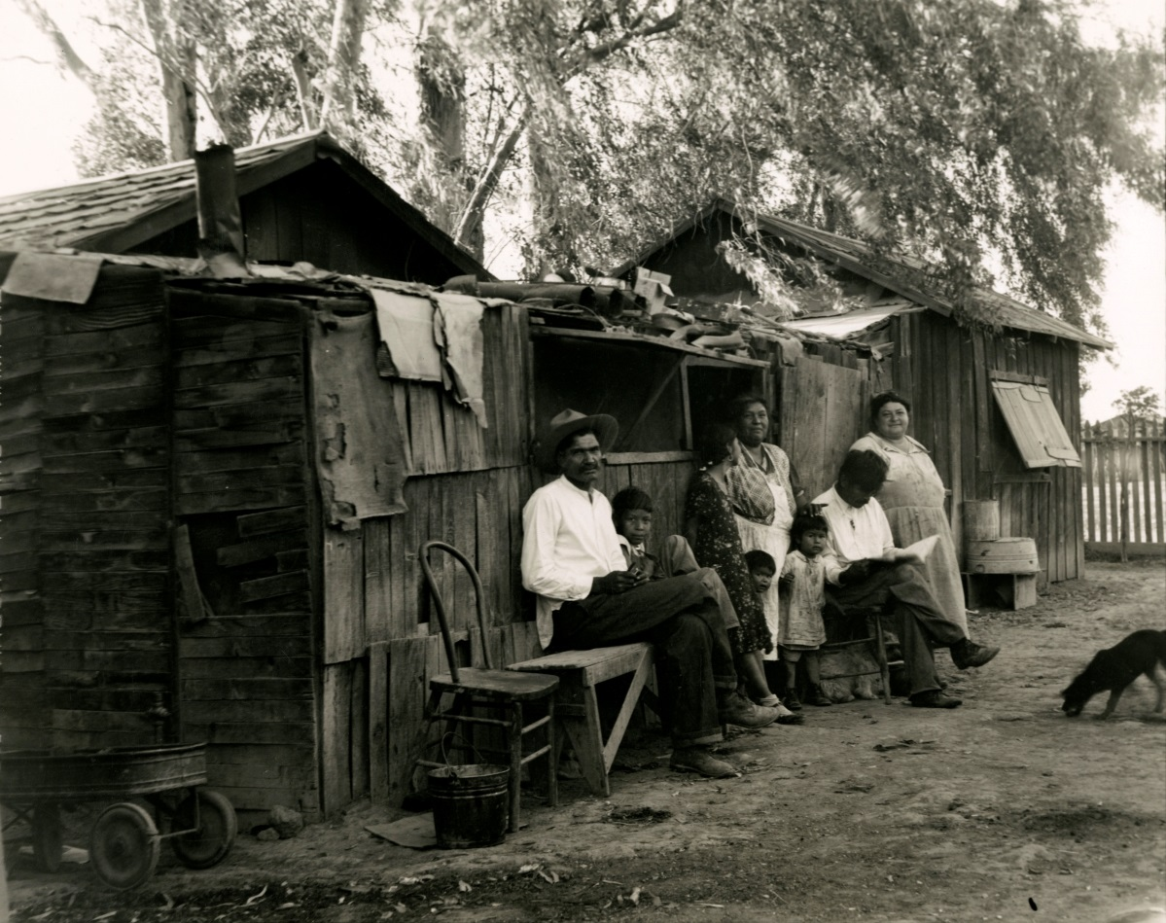
Migrants and Minorities in the West
Agriculture in CA during the 1920s and 30s is big business
Chinese Exclusion Act repealed

Slide 23
Dust Bowl
Severe drought from 1930-1941 in OK, TX, NM, CO, AR, and KS
Farmers had stripped the land of native vegetation to farm and nothing was left to hold down the soil causing huge clouds of dust to cover the land
Destroyed crops and caused mass exodus
“Okies”
Grapes of Wrath- John Steinbeck

Slide 24
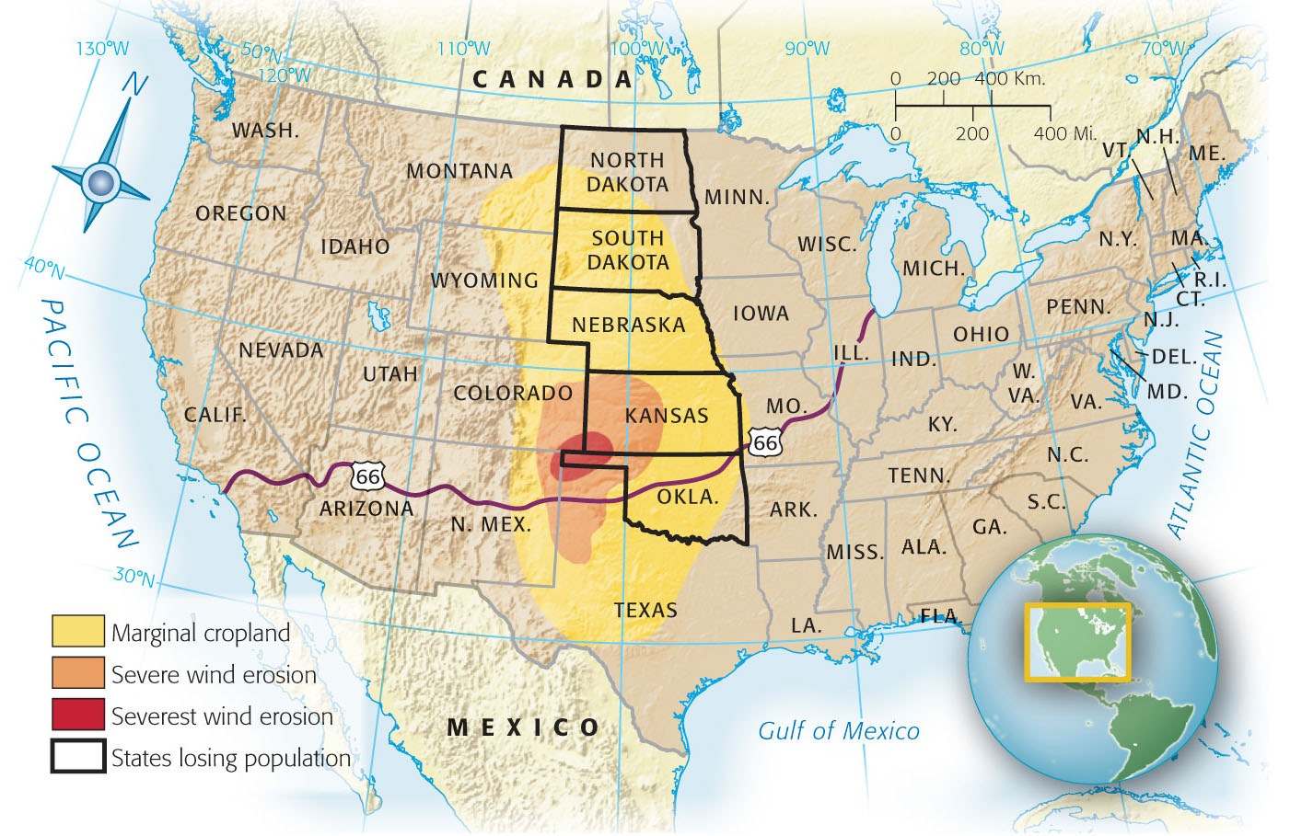
Map 33-1 p765
Notes:
Map 33.1 The Extent of Erosion
in the 1930s Note the extensive
wind erosion in the western Oklahoma
panhandle region, which
was dubbed the “Dust Bowl” in the
1930s. Mechanized farmers had
“busted” the sod of the southern
plains so thoroughly that they literally
broke the back of the land. Tons
of dust blew out of the Dust Bowl in
the 1930s and blotted the sun from
the skies as far away as New York.
A Kansas newspaperman reported
in 1935 that in his dust-darkened
town, “Lady Godiva could ride
through streets without even the
horse seeing her.”

Slide 25
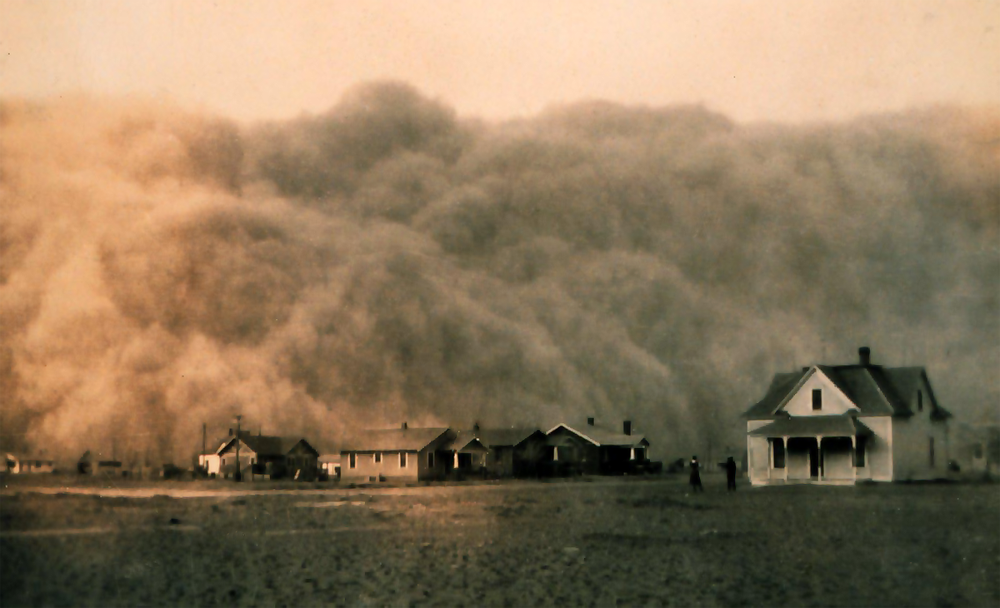
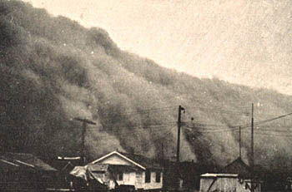
When one of these storms would roll through- the sun and sky could be blotted out as far away as New York

Slide 26
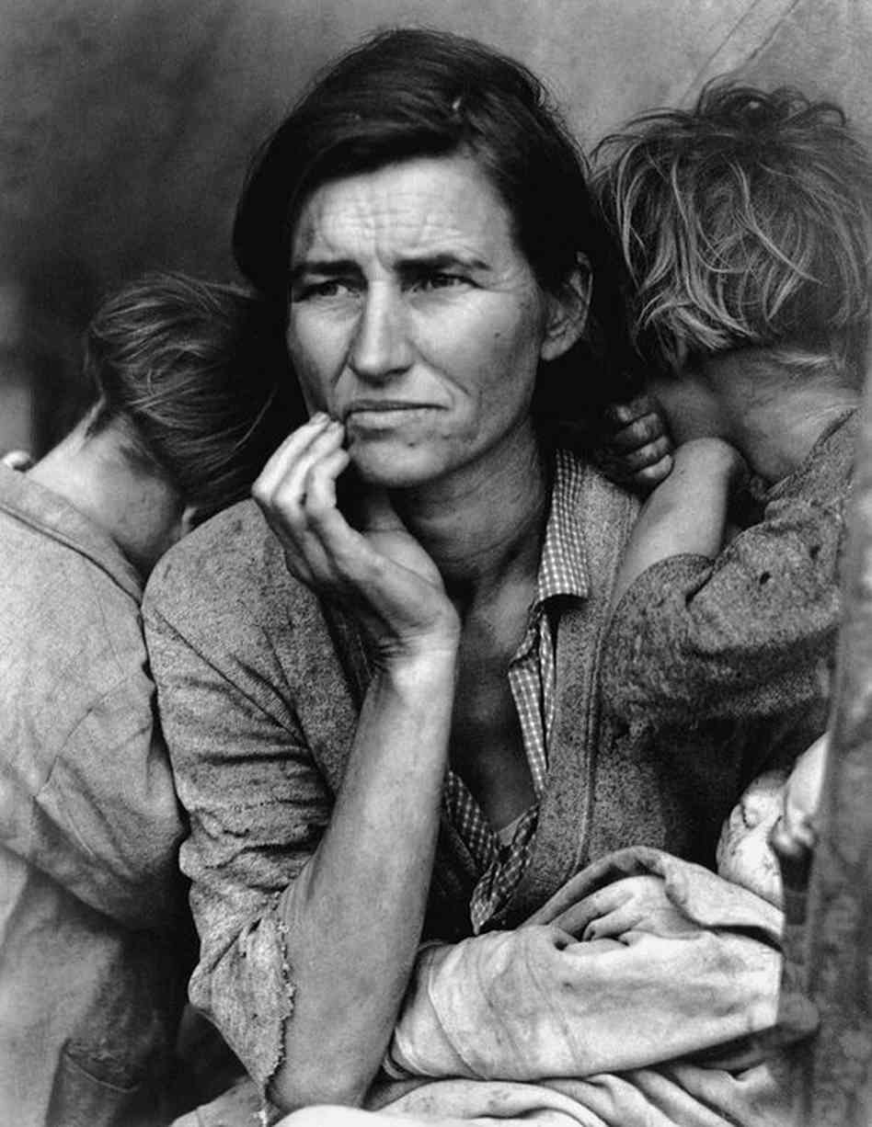
Migrant Mother: By Dorothea Lange

Slide 27
Legacies of the New Deal
1st time Americans experienced the federal gov’t as a part of their everyday lives
Fed gov’t took primary responsibility of welfare of people
Complete transformation of the Democratic party

Slide 28
The World at War
WWII: 1939-1945

Slide 29
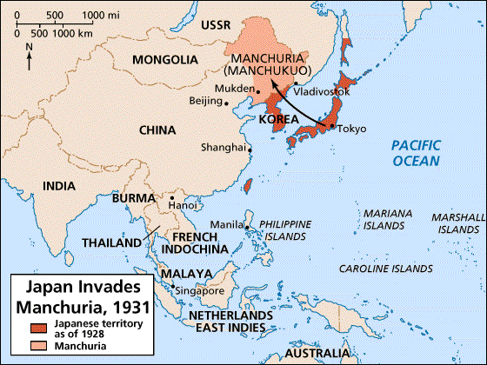
The Rise of Fascism
During the 1930s, a militaristic Japan invaded and brutalized Manchuria and China as it sought military and economic domination over Asia.

Slide 30
  The United States refused to recognize Japanese conquests in Asia and imposed an embargo on exports of oil and steel to Japan. Tensions rose, but both countries negotiated to avoid war.

Slide 31
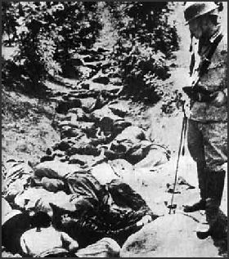
Rape of Nanking
Japanese atrocities against Chinese in Nanking
  Over 300,000 Chinese murdered
  The League of Nations condemned the aggression, and Japan withdrew from the League.

Slide 32
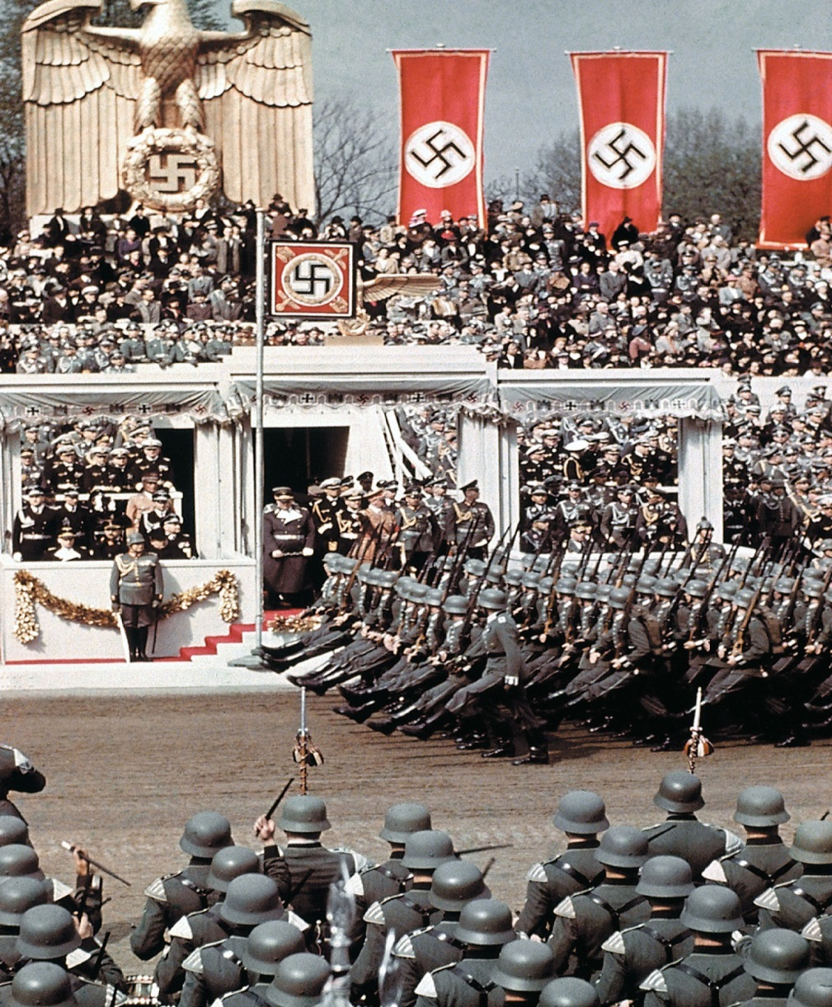
Fascism Con’t…
Italy invades and conquers Ethiopia by 1936
Rise of Hitler and the Nazi Party
Mein Kampf
Britain and France appease Hitler

Slide 33
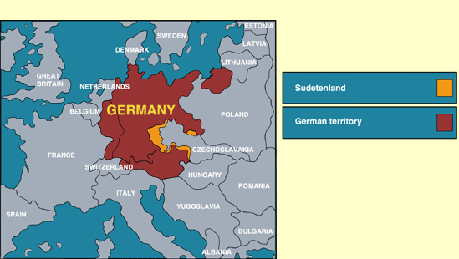
Isolationists vs Interventionists
US very limited in international affairs in the early 1930s
Neutrality Act of 1935 and Gerald P. Nye
Munich Conference in Sept. 1938
  Sudetenland

Slide 34
Con’t…
  On September 1, 1939, German troops attacked Poland; two days later Britain and France declared war on Germany. World War II had begun.
Aug 1939, Hitler signs Nonaggression Pact with Soviet Union (breaks it in 1941 w/Operation Barbarossa)

Slide 35
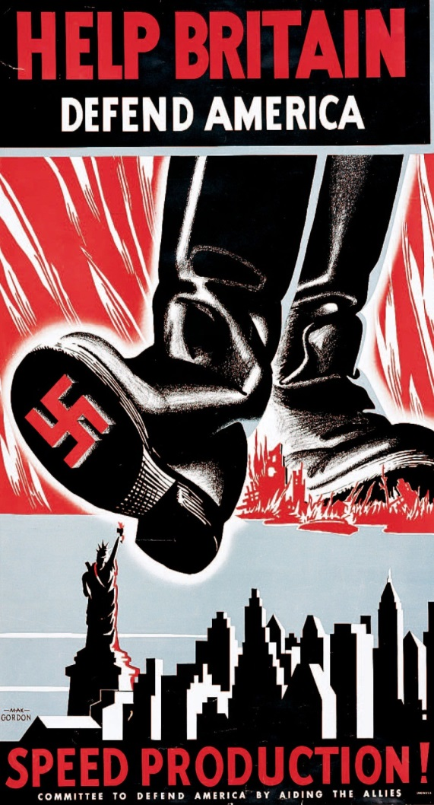
Retreat from Isolationism
  During the first two years US officially neutral
  During this time Germany overran France and most of Europe and pounded Britain from the air (The Battle of Britain)
  Despite strong isolationist sentiment at home, the United States increasingly helped Britain. It gave Britain war supplies and old naval warships in return for military bases in Bermuda and the Caribbean.

Slide 36
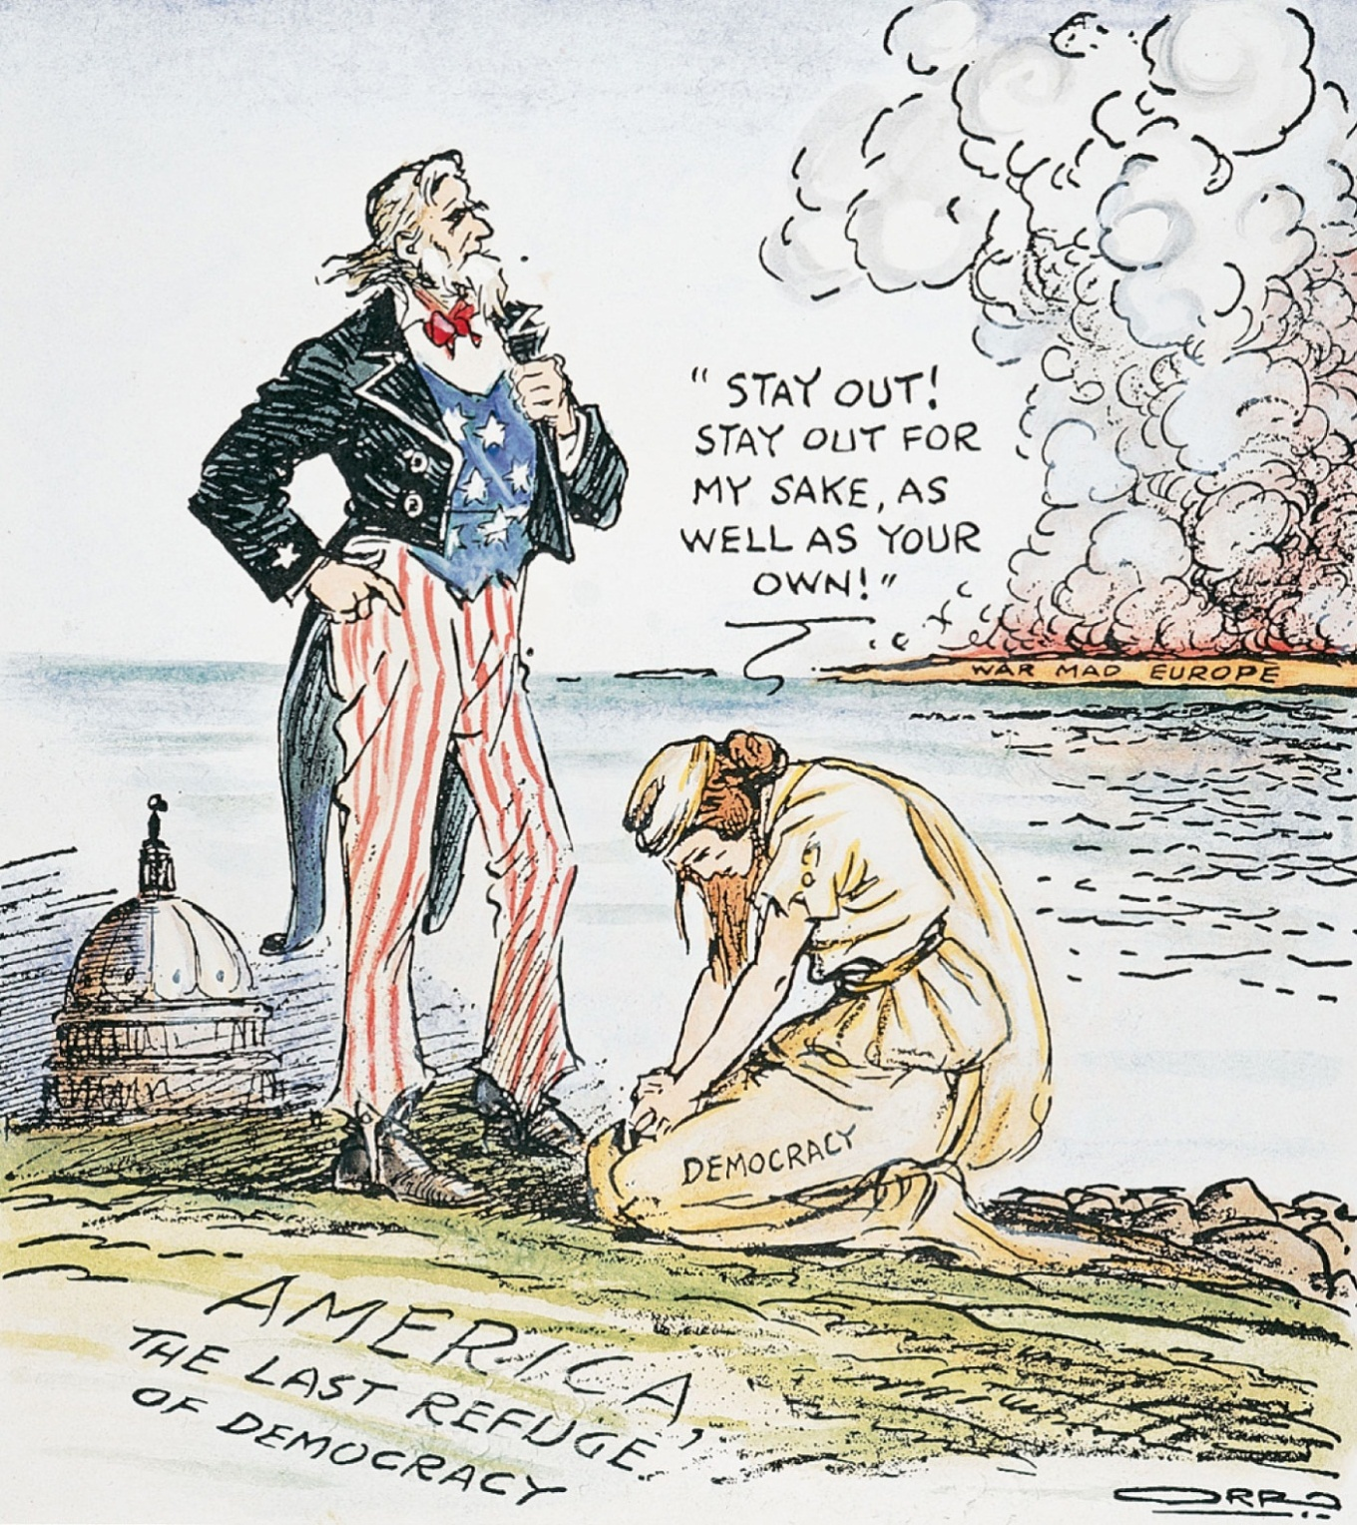
“The Only Way We Can Save Her”

Slide 37
1940 Election and 3rd Term
FDR wins for a 3rd term
Lend-Lease Act is passed to help allies
  Franklin Roosevelt compared it to “lending a garden hose to a next-door neighbor whose house is on fire.”

Slide 38
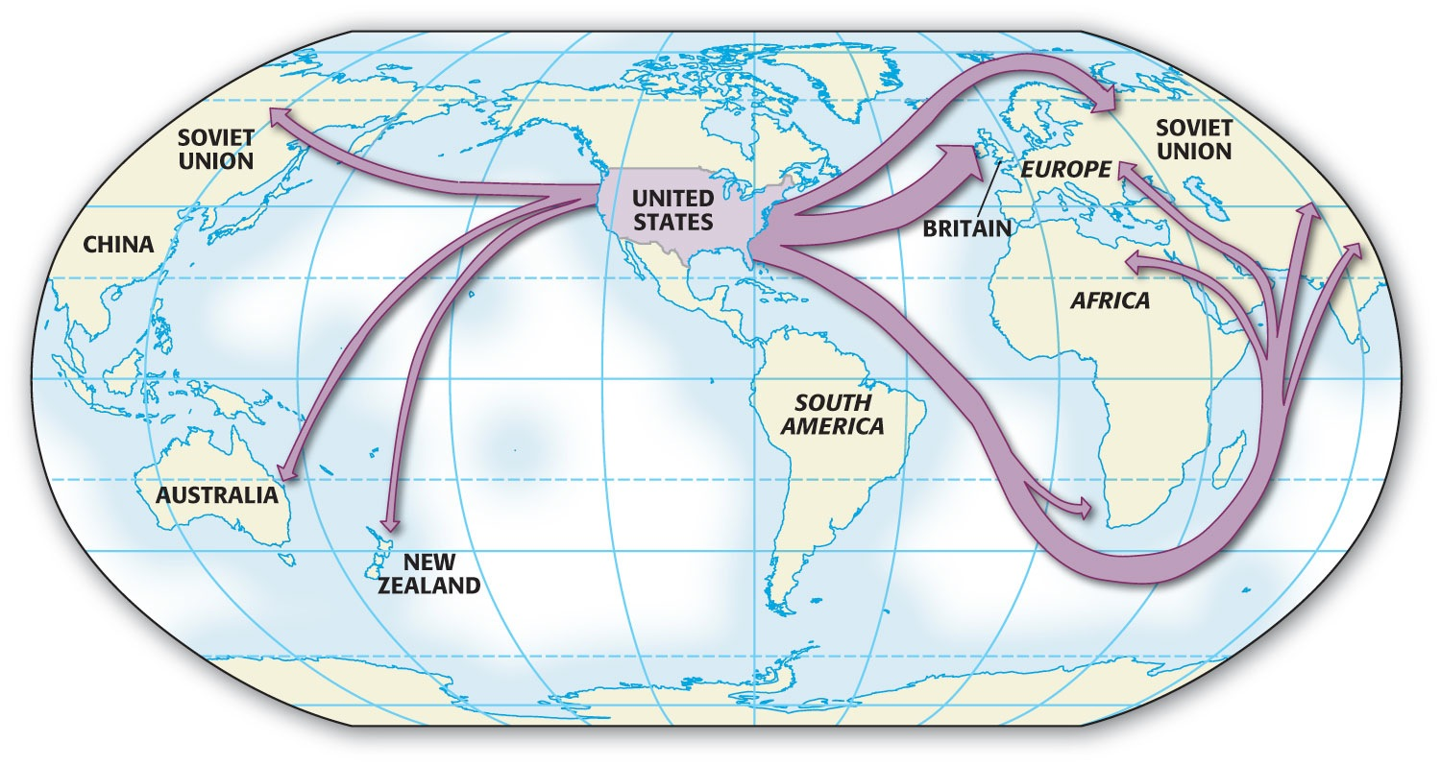
Main flow of Lend-Lease Aid

Slide 39
The Attack on Pearl Harbor
Tension b/t Japan and America throughout the 1930s
Japan signs Tri-Partite Act with Germany and Italy in 1940
US places trade embargo on Japan after Japan occupies part of French Indo-China

Slide 40
Con’t
While negotiating with the United States and without any warning, Japan carried out an air attack on the American naval base at Pearl Harbor, Hawaii, on December 7, 1941.
  The attack destroyed much of the American Pacific fleet and killed several thousand Americans.
  Roosevelt called it “a date that will live in infamy” as he asked Congress to declare war on Japan.

Slide 41
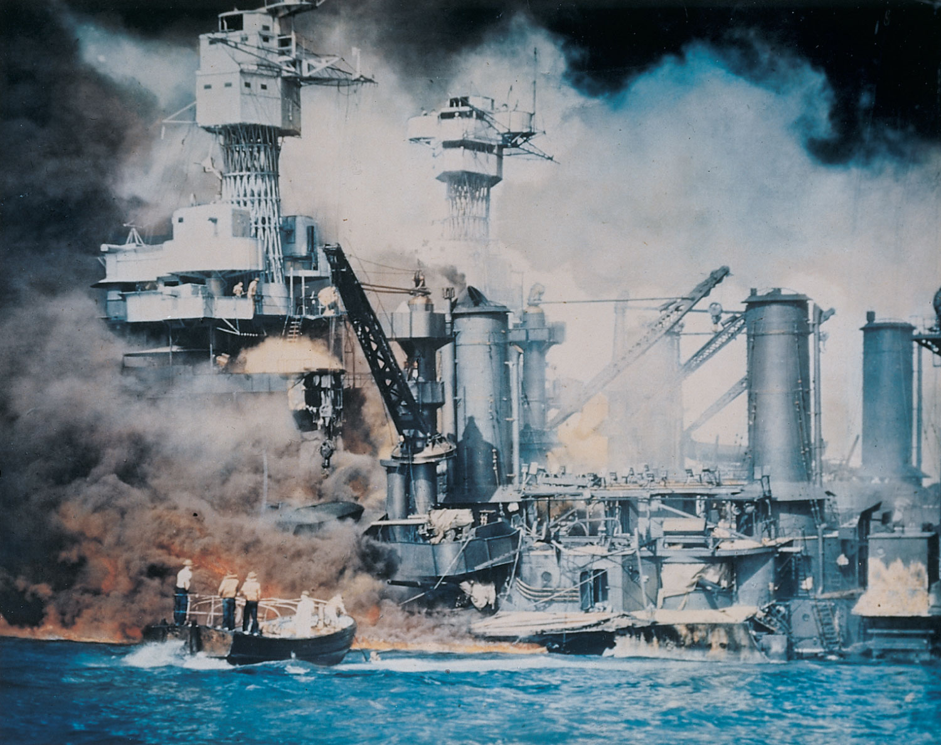
USS West Virginia- One of the first ships to be hit- sinking and killing 70 soldiers

Slide 42
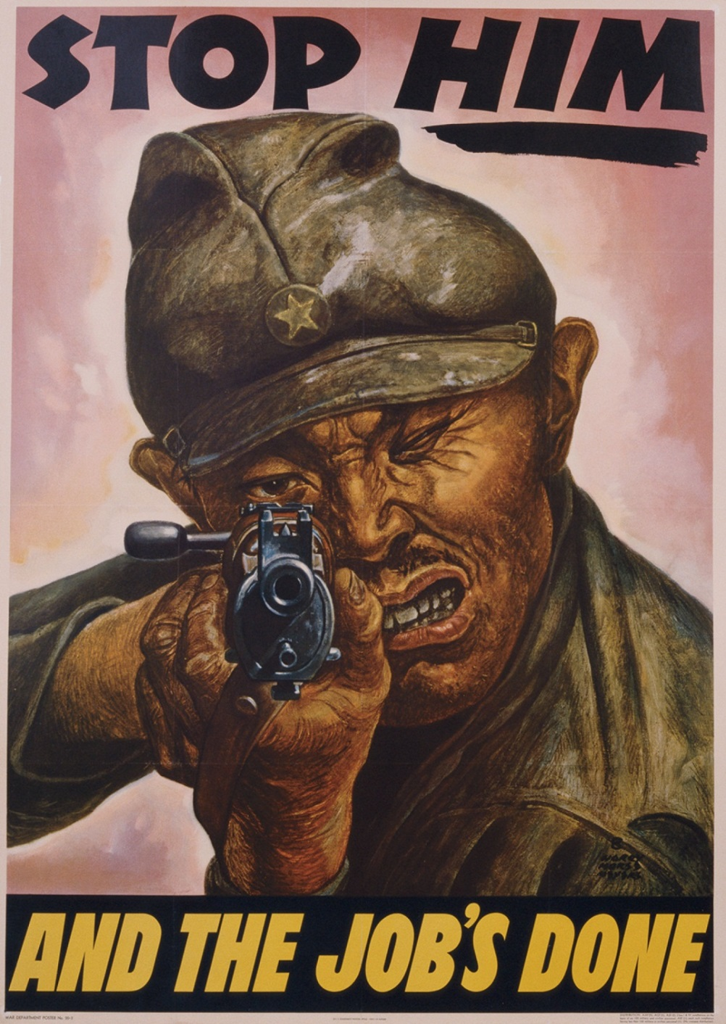
Con’t…
  After Pearl Harbor, Hitler honored a pact with Japan and declared war on the United States.
  The debates over isolationism in the United States were over.
  World War II was now a true world war, and the United States was fully involved.

Slide 43
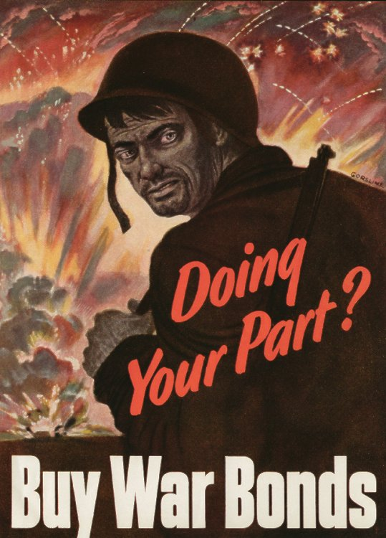
Financing the War
Average citizens taxed for first time in 1942
War bonds and income tax were used for financing the war.

Slide 44
Mobilizing the American Fighting Force
America and her allies (Britain, and the Soviet Union after being invaded by Germany) followed a “Defeat Hitler First” strategy. Most American military resources were targeted for Europe.
The draft (selective service) was used to provide personnel for the military

Slide 45
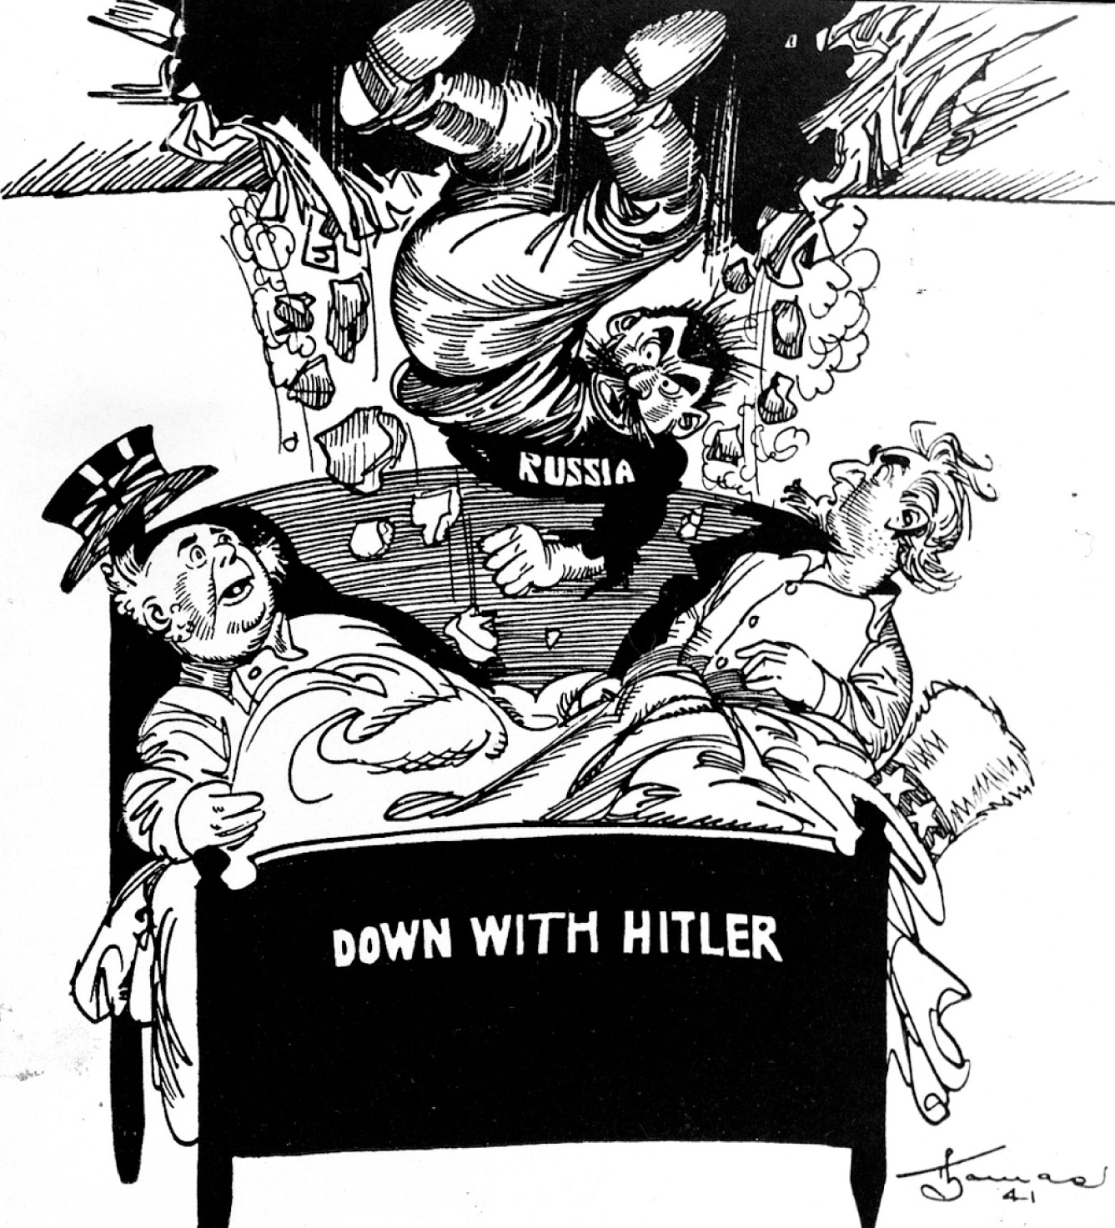
“Unexpected Guest”

Slide 46
Segregation
  Native Americans were never officially segregated. Communication codes of the Navajo were used (oral, not written language; impossible for the Japanese to break).
  African Americans generally served in segregated military units and were assigned to noncombat roles but demanded the right to serve in combat rather than support roles.

Slide 47
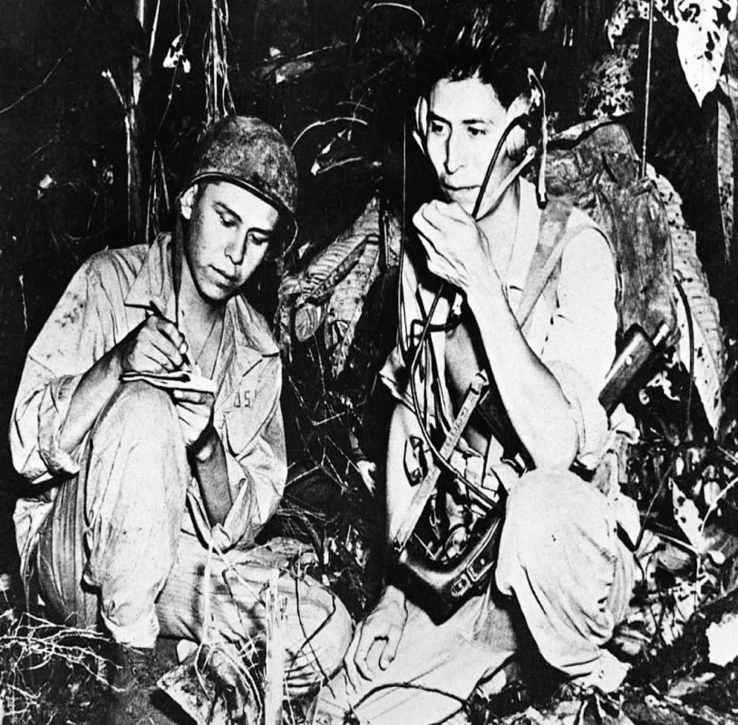
Con’t…
  Tuskegee Airmen were A. American and served in Europe with distinction (all-minority military unit)
  Nisei Regiments were all Asian American (of Japanese ancestry)
  and earned a high number of
  decorations
  Mexican Americans also fought,
  but in non-segregated units.

Slide 48
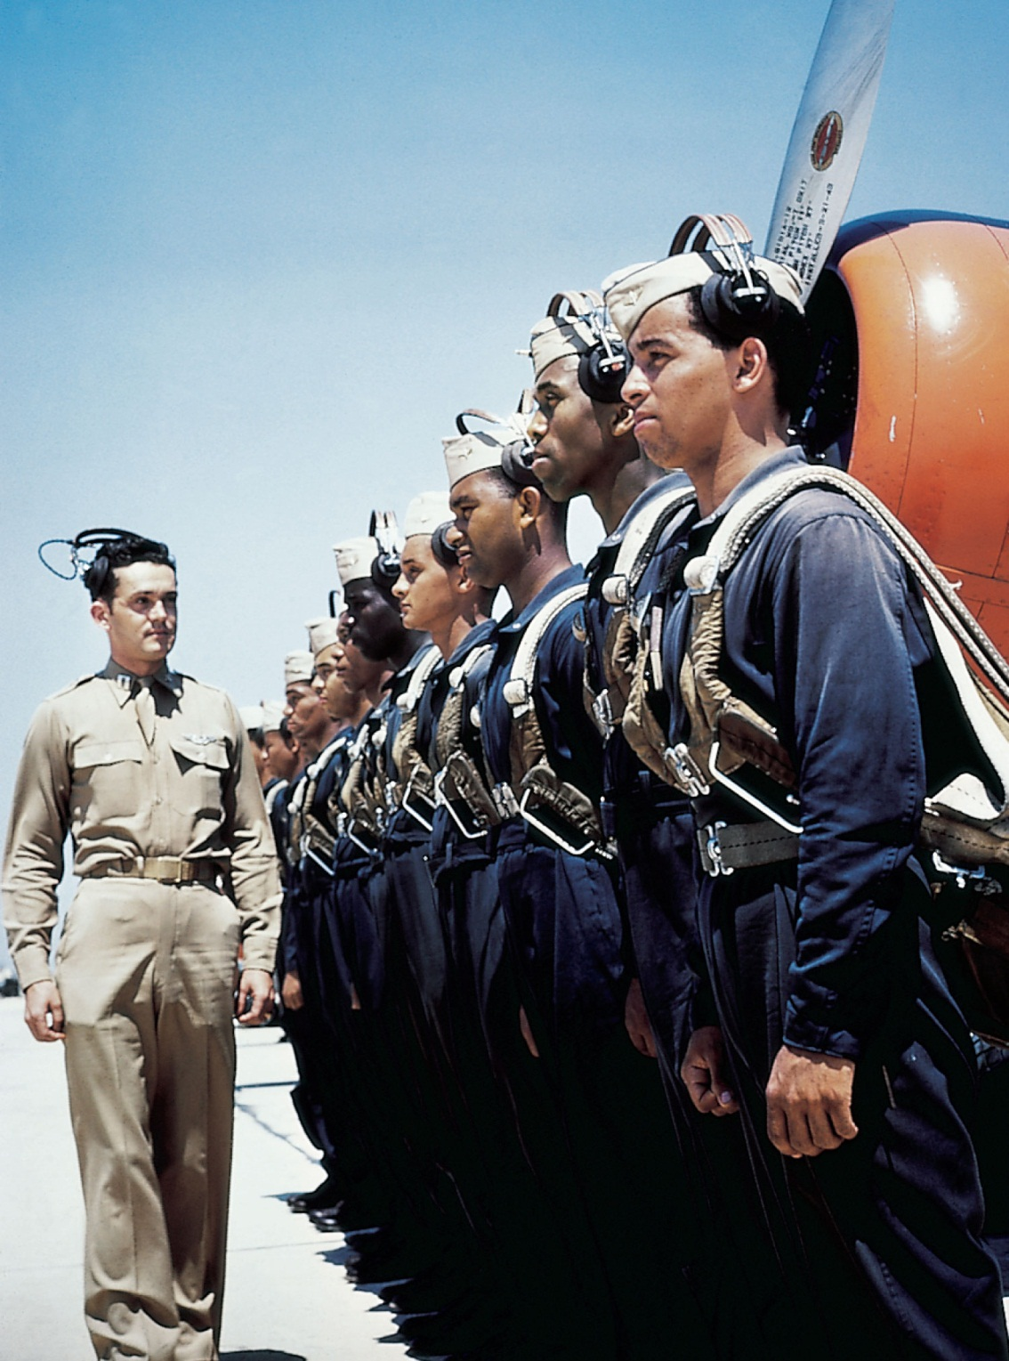
Flew more than 1600 fighter-support missions in N. Africa

Slide 49
  Minority units suffered high casualties and won numerous unit citations and individual medals for bravery in action.
The armed forces limited the types of duty assigned to women; they were barred from combat

Slide 50
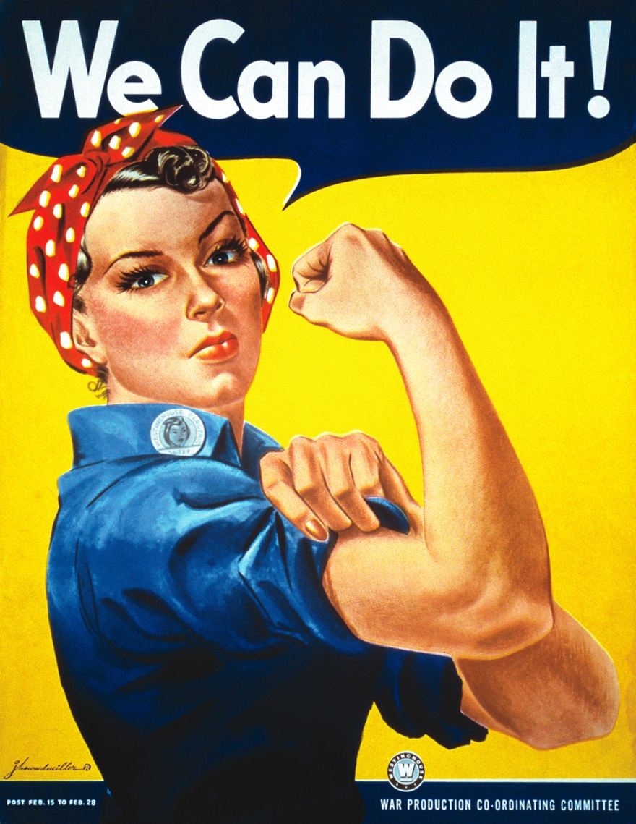
Workers and the War Effort
Businesses retooled from peacetime to wartime production (e.g., car manufacturing to tank manufacturing).
Women made up 36 percent of the labor force
  Rosie the Riveter as a means of female propaganda
  Minorities also entered the labor force

Slide 51
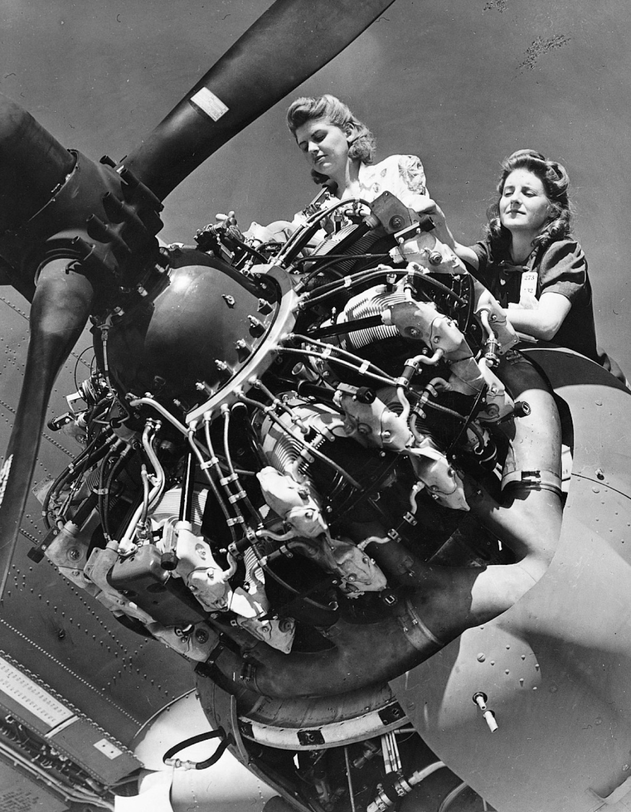
6 million women
entered the work force during WWII

Slide 52
Politics in Wartime
New Deal programs were dropped
GI Bill for soldiers
1944 election- Roosevelt ran with a new VP- Harry Truman and won his fourth election

Slide 53
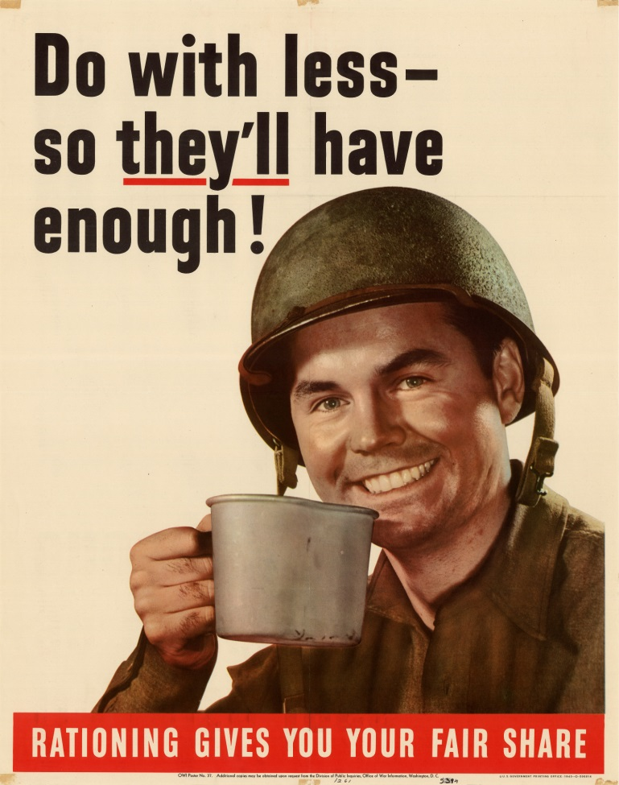
Life on the Home Front
United States government and industry forged a close working relationship to allocate resources effectively.
Rationing was used to maintain supply of essential products to the war effort.
Citizens volunteered in support of the war effort.

Slide 54
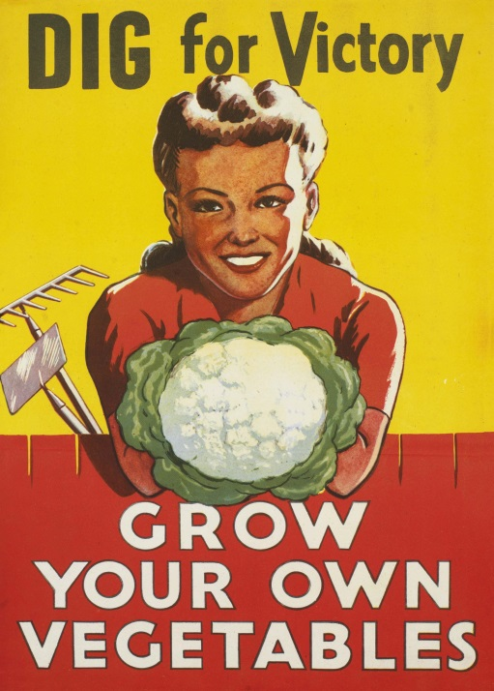
Con’t…
“Victory Gardens”
Media and communications assistance
  The United States government maintained strict censorship of reporting of the war.
  Public morale and ad campaigns kept Americans focused on the war effort.
  The entertainment industry produced movies, plays, and shows that boosted morale and patriotic support for the war effort as well as portrayed the enemy in stereotypical ways.

Slide 55
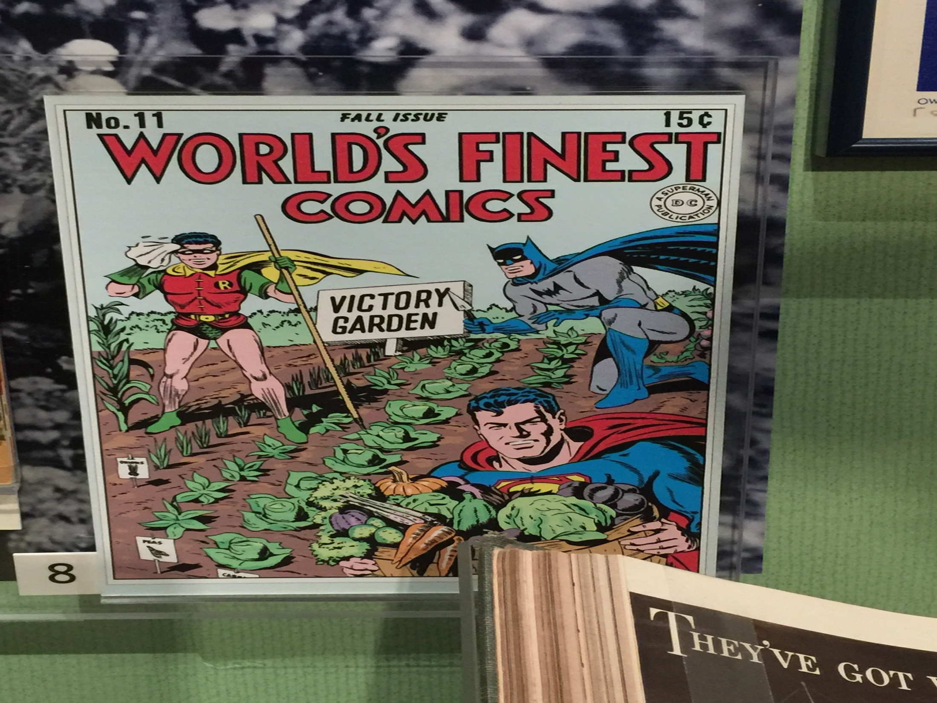

Slide 56
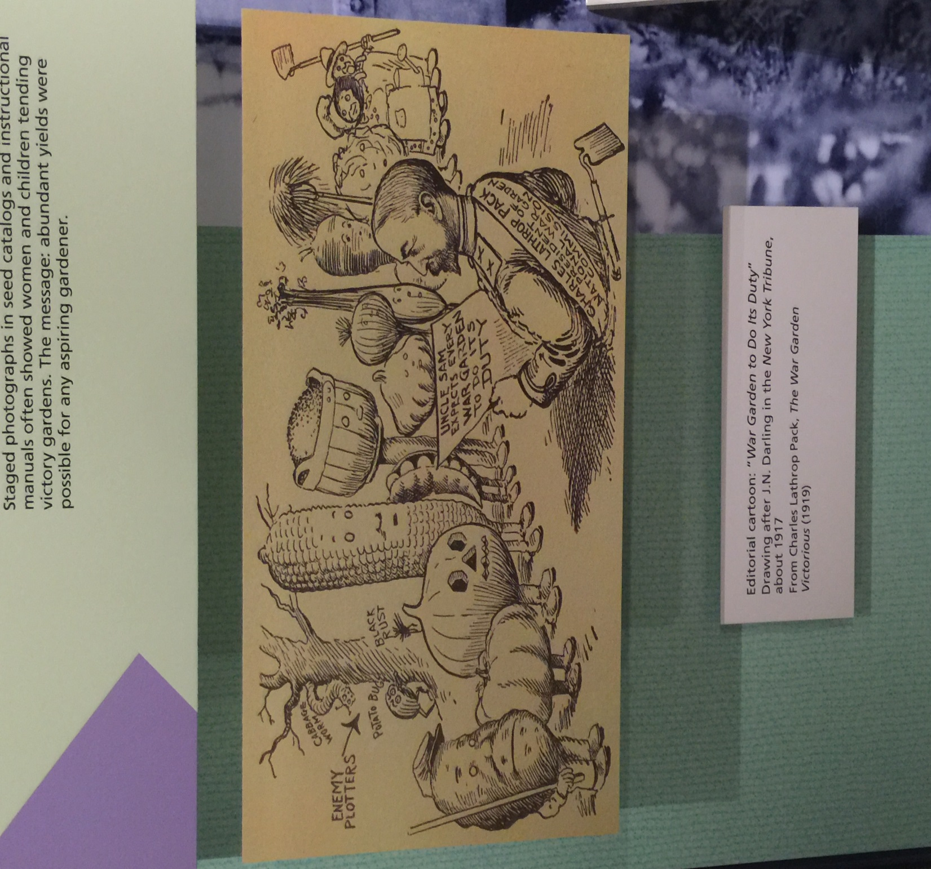

Slide 57
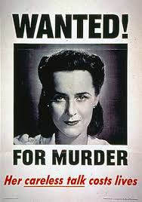
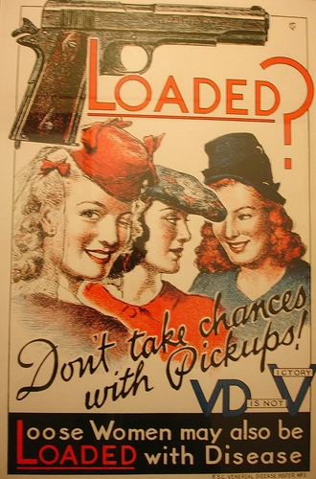

Slide 58
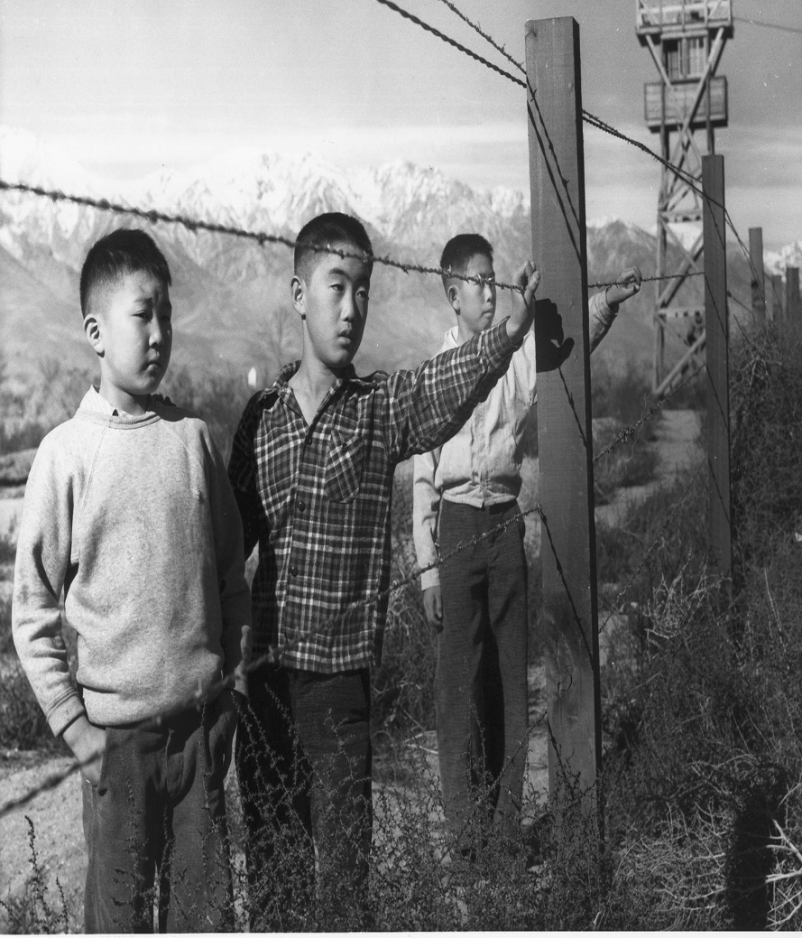
Internment of Japanese Americans
Internment of Japanese Americans on the West Coast
Executive Order 9066
Very little opposition from the public

Slide 59
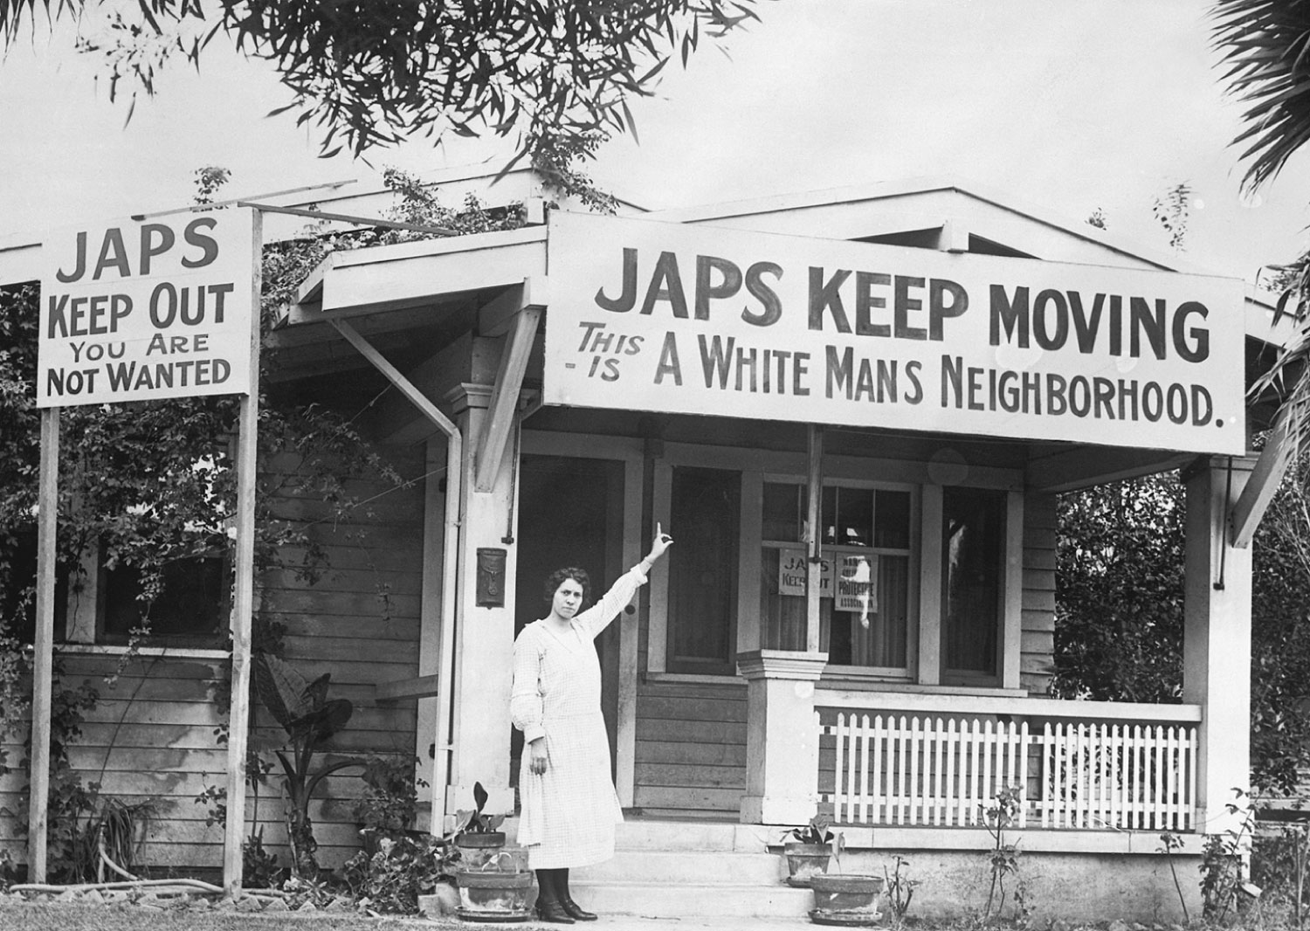

Slide 60
Con’t…
Hirabayashi v. United States (1943)
  The Supreme Court upheld the government’s right to act against Japanese Americans living on the West Coast of the United States.
  A public apology was eventually issued by the United States government, and financial payment was made to survivors.

Slide 61
The War in Europe
Germany hoped to defeat the Soviet Union quickly, gain control of Soviet oil fields, and force Britain out of the war through a bombing campaign and submarine warfare before America’s industrial and military strength could turn the tide.

Slide 62
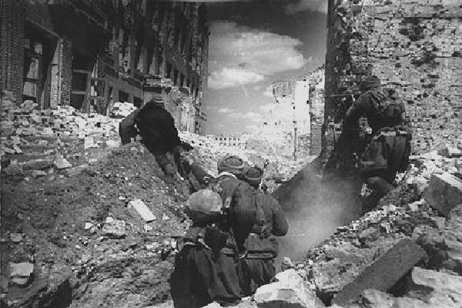
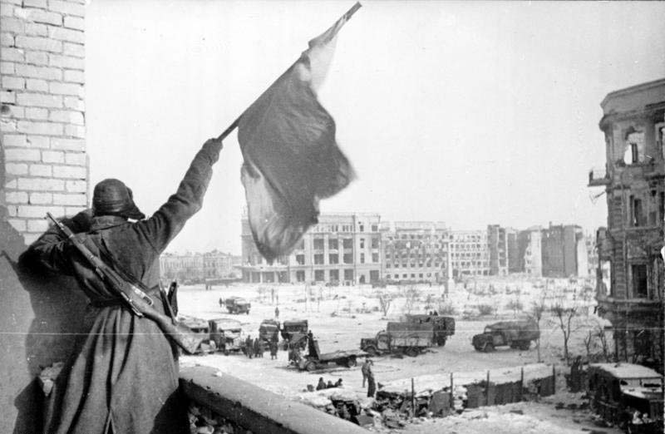
Stalingrad (1942-43)
  Stalingrad: Hundreds of thousands of German soldiers were killed or captured in a months-long siege of the Russian city of Stalingrad.
  This defeat prevented Germany from seizing the Soviet oil fields and turned the tide against Germany in the east.

Slide 63
North Africa
  El Alamein: German forces threatening to seize Egypt and the Suez Canal were defeated by the British.
  This defeat prevented Hitler from gaining access to Middle Eastern oil supplies and attacking the Soviet Union from the south.
  German African Korps led by Erwin Rommel and Allies led by George Patton and Eisenhower

Slide 64
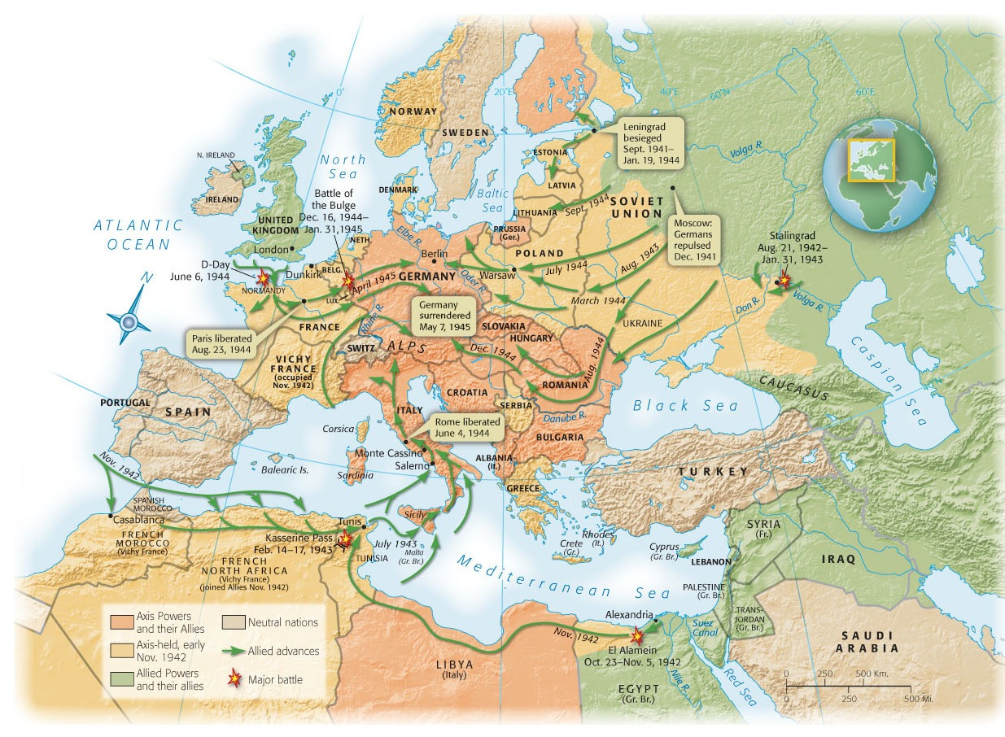

Slide 65
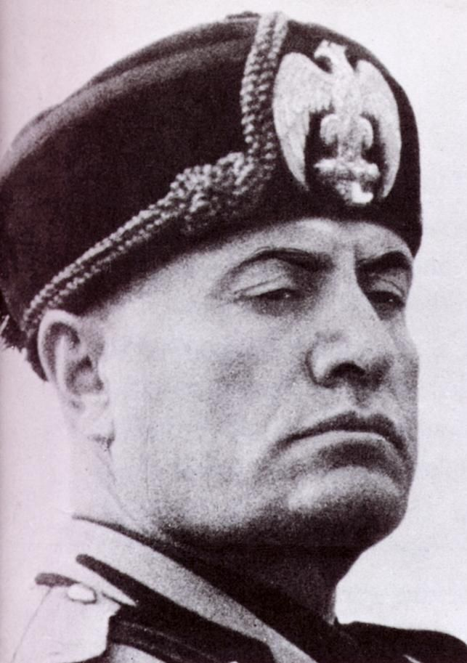
Italy Defeated
Mussolini’s fascist regime fell in July 1943
German forces fought Allies in Italy until Ger. had to surrender on May 1945

Slide 66
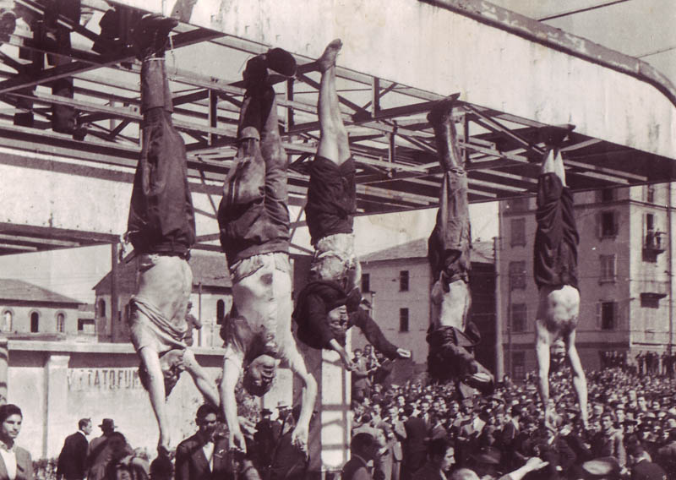

Slide 67
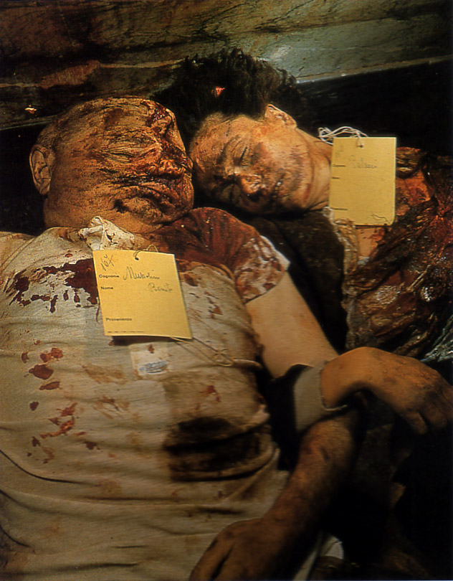

Slide 68
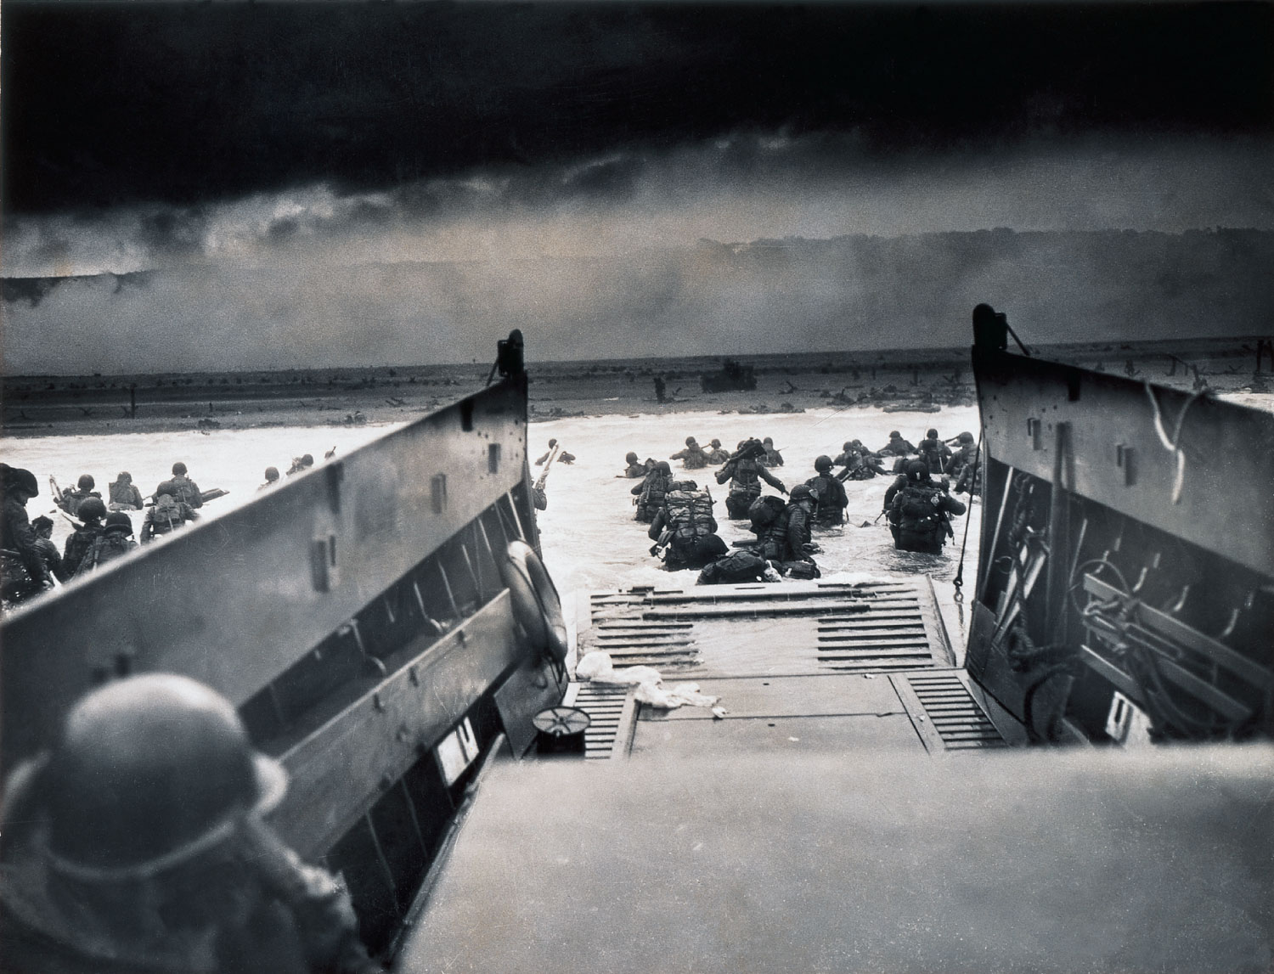
D-Day
The invasion of France came on D-Day, June 6, 1944; under General Eisenhower’s command
  Despite intense German opposition and heavy American casualties, the landings succeeded, and the liberation of western Europe from Hitler began

Slide 69
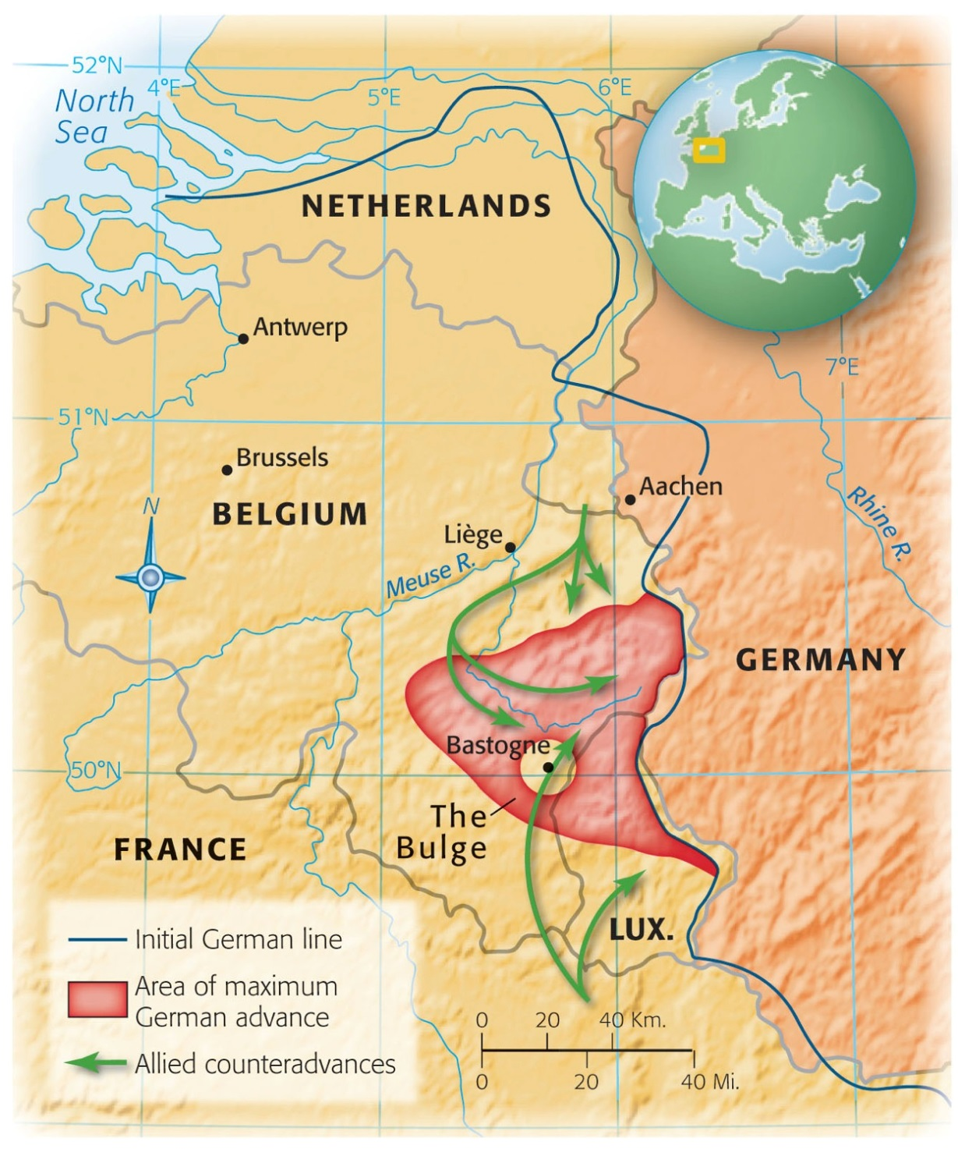
Ending the War in Europe
Allies drive most of Germans out of France by Sept. 1944
Battle of the Bulge
Hitler commits suicide b/f Soviet Troops capture him
Germany surrenders May 8, 1945

Slide 70
Holocaust
  genocide: The systematic and purposeful destruction of a racial, political, religious, or cultural group
  final solution: Germany’s decision to exterminate all Jews
  Affected groups:
    Jews
    Poles
    Slavs
    Gypsies
    “Undesirables” (homosexuals, the mentally ill, political dissidents)

Slide 71
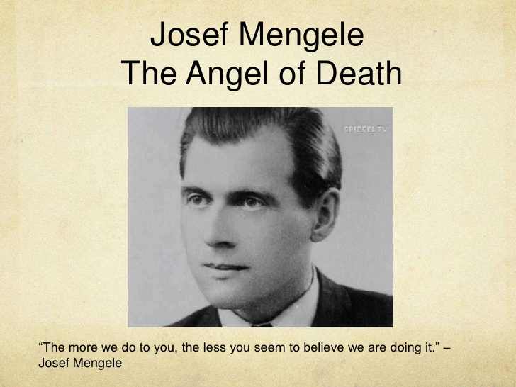

Slide 72
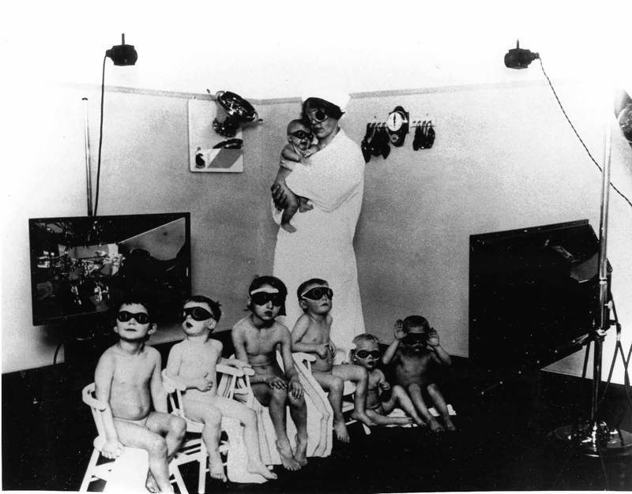

Slide 73
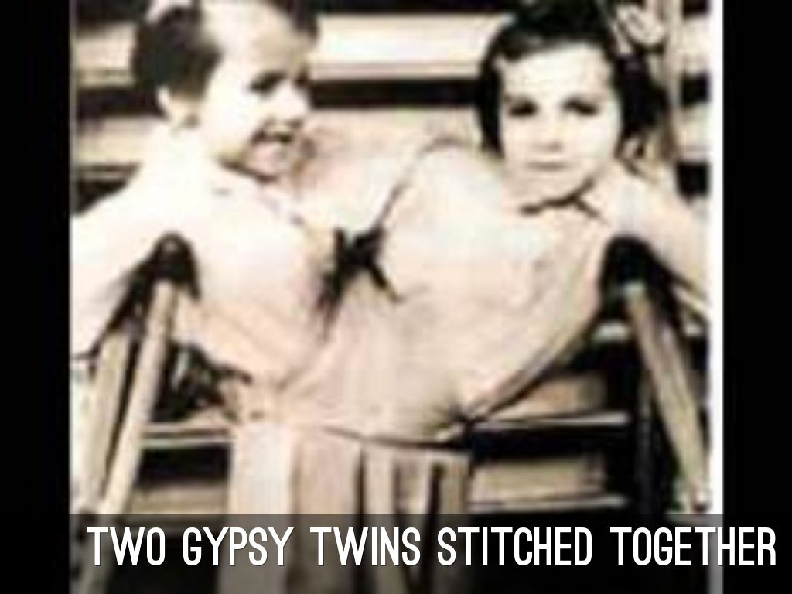
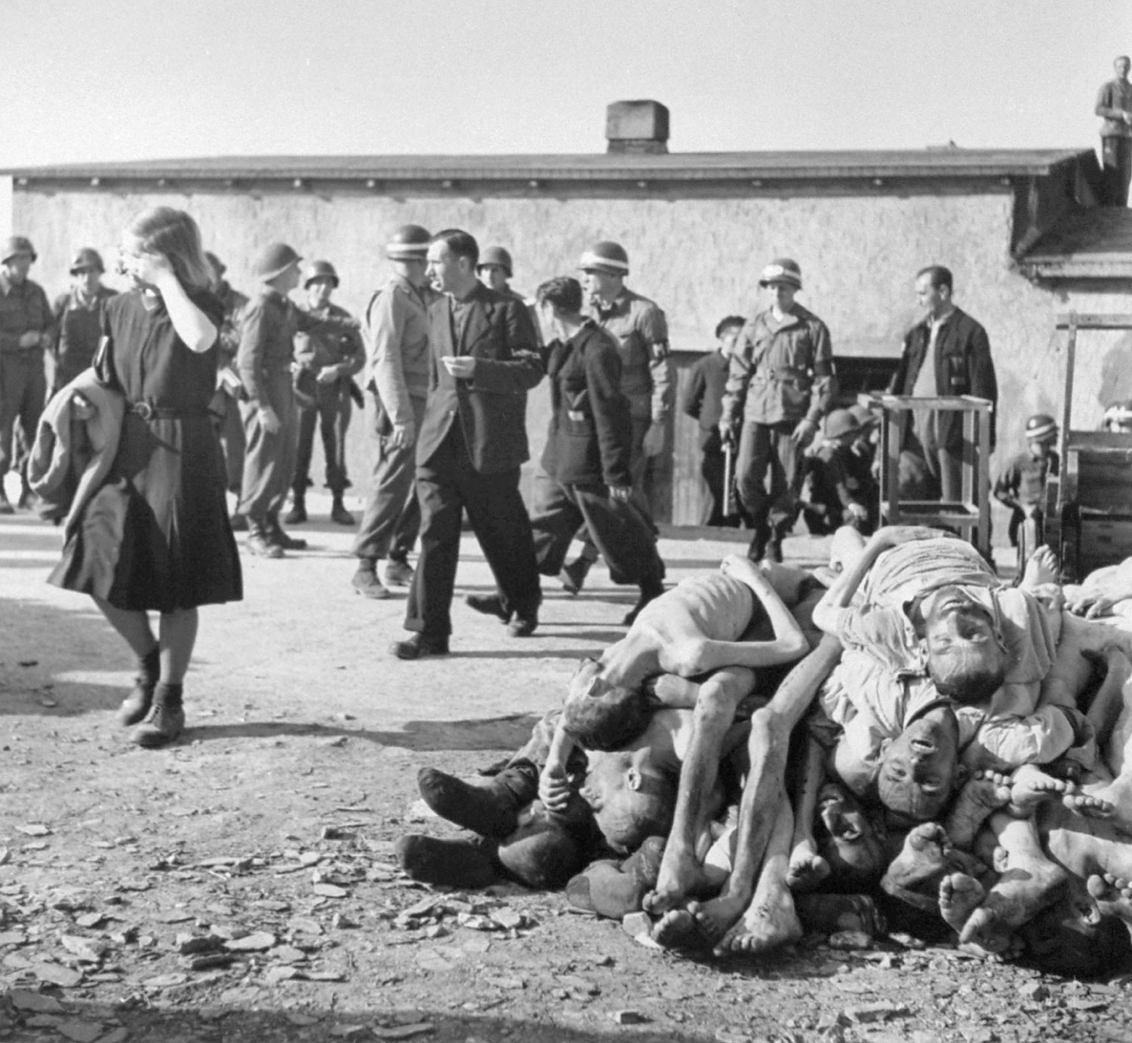

Slide 74
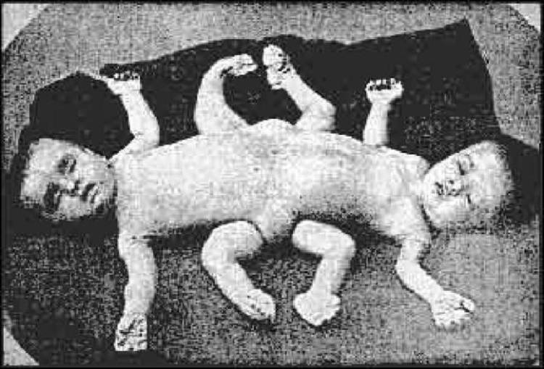

Slide 75
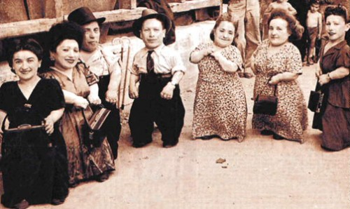
Ovitz Family

Slide 76
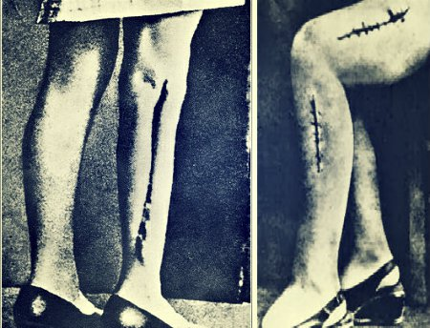

Ravensbruk Rabbits

Slide 77

Con’t…
So few Jews escaped b/c the world would not take them in
War Refugee Board
Anti-Semitism, fear of economic competition were among a few of the reasons the Jews were not protected

Slide 78
Geneva Convention
The Geneva Convention attempted to ensure the humane treatment of prisoners of war by establishing rules to be followed by all nations
  The treatment of prisoners of war in Europe more closely followed the ideas of the Geneva Convention.

Slide 79
The War in the Pacific
  Following Pearl Harbor, Japan invaded the Philippines and Indonesia and planned to invade both Australia and Hawaii.
  Her leaders hoped that America would then accept Japanese predominance in Southeast Asia and the Pacific, rather than conduct a bloody and costly war to reverse Japanese gains.

Slide 80

Bataan Death March
  The treatment of prisoners of war in the Pacific Theater often reflected the savagery of the fighting there.
  In the Bataan Death March (April 1942), American POWs suffered brutal treatment by the Japanese after surrender of the Philippines.

Slide 81



Slide 82
Fighting Japan
Midway: In the Battle of Midway (termed the “Miracle at Midway”), American naval forces defeated a much larger Japanese force as it prepared to seize Midway Island
  Coming only a few months after Pearl Harbor, a Japanese victory at Midway would have enabled Japan to invade Hawaii.
  The American victory ended the Japanese threat to Hawaii and began a series of American victories in the “island hopping” campaign, carrying the war closer and closer to Japan.

Slide 83


Slide 84
Pacific Theatre of War
Douglas MacArthur and Chester Nimitz
  In the Pacific, American military strategy called for an “island hopping” campaign, seizing islands closer and closer to Japan and using them as bases for air attacks on Japan, and for cutting off Japanese supplies through submarine warfare against Japanese shipping.

Slide 85
Iwo Jima and Okinawa
  Iwo Jima and Okinawa: The American invasions of the islands of Iwo Jima and Okinawa brought American forces closer than ever to Japan, but both invasions cost thousands of American lives and even more Japanese lives, as Japanese soldiers fought fiercely over every square inch of the islands.
  Japanese soldiers (and citizens) often committed suicide rather than surrender.

Slide 86


Feb. to March and April to June 1945- Iwo Jima and Okinawa
Why is victory at these
tiny Islands so
important?
Brings Allies within
360 miles of Japan
Brought America closer than ever to Japan. Cost thousands
of lives– even more Japanese, as Japanese fought fiercely
for every inch of the islands.
Japanese would rather commit suicide than surrender– (Kamikaze)

Slide 87

What was the Human Cost of taking
Iwo Jima and Okinawa?
American Death Toll:
6,000 Iwo Jima
7,500 Okinawa
Japanese Death Toll:
Over 120,000

Slide 88


Slide 89

Planning the Postwar World
Yalta Conference in 1945
Stalin wants satellite states controlled by Soviet Union
Germany divided into four occupied zones
Established the United Nations with a Security Council
Roosevelt dies from brain aneurysm April 12, 1945
  Truman is sworn in
Truman

Slide 90
Manhattan Project
Secret project to develop the atomic bomb
  Use of the atomic bomb: Facing the prospect of horrendous American and Japanese casualties if American forces were to invade Japan itself, President Harry Truman ordered the use of atomic bombs on the Japanese cities of Hiroshima (August 6, 1945) and Nagasaki (August 9, 1945) to force the Japanese to surrender.
  Tens of thousands of people were killed in both cities. Shortly after the bombs were used, the Japanese leaders surrendered, avoiding the need for American forces to invade Japan.

Slide 91


Slide 92





Slide 93


August 1945- Atomic Bomb
Prospect of terrible casualties if U.S. invaded Japan lead to
Harry Truman ordering use of atomic bomb on cities of
Hiroshima and Nagasaki to force surrender. Japan surrenders.
70,000 people killed at Hiroshima
40,000 people killed at Nagasaki
Little Boy
Fat Man

Slide 94


Slide 95
Nuremberg Trials
  Nazi leaders and others were convicted of war crimes.
  The Nuremberg trials emphasized individual responsibility for actions during a war, regardless of orders received.
  The trials led to increased demand for a Jewish homeland.

