Slide 1
Funko Pop Figurines
Feat. Influential People form WWII

Slide 2
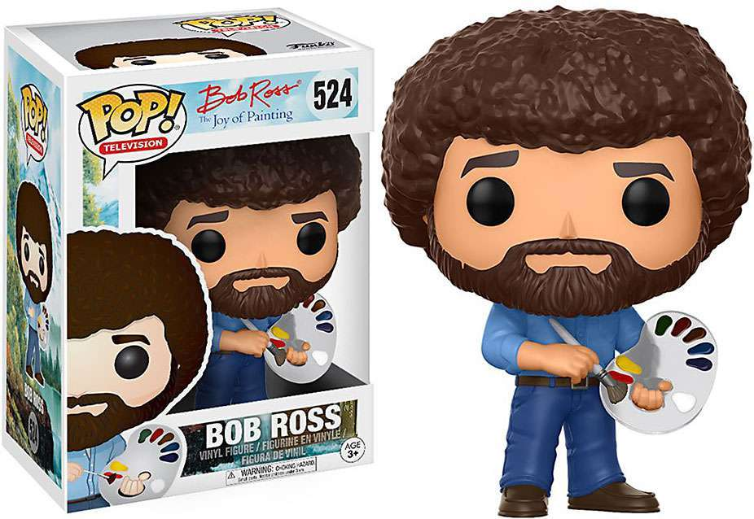
Funko Pop?
I didn’t know what it was either…
In my brief search, I found this one to be particularly funny

Slide 3
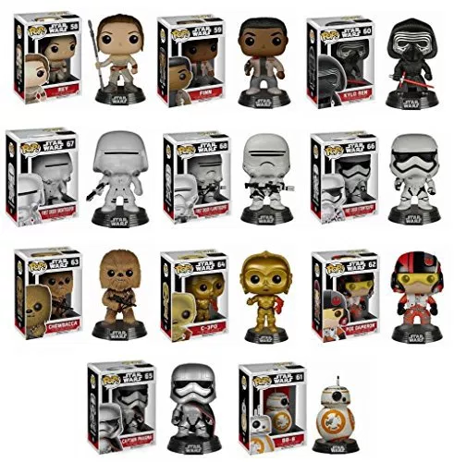
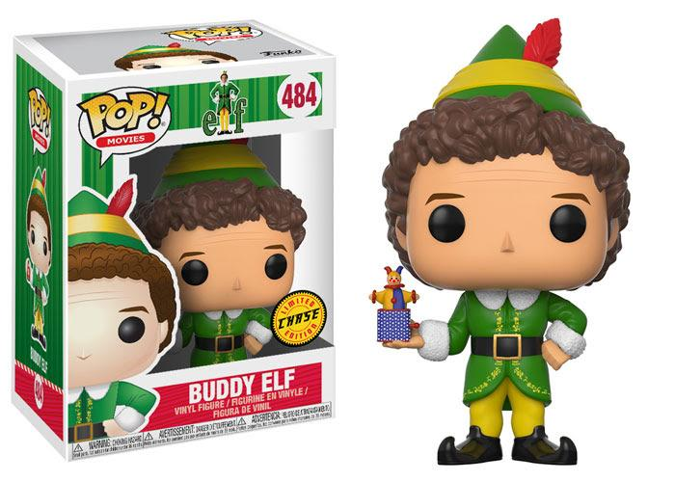
More on Funko
Some figurines are individual, but part of a series, like these Star Wars ones
While some are just their own individual, like Buddy the Elf

Slide 4
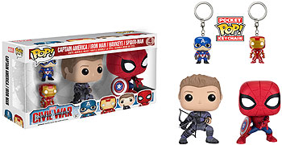
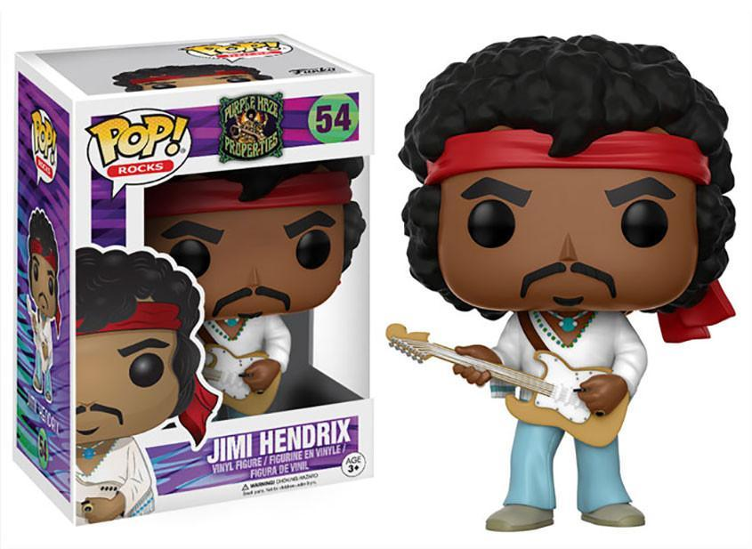
More on Funko
Some also come as a small set with like characters, like Marvel’s Civil War
Notice that all of the characters have unique features and accessories to them that help you understand what defines that character, like Jimi Hendrix here with his guitar

Slide 5
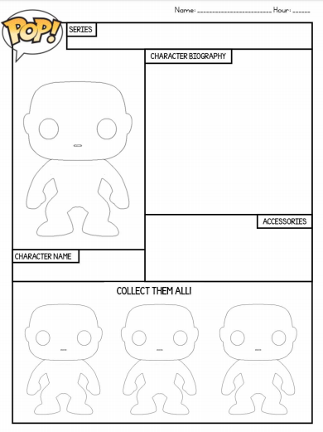
Let’s get historical
If we were to make one of these for a historical character, how would we go about doing so?
Contextualize that character first
Notes:
Genghis Khan, Alexander the Great, Mansa Musa, Qin Shi huangdhi, Hernan Cortes, ...

Slide 6
We can’t just have the figure though...
We’re going to need some written info about this character, give it some accessories it might use, and some other figurines within the same series
A more fun way to review and a little break from NOTES NOTES NOTES

Slide 7
Directions
Renaissance POP FIGURES
Pick ONE main character from this time to do the Funko Pop figure about
Biography – This should be in your own words and include the major achievements of your person and their impact on the Renaissance - should be 6-8 sentences
Accessories - must have at least three that are logical and relevant to that character
“Collect them all!” - you can have some people that don’t necessarily have names, but are relevant to this person in their corresponding empire (a caption for them would be great)
Must have color, be historically accurate.

Slide 8
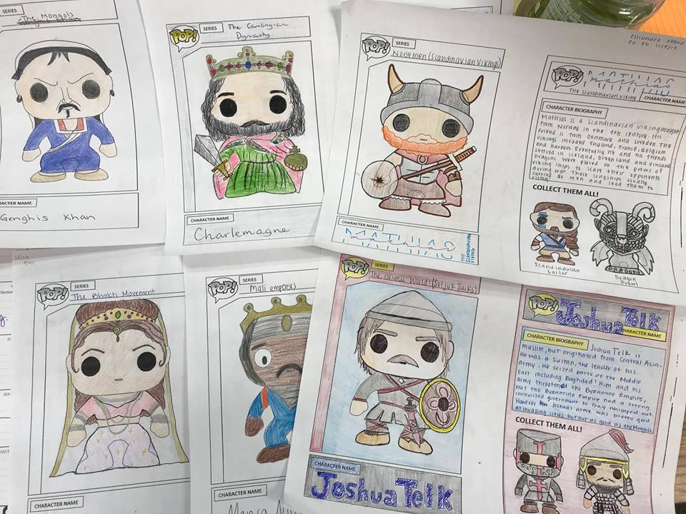
Historical Examples

