Slide 1
Unit 9
Cold War and Civil Rights

Slide 2
Post War Outcomes

Slide 3
Germany
The end of World War II found Soviet forces occupying most of Eastern and Central Europe and the eastern portion of Germany.
Potsdam Conference: 1945

Slide 4
Con’t
Germany was partitioned into East and West Germany.
West Germany became democratic and resumed self-government after a few years of American, British, and French occupation.
East Germany remained under the domination of the Soviet Union and did not adopt democratic institutions.

Slide 5
Japan
Following her defeat, Japan was occupied by American forces. It soon adopted a democratic form of government, resumed self-government, and became a strong ally of the United States.
Europe lay in ruins, and the United States launched the Marshall Plan, which provided massive financial aid to rebuild European economies and prevent the spread of communism.

Slide 6
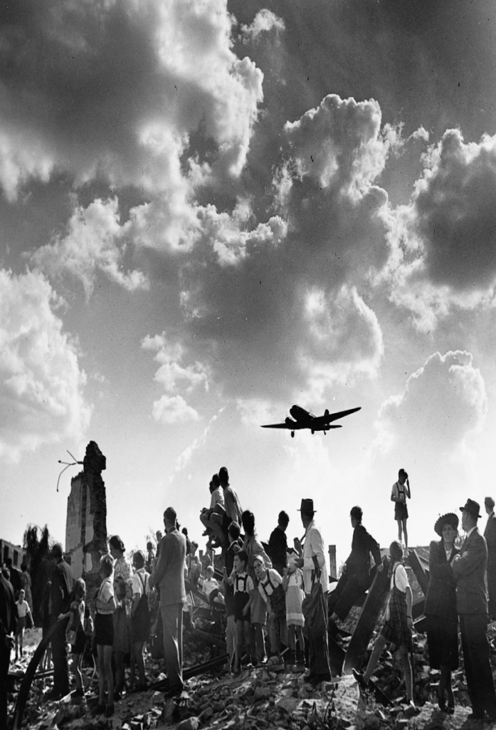
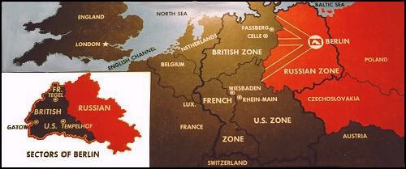
Berlin Airlift
April 1948-May 1949
US aid

Slide 7
646 tons of flour and wheat
125 tons of cereal
180 tons of potatoes
180 tons of sugar
11 tons of coffee
19 tons of powdered milk
38 tons of salt
10 tons of cheese

Slide 8
Origins of the Cold War

Slide 9
The Cold War lasted from the end of World War II until the collapse of the Soviet Union.
The United States and the Soviet Union represented starkly different fundamental values. The United States represented democratic political institutions and a generally free market economic system. The Soviet Union was a totalitarian government with a communist (socialist) economic system.

Slide 10
Truman Doctrine
The Truman Doctrine of “containment of communism” was a guiding principle of American foreign policy throughout the Cold War, not to roll it back, but to keep it from spreading and to resist communist aggression into other countries.
Civil War in Greece w/ Greek Communist guerillas
Military/economic assistance in Turkey too

Slide 11
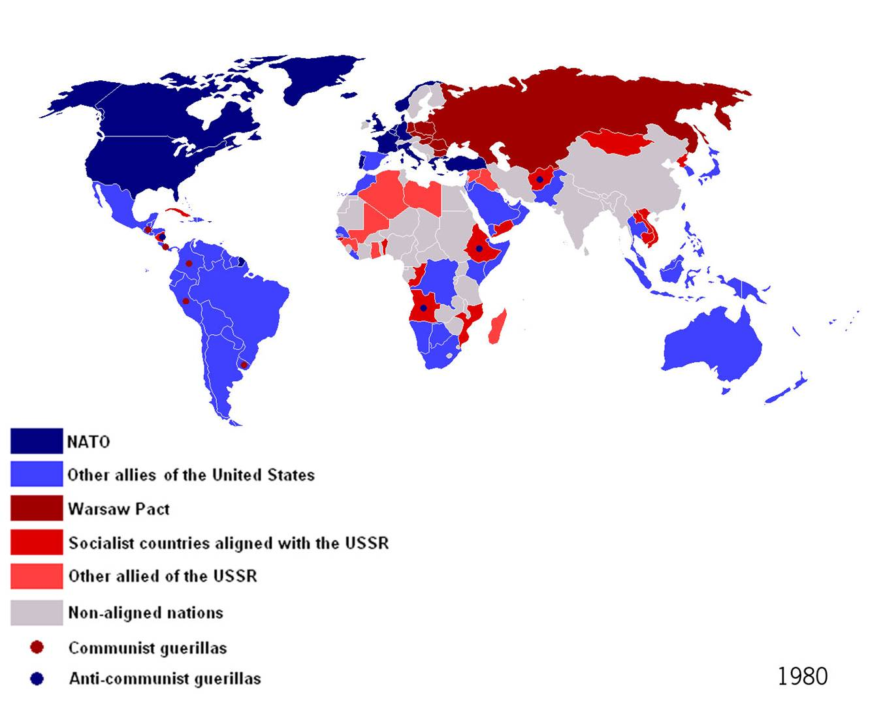
NATO vs Warsaw
1949- NATO
1955- Warsaw

Slide 12
China
Chinese Civil War
  Mao Zedong vs Chiang Kai-shek
People’s Republic of China in 1949
China prevented from joining UN

Slide 13
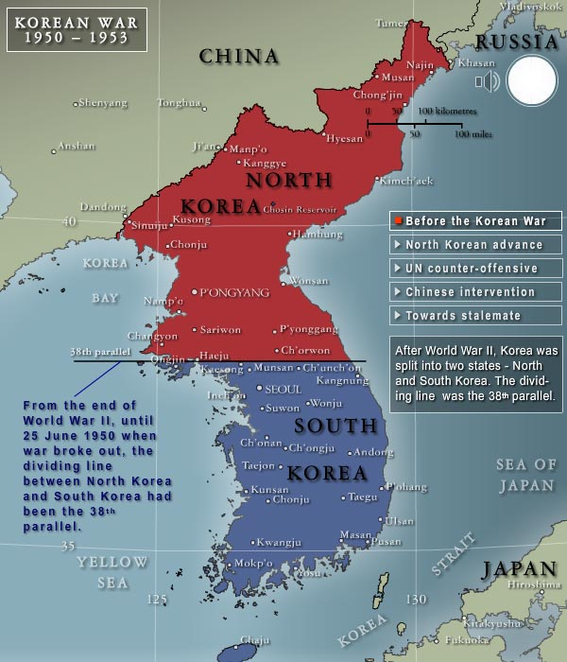
Korean War- 1950-1953
American involvement in the Korean War in the early 1950s reflected the American policy of containment of communism.
Kim Il Sung and Syngman Rhee
UN Peacekeeping forces sent to Korea

Slide 14
Con’t
Communist Chinese forces came into the war on the side of North Korea, and although the war threatened to widen, it eventually ended in a stalemate with South Korea free of communist occupation.
MacArthur vs Truman

Slide 15
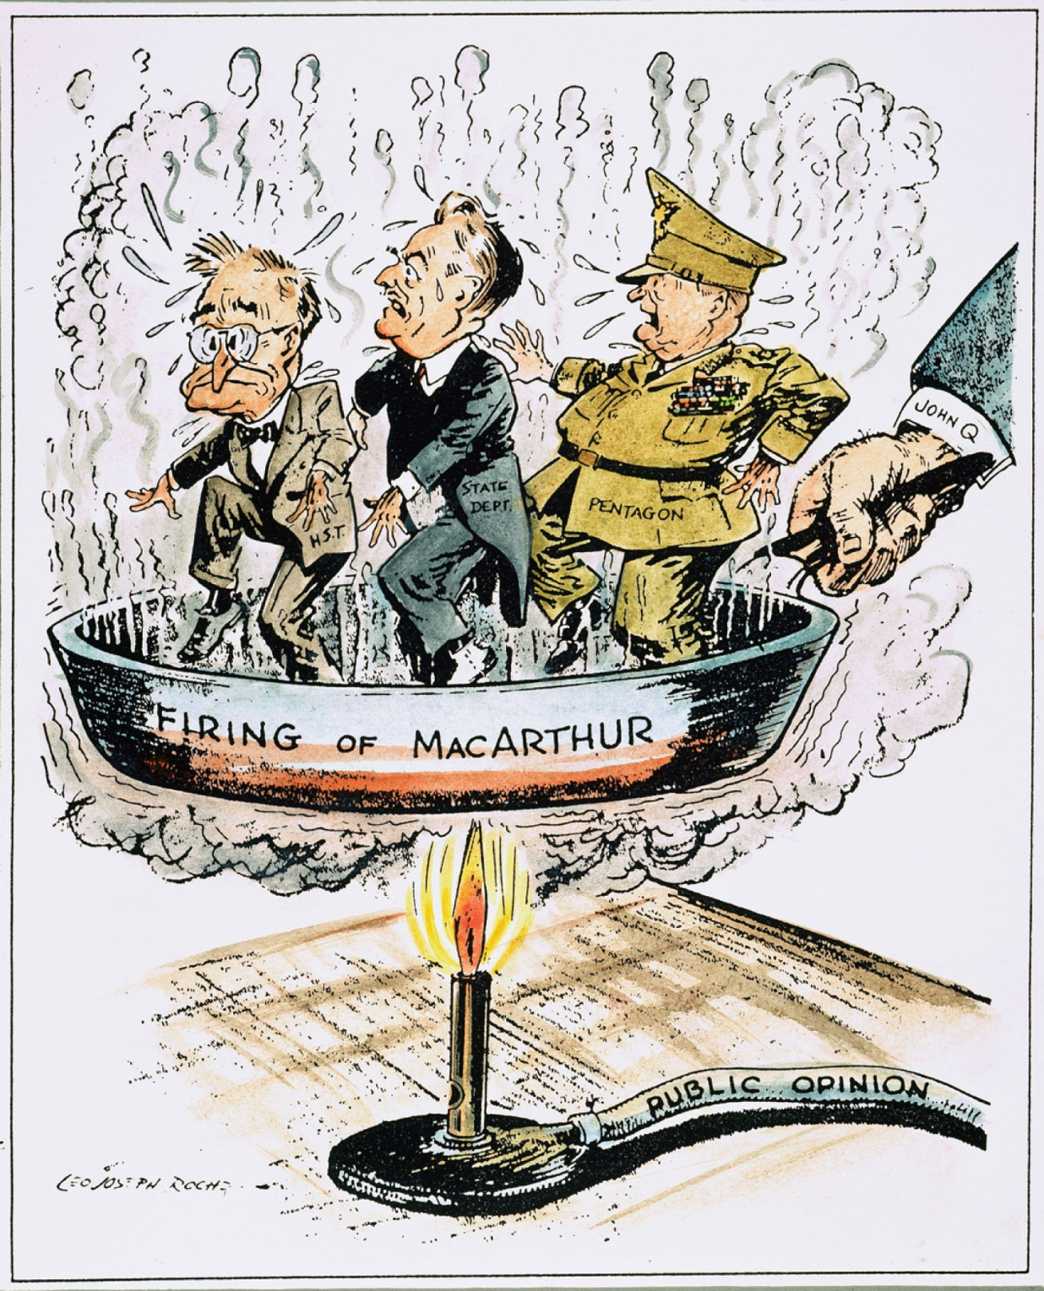

Slide 16
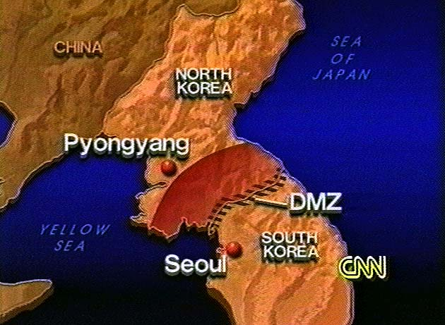
Con’t
Truce declared in 1953
Korea divided at 38th parallel
American foreign policy increases

Slide 17
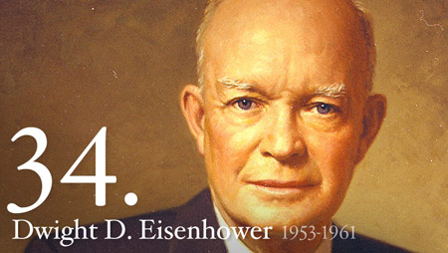
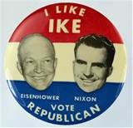
President Eisenhower
Ran against Dem. Adlai Stevenson
Richard Nixon= running mate

Slide 18
Threat of Nuclear War
President Eisenhower adopted a policy of “massive retaliation” to deter any nuclear strike by the Soviets.

Slide 19
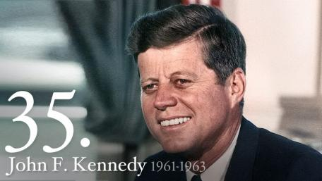
President John F. Kennedy
Democrat
Ran against Richard Nixon
Running mate= Lyndon B. Johnson

Slide 20
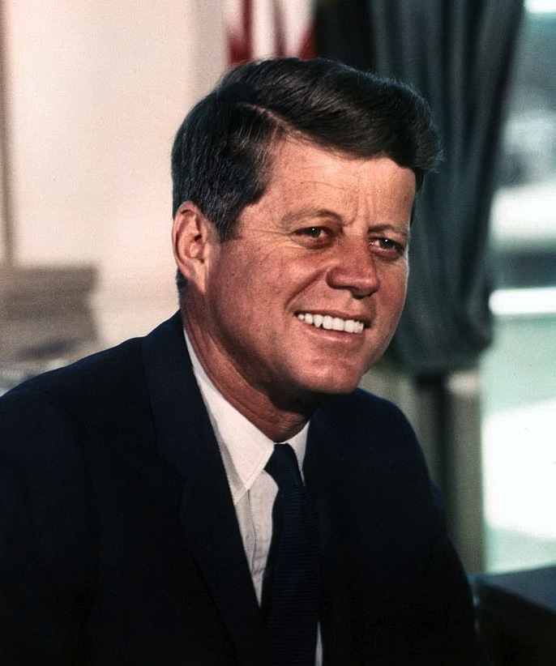
JFK
President Kennedy in his inaugural address:
the United States would “pay any price, bear any burden, meet any hardship, support any friend, oppose any foe, in order to assure the survival and the success of liberty.”
“Ask not what your country can do for you; ask what you can do for your country.”

Slide 21
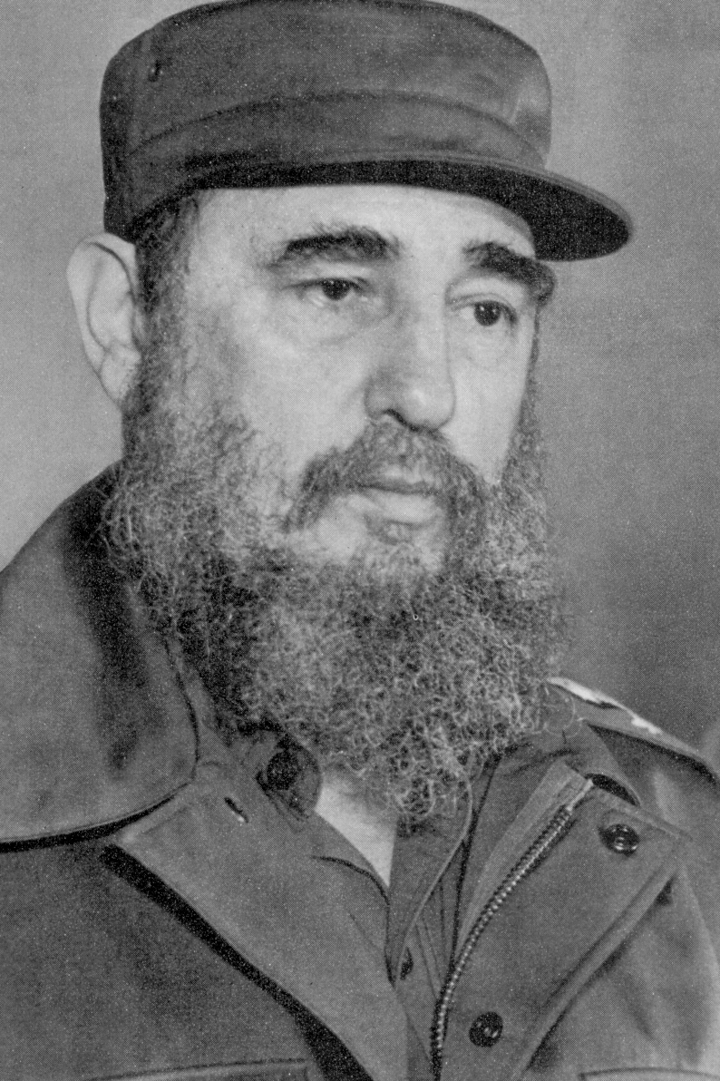
US vs Cuba
Fidel Castro led a communist revolution that took over Cuba in the late 1950s
Overthrew Batista in 1959
Fidel Castro

Slide 22
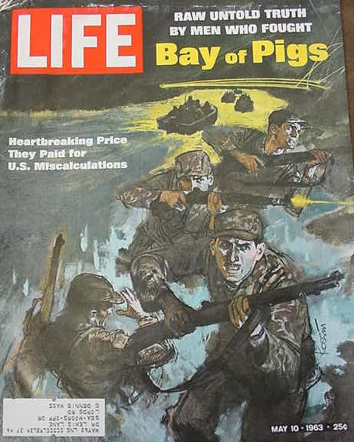
Con’t
Cuba and Soviet Union become allies
Bay of Pigs- utter failure for US- Many Cubans fled to Florida and later attempted to invade Cuba and overthrow Castro.

Slide 23
Cuban Missile Crisis- 1962
Soviet missiles in Cuba
World on brink of nuclear war
President J.F. Kennedy and Khrushchev negotiate
Cold War continues 25 more years

Slide 24
Cold War on the Home Front
The fear of communism and the threat of nuclear war affected American life throughout the Cold War.
During the 1950s and 1960s, American schools regularly held drills to train children what to do in case of a nuclear attack, and American citizens were urged by the government to build bomb shelters in their own basements.

Slide 25
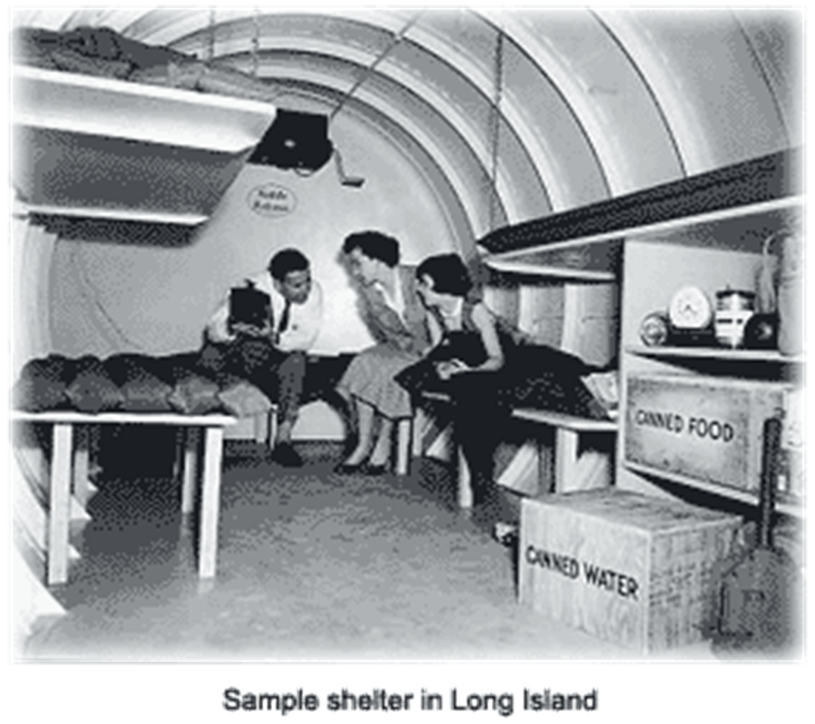
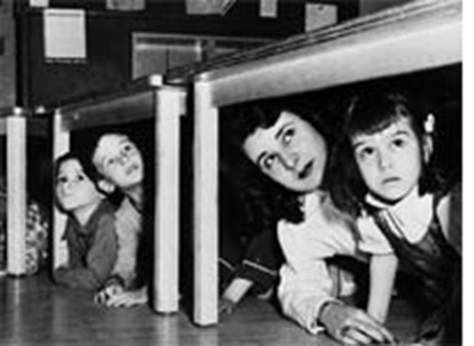

Slide 26
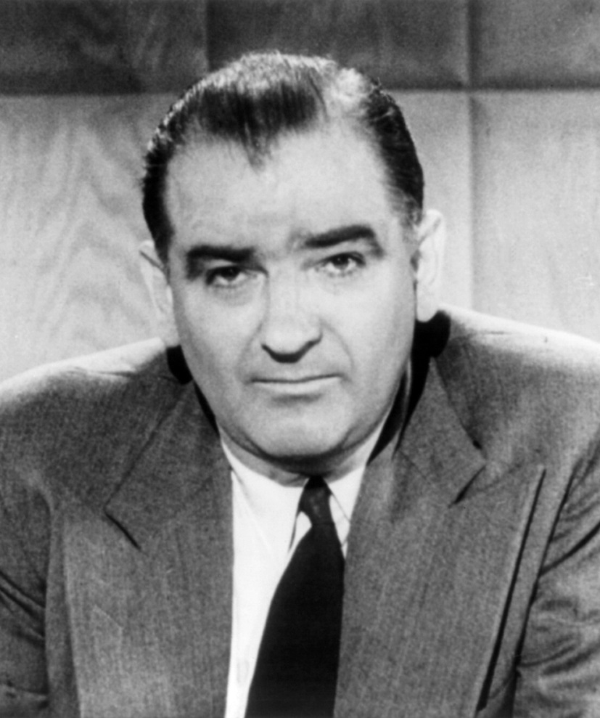
McCarthyism
McCarthyism—the making of false accusations based on rumor or guilt by association.
House Un-American Activities Committee
“Great Fear”
Joseph McCarthy

Slide 27
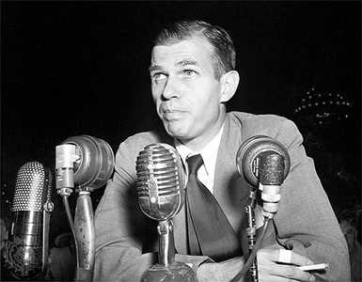
Spies
Alger Hiss accused of being a Soviet spy

Slide 28
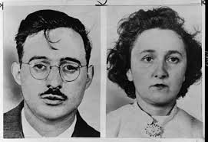
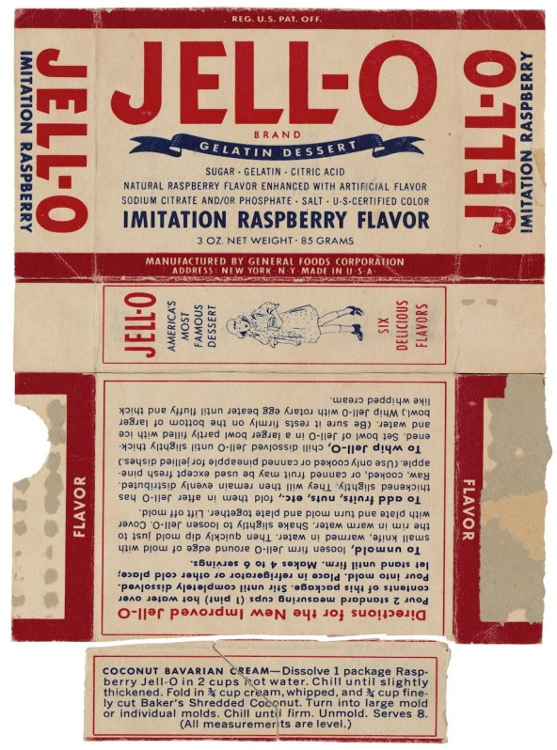
Con’t
Julius and Ethel Rosenberg
  Accused of giving information about atomic weapons to Soviet Union
Both cases increased domestic fears of communism.

Slide 29
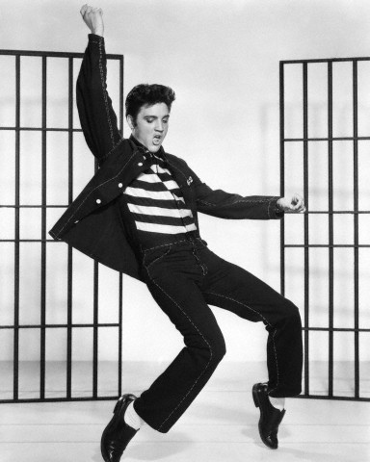
Culture
The baby boom era appears
New youth culture
appear
  Rock and roll
  Controversial

Slide 30
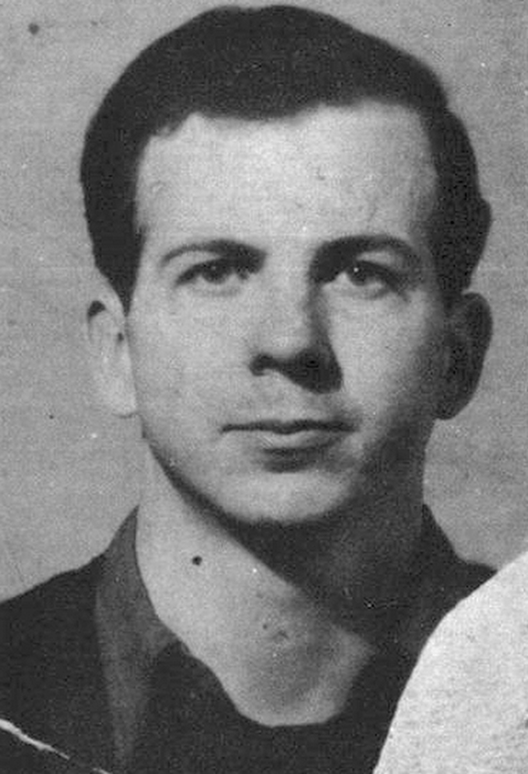
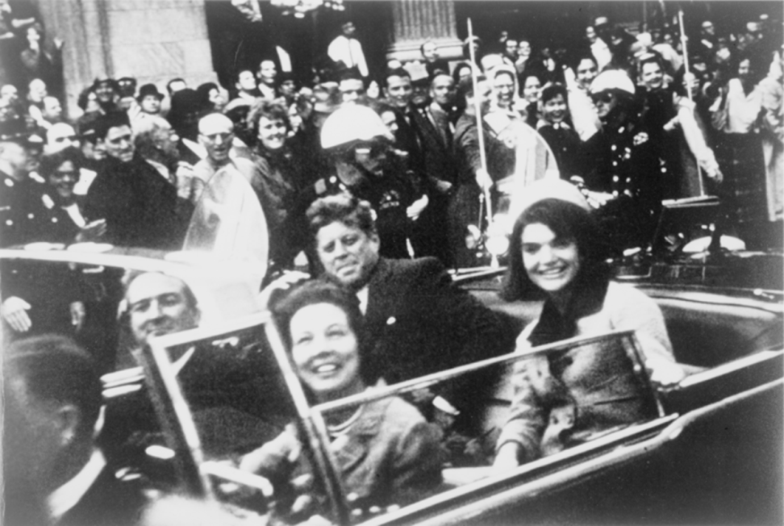
JFK Assassinated
1963- Dallas Texas
Killed by Lee Harvey Oswald
Warren Commission
Oswald

Slide 31
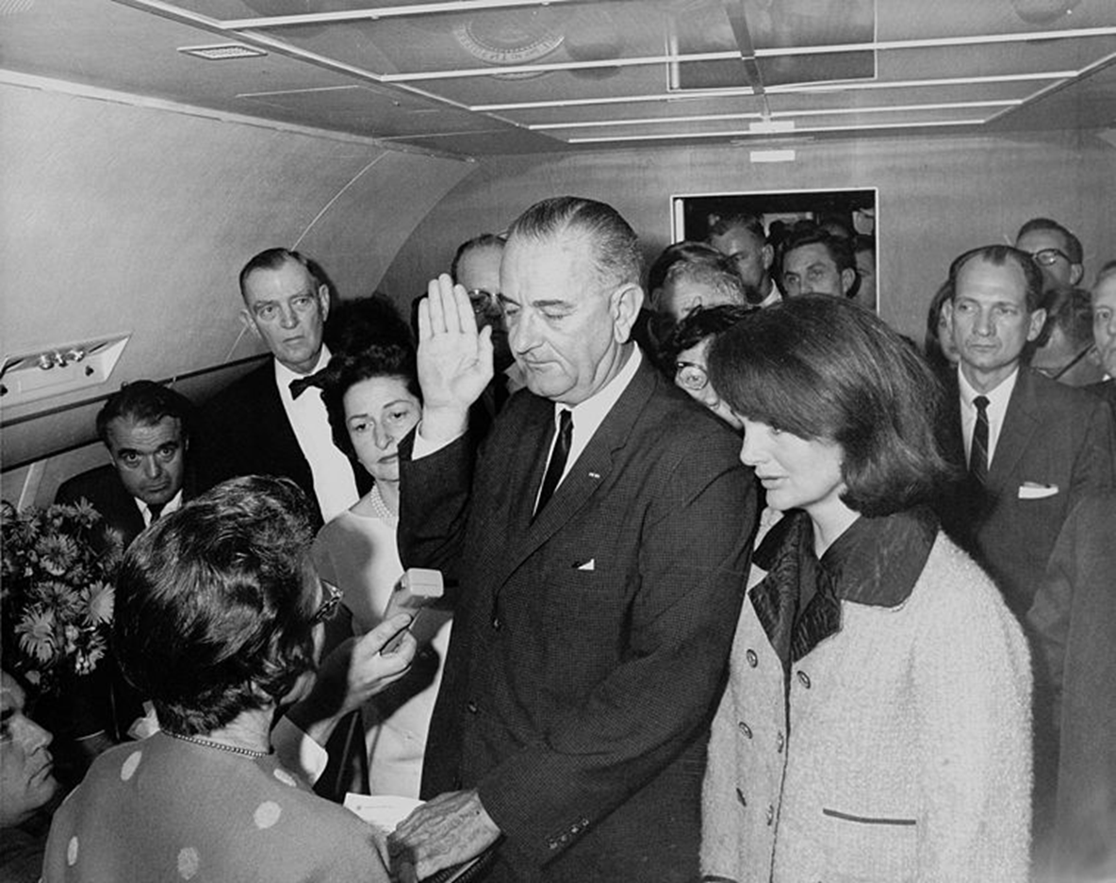
VP Lyndon Johnson being sworn in on Air force One

Slide 32
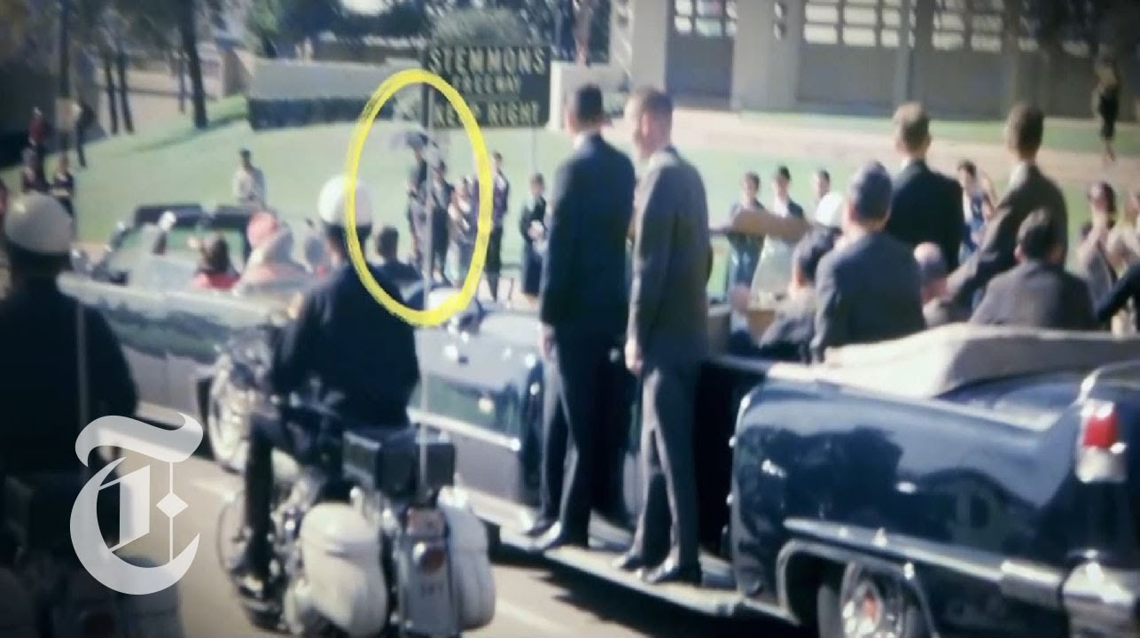
“Umbrella Man”
*One of the closest bystanders to JFK when he was assassinated
*Sunny day – why umbrella?
*Seen in video as spinning umbrella clockwise as JFK draws near- a signal?

Slide 33
Vietnam War (1954-75)
American involvement in Vietnam also reflected the Cold War policy of containment of communism.
Beginning in the 1950s and continuing into the early 1960s, the communist government of North Vietnam attempted to install through force a communist government in South Vietnam. The United States helped South Vietnam resist.

Slide 34
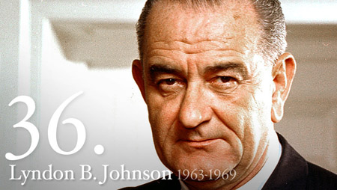
Con’t
The American military buildup in Vietnam began under President John Kennedy. After Kennedy’s assassination in 1963, the buildup was intensified under President Lyndon Johnson.
Gulf of Tonkin Resolution
Operation Rolling Thunder

Slide 35
Con’t
Vietcong and Tet Offensive
The scale of combat in Vietnam grew larger during the 1960s. American military forces repeatedly defeated the North Vietnamese forces in the field, but by fighting a limited war, could not force an end to the war on favorable terms.

Slide 36
Public Opinion on Vietnam
America became bitterly divided over the issue. While there was support for the American military and conduct of the war among many Americans, others opposed the war, and active opposition to the war mounted, especially on college campuses.

Slide 37
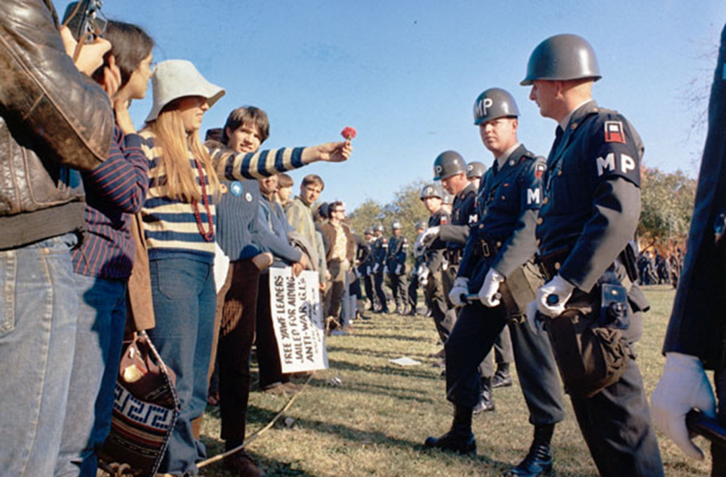
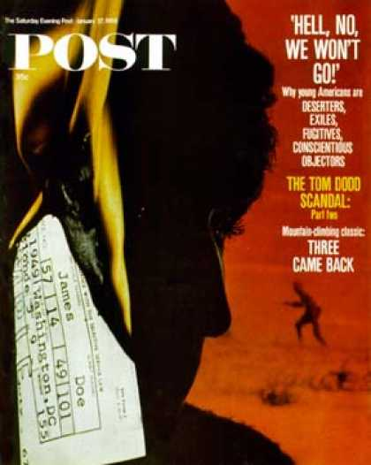
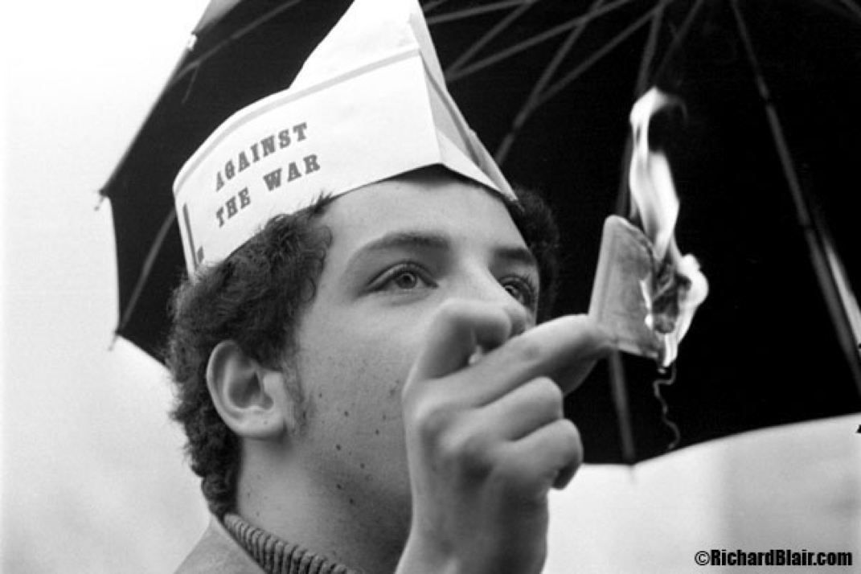
Student Activism
Protests on the draft

Slide 38
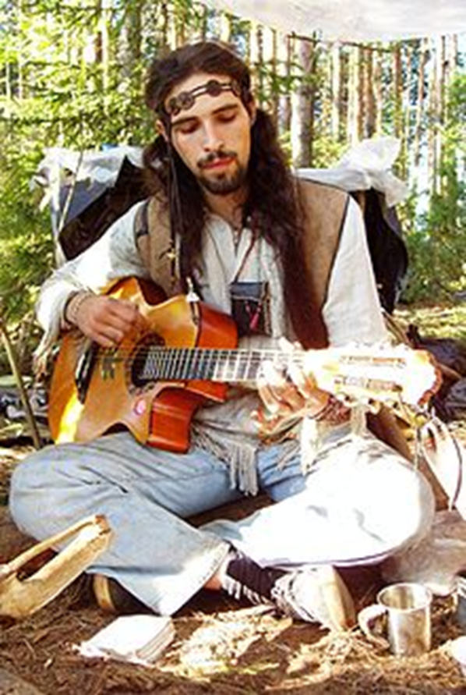
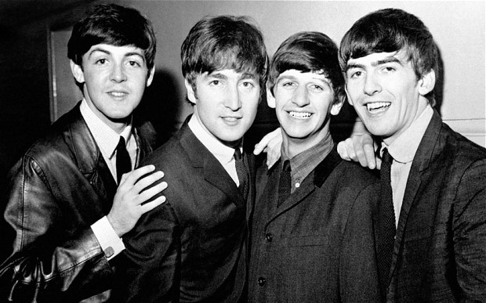
Counterculture
Hippies – Pete Seeger, Bob Dylan
  Political idealism, loss of patience with war
The Beatles
  Cause generational divide

Slide 39
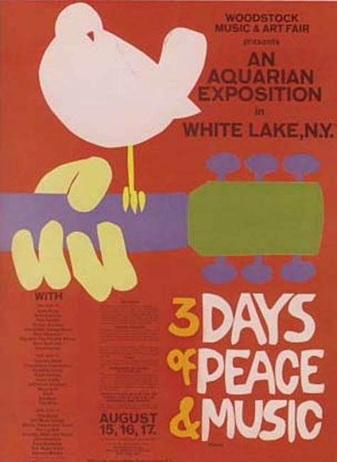
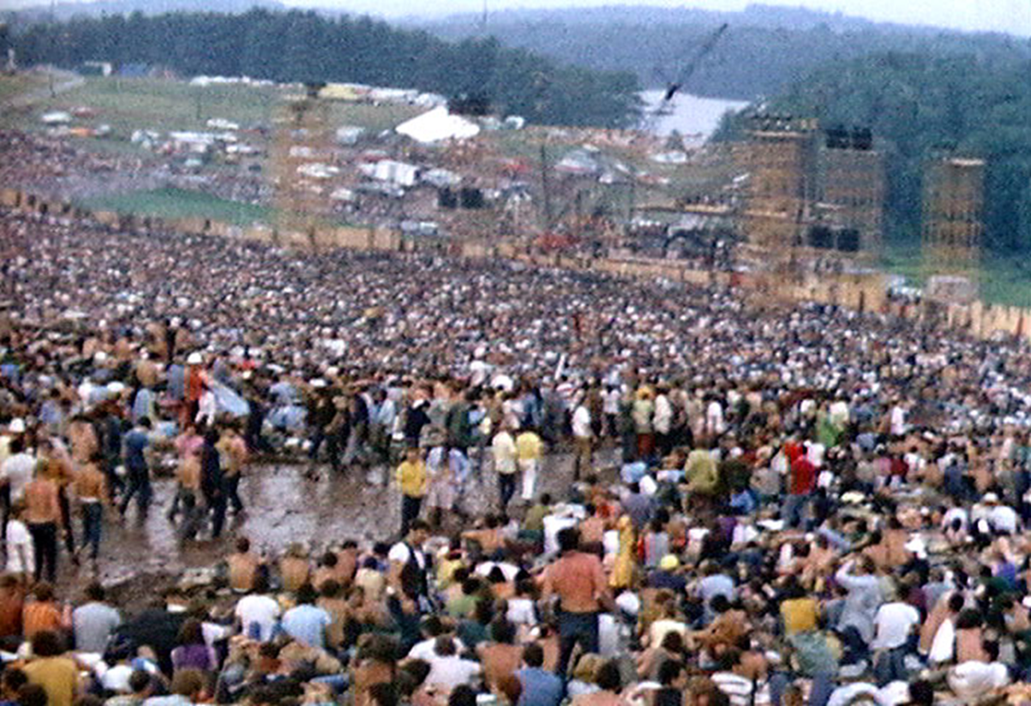
Woodstock
August 1969

Slide 40
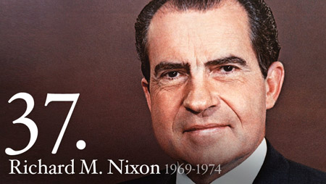
Nixon Elected President
After Johnson declined to seek re-election, President Nixon was elected on a pledge to bring the war to an honorable end.

Slide 41
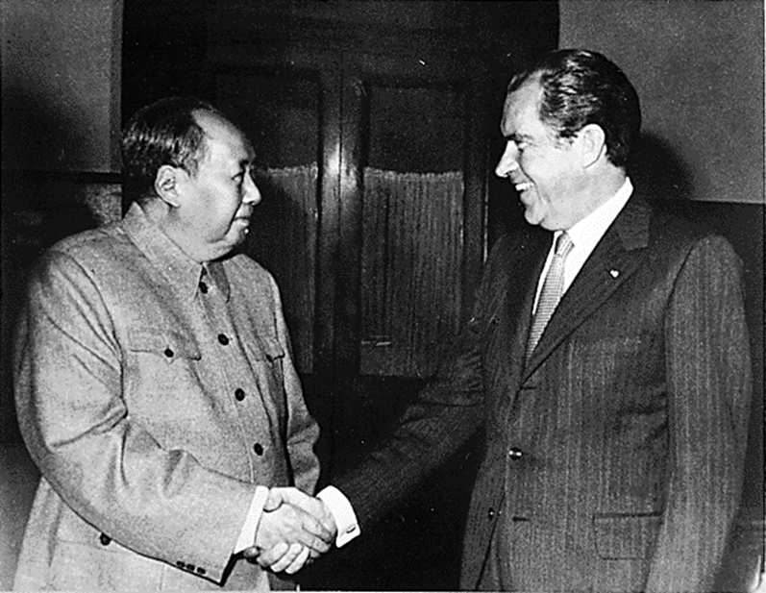
Détente
Nixons policy for peaceful coexistence with Soviet Union and China
Nixon travels to China
SALT

Slide 42
Vietnamization
Nixon instituted a policy of “Vietnamization,” withdrawing American troops and replacing them with South Vietnamese forces while maintaining military aid to the South Vietnamese.
Ultimately “Vietnamization” failed when South Vietnamese troops proved unable to resist invasion by the Soviet-supplied North Vietnamese Army.

Slide 43
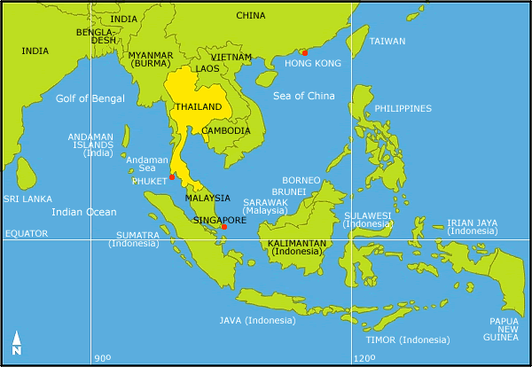
Cambodia
Bombing of Cambodia
  Led to antiwar demonstrations in DC
Invasion of Cambodia
  Led to rise of Khmer Rouge

Slide 44
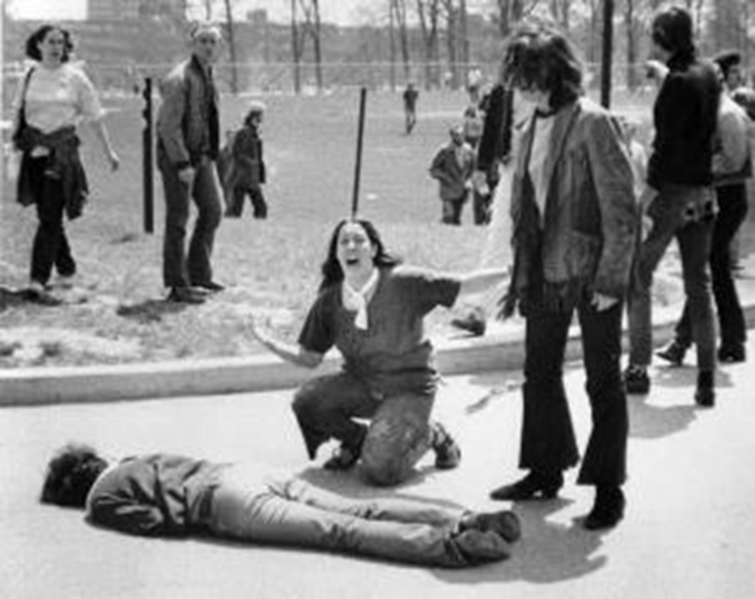
Protests
NY Times uncovered invasion of Cambodia
Kent State Massacre
“Kent State Four”

Slide 45
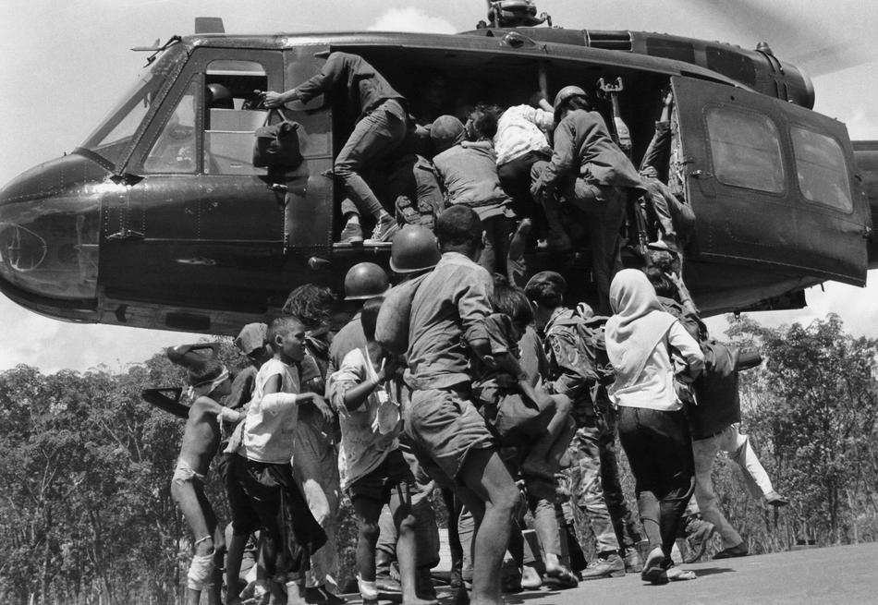
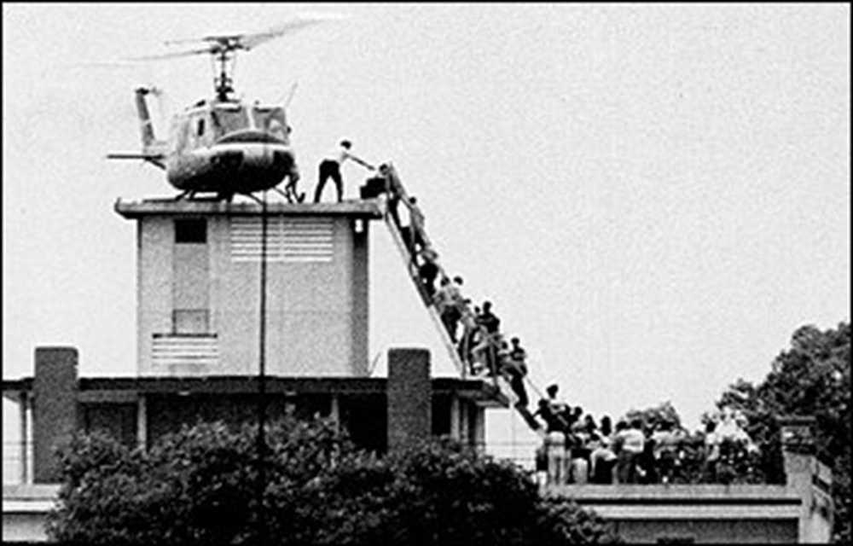
Fall of Vietnam
South Vietnam falls to communism
Vietnam reunited April 29, 1975
Saigon renamed Ho Chi Minh City

Slide 46
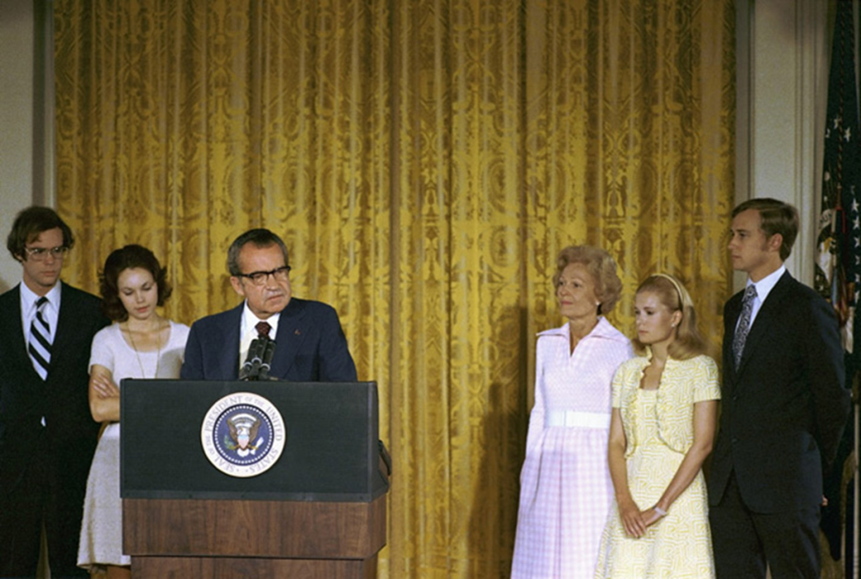
Watergate Scandal
Began with break-in at Democratic National Committee’s headquarters
Daniel Ellsberg
“Plumbers” and CREEP in the White House

Slide 47
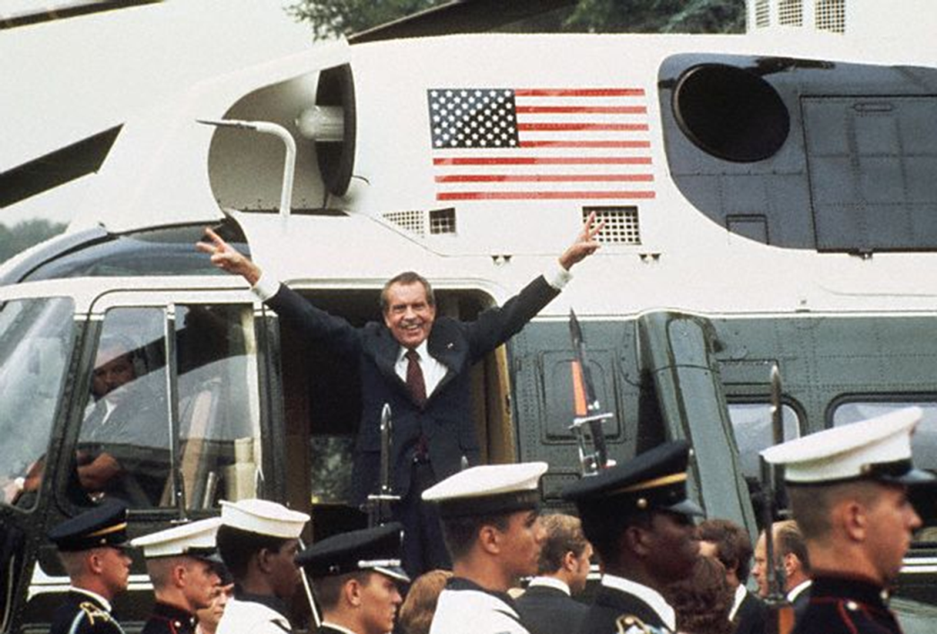
Con’t
Nixon faces impeachment, resigns instead

Slide 48
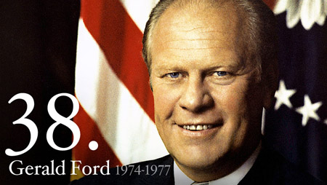
Con’t
Gerald Ford sworn in and pardons Nixon

Slide 49
Virginia during Cold War
The Cold War made foreign policy a major issue in every presidential election during the period.
The heavy military expenditures throughout the Cold War benefited Virginia’s economy proportionately more than any other state, especially in Hampton Roads, home to several large naval and air bases, and in Northern Virginia, home to the Pentagon and numerous private companies that contract with the military.

Slide 50
Military forces during Cold War
Unlike veterans of World War II, who returned to a grateful and supportive nation, Vietnam veterans returned often to face indifference or outright hostility from some who opposed the war
It was not until several years after the end of the Vietnam War that the wounds of the war began to heal in America, and Vietnam veterans were recognized and honored for their service and sacrifices.

Slide 51
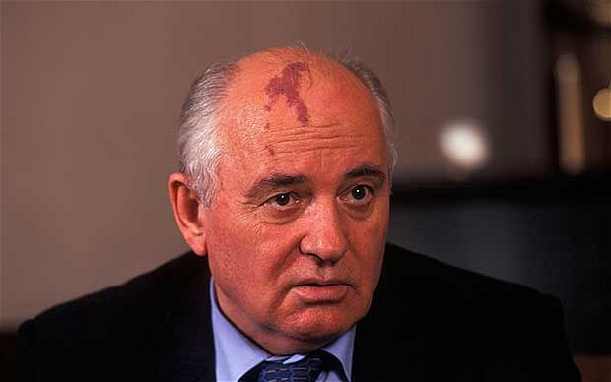
Internal problems of the Soviet Union
President Mikhail Gorbachev
  Raising nationalism in Soviet republics
  Increasing Soviet military expenses to compete with the United States
  Gorbachev’s glasnost and perestroika (openness and economic restructuring)

Slide 52
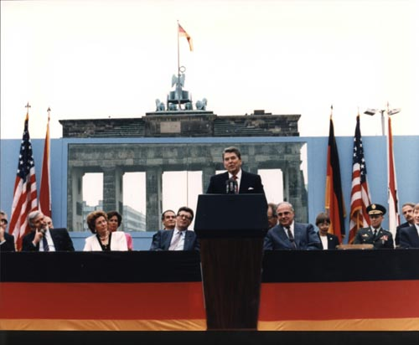
President Ronald Reagan
Challenged moral legitimacy of the Soviet Union, for example, in a speech at the Berlin Wall (“Mr. Gorbachev, tear down this wall!”)
Increased United States military and economic pressure on the Soviet Union

Slide 53
Selected post-Cold War era goals and policies
Foreign aid
Humanitarian aid
Support for human rights

Slide 54
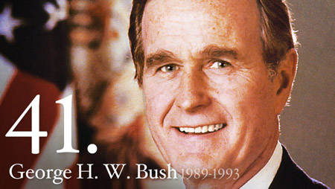
President George H. W. Bush, 1989–1993
Fall of communism in Eastern Europe
Reunification of Germany
Collapse of Yugoslavia
Breakup of the Soviet state
  Berlin Wall torn down in 1989. Cold War officially over in 1991

Slide 55
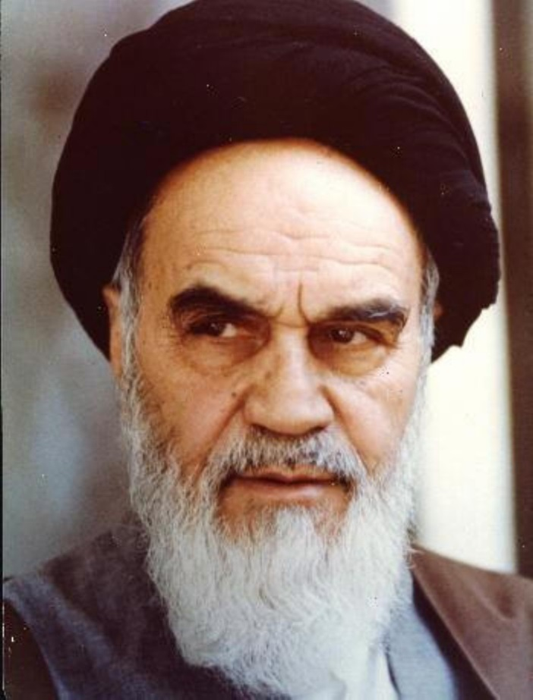
Tension in the Middle East
Iranian leader Ayatollah Khomeini
Iraqi leader Saddam Hussein
Khomeini

Slide 56
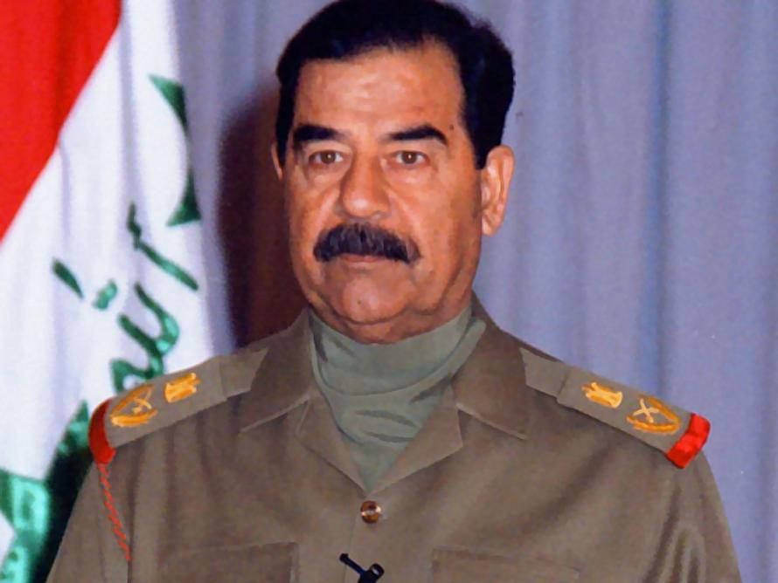
Persian Gulf War of 1990–1991
Iraq invades Kuwait (compromises US access to oil)
Hussein

Slide 57
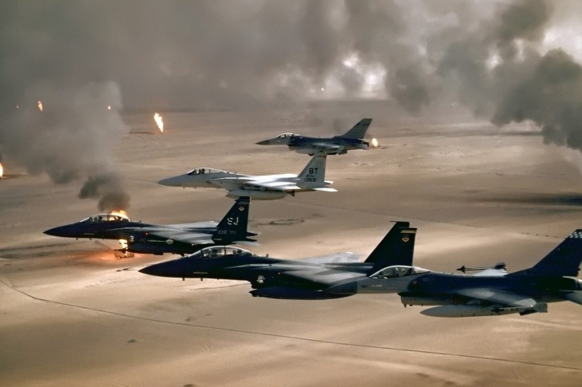
Operation Desert Storm
January 17, 1991- US air offensive against Iraq
Use of latest military technology
Destroys much of Iraqi air force

Slide 58
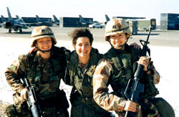
Persian Gulf War
42 day war
Resolution 687
First war in which American women served in a combat role

Slide 59
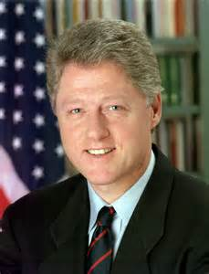
President William J. Clinton, 1993–2001
North American Free Trade Agreement (NAFTA)
Full diplomatic relations with Vietnam
Lifting of economic sanctions against South Africa when her government ended the policy of apartheid

Slide 60
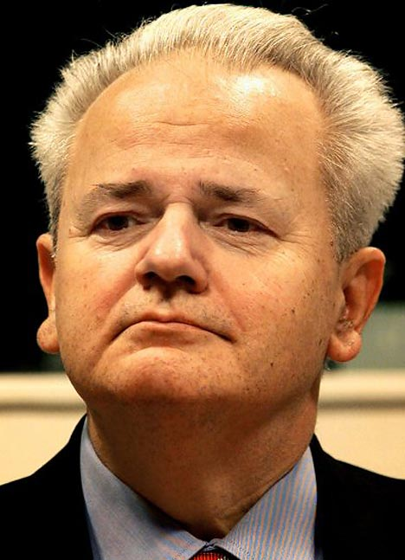
NATO action in former Yugoslavia
Under Clinton
Slobodan Milosevic – Serbian leader
  Led genocide against Albanians, Bosnians Muslims and Croatians
  “Butcher of the Balkans”
  Charged with crimes against humanity
Milosevic

Slide 61
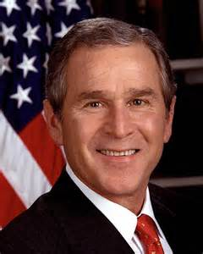
President George W. Bush, 2001–2009
Terrorists attacks on United States soil on 9/11/2001

Slide 62

War in Afghanistan
Goal was to dismantle al-Qaeda and remove Taliban from power (Osama Bin Laden)

Slide 63

War in Iraq
Saddam Hussein was president- US felt he was a threat with WMD.
Invaded Iraq to topple Socialist gov’t
Hussein

Slide 64
Civil Rights

Slide 65

Brown v. Board of Education- 1954
Supreme Court decision that segregated schools are unequal and must desegregate
Linda Brown
NAACP lawyer- Thurgood Marshall
White Citizens Council

Slide 66

Little Rock 9
Students at Central High School in Little Rock Arkansas were not allowed to integrate due to mobs outside the school
Eisenhower sent in federal troops to allow the students to attend school

Slide 67

Civil Rights Movements
Rosa Parks- 1955 in Montgomery Alabama
Martin Luther King Jr. starts Montgomery bus boycott

Slide 68

Jr. and his wife Coretta being arrested in Alabama

Slide 69

Woolworths “sit in”
February 1, 1960 4 black students from NC A&T took “white only” seats at Woolworth’s lunch counter
  Arrested, but Woolworth lunch counters were desegregated

Slide 70
Civil Rights in VA
Massive Resistance: Closing some schools
Establishment of private academies
White flight from urban school systems
National Association for the Advancement of Colored People (NAACP) Challenged segregation in the courts.
  Oliver Hill: NAACP Legal Defense Team in Virginia

Slide 71

1963 March on Washington
Participants were inspired by the “I Have a Dream” speech given by Dr. Martin Luther King, Jr.
The march helped influence public opinion to support civil rights legislation.
The march demonstrated the power of nonviolent, mass protest.

Slide 72
Civil Rights Act of 1964
The act prohibited discrimination based on race, color, religion, gender, or national origin.
The act desegregated public accommodations.
President Lyndon B. Johnson played an important role in the passage of the act

Slide 73
Voting Rights Act of 1965
The act outlawed literacy tests.
Federal registrars were sent to the South to register voters.
The act resulted in an increase in African American voters.
President Johnson played an important role in the passage of the act

Slide 74


Beyond Civil Rights
African American counter-culture
Black Muslims
Malcolm X
Black Panthers

Slide 75

MLK Jr. Assassinated
April 4, 1968 in Memphis Tennessee
James Earl Ray

