Slide 1
Civil War and Reconstruction
Unit 5

Slide 2
Road to the Civil War

Slide 3
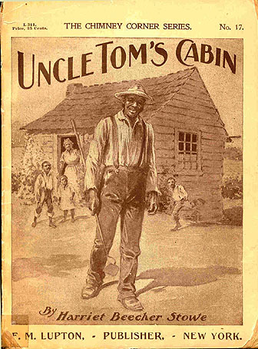
Antislavery Literature
Harriet Beecher Stowe: Uncle Tom’s Cabin
Condemned by the South
North: Abolitionists
South: Defenders of slavery

Slide 4
“Bleeding Kansas”
Immigrants sent into Kansas to prevent slavery from taking hold
1855 election in Kansas to vote on new legislature
  “Border Ruffians”
  Burning of free-soil Lawrence, KS.

Slide 5
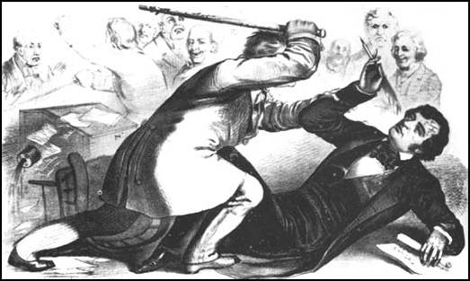
Charles Sumner
Senator from MA
Caned by Congressman Preston Brooks
Symbol for the evils of slavery

Slide 6
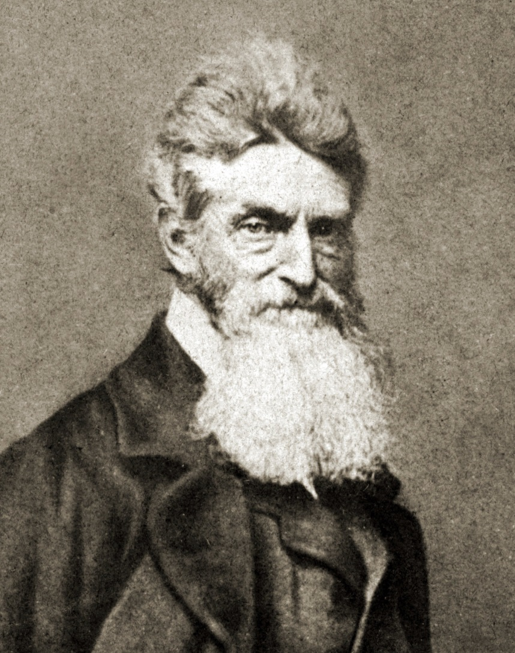
Pottawatomie Massacre
John Brown
  Extreme abolitionist
In response to burning of Lawrence
Attack unpunished
John Brown

Slide 7
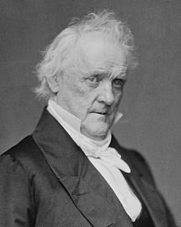
Election of 1856
James Buchanan- Democratic nominee
Becomes 15th pres.
The 1850’s were known for having ineffective presidential leadership (one cause of Civil War)
Buchanan

Slide 8
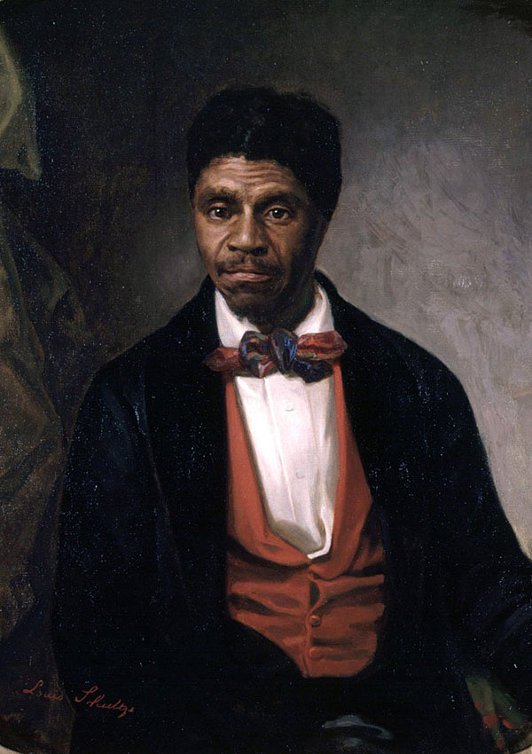
Dred-Scott Decision
1857
Dred Scott- slave in Wisconsin territory
Sues for freedom – Dred Scott V. Sanford
Chief Justice Roger B. Taney
Decisions:
  No African Americans can sue in fed. Court
  Slaves allowed in slave free territory
  Slaves cannot be taken from owners without due process of law

Slide 9
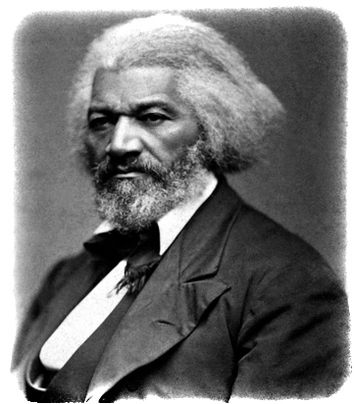
Frederick Douglass
The North Star
Former slave
In the future: Urged Lincoln to recruit former enslaved African Americans to fight in the Union Army
Douglass

Slide 10
Lincoln-Douglas Debates (1858)
S. Douglas vs Lincoln for senate seat in Illinois
Lincoln- "A house divided cannot stand. I believe this government cannot endure; permanently half slave and half free.”
Lincoln has debates turned into a book

Slide 11
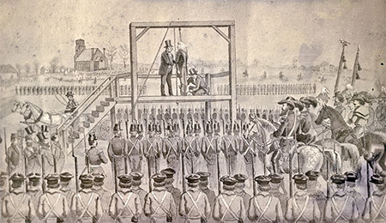
Attack on Harper’s Ferry
John Brown (again)
    Wants to lead southern slaves in rebellion to allow them to establish a black free state
Oct. 1859- seized arsenal forced to surrender
Hung but seen as a martyr in the North

Slide 12
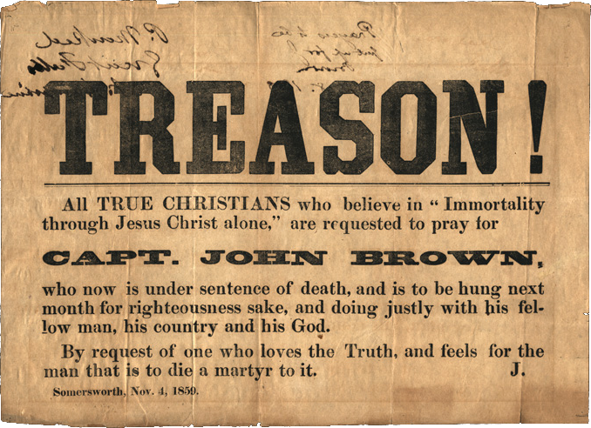

Slide 13
Nominating Conventions of 1860
Democratic party split in two
  Douglas nominated for Northern portion
  Platform? Popular Sovereignty
Republican party nominated Lincoln
  Platform? Non-extension of slavery, tariffs, Pacific Railroad

Slide 14
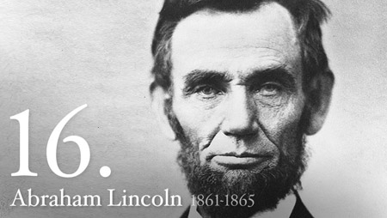
Election of 1860
Lincoln won with only 40% of the vote
Democrats still in control over both houses and majority on Supreme Court
The election of Lincoln was followed by the secession of several Southern states that feared Lincoln would try to abolish slavery

Slide 15
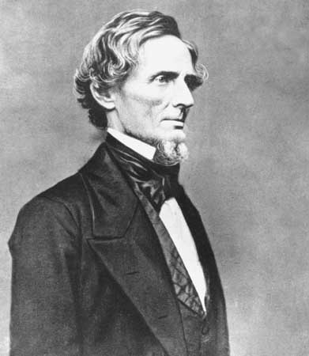
Southern States Secede
SC first to call for convention to question idea of secession
Dec. 1860- Unanimous vote to secede
Buchanan’s “lame-duck” period
Confederate States of America formed
Jefferson Davis is a US senator who became the president of the Confederate States of America
Davis

Slide 16
Justification for Secession
S. said N. had too much political power
Slavery heart of the issue
Crittenden Amendments
  Failed

Slide 17
Lincolns Early Presidency
Inaugural speech
  Vowed to preserve the Union; to "hold, occupy, and possess" Federal property in the South; -- "Physically speaking, we cannot separate"
South regarded speech as a declaration of war

Slide 18
Civil War
1861-1865

Slide 19
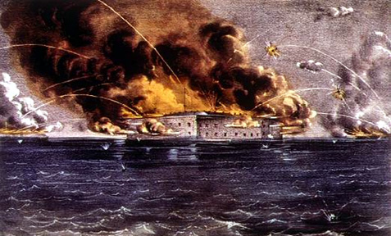
Attack on Fort Sumter
Charleston Harbor (SC)
  Major Robert Anderson
Supplies sent to soldiers in Ft. Sumter- seen as act of aggression by the south.
April 12, 1861- Fort attacked
*This was the opening confrontation of the Civil War

Slide 20
Con’t
Attack provokes North
President Lincoln’s call for federal troops in 1861 is another cause of the Civil War
As President of the US during the Civil War- he insisted that the Union be held together- by force if necessary
Virginia secedes (April 17, 1861)

Slide 21
Border Slave States
MO, KY, MD, WV, DE
WV created in mid-1861
Agreed to fight to preserve union (not slavery)
“5 Civilized Tribes” join confederacy

Slide 22
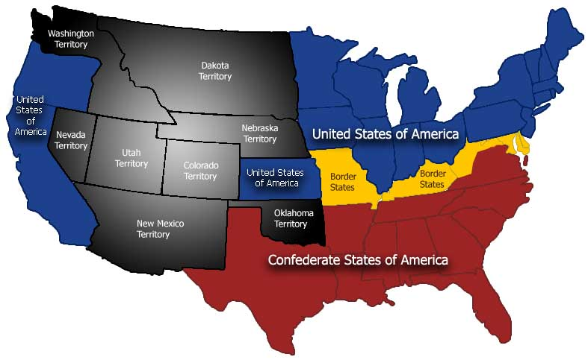

Slide 23
Confederate Assets and Disadvantages
Assets :
  Fight defensively (less troops)
  Talented officers
Disadvantages
  Not enough industry
  Breakdown of transportation

Slide 24
Northern Advantages
Larger pop.
Most of the nations wealth and manufacturing and railroads
Controlled the sea

Slide 25
The Confederacy
Their constitution mainly copied from Union
Davis wanted strong central gov’t (bitterly opposed)
Almost impeached

Slide 26
Raising Armies
North:
Originally volunteers
1863- Conscription for the first time in US history
South:
Much fewer troops
Forced conscription 1862
Both:
1. Hand-to-hand combat
2. Wartime diaries recorded this harsh reality

Slide 27
African- American Soldiers
African-American soldiers allowed in North
(The Emancipation allowed for the enlistment of African American soldiers )
South forced to enlist slaves to fight and keep farms running

Slide 28
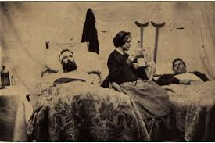
Women During the War
Managed homes
Often faced poverty and hunger
New roles in agriculture, nursing, and war industries

Slide 29
Financial Aspects to the War
Raising money in the north (first income tax)
Southern Finances-
  Sold bonds
  “Runaway Inflation”

Slide 30
Westward Movement
Pacific Railway Act- 1863
The completion of the Transcontinental Railroad soon after the war ended intensified the westward movement of settlers into the states between the Mississippi River and the Pacific Ocean.

Slide 31
War in the East

Slide 32
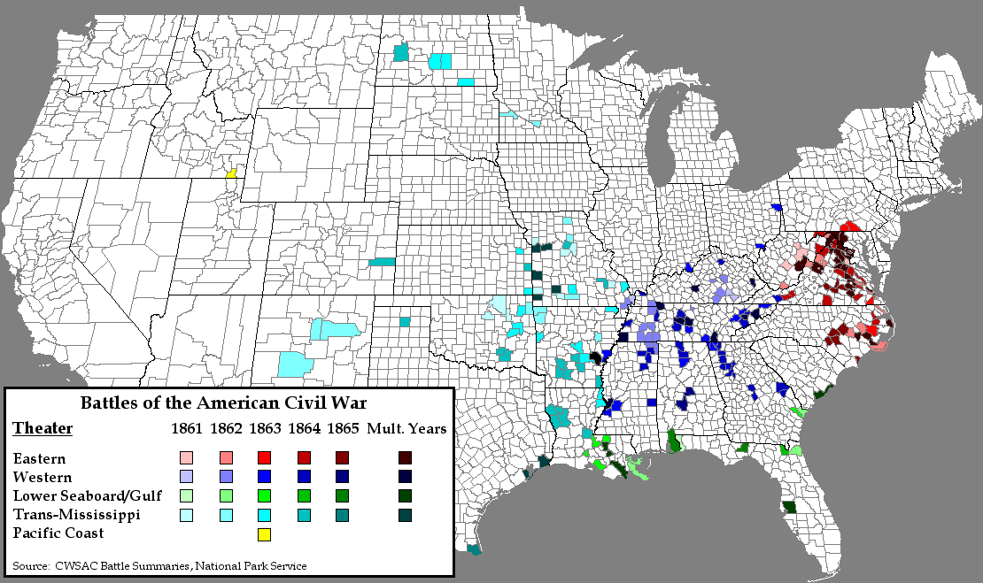

Slide 33
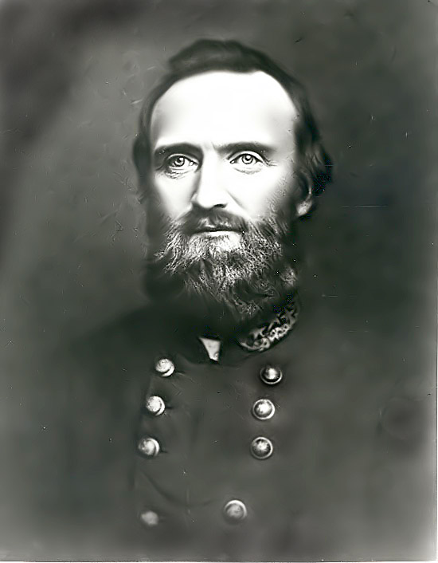
Battle of Bull Run (July 1861)
Manassas, VA
Wanted a quick defeat of confederates
Stonewall Jackson surprises union
Shows everyone this war will be long and bloody
Stonewall Jackson

Slide 34
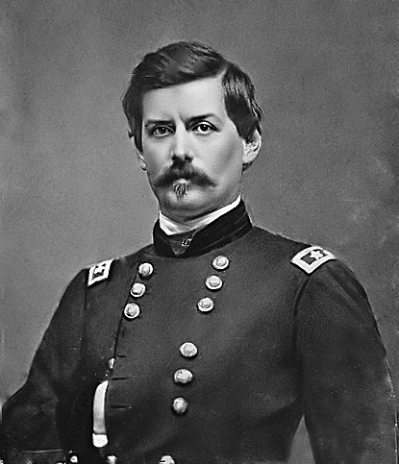
George B. McClellan
Union Gen. of the Army of the Potomac
TOO cautious!
This is his downfall
McClellan

Slide 35
Peninsula Campaign
April 5-June 16th, 1862
McClellan tries to plan to flank Richmond
Seven Day’s Battles
Robert E. Lee becomes Confederate general of the Army of Northern Virginia (Lee opposed secession, but did not believe the Union should be held together by force),
Union fails- McClellan fired. General Pope hired

Slide 36
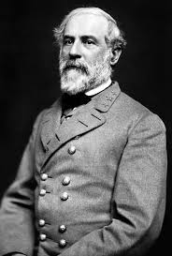
2nd Battle of Bull Run
July 14- August 30th 1862
Lee and Jackson join forces against Union soldiers
Pope fired, McClellan re-hired
Robert E. Lee

Slide 37
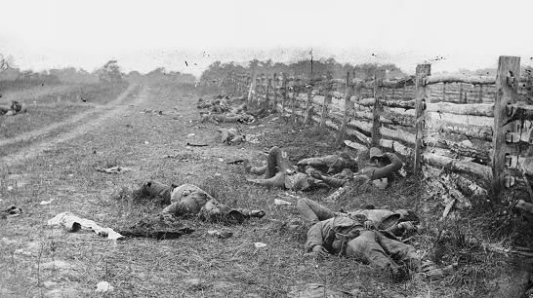
Antietam
Sept, 17th- 1862 in MD
Lee wanted to gain foreign support (huge deal!)
Battle ended in a stalemate
McClellan officially replaced by Gen. Ambrose Burnside
Bloodiest day in American history
No foreign support forthcoming for South
McClellan permanently fired

Slide 38
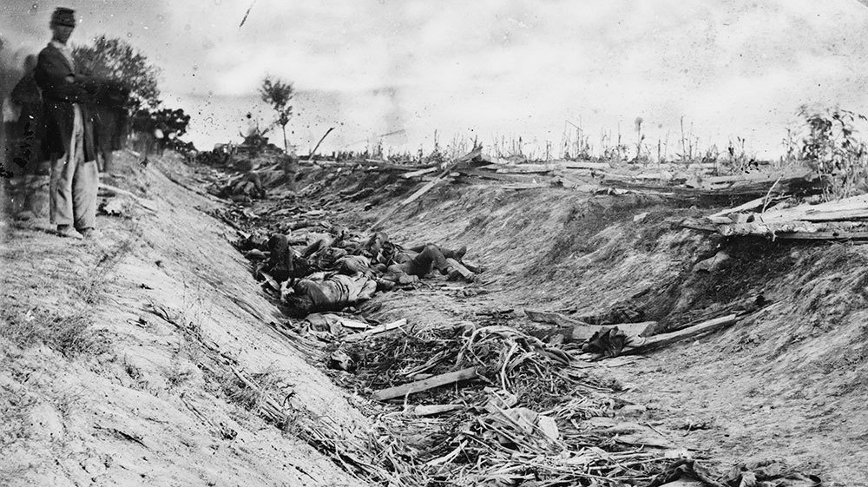

Slide 39
Emancipation Proclamation
The Emancipation Proclamation was issued after the Battle of Antietam
Effective Jan 1st 1863
Civil War now a moral crusade
Made the abolition of slavery a Northern war aim
Discouraged any interference of foreign governments
Allowed for the enlistment of African American soldiers in the Union Army

Slide 40
Con’t
Constitutionality questioned
13th Amendment considered one of the 3 civil war amendments which said slavery was abolished permanently in the United States
Didn’t really affect the slaves…

Slide 41
Reaction
Many northerners- Lincoln went too far
Abolitionists- didn’t go far enough
South- Lincoln trying to start slave insurrection

Slide 42
War in the West
Gen. Ulysses S. Grant- Lincolns best general
He is the Union military commander, who won victories over the South after several other Union commanders had failed
Battle at Shiloh (April 1862)

Slide 43
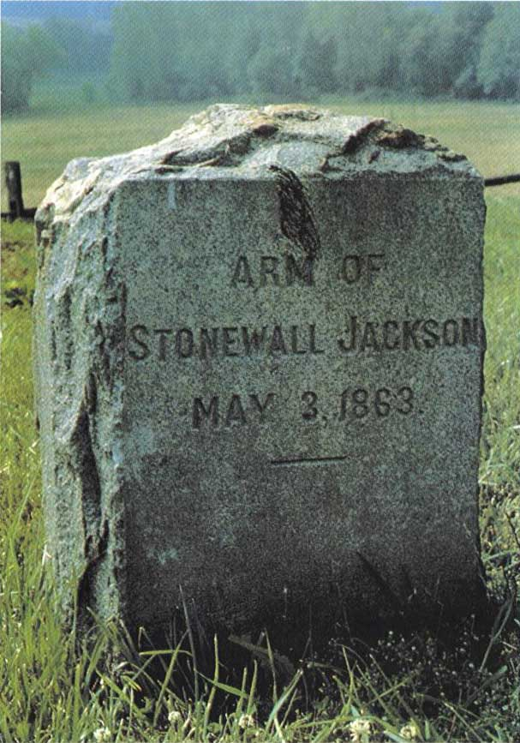
War in the East
Chancellorsville (May 1863)
  Union defeated
  Stonewall Jackson is killed
  Lee: “I have lost my right arm”

Slide 44
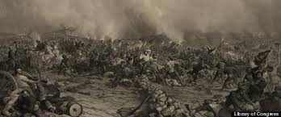
Battle of Gettysburg
July 1-3, 1863
Lee invades PA
Bloodiest battle of the Civil War
Lee retreats/confederates lose
The Battle of Gettysburg was the turning point of the Civil War

Slide 45
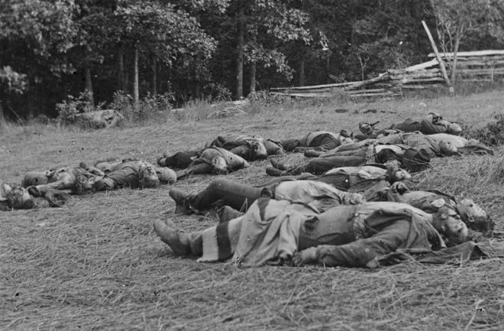
Taken 1st day at McPherson’s Woods where the heaviest fighting took place

Slide 46
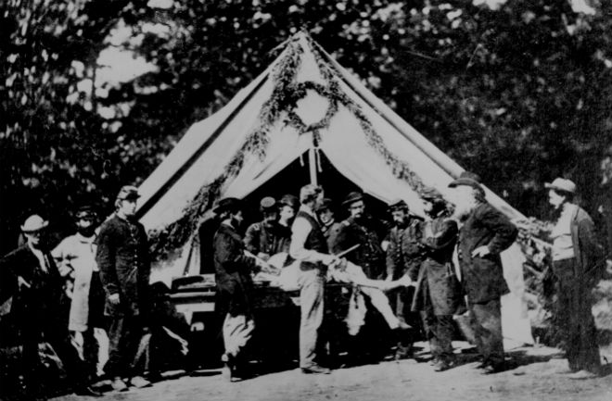
Union solider getting ready to have leg amputated

Slide 47
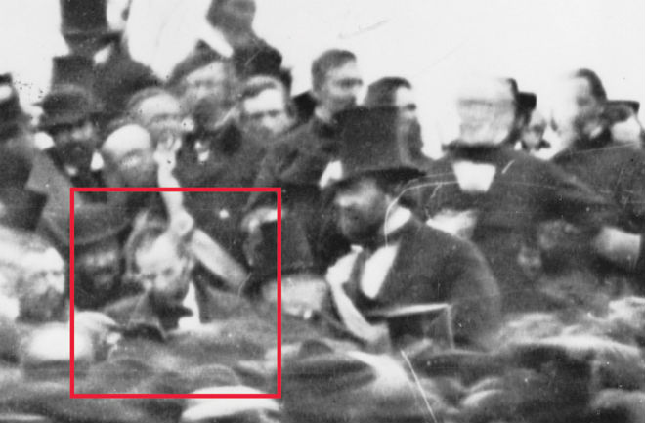
Lincoln visiting Battlefield. Will soon give his Gettysburg Address

Slide 48
Gettysburg Address
Nov. 1863
Lincoln described the Civil War as a struggle to preserve a nation that was dedicated to the proposition that “all men are created equal” and that was ruled by a government “of the people, by the people, and for the people.”
Lincoln believed America was “one nation,” not a collection of sovereign states. Southerners believed that states had freely joined the Union and could freely leave.

Slide 49
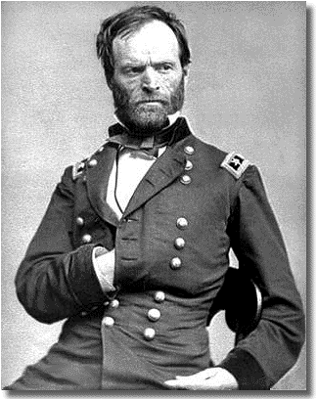
End of the War in the West
Vicksburg campaign
Significance?
William Tecumseh Sherman
  “War is hell”
  Marched through GA, NC, and SC
Sherman

Slide 50
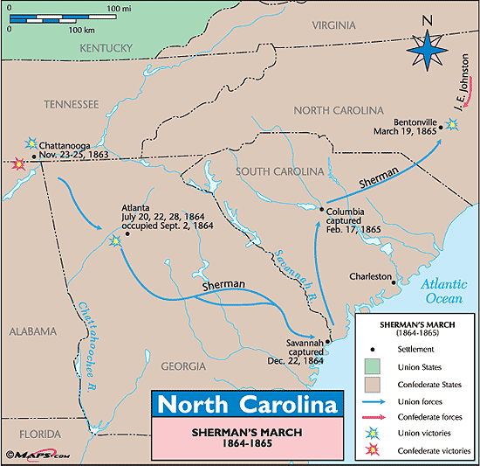

Slide 51
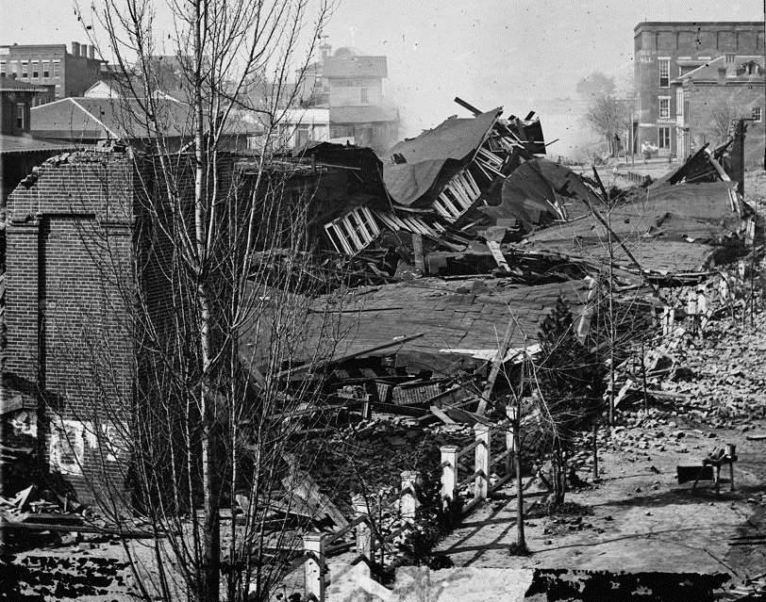
Railway station in Atlanta

Slide 52
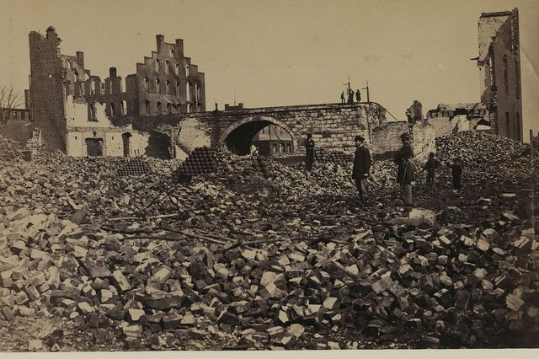

Slide 53
Election of 1864
Union Party (Republicans and War Democrats) nominate Lincoln and Andrew Johnson as his VP
Democratic Party- George McClellan
“Don’t swap horses in the middle of the river”
“With malice toward none, with charity for all”

Slide 54
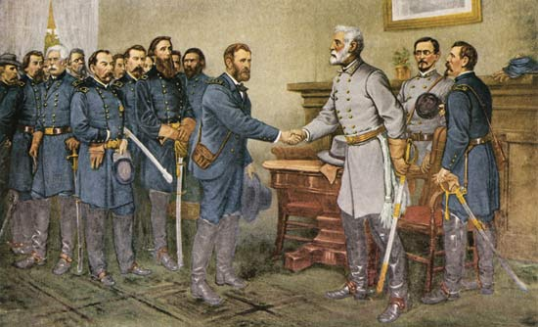
Lee’s Surrender – April 9, 1865
Grant’s VA Campaign
April 2- Davis flees to Danville
Appomattox is the site of Lee’s surrender to Grant
Lee urged Southerners to accept defeat and unite as Americans again, when some Southerners wanted to fight on after Appomattox

Slide 55
Post-Civil War Era

Slide 56
Ulysses S. Grants Views
Urged radical Republicans not to be harsh with former Confederates
Was elected president and served during most of Reconstruction
Advocated rights for the freedman
Opposed retribution directed at the defeated South

Slide 57
Lincoln’s Views
* Lincoln’s view that the United States was one indivisible nation had prevailed.
Lincoln believed that since secession was illegal, Confederate governments in the Southern states were illegitimate and the states had never really left the Union. He believed that Reconstruction was a matter of quickly restoring legitimate Southern state governments that were loyal to the Union.
Lincoln also believed that to reunify the nation, the federal government should not punish the South, but act “with malice towards none, with charity for all… to bind up the nation’s wounds….”

Slide 58
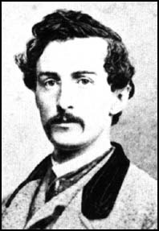
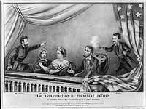
Lincoln’s Assassination
April 14, 1865
Ford’s Theater
John Wilkes Booth
John Wilkes Booth

Slide 59
Results and costs of the Civil War
The North and Midwest emerged with strong and growing industrial economies, laying the foundation for the sweeping industrialization of the nation (other than the South) in the next half-century and the emergence of the United States as a global economic power by the beginning of the twentieth century.
After the war, especially in the South, soldiers returned home to find destroyed homes and poverty. Soldiers on both sides lived with permanent disabilities
2% population dead and war cost $15 B.
Nullification/Succession is never again an issue

Slide 60
Reconstruction
Jefferson Davis imprisoned
Robert E. Lee-
Urged Southerners to reconcile and rejoin the United States
Served as president of Washington College (Washington & Lee University today)
Emphasized the importance of education to the nation’s future

Slide 61
13th Amendment
1865
13th Amendment considered one of the 3 civil war amendments which said slavery was abolished permanently in the United States

Slide 62
Rebuilding the South
The Southern states were left embittered and devastated by the war.
Farms, railroads, and factories had been destroyed throughout the South.
Confederate money was worthless. Many towns and cities such as Richmond and Atlanta lay in ruins, and the source of labor was greatly changed due to the loss of life during the war and the end of slavery.
The South would remain an agriculture-based economy and the poorest section of the nation for many decades afterward.

Slide 63
African Americans
Freedmen’s Bureau- 1865
    “Forty Acres and a mule”
    Only lasted to 1872

Slide 64
14th Amendment and Radical Republicans
1866
2nd of 3 Civil War Amendments- States were prohibited from denying equal rights under the law to any American
The assassination of Lincoln just a few days after Lee’s surrender at Appomattox enabled Radical Republicans to influence the process of Reconstruction in a manner much more punitive towards the former Confederate states.

Slide 65
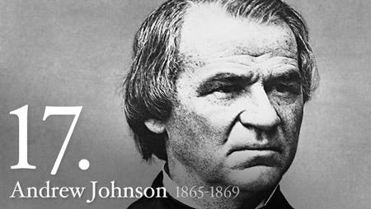
Johnson is Impeached
Radical Republicans also believed in aggressively guaranteeing voting and other civil rights to African Americans.
Tenure in Office Act
Secretary of War- Edwin Stanton
R.R. clashed repeatedly with Johnson, over the issue of civil rights for freed slaves, eventually impeaching him, but failing to remove him from office.

Slide 66
Military Reconstruction
Military Reconstruction Act- 1867
The states that seceded were not allowed back into the Union immediately, but were put under military occupation.
15th Amendment: 1870
*The 15th Amendment- 3rd of 3 civil war amendments that stated Voting rights were guaranteed regardless of “race, color, or previous condition of servitude” (former slaves)
Loopholes?

Slide 67
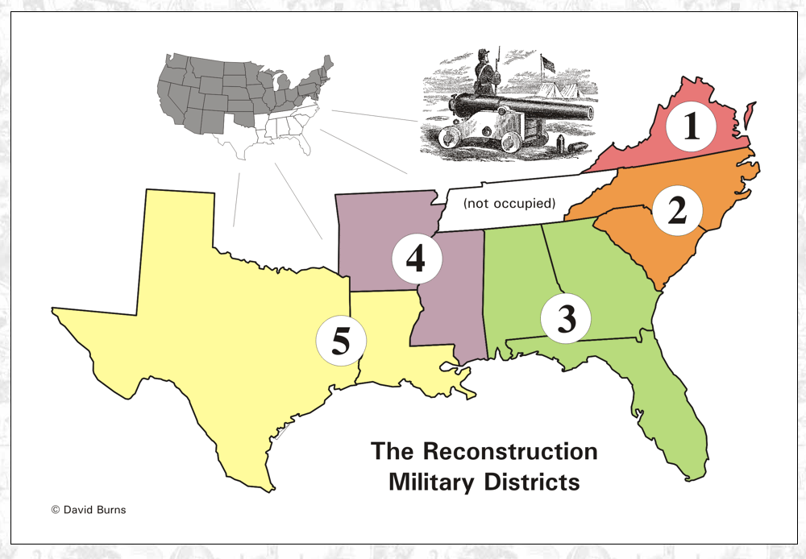

Slide 68
Frederick Douglass
Supported full equality for African Americans
Advocated for the passage of the 14th and 15th Amendments
Encouraged federal government actions to protect the rights of freedmen in the South
Served as ambassador to Haiti and in the civil service

Slide 69
Radical Reconstruction in the South
“Scalawag’s”
“Carpetbaggers”
Positives from Reconstruction

Slide 70
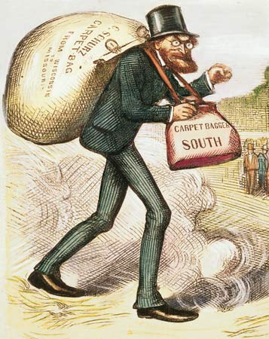
Carpetbagger- By Thomas Nast

Slide 71
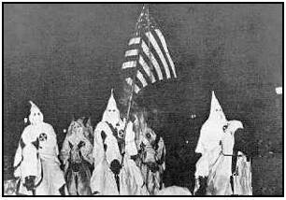
Rise of the Ku Klux Klan
Founded in 1866
Rebellion against radical rule
Goal to overthrow reconstruction gov’t in South
“Invisible Empire of the South”
“KKK Act”

Slide 72
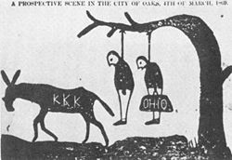

Slide 73
Rise of the Solid South
White supremacist South dominated by Democrats
Began increased violence, racism, discrimination towards blacks that would last for generations
Coalition of prewar Democrats and Union Whigs attempted to undo changes brought about by the Civil War

Slide 74
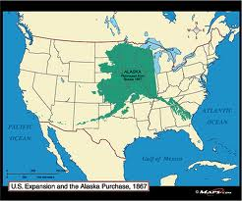
Purchase of Alaska
1867
Russia doesn’t want war w/ Britain in NA
US purchases Alaska for $7.2 million
Major source of oil and fisheries

Slide 75
Civil Rights Act of 1875
Crime to deny full and equal use of public places to anyone
NOT enforced
Another true civil rights act won’t be attempted for 90 years

Slide 76
End of Reconstruction
1870- All former Confederate states now a part of the union
Election of 1876- Rep. Rutherford B. Hayes vs Dem. Sam Tilden (inconclusive)
Leads to Compromise of 1877
In return for support from Southern Democrats in the electoral college vote, the Republicans agreed to end the military occupation of the South.
Known as the Compromise of 1877, this enabled former Confederates who controlled the Democratic Party to regain power. It opened the door to the “Jim Crow Era” and began a long period in which African Americans in the South were denied the full rights of American citizenship.

Slide 77
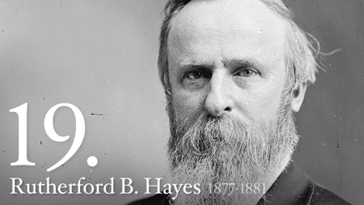
Con’t…
Hayes is elected the new president
The Reconstruction period ended
Period of weak presidents to follow

