Slide 1
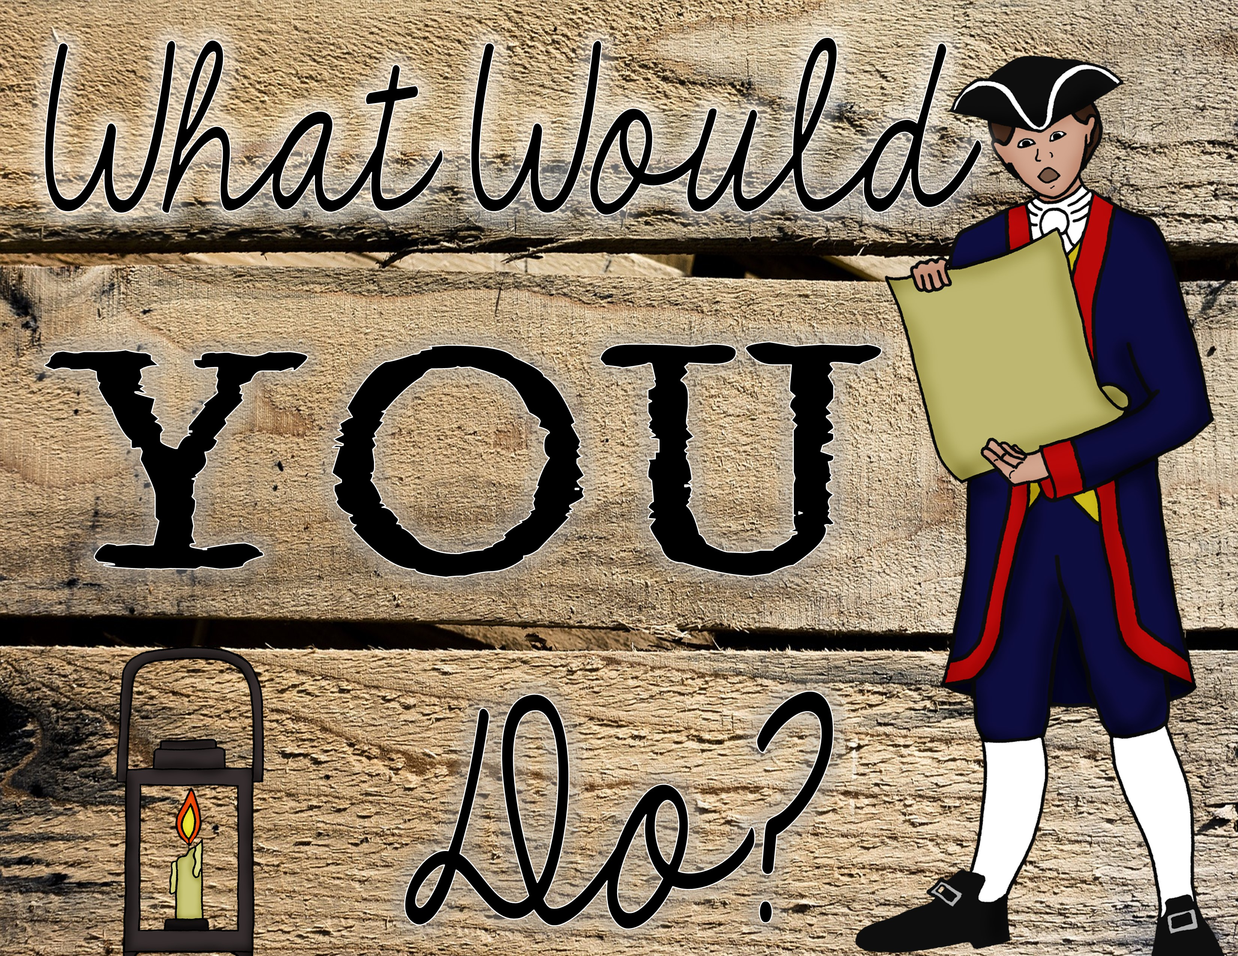

Slide 2
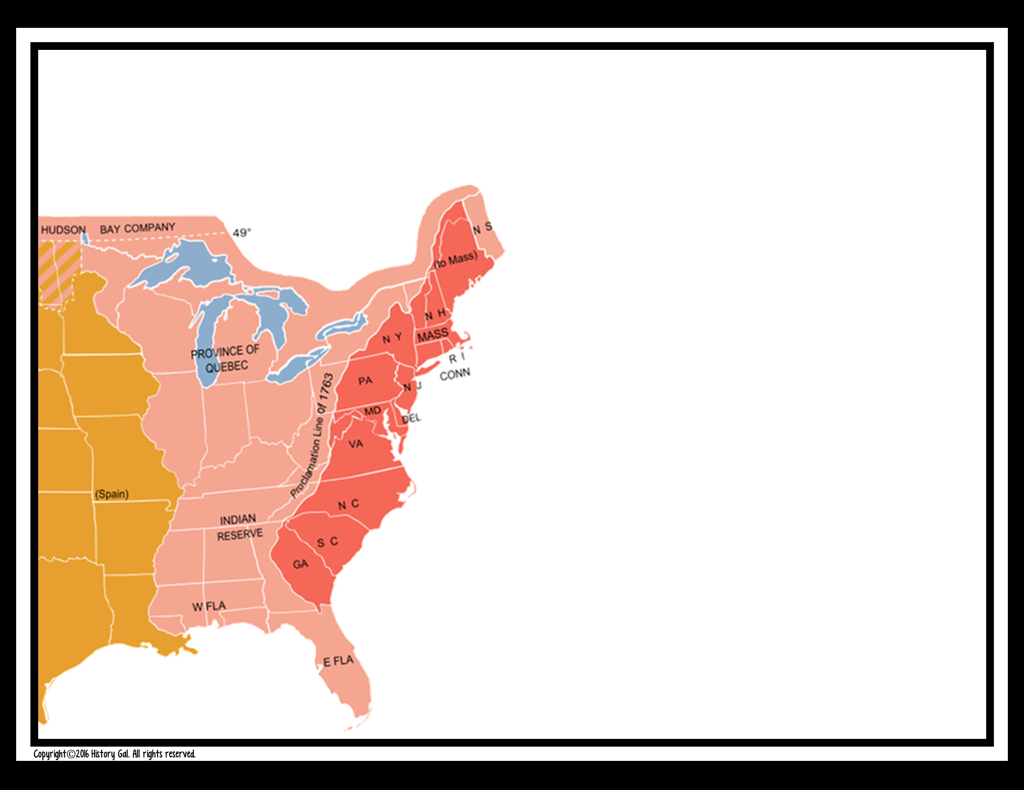
#1
The year is 1763, you just heard that colonists are not allowed to settle west of the Appalachian Mountains. What will you do?

Slide 3
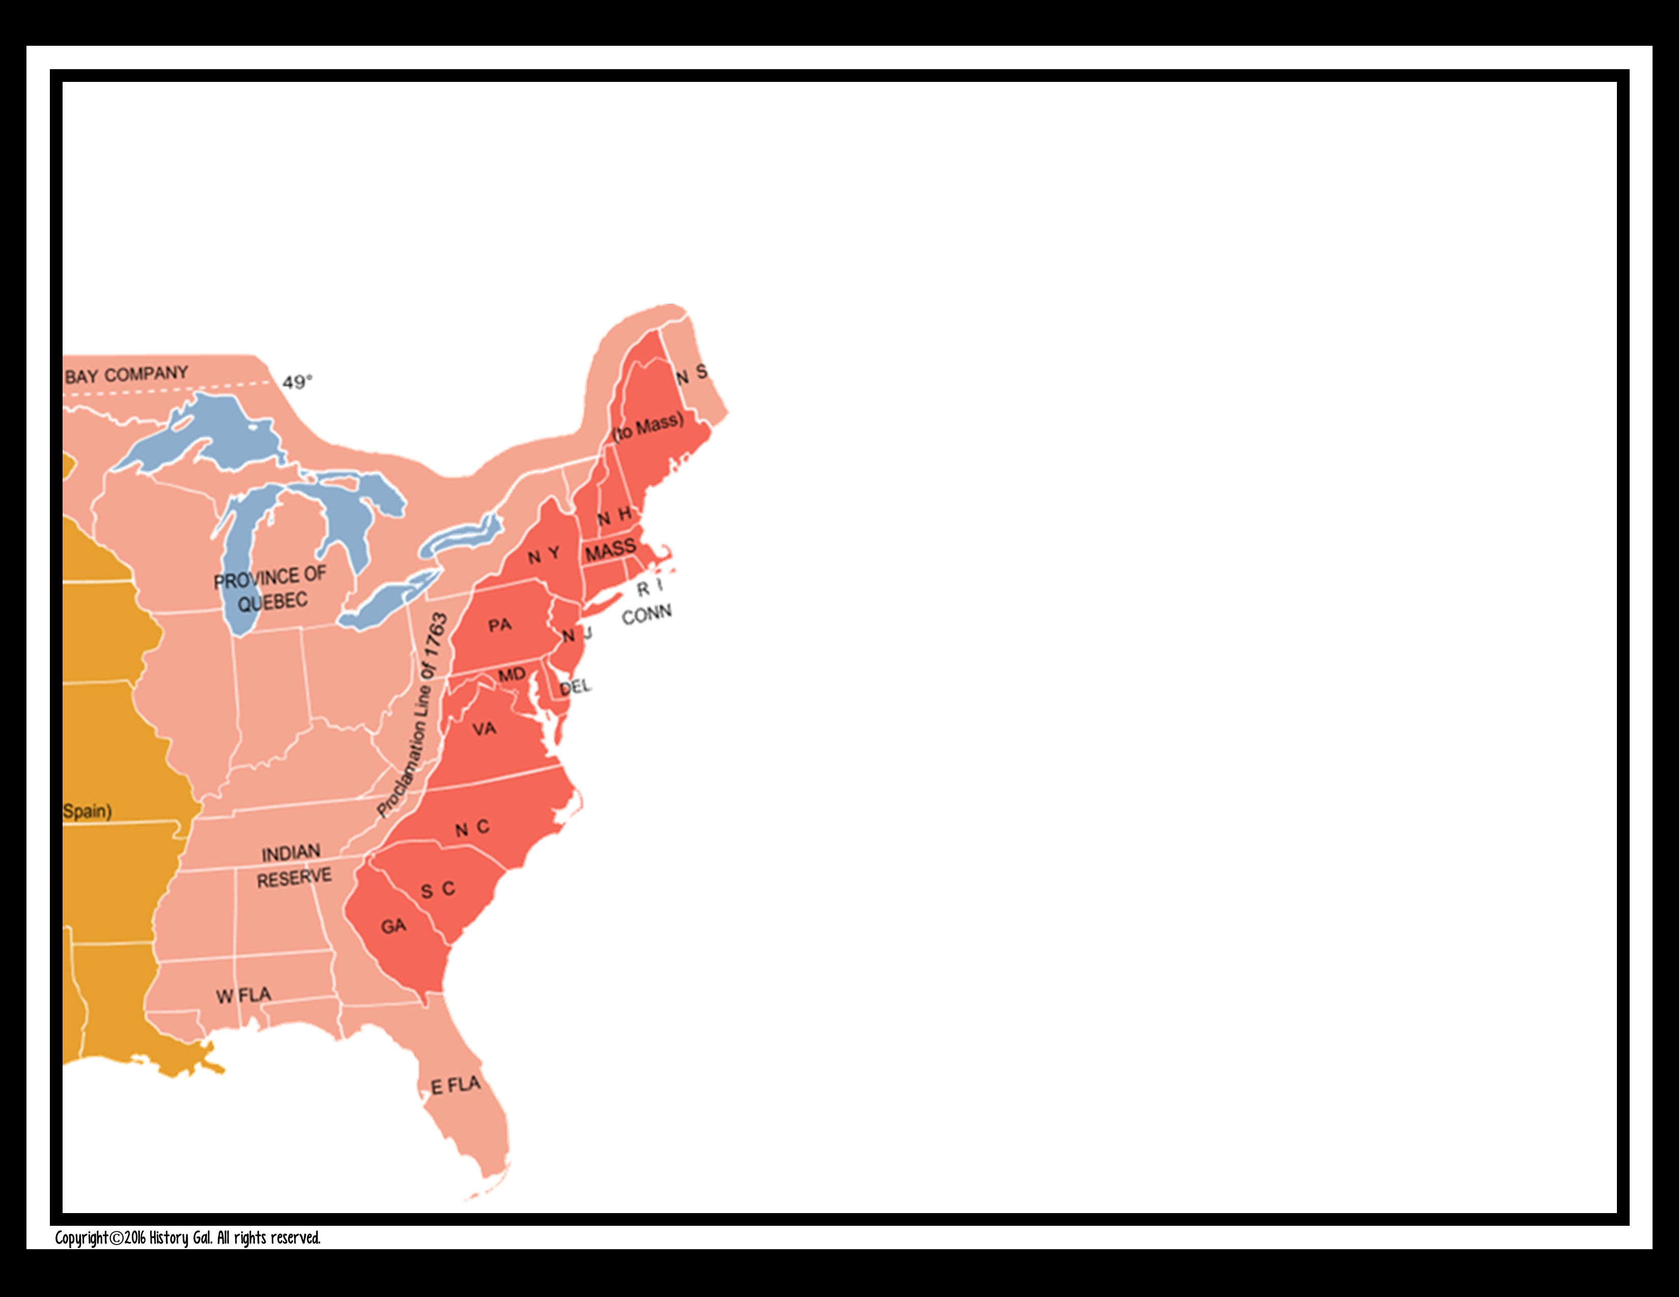
A. Nothing. You didn’t really want to settle in the west anyway and worry about being killed in the middle of the night by Indians.
B. Move your family and settle there anyway. They can’t tell you where to live!

Slide 4
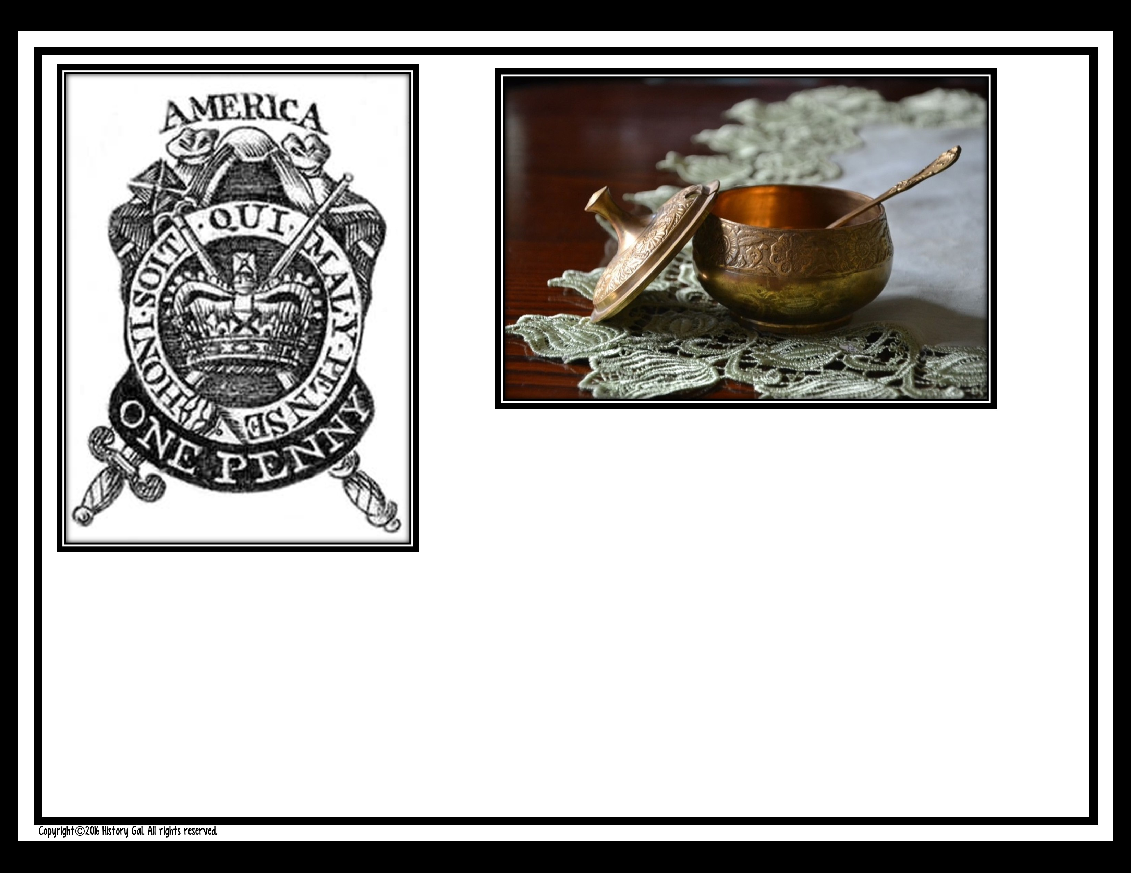
#2
The British crown is in debt from fighting the French and Indian War.
They decide to place taxes on luxuries like foreign sugar and on paper. What will you do?

Slide 5
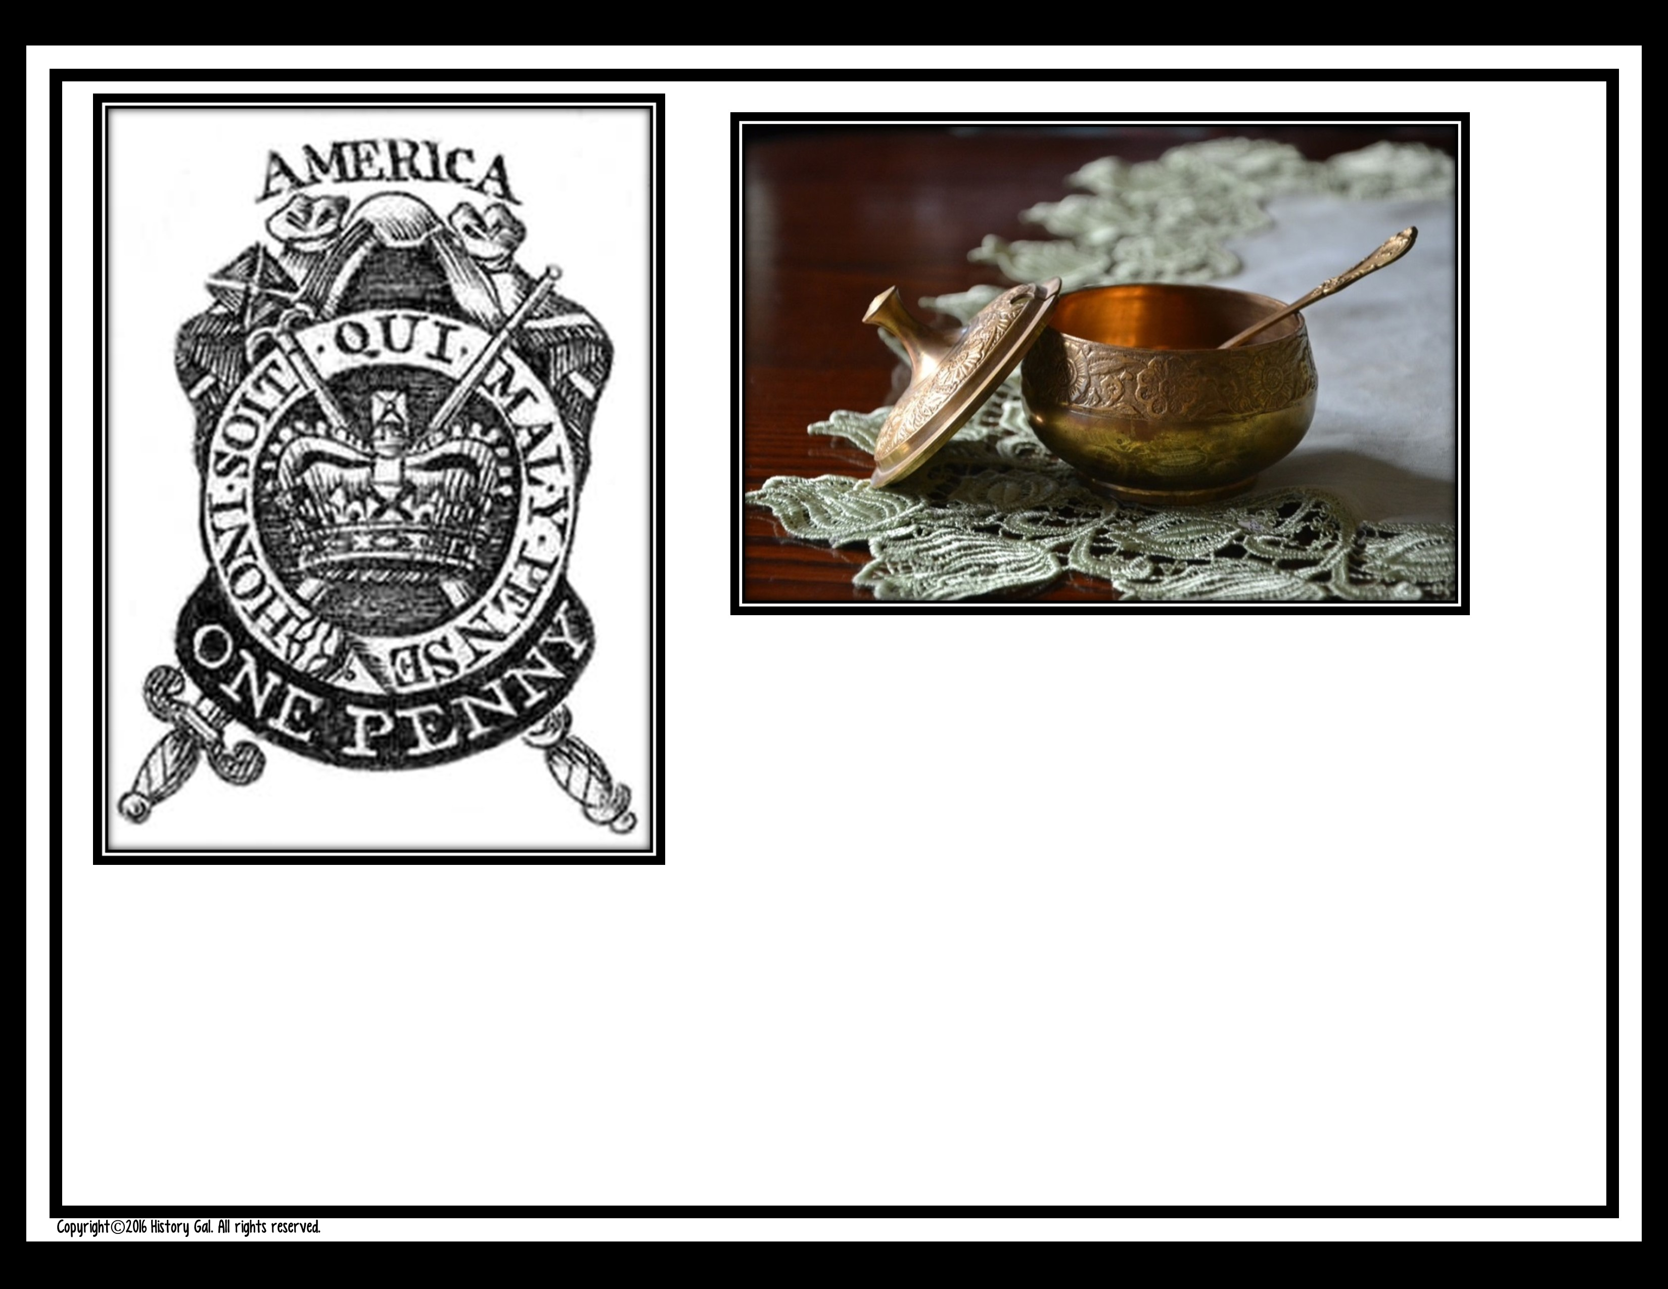
A. Pay the taxes. After all, the British
helped secure your colony from France and protected it from the Indians.

Slide 6
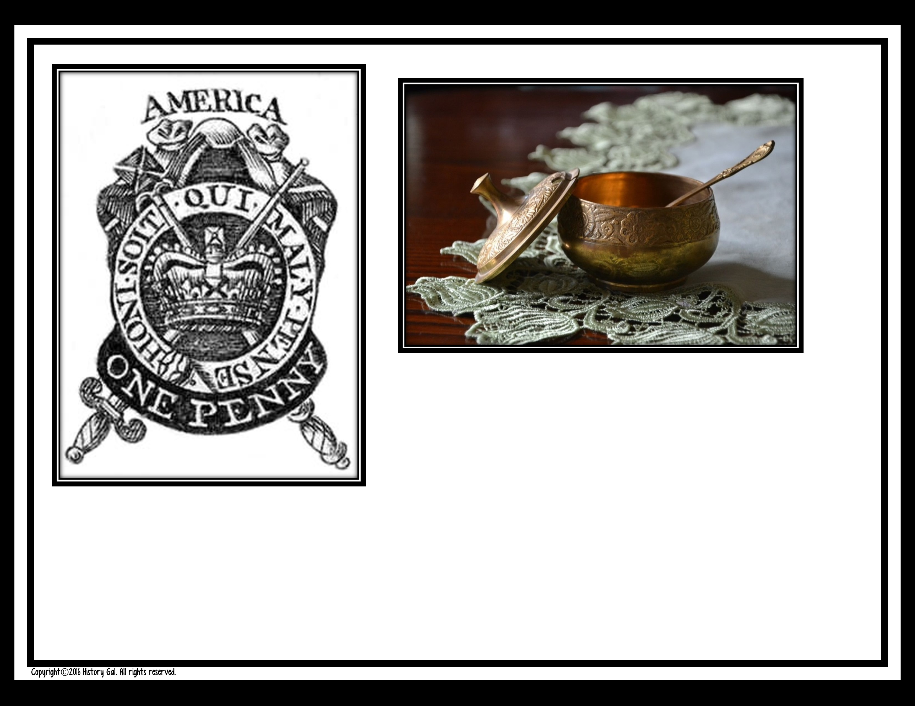
B. Boycott sugar. You need to lose some weight anyway. As for
the paper tax, you have a friend who can forge the official stamp so you don’t have to pay that tax either.

Slide 7
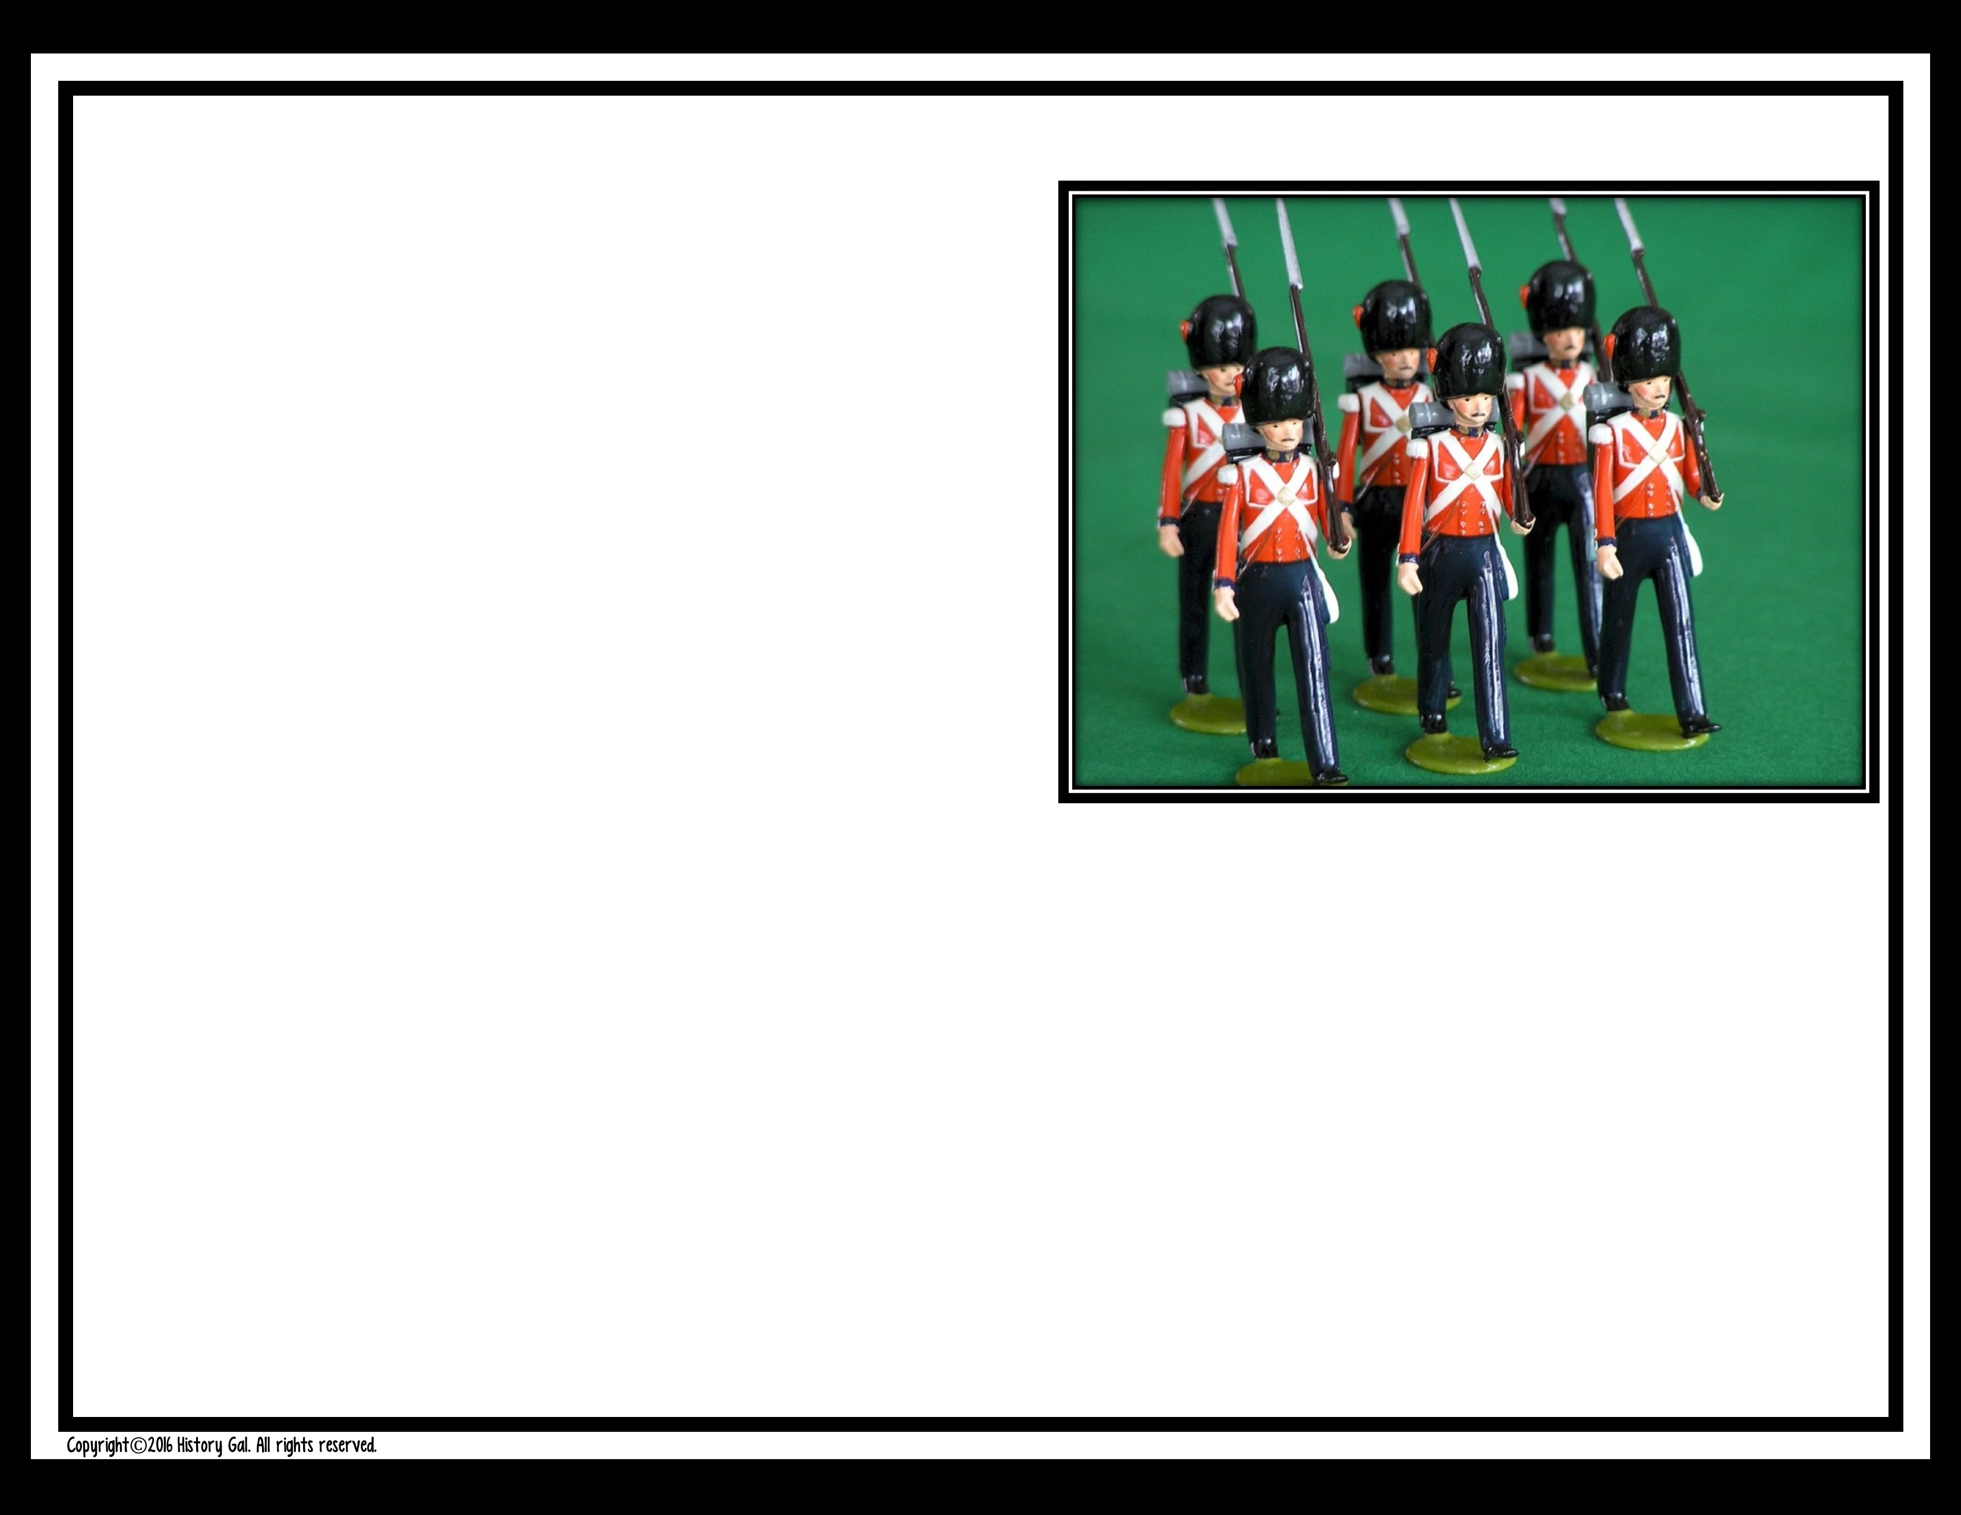
#3
The British need a place to house their soldiers. They pass a law
requiring colonists to provide shelter and food for their soldiers. What will you do?

Slide 8
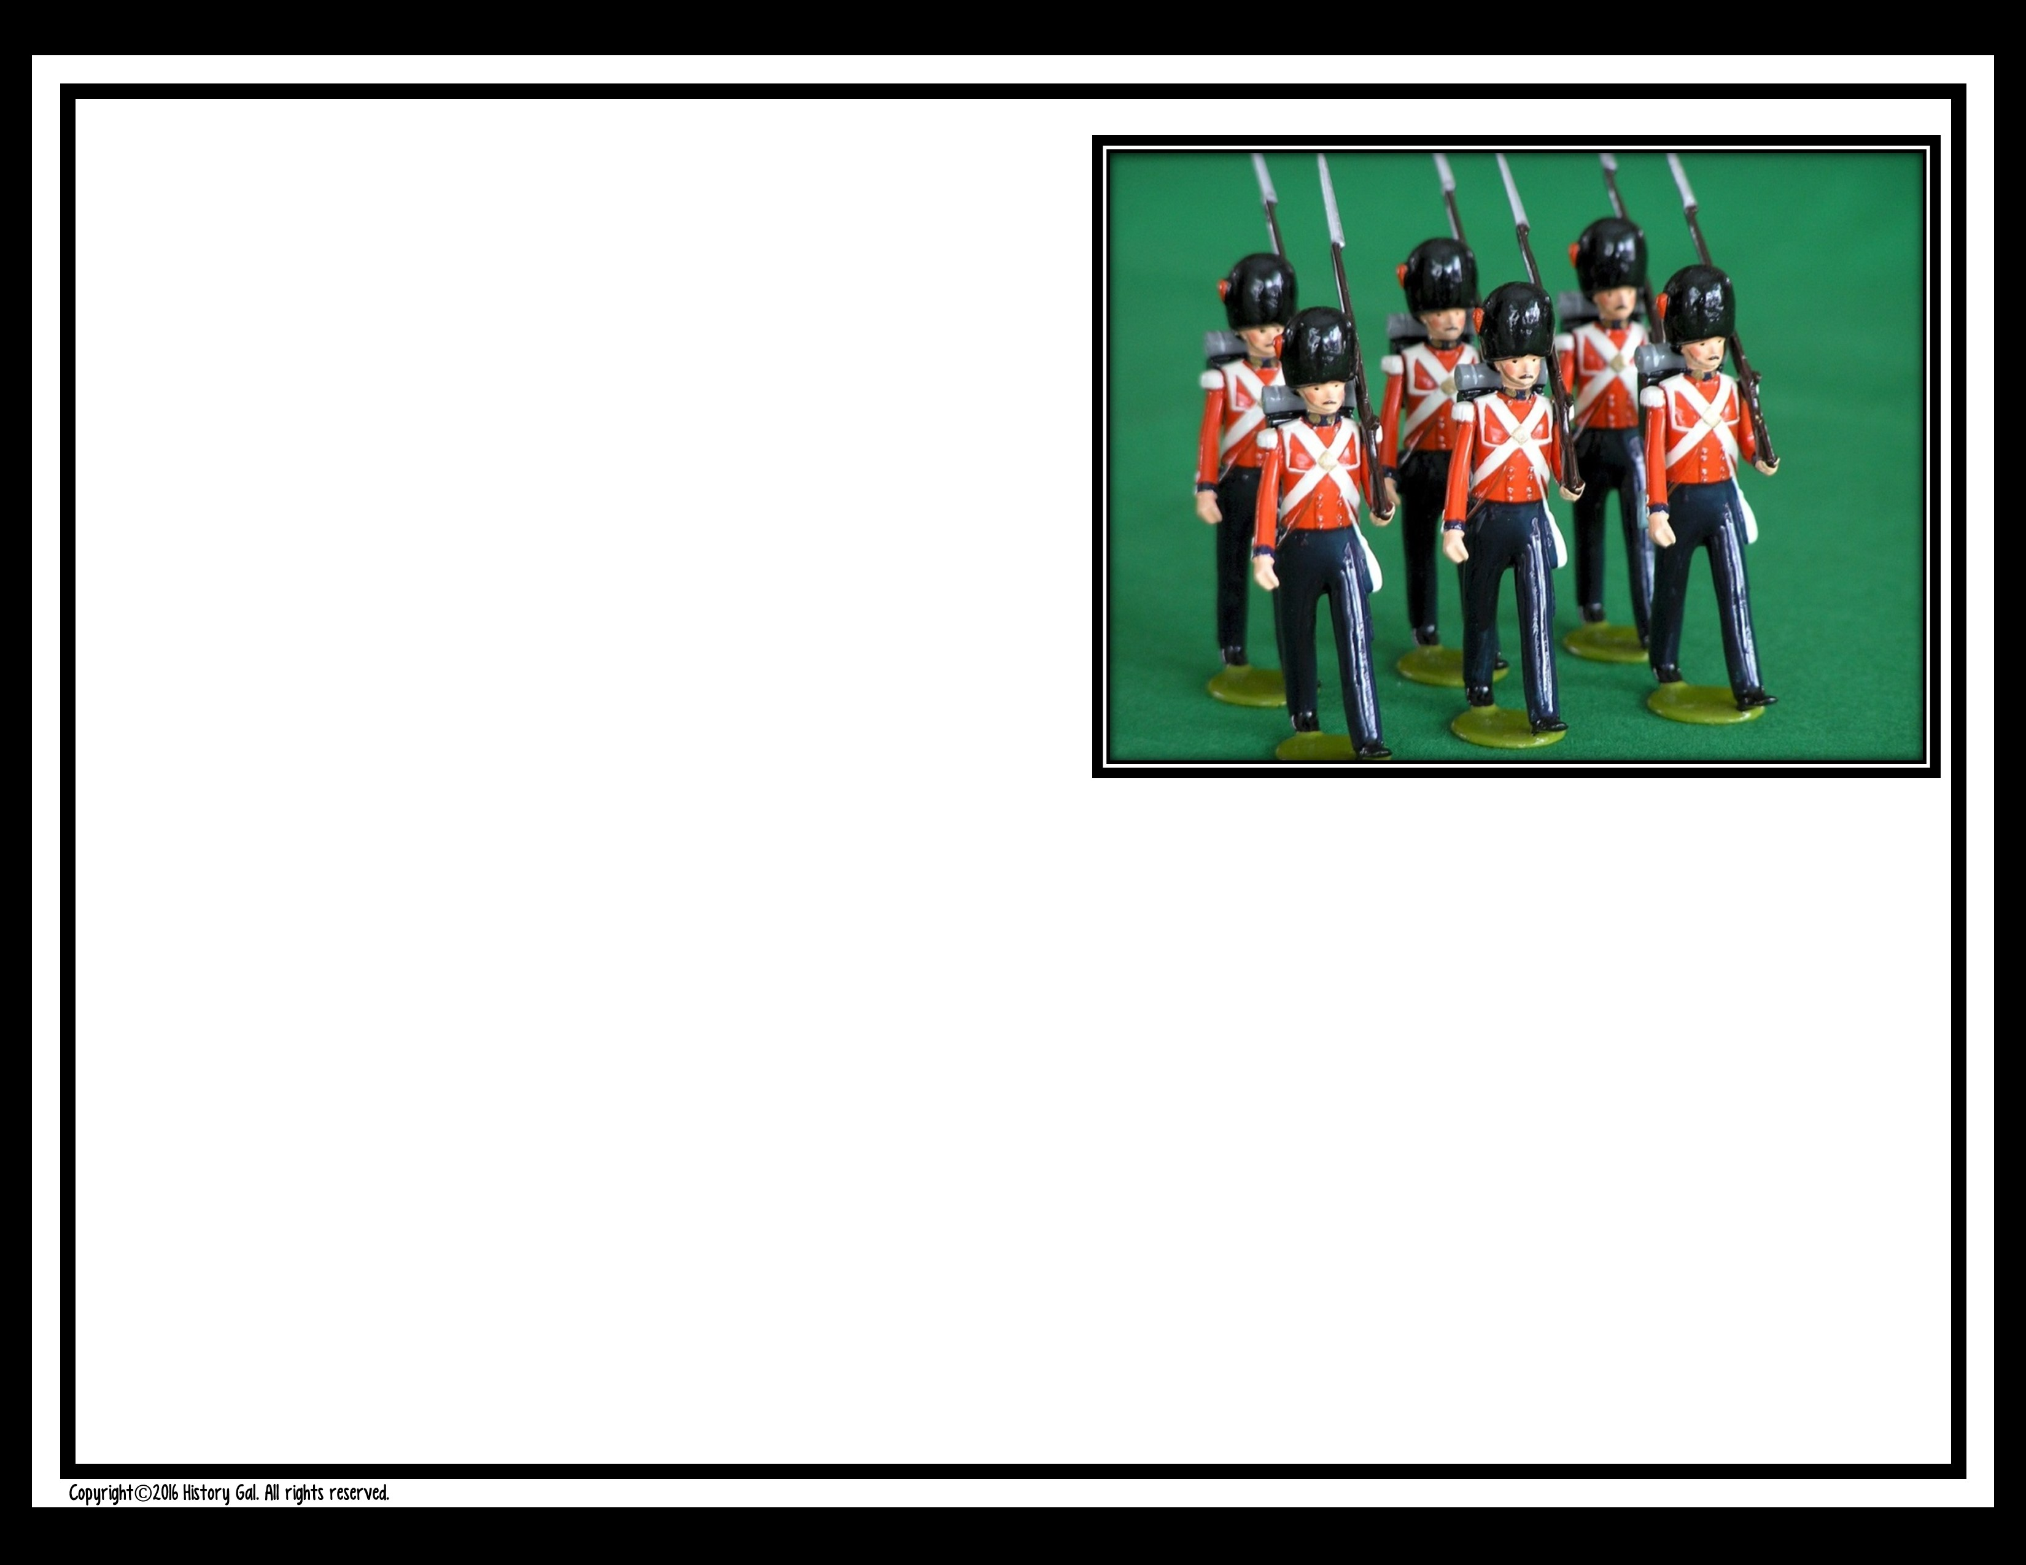
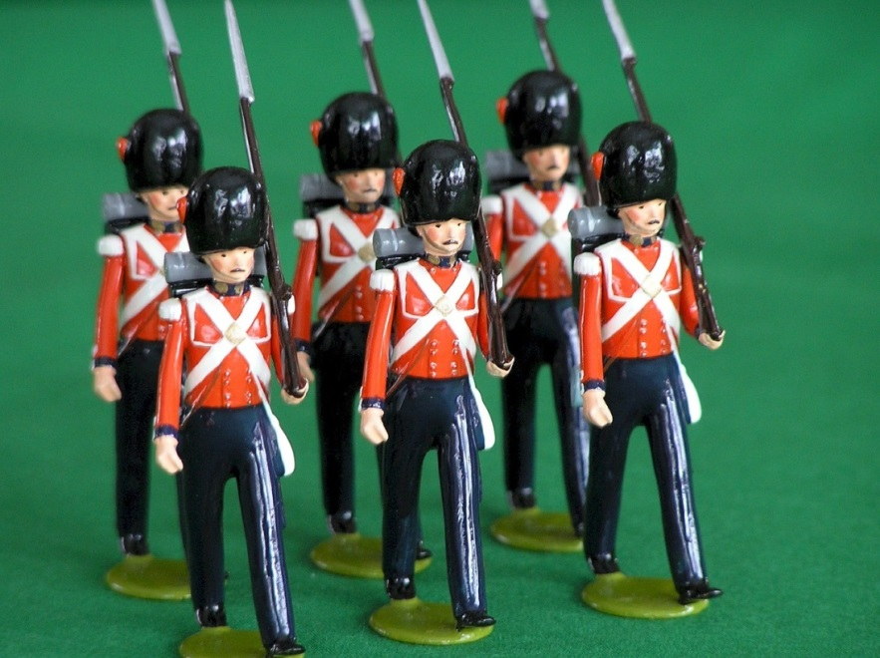
A. Gladly offer your house and food to those young men far from home
who are protecting you and your family from Indian raids.

Slide 9
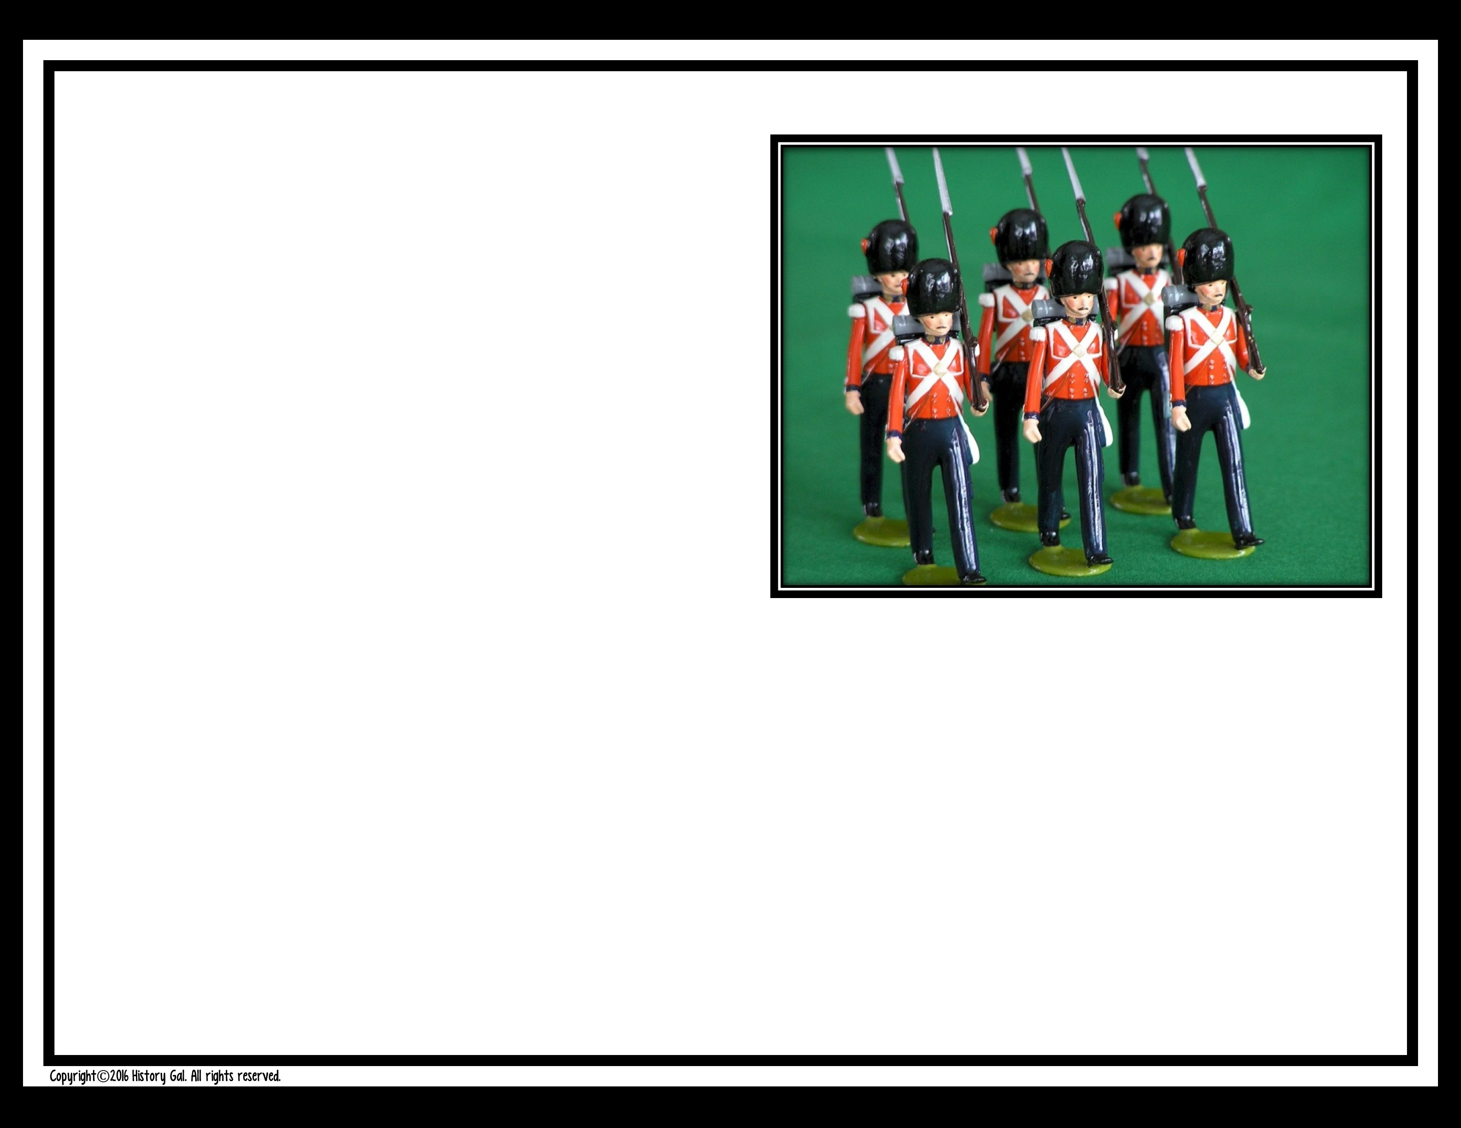
B. What?! You don’t want the soldiers in your town much less in your own
house! You’d rather go to jail than house some lobster-backs.

Slide 10

#4
In May 1765, a group of representatives from 9 colonies are gathering together to resolve that only their elected officials, not
the British Parliament, could approve taxes like the Stamp Act. Do you join the group as a representative from your colony?

Slide 11
A. No way. Are these people crazy?! You can’t challenge British law!
B. You’ve already signed up.

Slide 12
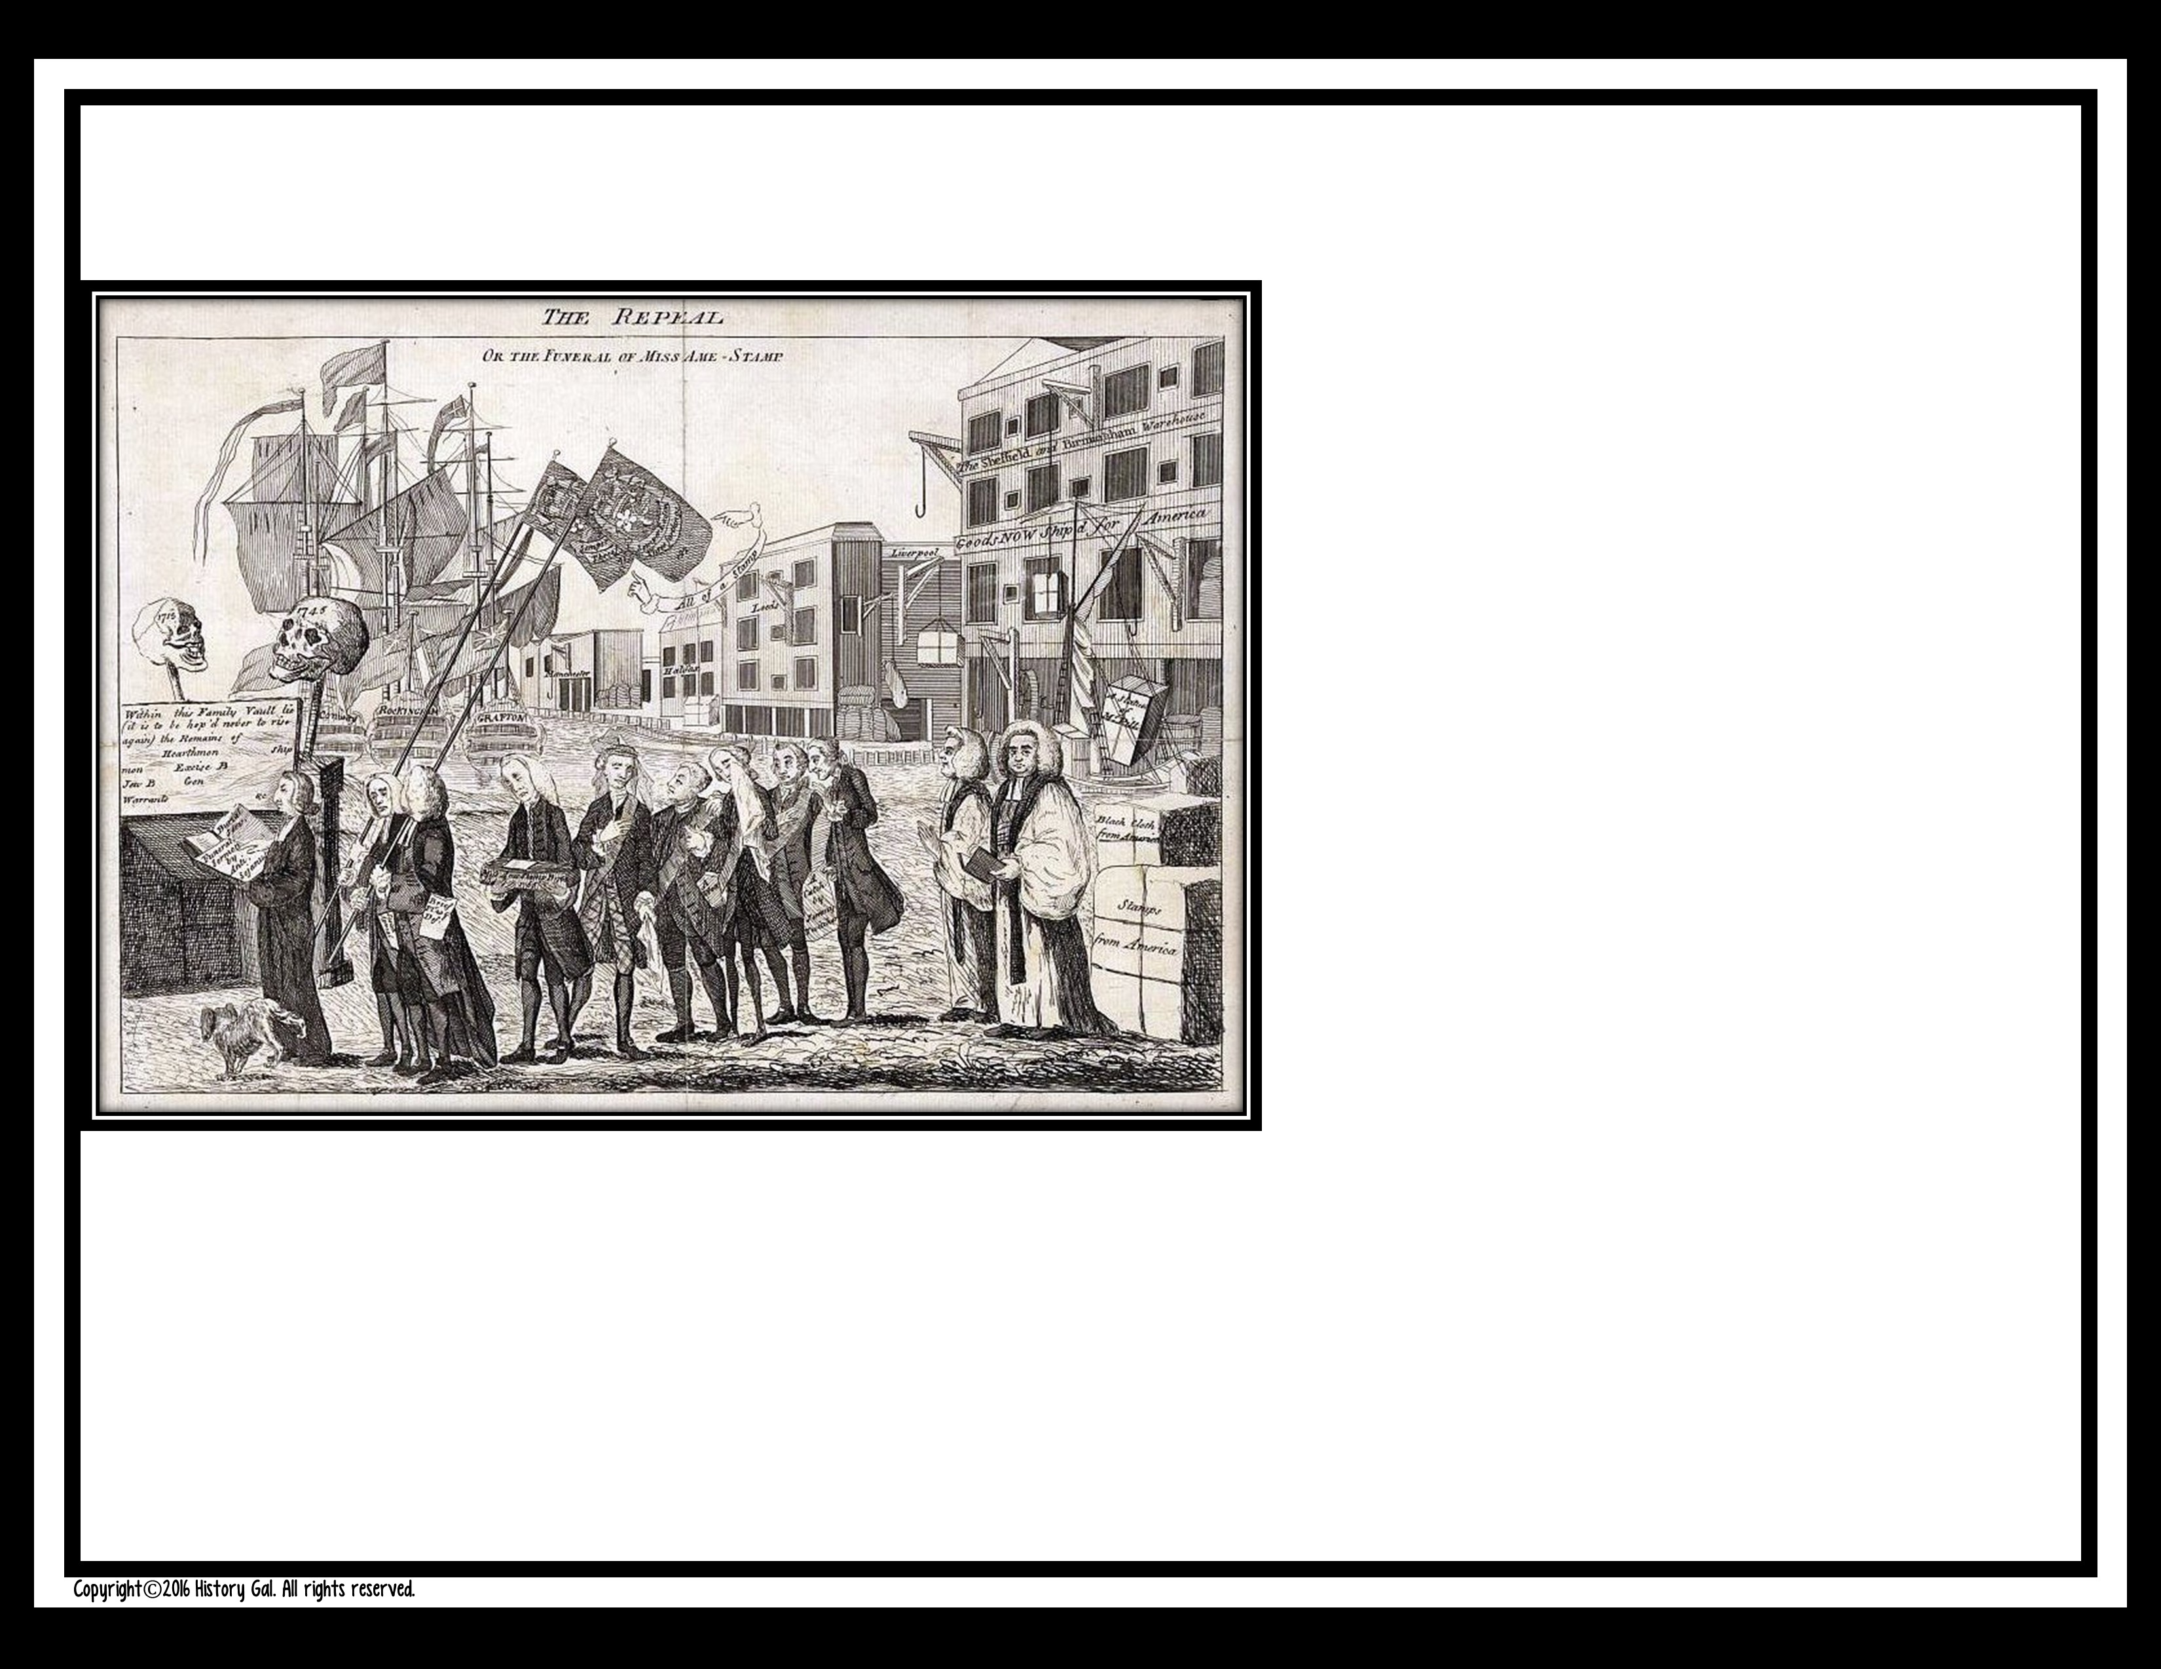
#5
The British government repealed the Stamp Act, but passed the
Declaratory Act stating that British
Parliament has the authority to pass laws that the colonists must follow. Do you agree or disagree?

Slide 13
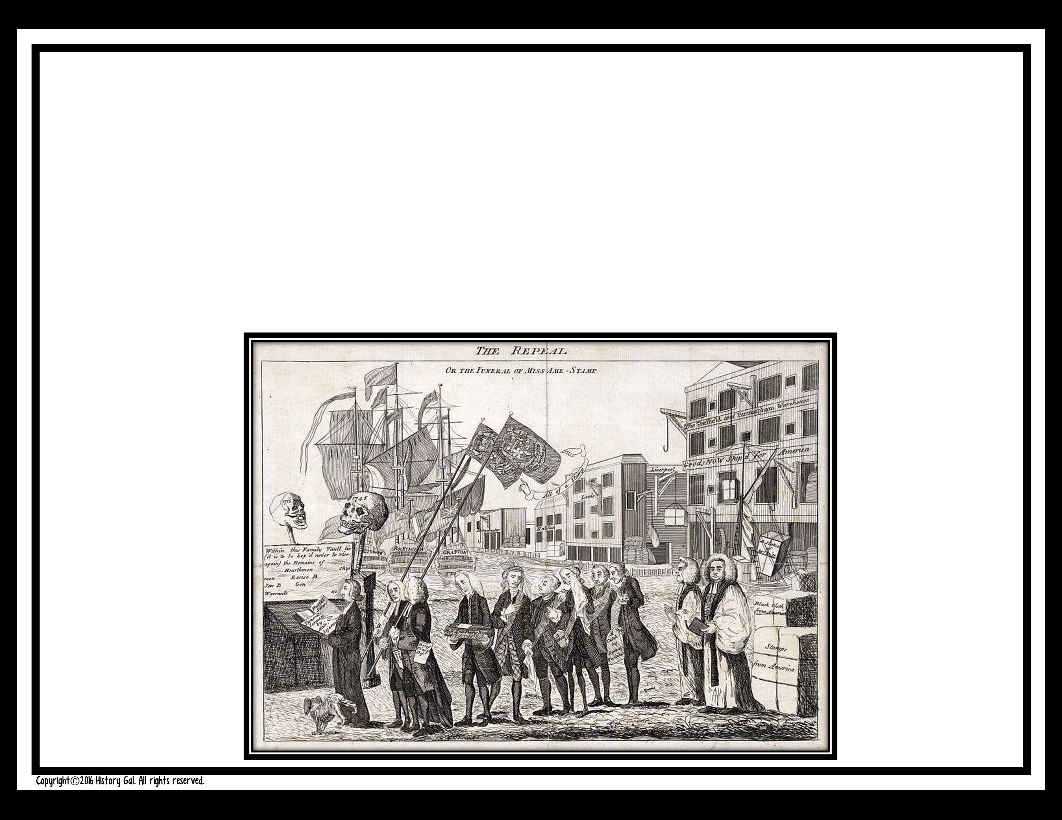
A. You agree. You are, in fact, a British subject so, of course, they have the authority to pass laws and you must follow them.

Slide 14
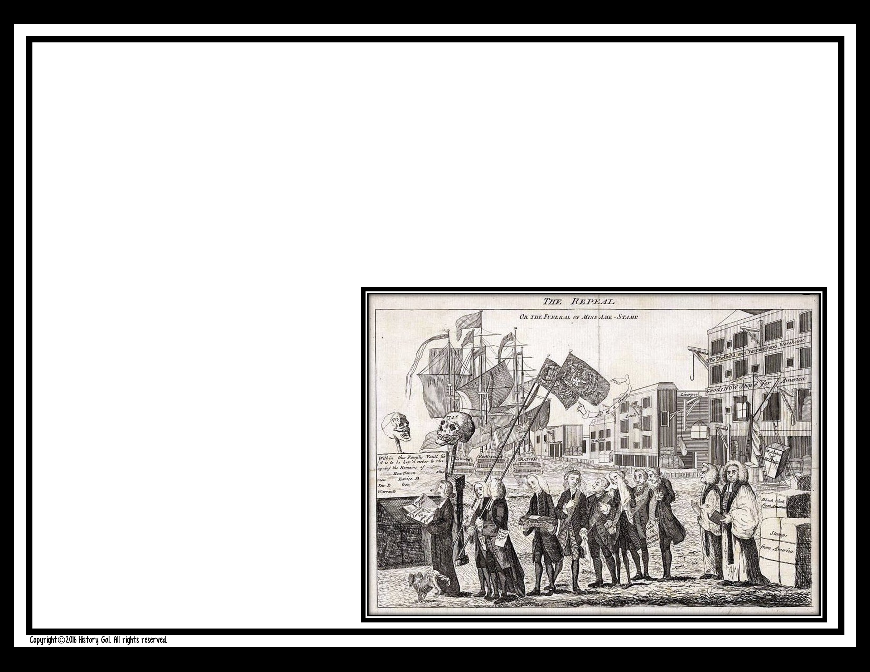
B. You disagree. For years, the British government left the colonies alone and now all of a sudden the British government has decided that the colonies should no longer be ignored.
Rubbish! You
left England to
get away from
them and want
to be left alone.

Slide 15
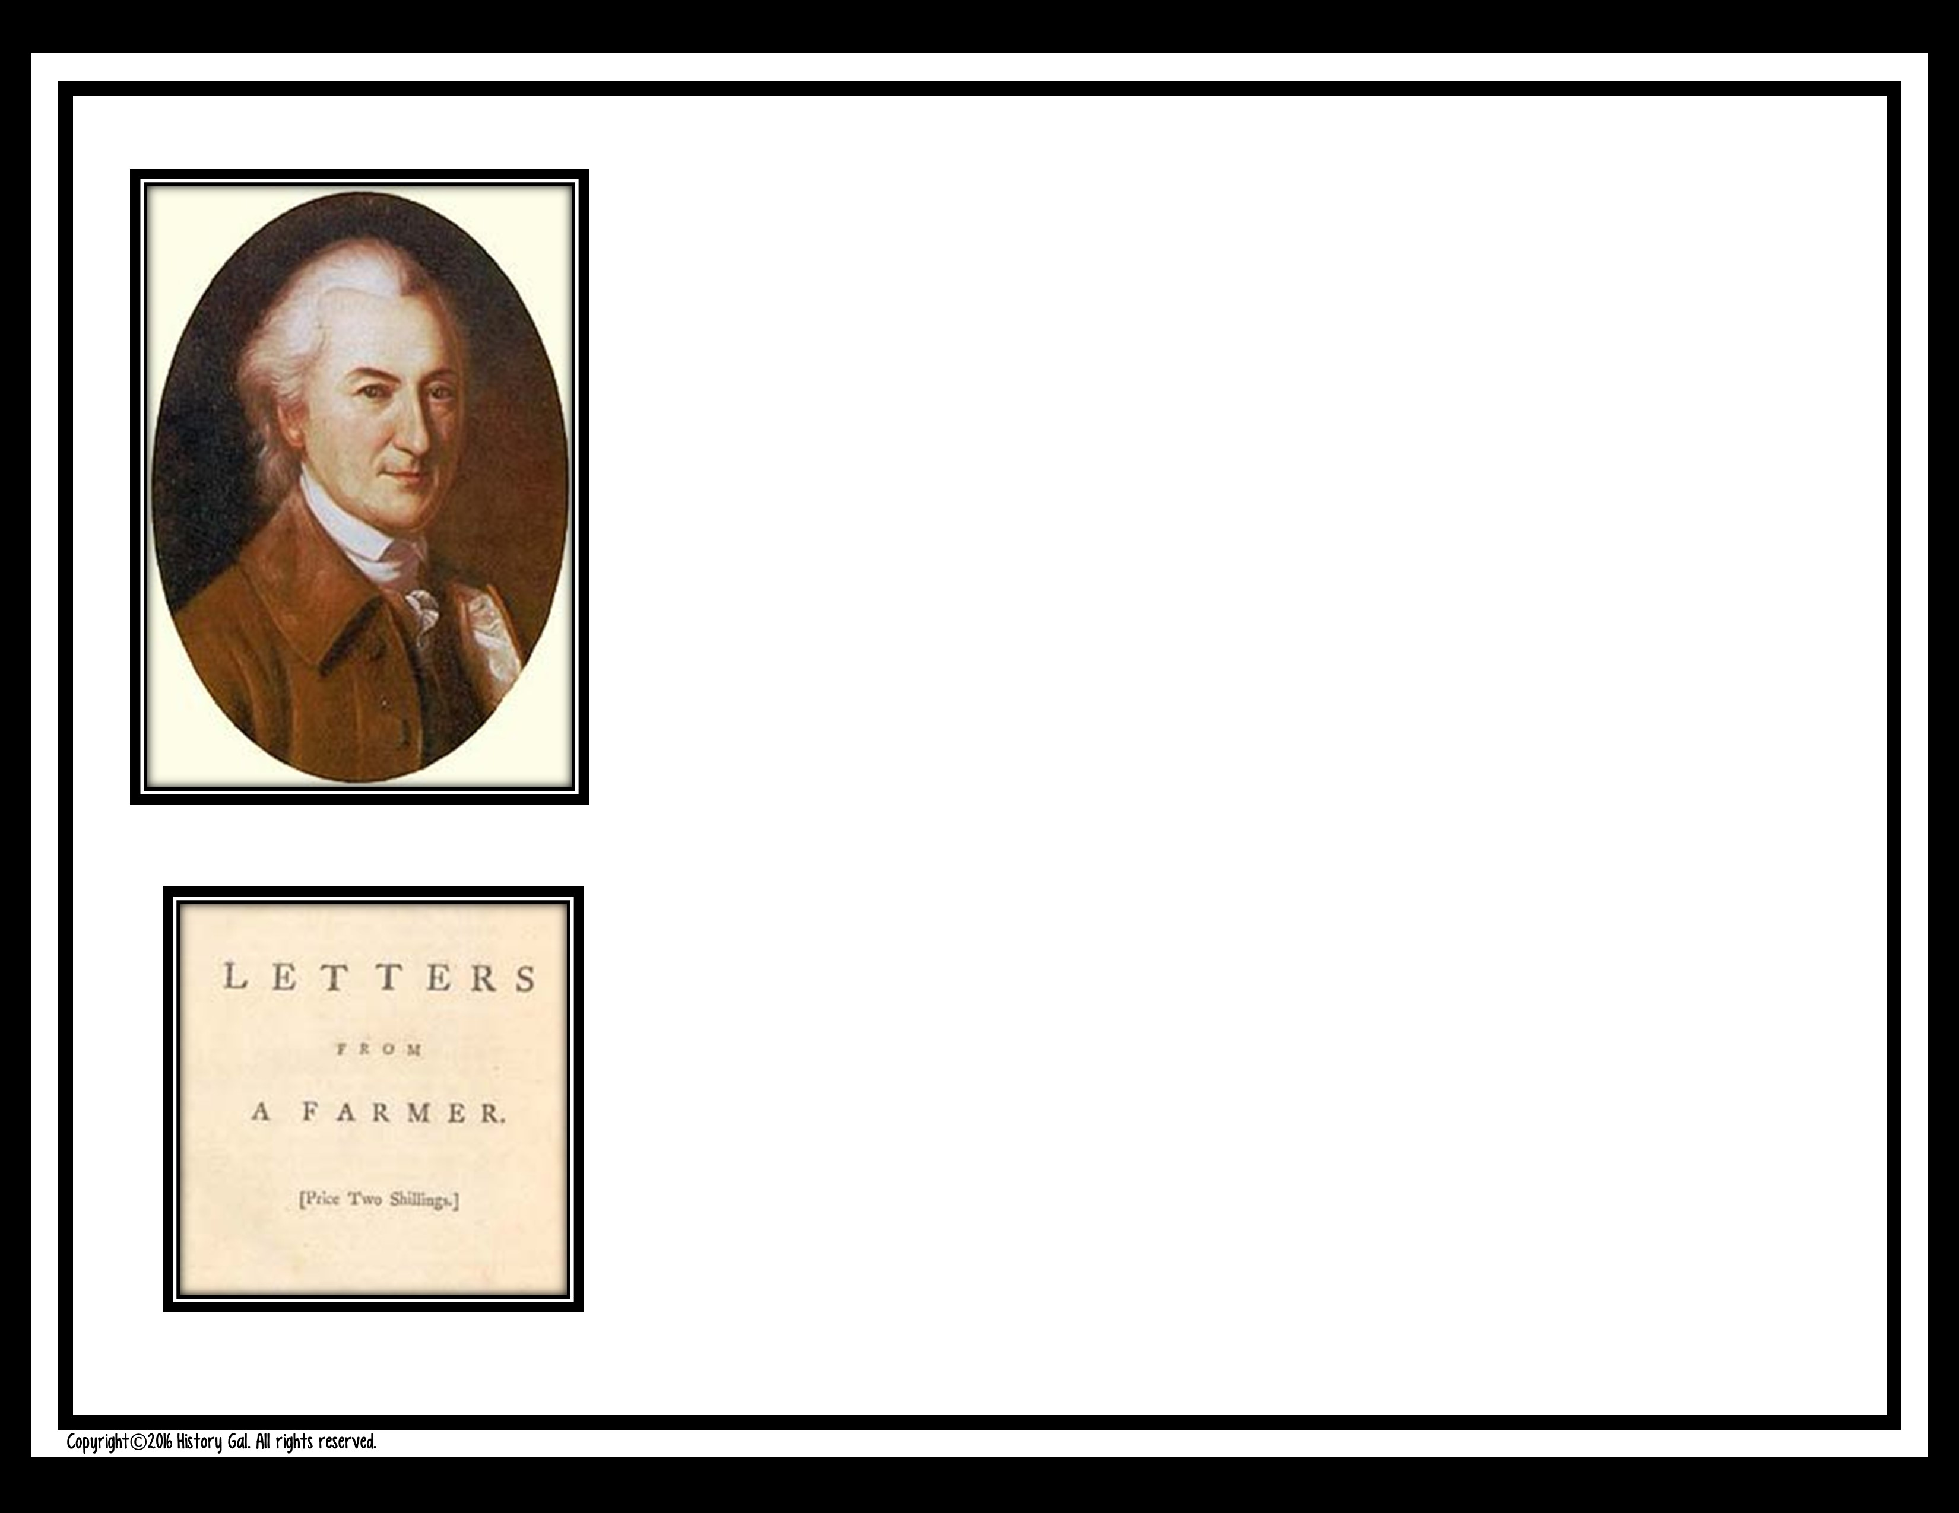
#6
The year is 1767 and you just picked up a pamphlet called “Letters from A Farmer in Pennsylvania” by a John Dickinson. In it, he argues that taxes should not be levied without the consent of colonial representatives. What do you think?

Slide 16
A. You think he is making a big deal out of nothing. Every law and tax the British Parliament passes is for the benefit of the colonies. It’s like having a mother who does things for the greater good for her children, not to be well liked.

Slide 17
B. You agree wholeheartedly. Parliament must have colonial representatives that give their consent to be taxed, otherwise the taxes are null and void.

Slide 18
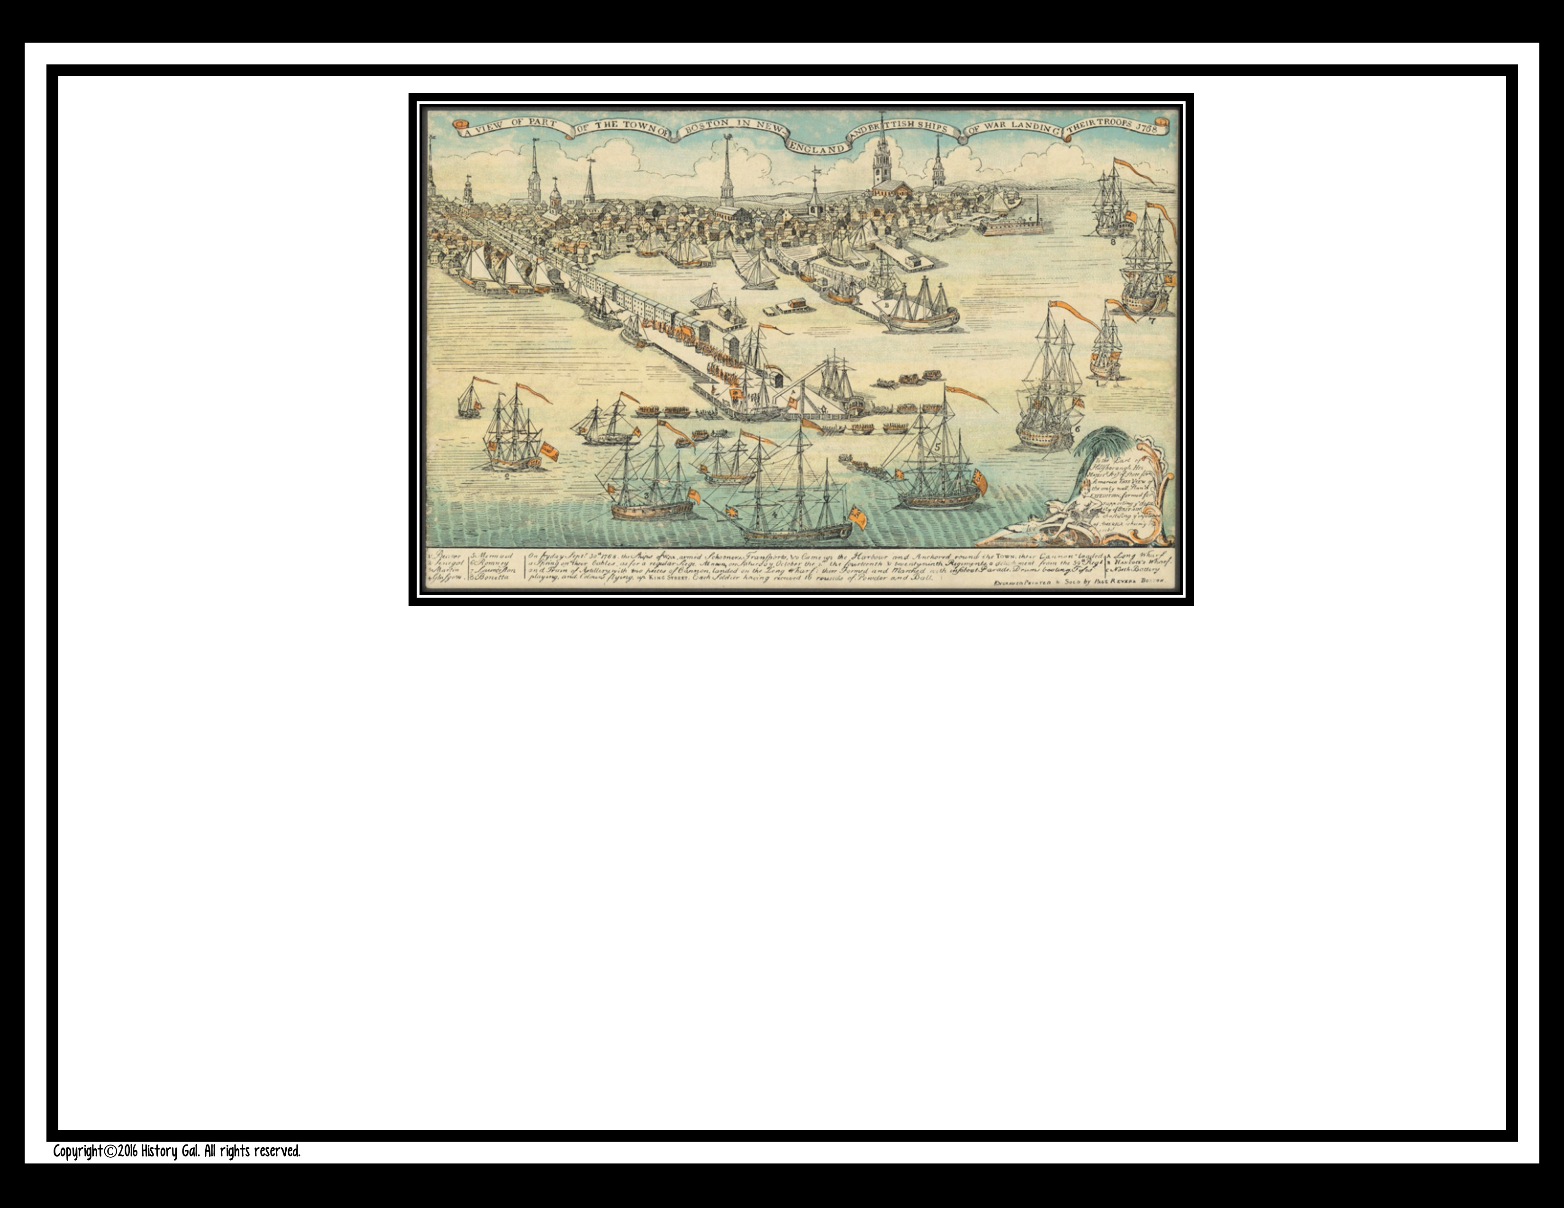
#7
The colony of Massachusetts has sent a Circular Letter to every colonial legislature urging them to petition the British Parliament to repeal the Townsend Acts. As a representative for your colony will you do as they request?

Slide 19
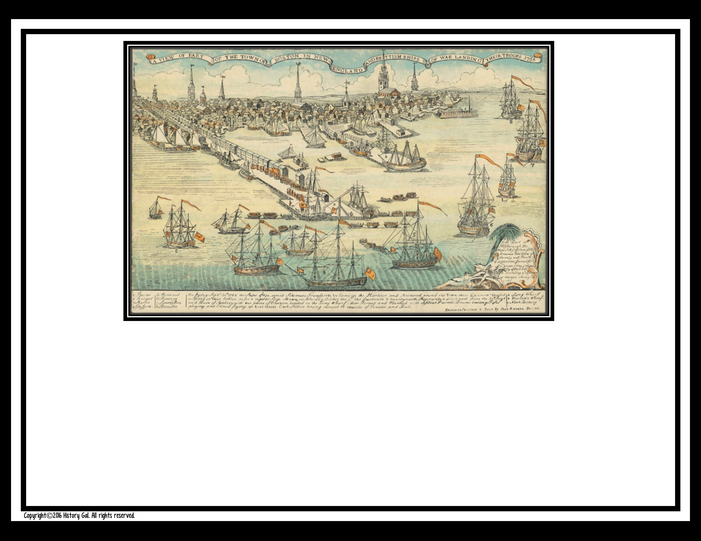
  A. Absolutely not! The last thing you want to do is anger Parliament and have them pass more taxes!

Slide 20
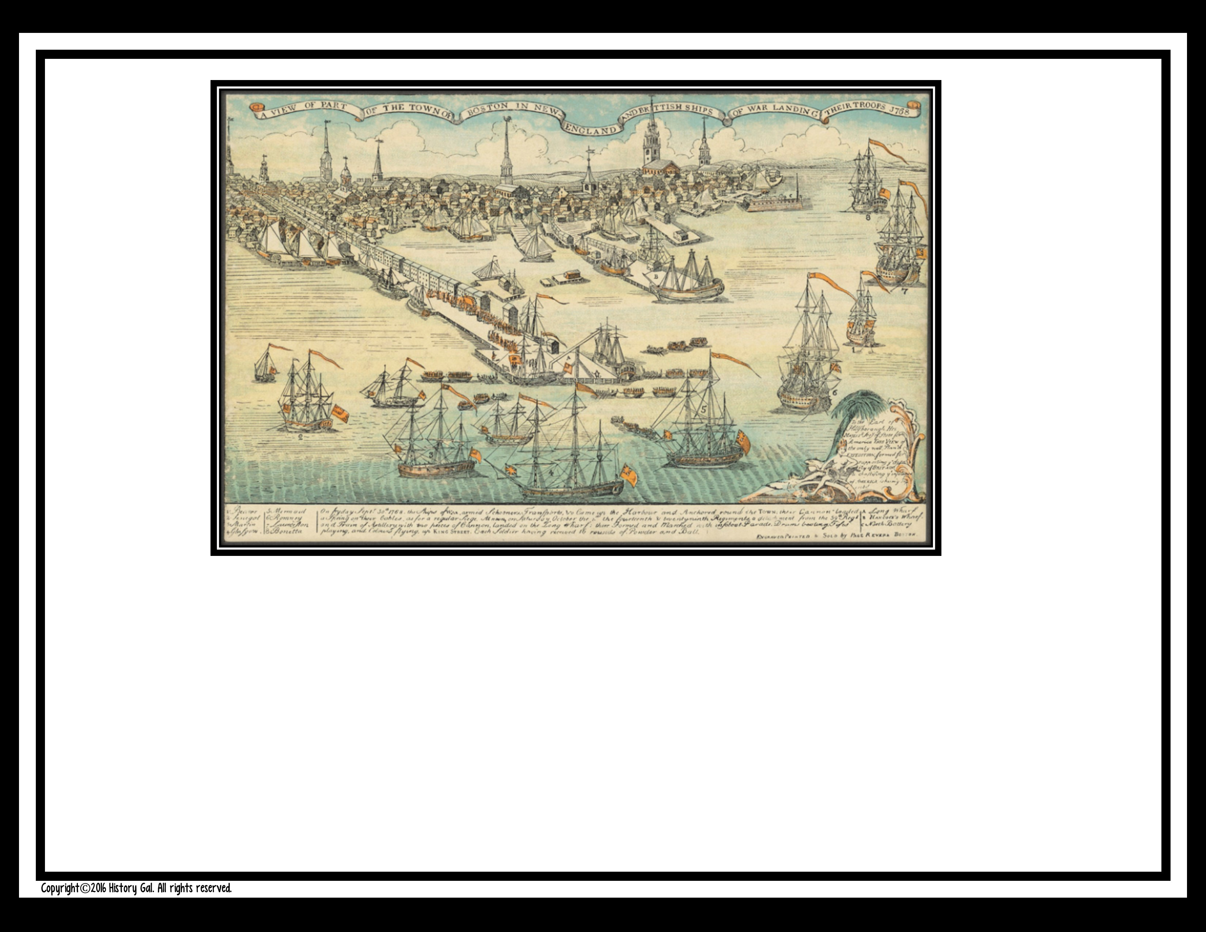
  B. Definitely! They need to know that we won’t just sit back and comply with ridiculous laws!

Slide 21
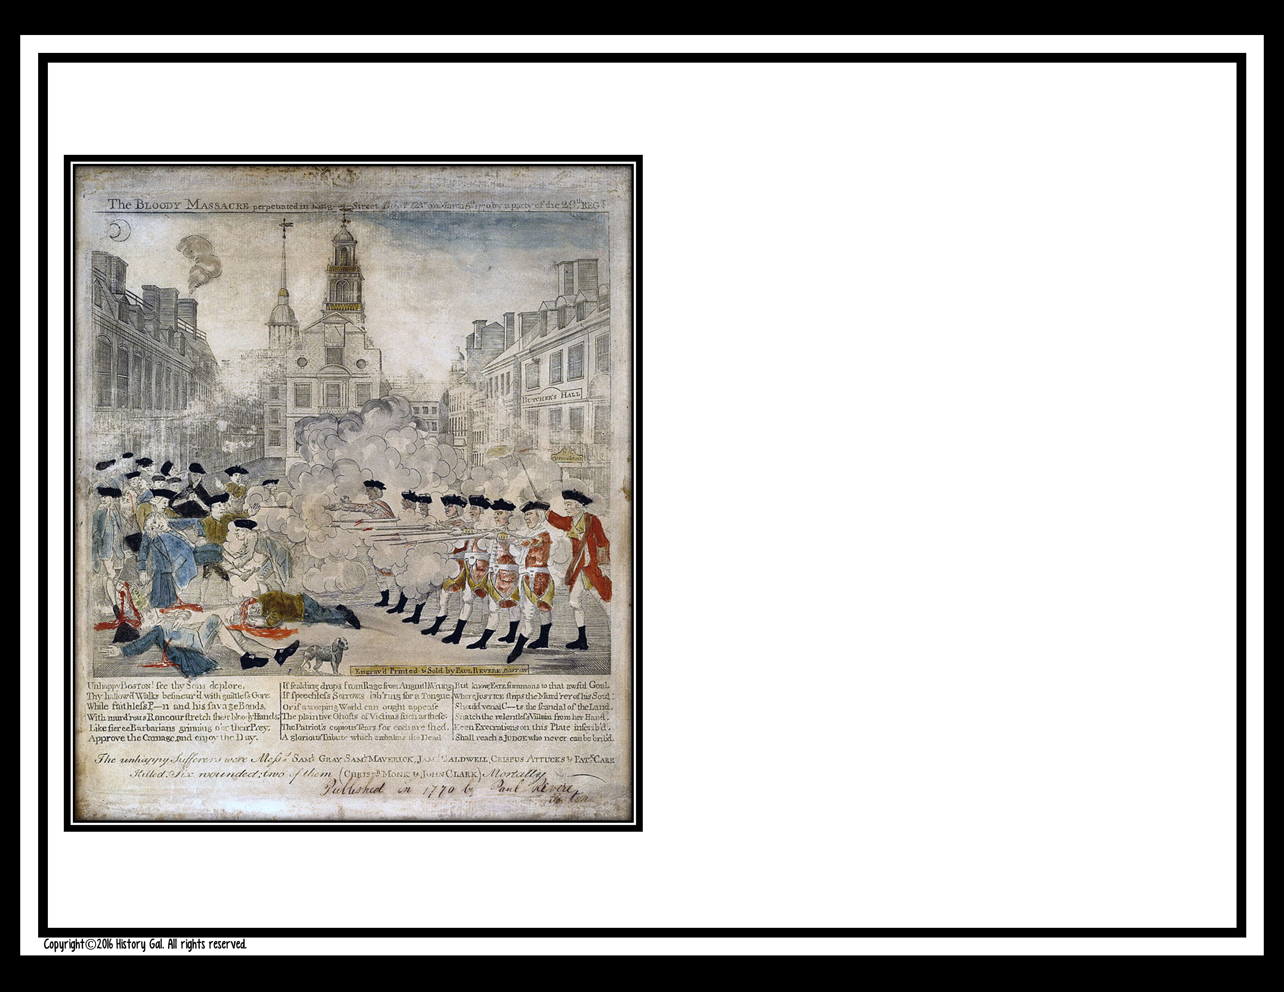
#8
As a lawyer, you have been asked to defend the soldiers who were arrested for firing into a crowd of colonists in 1770 Boston. Will you do it?

Slide 22
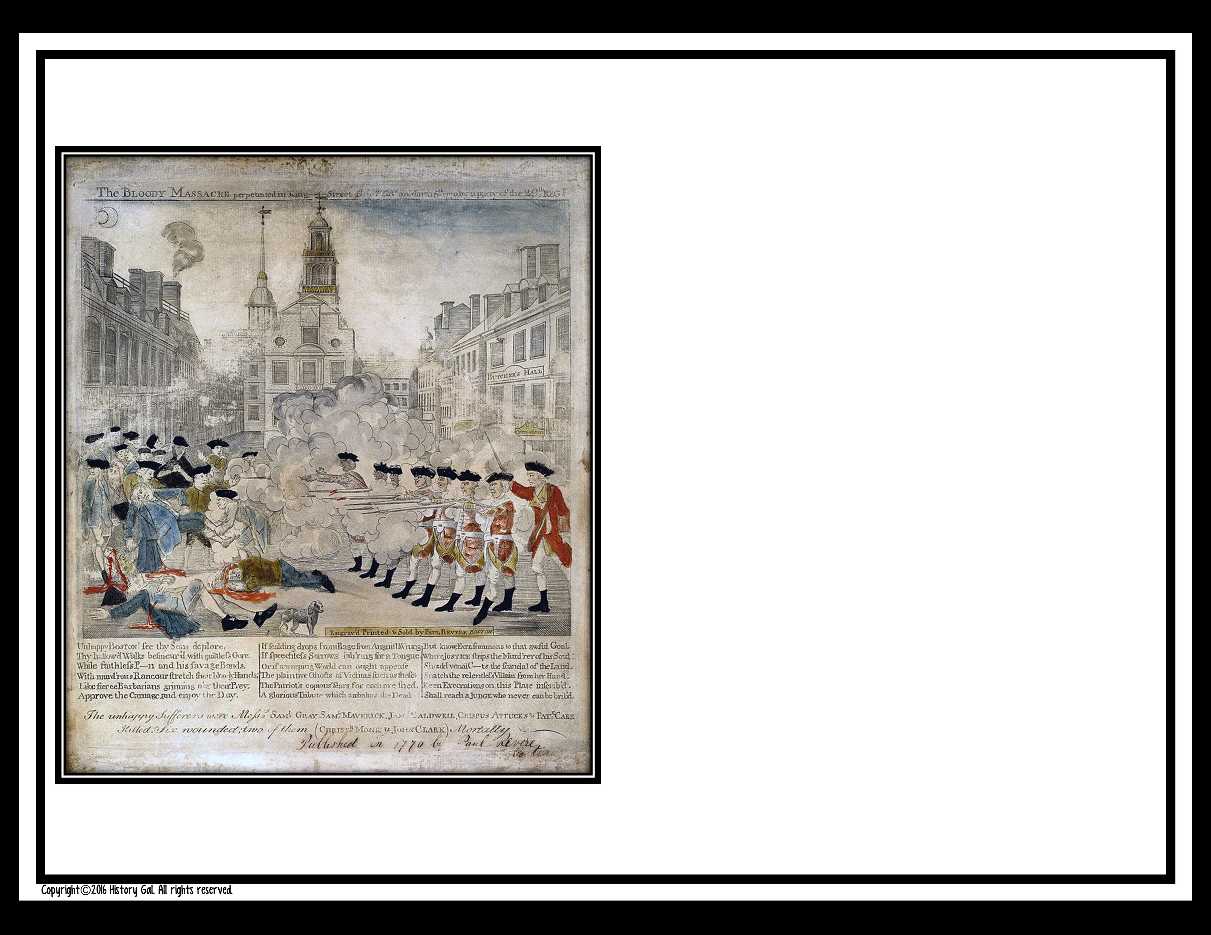
A. Yes. Every person deserves a fair trial. Besides, they were provoked by a violent crowd and they felt like their lives were in danger.

Slide 23

B. No. Even a lawyer has their standards and you refuse to defend British soldier scum.

Slide 24
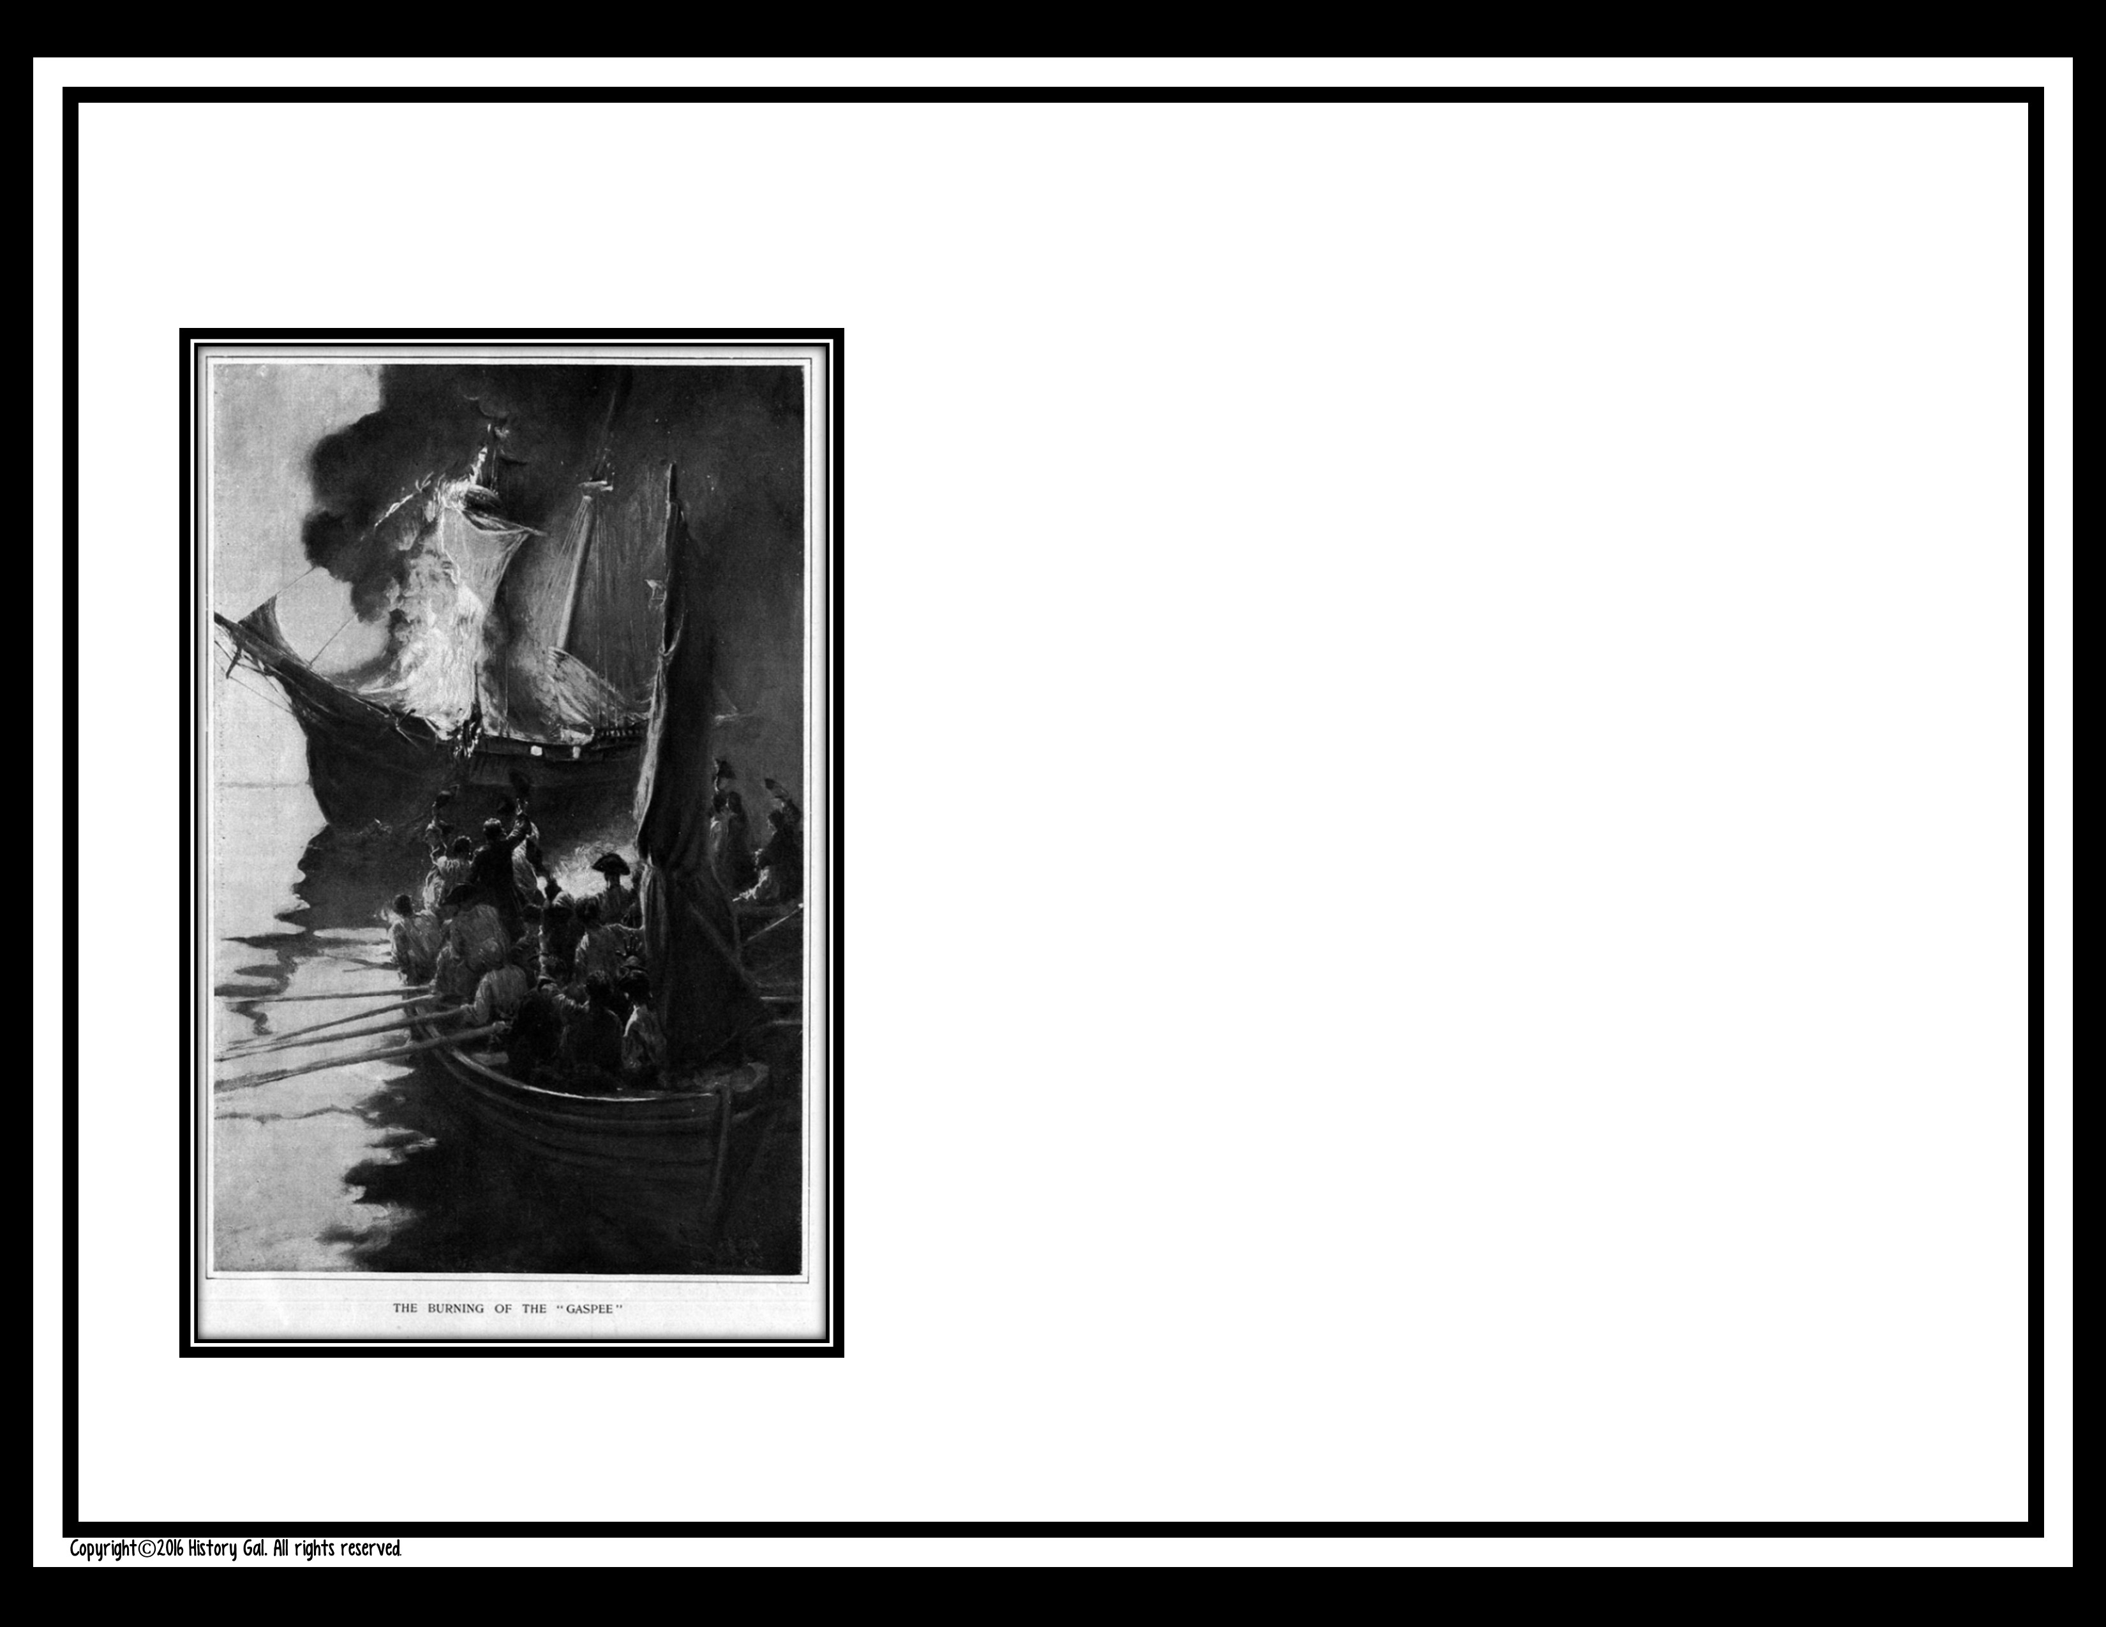
#9
It’s 1772, you read in the newspaper that Rhode Island colonists burned a British patrol ship, the HMS Gaspee. What is your reaction?

Slide 25
A. Crazy Rhode Islanders. No good can come from burning a British ship. You think things were bad before? Just wait until the British retaliate!

Slide 26
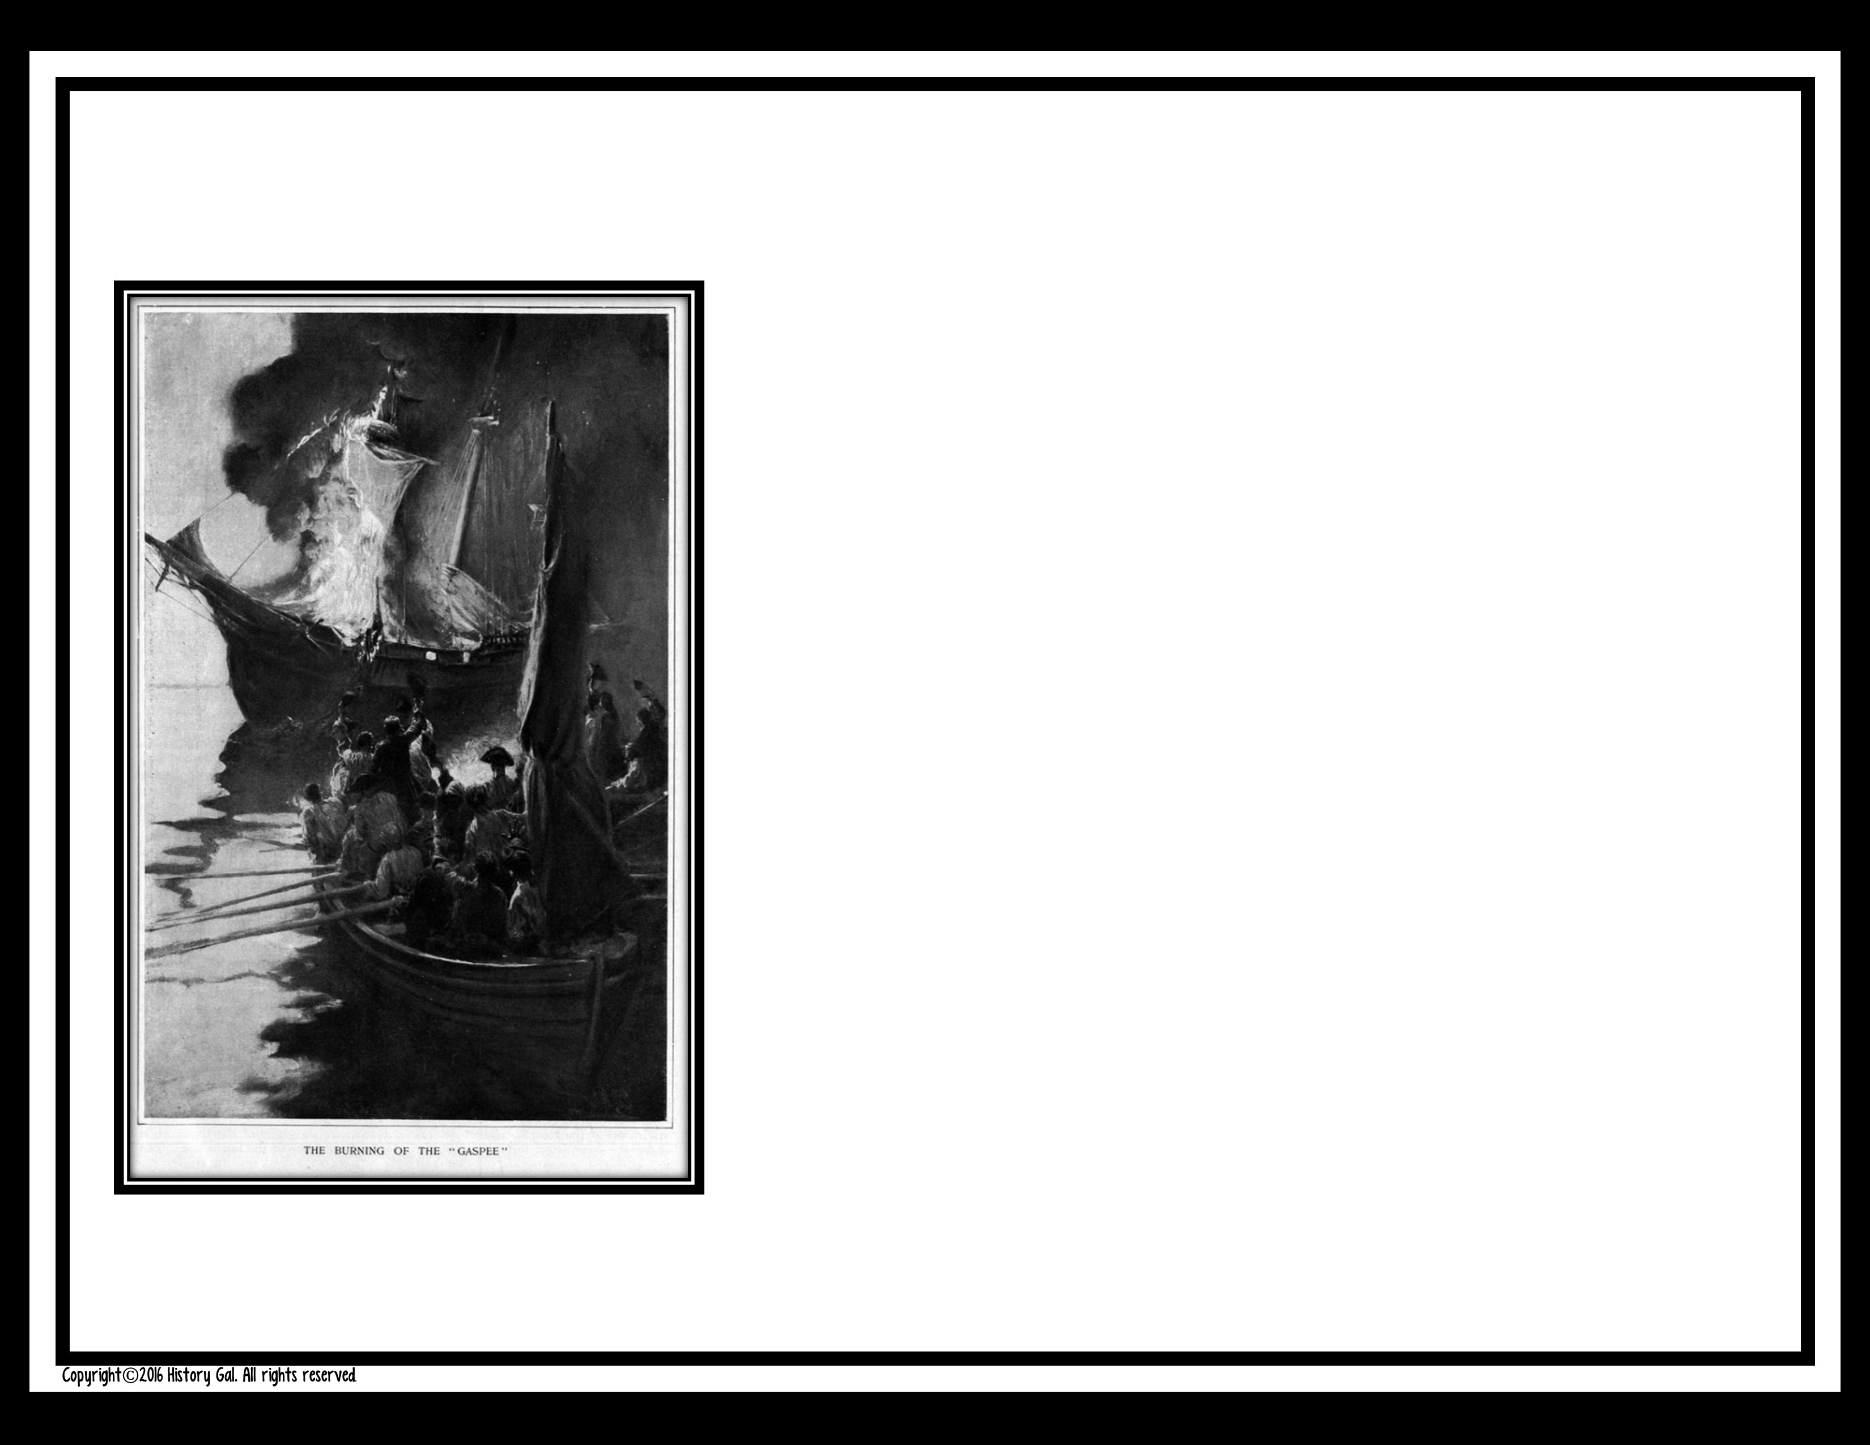
B. Good for them! Those darn patrol ships are always trying to catch us smuggling in our contraband. If Parliament would stop passing all these tax laws, we wouldn’t have to resort to smuggling.

Slide 27
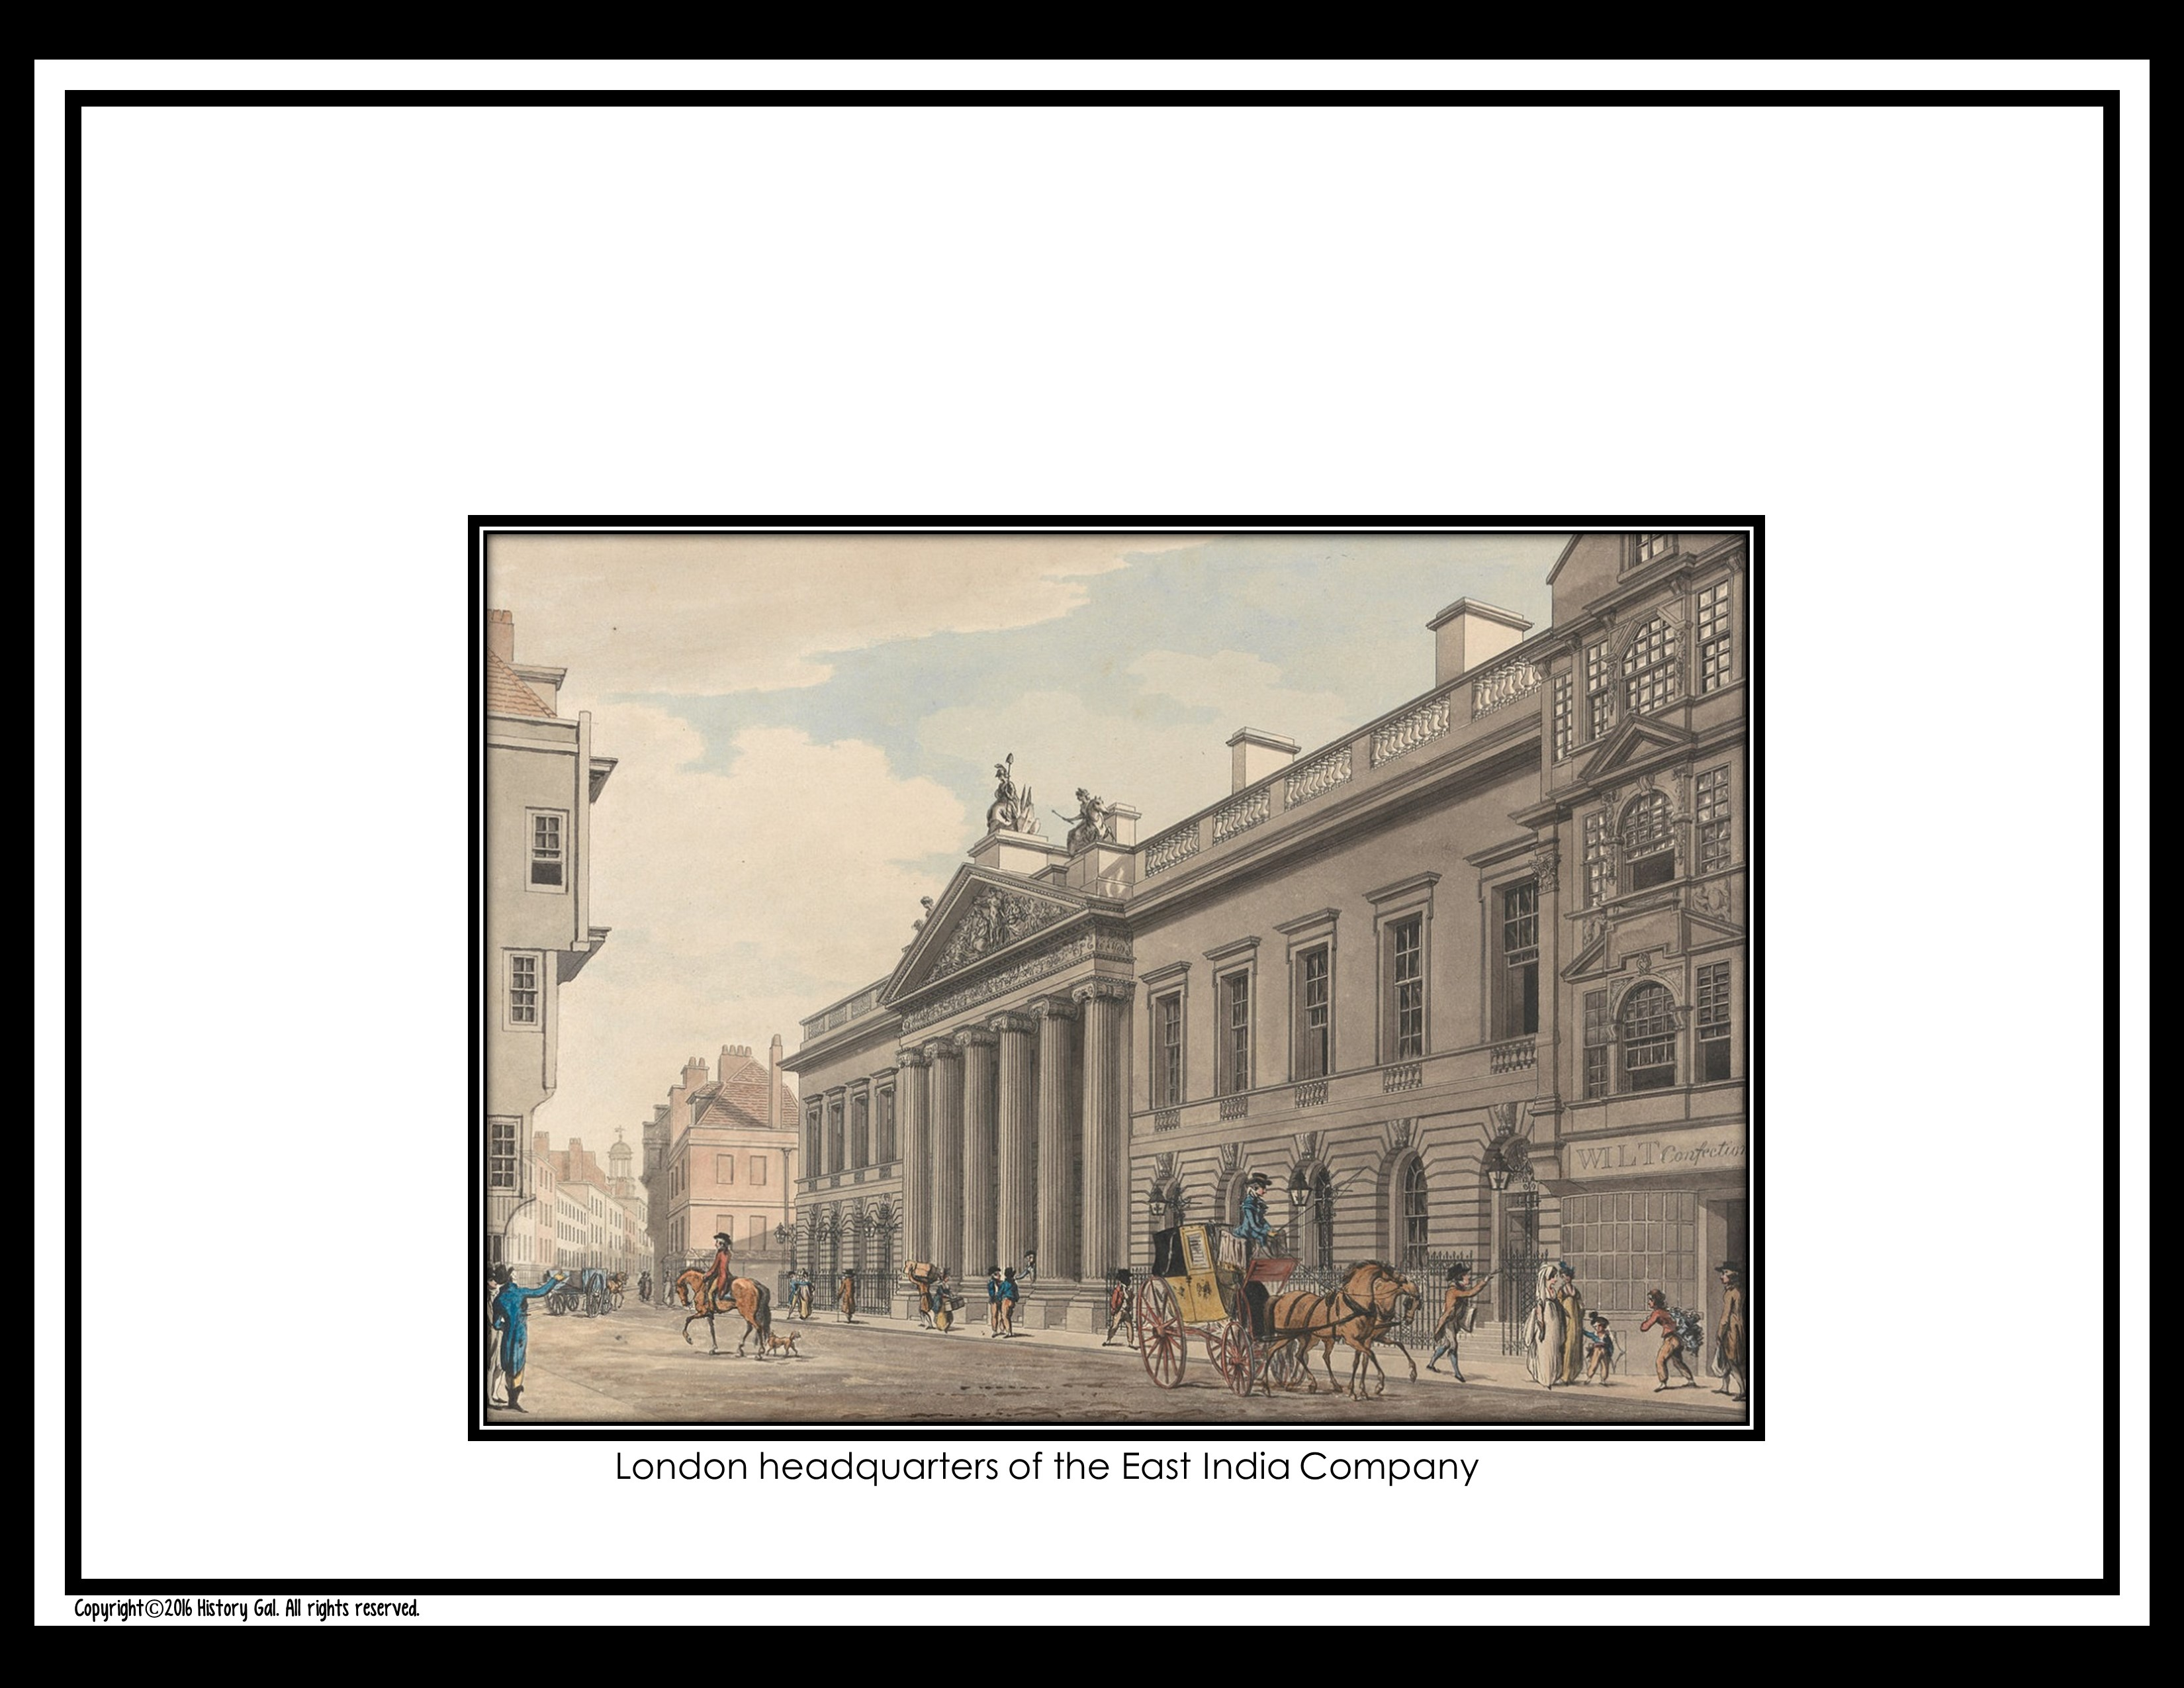
Now there’s another Tea Act. What will you do?
#10

Slide 28
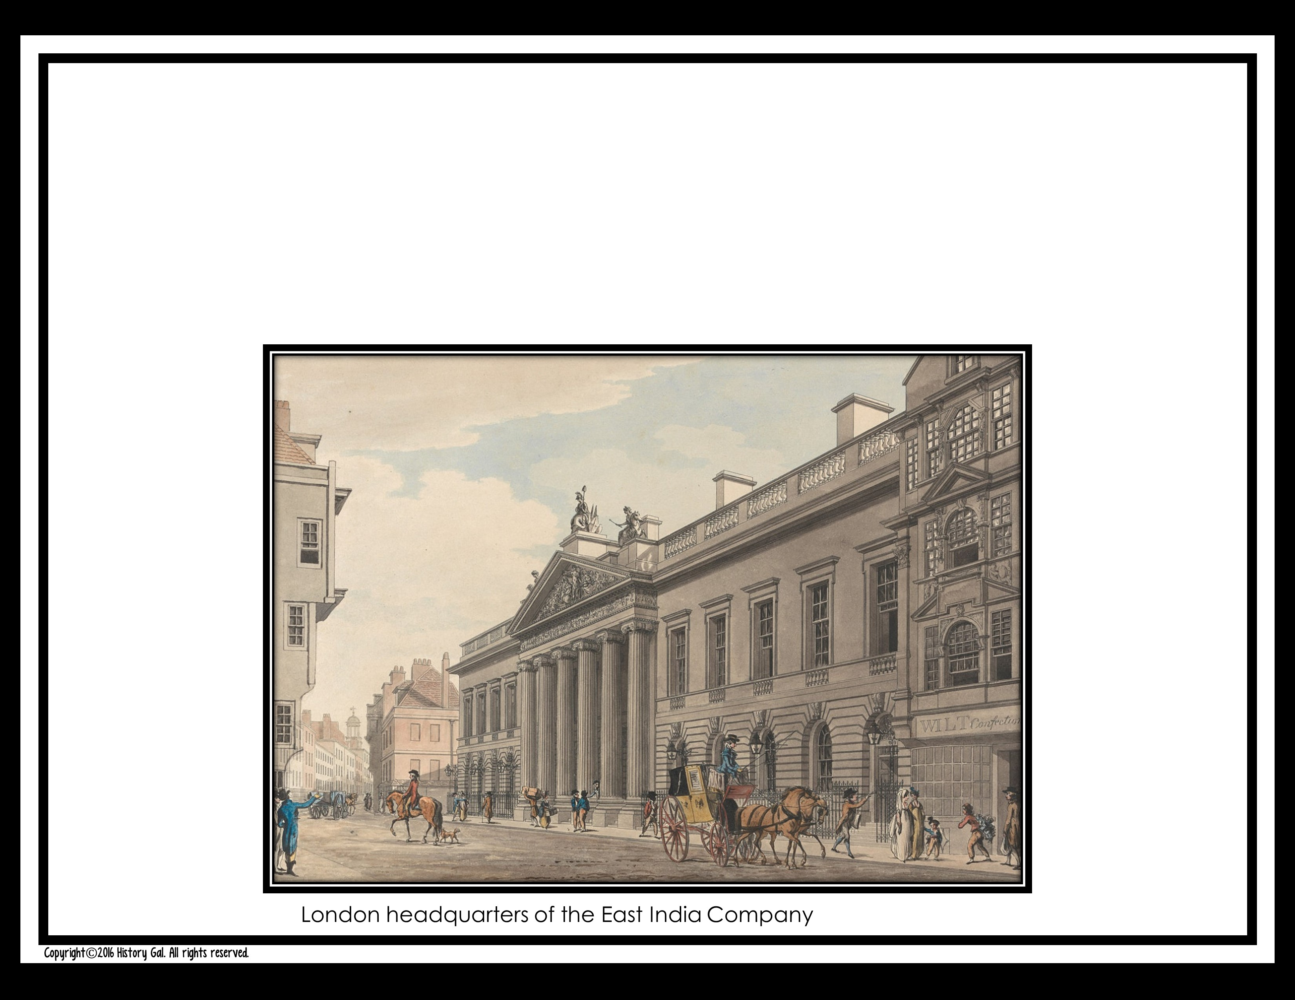
A. Pay the tax. You love your tea and if you have to pay a little more for it, so be it.

Slide 29
B. Boycott. You never really liked tea anyway. Now’s a good time to try coffee.

Slide 30
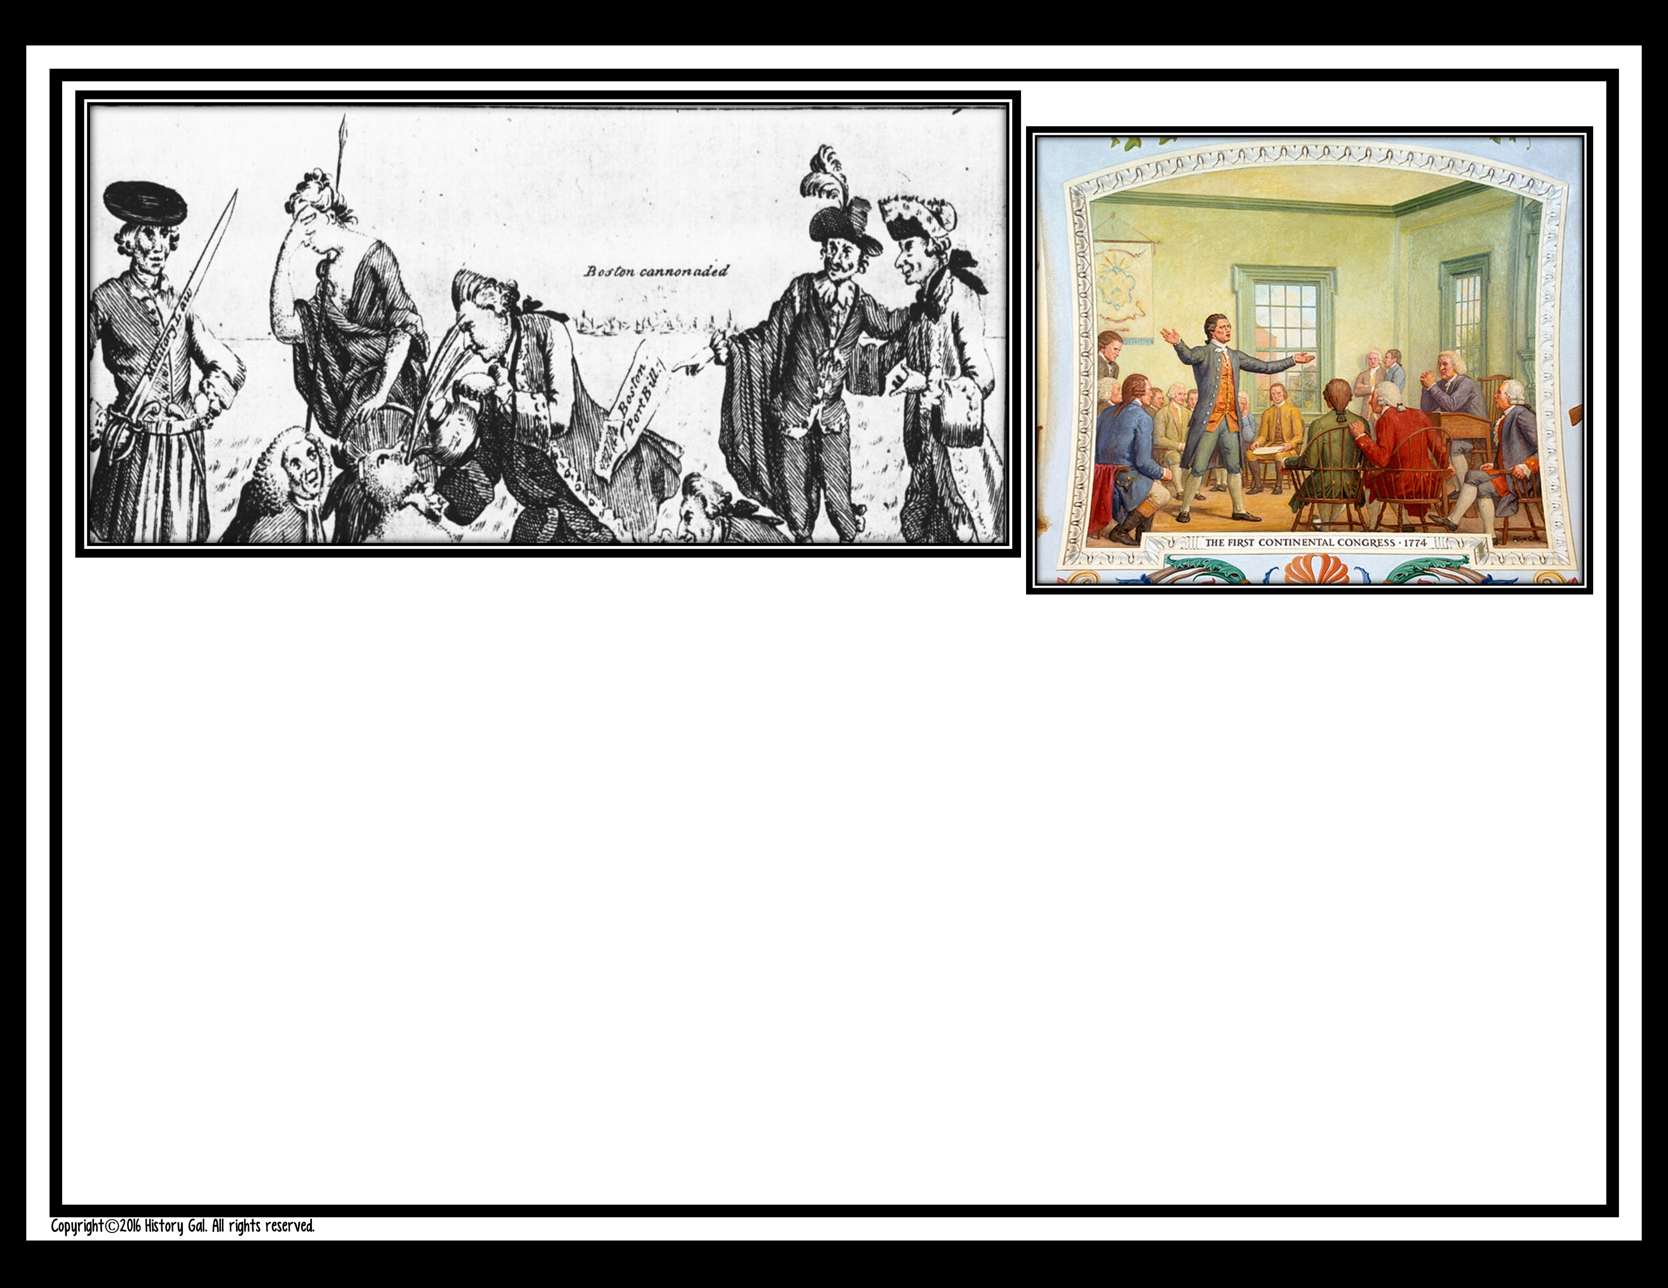
#11
Things are heating up some more. Some Bostonians had a “tea party” and dumped a shipload of British tea into the Boston Harbor. The British government is furious and passed a series of laws colonists are calling the Intolerable Acts. A few months later you’ve been invited to join a Continental Congress of colonial representatives meeting in Philadelphia to discuss everything that’s been going on. Do you go?

Slide 31
A. Yes. But only to be a voice of reason and make sure nothing crazy happens.
B. Yes! Finally, you have a chance to convince the British to make some real changes.

Slide 32
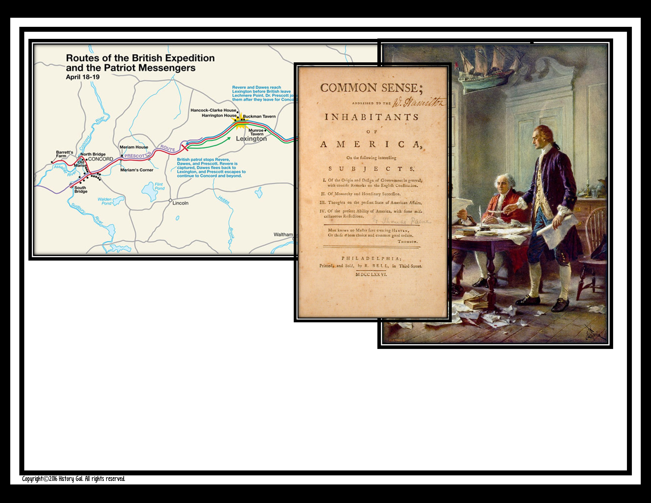
#12
In April 1775,
colonial militia and
British troops clash at
Lexington and Concord. The Continental Congress offers an olive branch to King George III, but he doesn’t even read it. So, Thomas Jefferson drafts a Declaration of Independence. Will you sign it?

Slide 33
A. No. There has to be another solution. Independence?! What a crazy idea!

Slide 34
B. Yes! You sign your name large enough that the king can read it without his glasses!

Slide 35

Add up the number of times you chose the letter “a” and the letter “b.”

Slide 36
If you have more “a” responses than “b” responses you would probably have been a Tory (a loyalist or British supporter) during the American Revolution.
If you have more “b” responses than “a” responses, you would probably have been a Patriot (rebel) during the American Revolution.

Slide 37
Of course, living in the 21st century, it is hard to believe that anyone would have chosen to remain loyal to Great Britain during the Revolution. However, we have the benefit of knowing the outcome. People living in the colonies in 1775, did not.

Slide 38
It is estimated that 1/3 of the colonists were Tories, 1/3 of the colonists were Patriots, and 1/3 of the colonists were on the fence or neutral.

Slide 39
FOLLOW-UP QUESTIONS
What are some reasons or factors that would help colonists remain loyal to Great Britain?
Why do you think some colonists remained neutral?

Slide 40
3. What are some reasons or factors that convinced colonists to join the side of the Patriots?
4. If you lived in 1775 and had no idea what the outcome of a war with Great Britain
would be, which side would you have chosen? Why?

