Slide 1
Unit Seven
Imperialism, World war I, 1920’s

Slide 2
American Imperialism

Slide 3
Causes of US Imperialism
End of the frontier
Foreign trade becomes increasingly important to American economy
Growth in international trade occurred from the late 1800s to World War I—the first era of a true “global economy.”

Slide 4
Con’t
Desire to compete with Europe for overseas Empires
Proponent of US expansion:
  Theodore Roosevelt

Slide 5
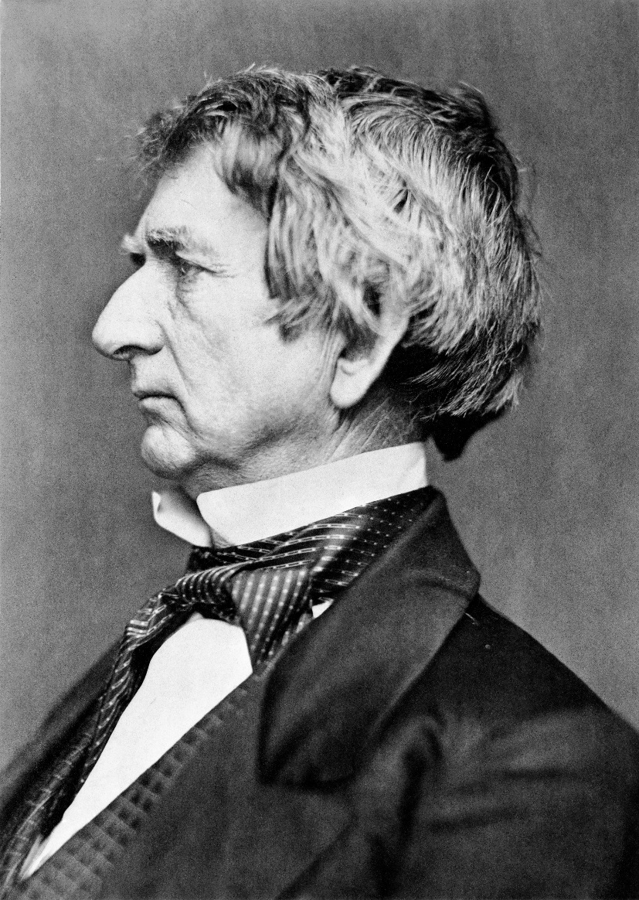
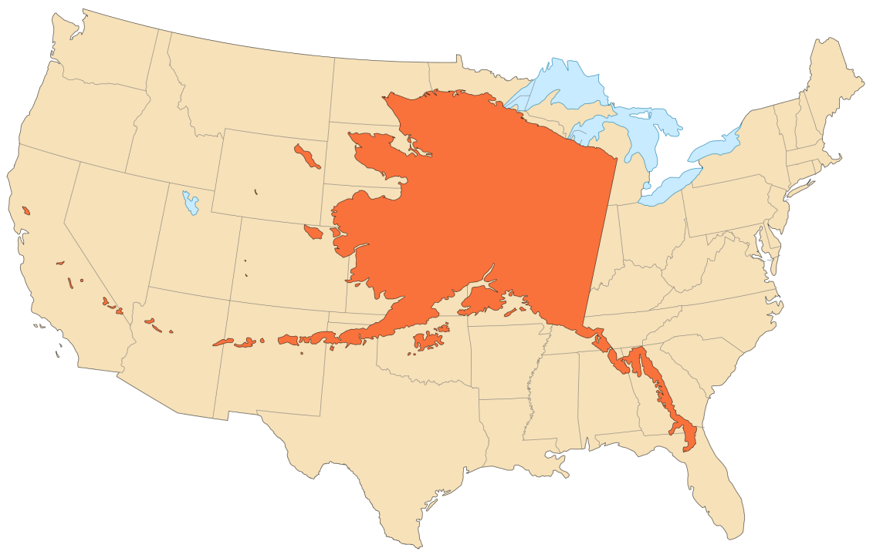
Purchase of Alaska
1867
“Seward’s Folly”

Slide 6
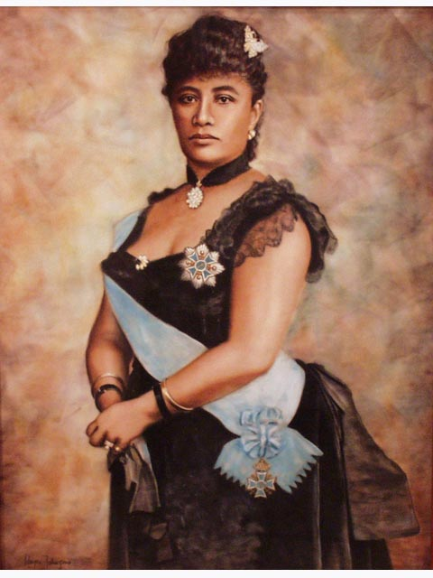

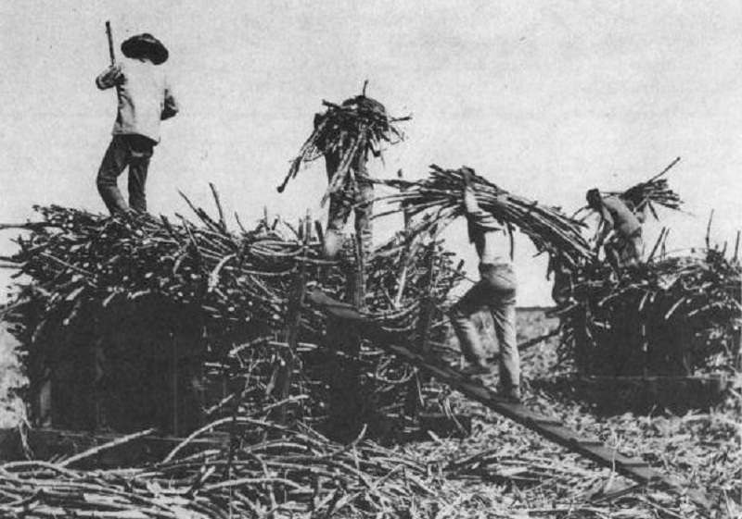
Hawaii
Since 1800’s the US saw Hawaii as an
extension of the Pacific coast
Queen Liliuokalani believed Hawaii
should be controlled by Hawaiians
1893-The US attempted to depose Hawaii’s monarchy
Treaty to annex Hawaii abandoned…for now…

Slide 7
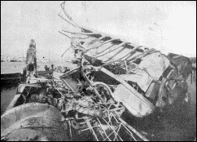
Cuba
Atrocities in Cuba sensationalized by “yellow press”
Spanish in Cuba revolt
Explosion of the U.S.S. Maine,
Feb. 15th 1898 is the
immediate cause of the
Spanish American War
“Remember the Maine…to
hell with Spain!”

Slide 8
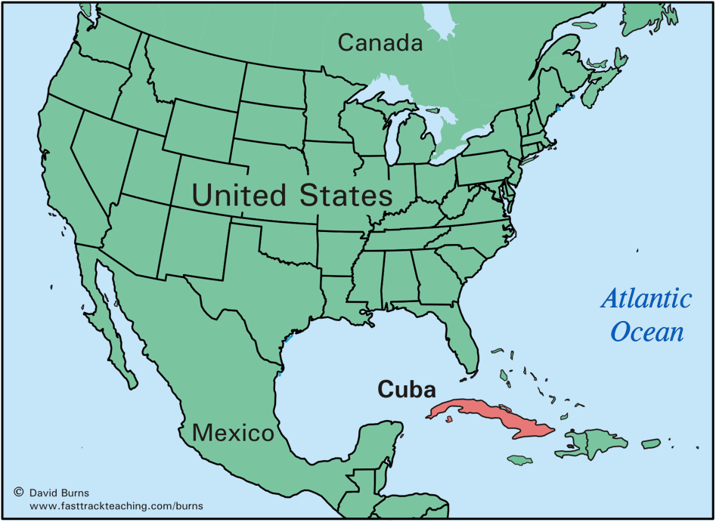

Slide 9
Spanish-American war-1898
McKinley and Wall Street not eager for war but yellow press forced the issue
Teller Amendment

Slide 10
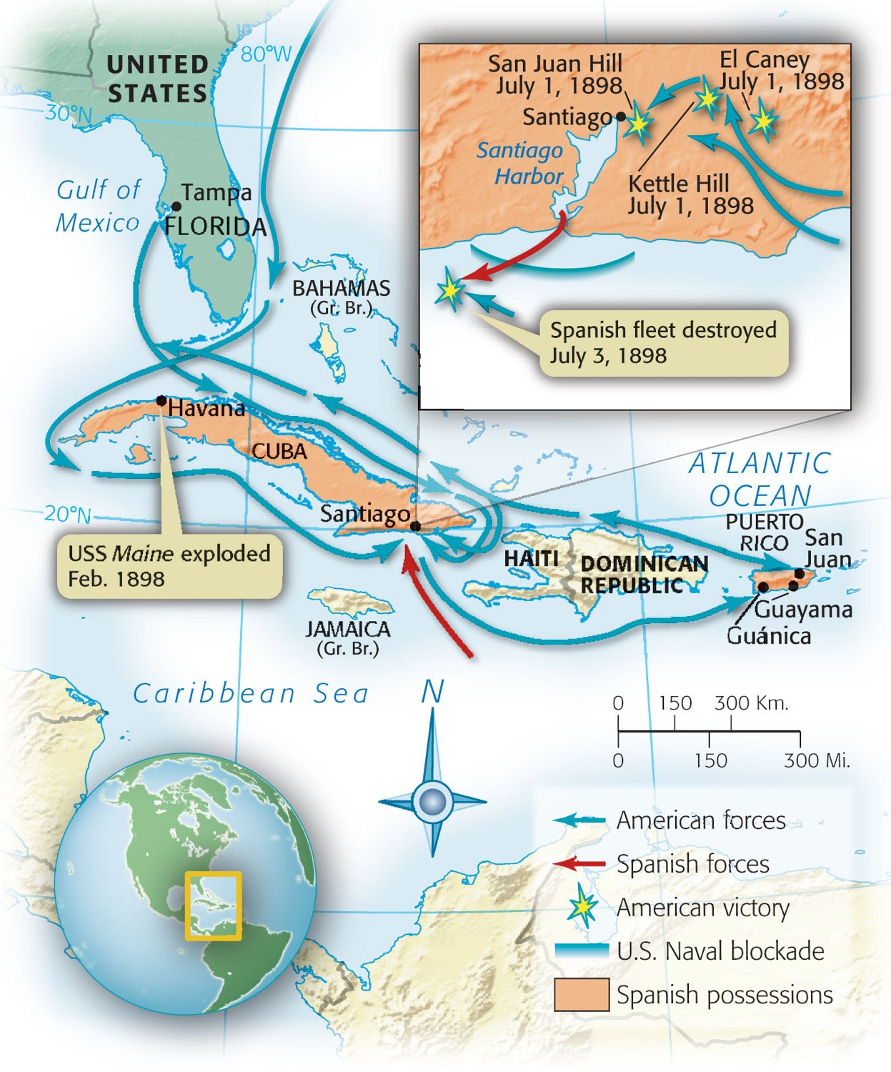
US Invasion of Cuba and Puerto Rico
Spain vs US
Santiago Bay
US Army invades
Puerto Rico
Teddy Roosevelt
and his “Rough
Riders”
  San Juan Hill

Slide 11
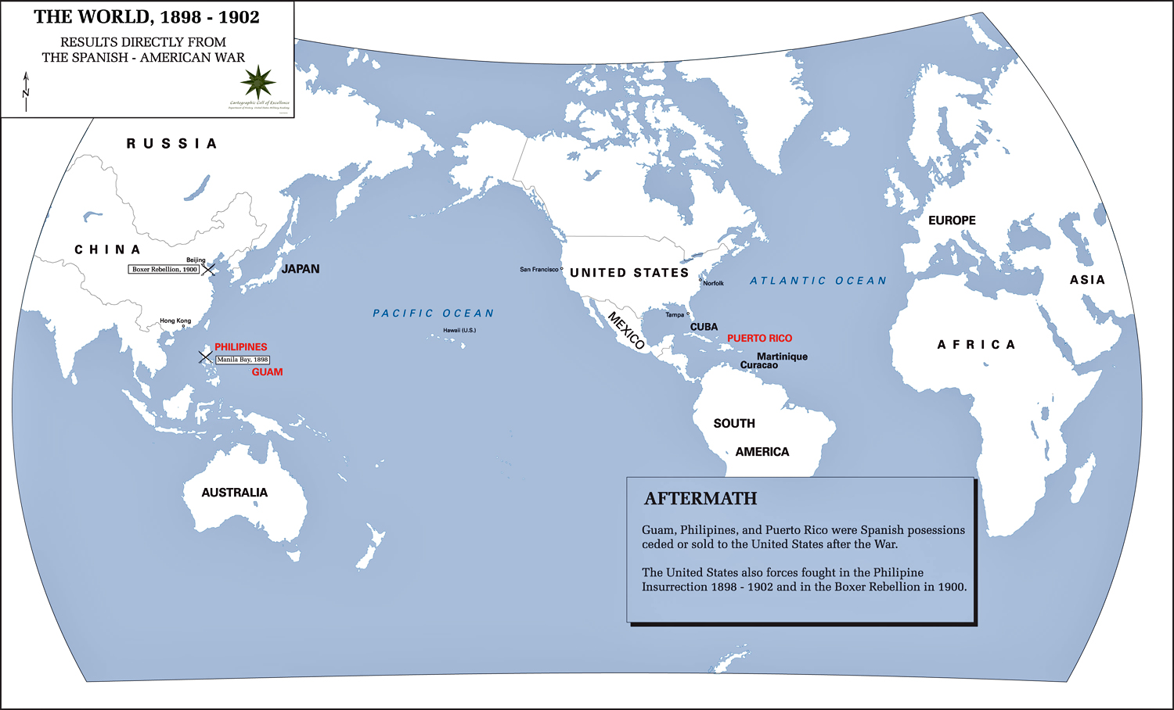
Admiral George Dewey victorious at Manila Bay

Slide 12
Annexation of Hawaii
July 1898
US said we needed Hawaii as a coal station for Dewey’s troops on their way to Manila Bay in the Philippines

Slide 13
Treaty of Paris
1898
Cuba freed from Spain
US gains Puerto Rico and Guam as a territory
Philippines a major issue in negotiations
  Philippines: Annexed after the Spanish American War

Slide 14
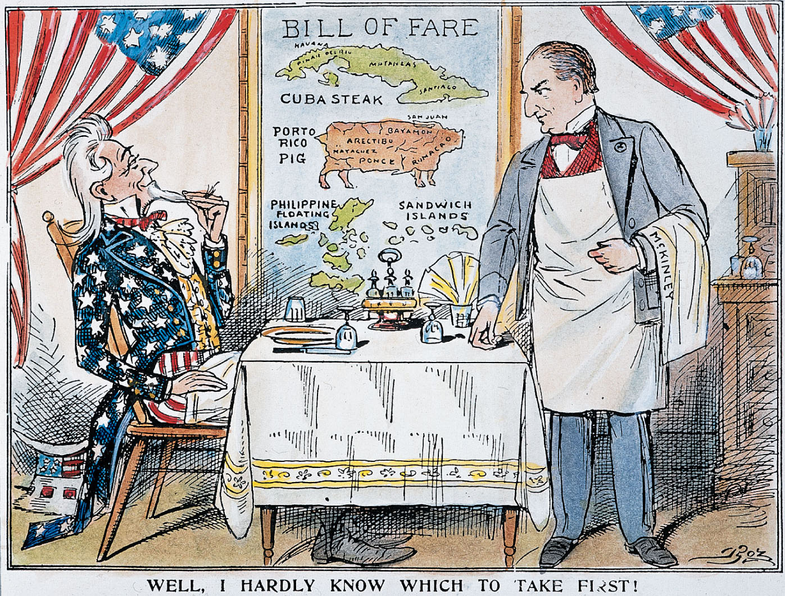

Slide 15
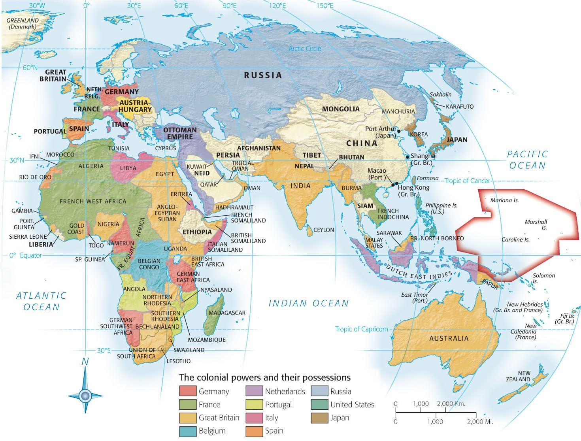

Slide 16
Open Door Policy In China
China becomes “Sphere of Influence” for Japan and W. Europe
Open Door Note- 1899
  Open Door Policy: Secretary of State John Hay proposed a policy that would give all nations equal trading rights in China.
Urged all foreigners in China to obey Chinese law, observe fair competition

Slide 17
Election of 1900
Rematch of Election of 1896
Republicans- McKinley vs Democrat- William Jennings Bryan
McKinley wins- is assassinated a year later
T. Roosevelt is sworn in
  “Speak softly but carry a big stick and you will go far”

Slide 18
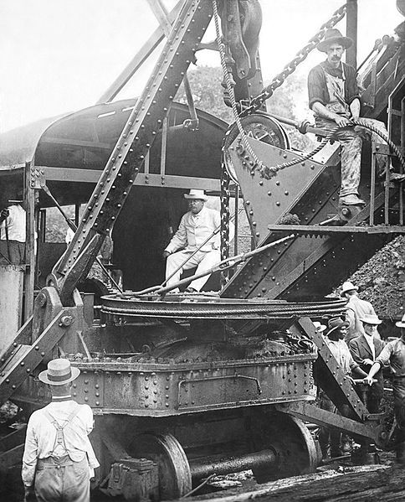
Panama Canal- 1903
Spanish-American War emphasized need for a canal to connect Atlantic and Pacific Oceans
Panama revolution from Colombia
The United States encouraged Panama’s independence from Colombia.

Slide 19
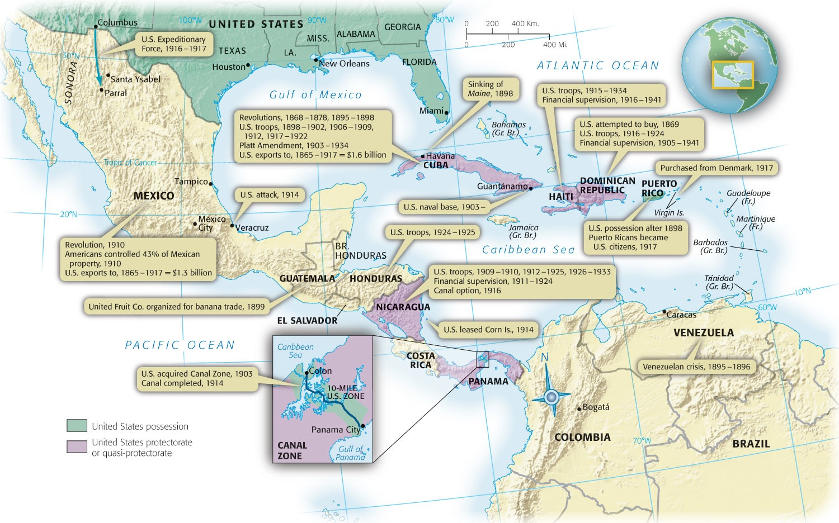
Map 29-2 p668
Notes:
Map 29.2 The United States in the Caribbean, 1898–1941 This map explains why
many Latin Americans accused the United States of turning the Caribbean Sea into a “Yankee
lake.” It also suggests that Uncle Sam was much less “isolationist” in his own backyard
than he was in faraway Europe or Asia.

Slide 20
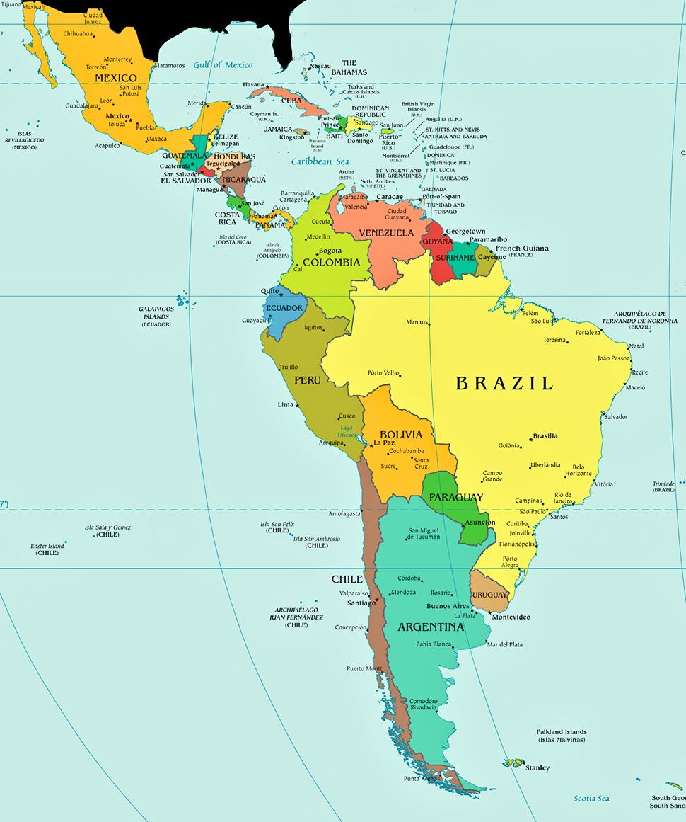
Roosevelt Corollary
Venezuelan Crisis
Addendum to the Monroe Doctrine by Theodore Roosevelt

Slide 21
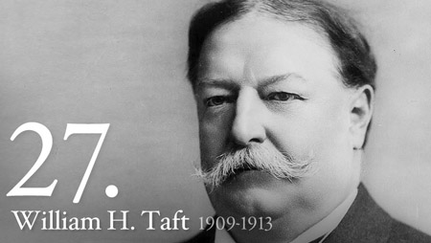
Election of 1908
Rep. William H. Taft defeats D. William Jennings Bryan
Taft

Slide 22
Dollar Diplomacy
President Taft urged American banks and businesses to invest in Latin America.
He promised that the United States would step in if unrest threatened their investments.

Slide 23
Split in the Republican Party
Taft-Roosevelt split
Roosevelt did not like Taft's presidential choices so he ran for a 3rd term
Republicans nominate Taft
Progressives leave party and create Bull-Moose Party and nominate Roosevelt

Slide 24
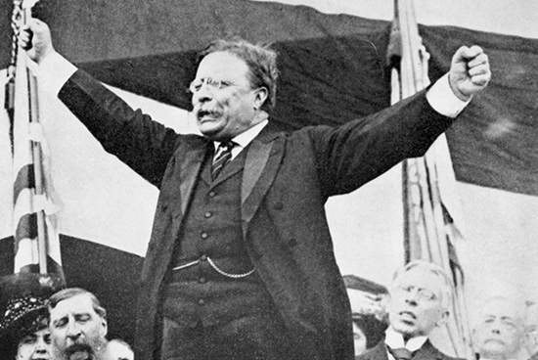
“It takes more than one bullet to kill a Bull-Moose!”

Slide 25
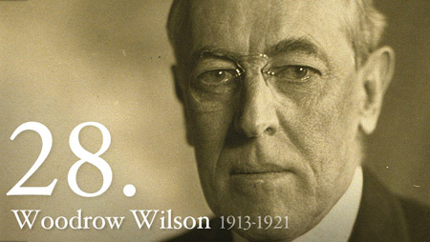
Election of 1912
Democrat Woodrow Wilson vs Bull-Moose Roosevelt and Rep. Taft
Wilson wins! (B/c of the Republican party split)
Wilson

Slide 26
“New Freedom”
Wilsons 1912 campaign slogan
Attacked the “triple wall of privilege”:
  Tariff- Reduced tariff rates to help farmers
  Banks- Helped reduce loans
  Trusts- Created Clayton Anti-Trust Act b/c he didn’t distinguish b/t good and bad trusts!

Slide 27
Election of 1916
Roosevelt refuses to run again and split the Rep. party
  “He kept us out of the war”
Wilson vs Rep. Charles Hughes
Wilson wins based on his antiwar policies

Slide 28
World war One
1914-1918

Slide 29
Causes of WWI
MAIN
Militarism
Alliances
Imperialism
Nationalism

Slide 30
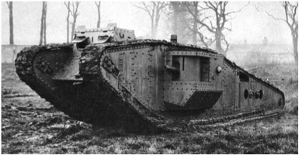
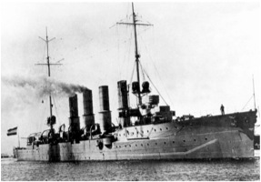
Imperialism
European countries want power so they build empires.
Germany felt denied land b/c she was the newcomer
Protecting imperial interests led to countries building larger armies and navies

Slide 31
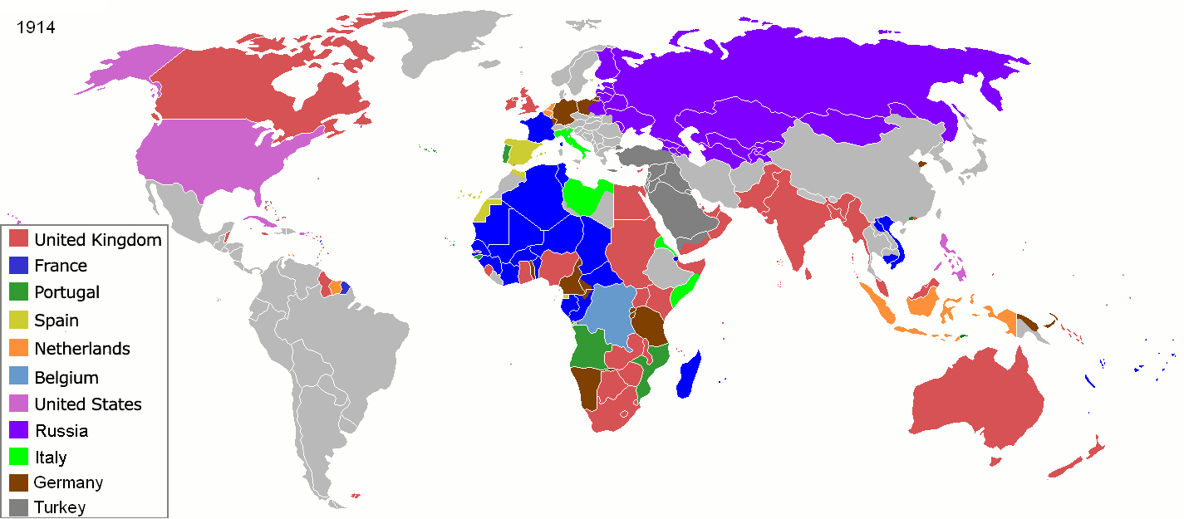
Empires of the World, 1914

Slide 32
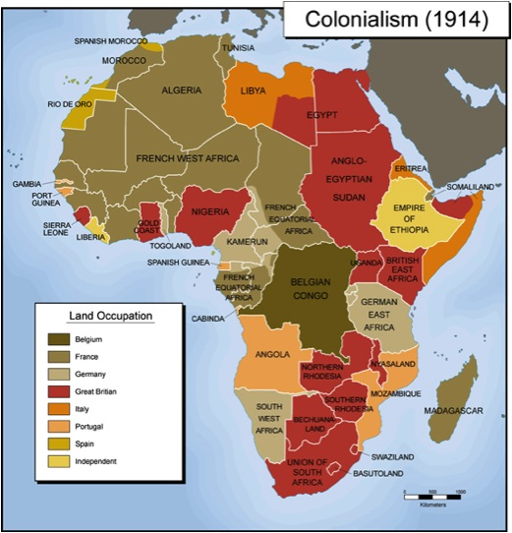

Slide 33
Alliances
European powers feared attack from their rivals in Europe
To protect themselves they formed military alliances – agreements to cooperate
Britain, France and Russia were allies in the Triple Entente
Germany, Austria-Hungary and Italy formed the Triple Alliance
Members of both alliances agreed that an attack on one ally would be treated as an attack on them all!

Slide 34
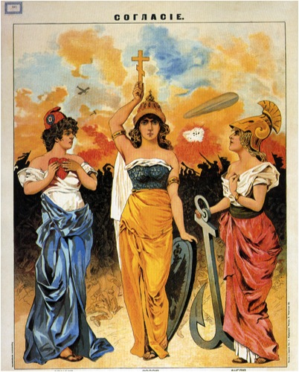
1914, Russian poster that reads “agreement”
Britain (left) and France (right) look to Mother Russia to lead them in the coming war

Slide 35
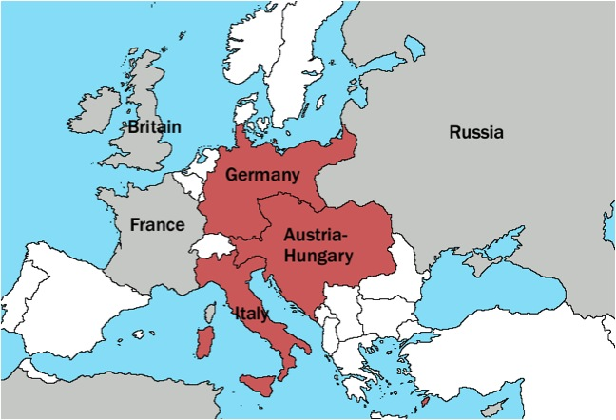
European Alliances, 1914
Triple Alliance – Red
Triple Entente – Grey

Slide 36
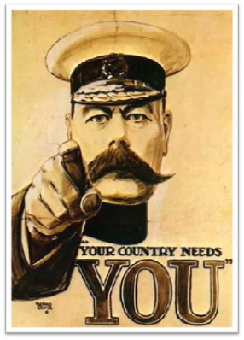
Militarism
Military very important part of countries strength!
European powers feared their neighbors so they began to strengthen their militaries

Slide 37
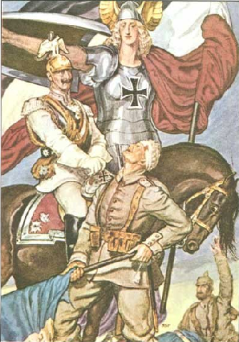
Nationalism
Your country is superior to all others!
Fighting to defend country is NOBLE
Serbia wanted to take over Bosnia-Herzeogivna (which was part of Austria-Hungary)

Slide 38
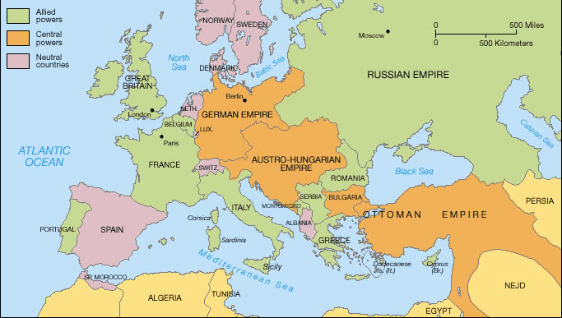
Serbia feeling the squeeze!

Slide 39
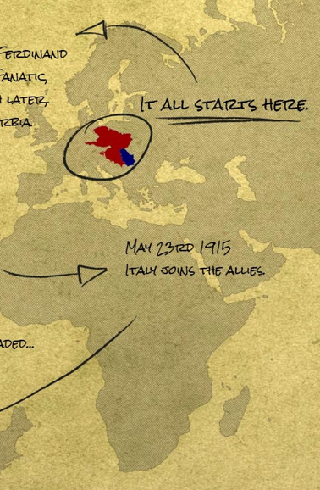
Assassination
“The Spark”
Archduke Ferdinand is assassinated by Serbian nationalist Gavrilo Princip

Slide 40
The Great War Rages in Europe
Austria wants investigators to look at evidence and Serbia says “NO” because its backed by Russia
Austria-Hungary used the assassination as an excuse to invade Serbia

Slide 41

The Dominoes Begin to Fall…
When Austria-Hungary invaded Serbia
Russia honored an agreement with Serbia and came to their defense
Germany then backed its ally, Austria-Hungary
  Attacks France with Schlieffen Plan
While Britain and France backed their ally, Russia
Just over a month after the assassination all of Europe was at war
(Italy is lured to side of allies in 1915)

Slide 42
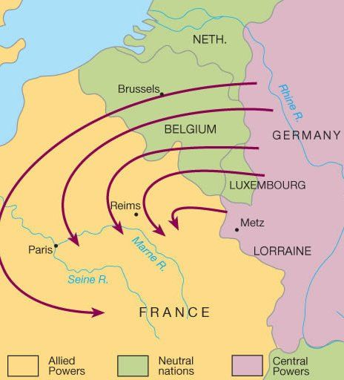

Slide 43
Main players in WWi
Central Powers: Germany, Austria-Hungary, and later Ottoman Empire & Bulgaria.
Allies: France, Britain, Russia, (later Japan, Italy, and the U.S.)

Slide 44
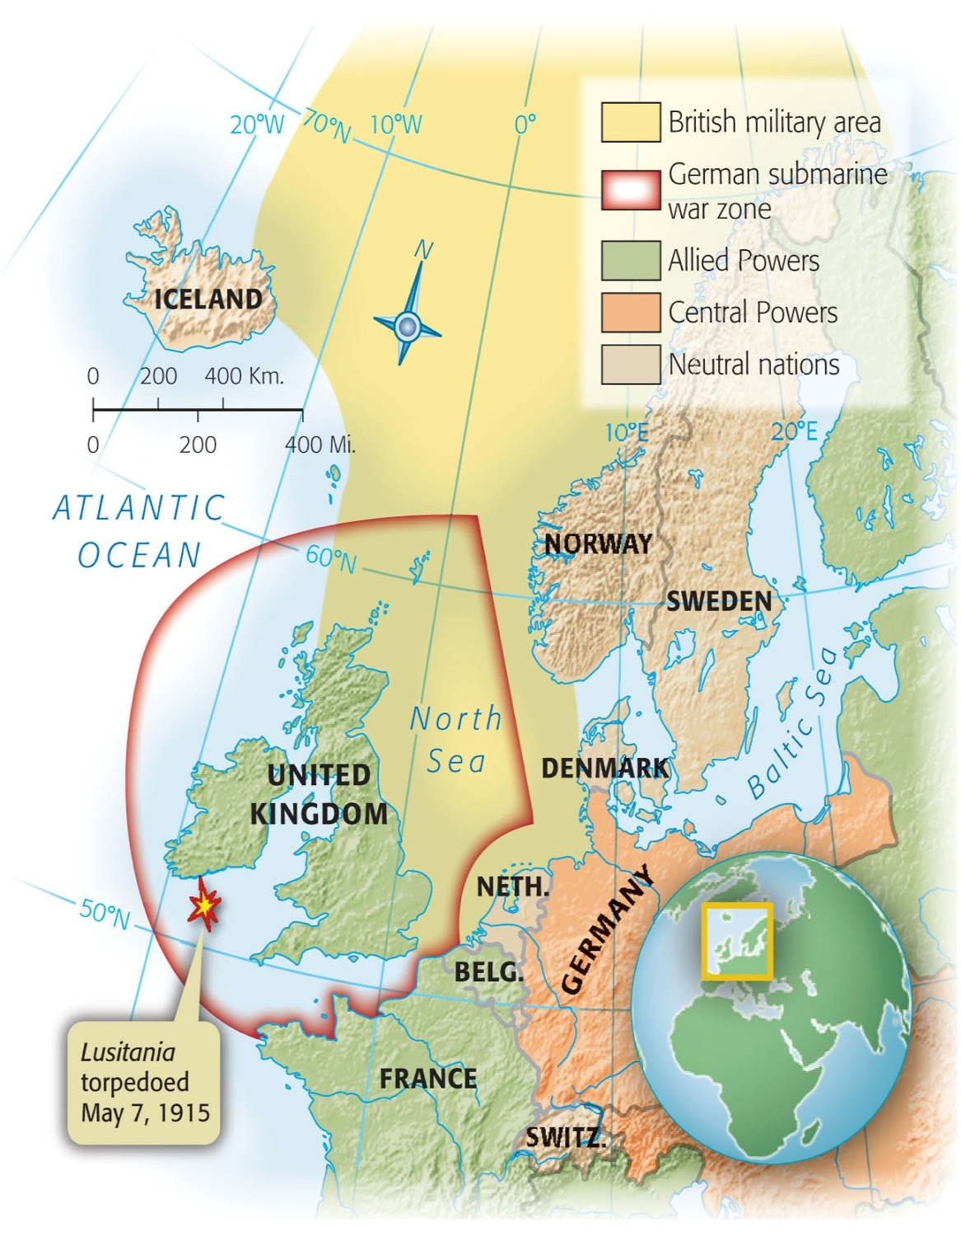
US Neutrality (??)
For three years, America remained neutral, and there was strong sentiment not to get involved in a European war
Germany starts submarine war on British coastline

Slide 45
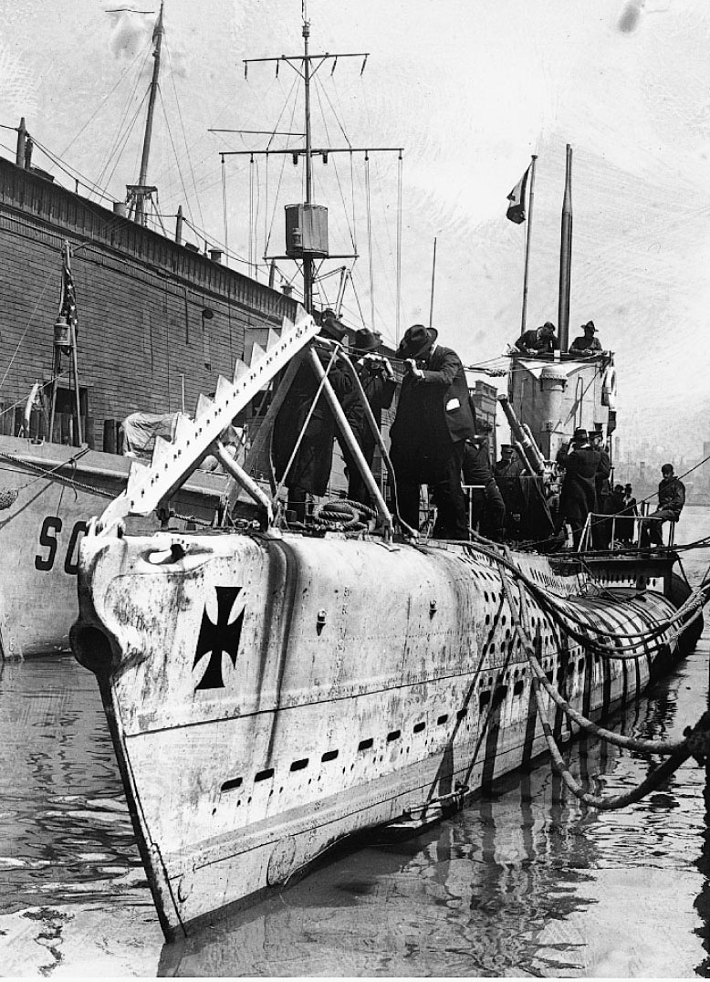
Sinking of the Lusitania
German U-boats
Lusitania is sunk killing 128 Americans
US on the way to war

Slide 46
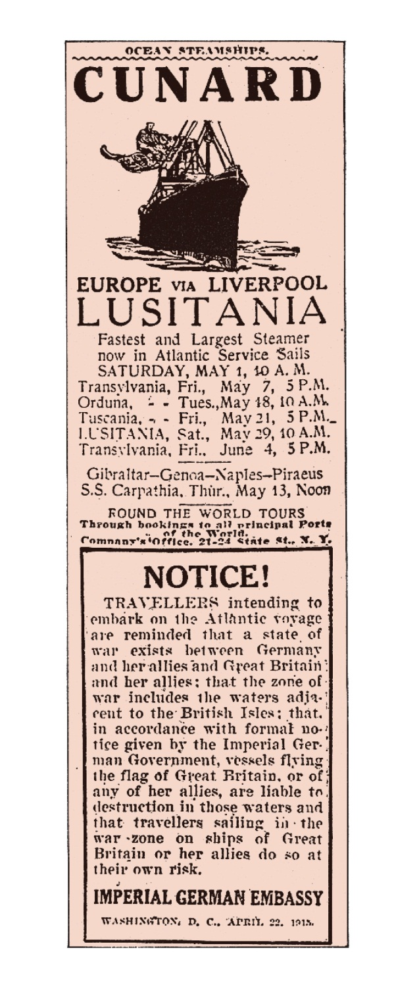
p673
Notes:
Advertisement from the New York Herald, May 1,
1915 Six days later the Lusitania was sunk. Note the
German warning.

Slide 47
German Aggression Pulls US into War
Germany declares intention of unrestricted submarine warfare
Zimmerman Note
The decision to enter the war was the result of continuing German submarine warfare (violating freedom of the seas) and American ties to Great Britain.

Slide 48
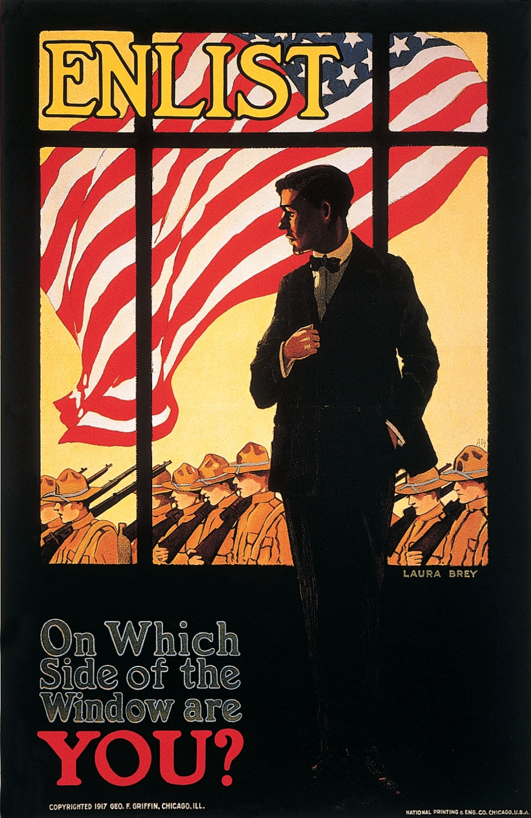
p681
Notes:
Patriotic Persuasion Worried about the public’s
enthusiasm for the war, the government employed all the
arts of psychology and propaganda to sustain the martial
spirit. The prewar song “I Didn’t Raise My Boy to Be a
Soldier” was changed to “I Didn’t Raise My Boy to Be a
Slacker,” which in turn inspired the cruel parody “I Didn’t
Raise My Boy to Be a Sausage.”

Slide 49
Wilsonian Idealism
US pride of isolationism
"Make the world safe for democracy" as a crusade
“A war to end all wars”

Slide 50
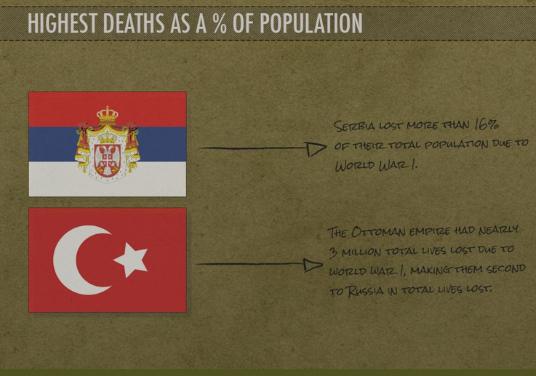
Mobilizing the army
Segregation in the American Army
High casualties

Slide 51
Versailles Peace COnference

Slide 52
Wilsons Fourteen Points
“Big Four”
Wilson’s plan to eliminate the causes of war
  Freedom of the Seas
  Self-determination (independence to minority groups)
  League of Nations
  Mandate System
    Controlling conquered territories until they are stabilized enough for self gov’t

Slide 53
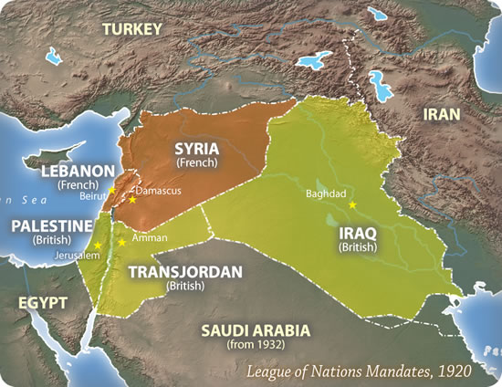

Slide 54
Versailles Peace Conference
Wilsons main goal was to create League of Nations
Compromised on self-determination with the mandate system
The French and English insisted on punishment of Germany.
National boundaries were redrawn, creating many new nations.

Slide 55
Defeat of Versailles Treaty
American public- YES
Republican Senate- NO
Democrats lost the presidential election in 1920 and the Senate failed to approve the Treaty of Versailles (So we are NOT in the league of nations)

Slide 56
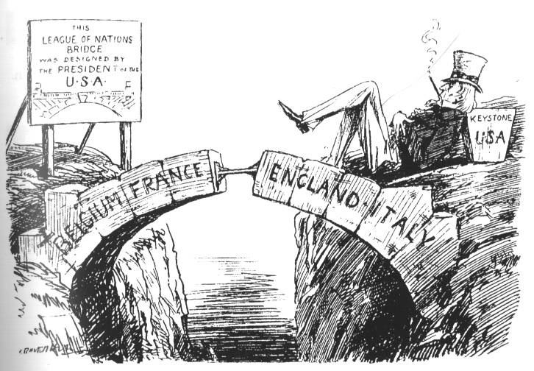

Slide 57
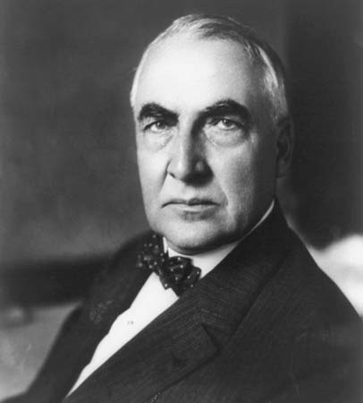
Election of 1920
Rep. Warren G. Harding vs Dem. James M. Cox
Harding wins

Slide 58
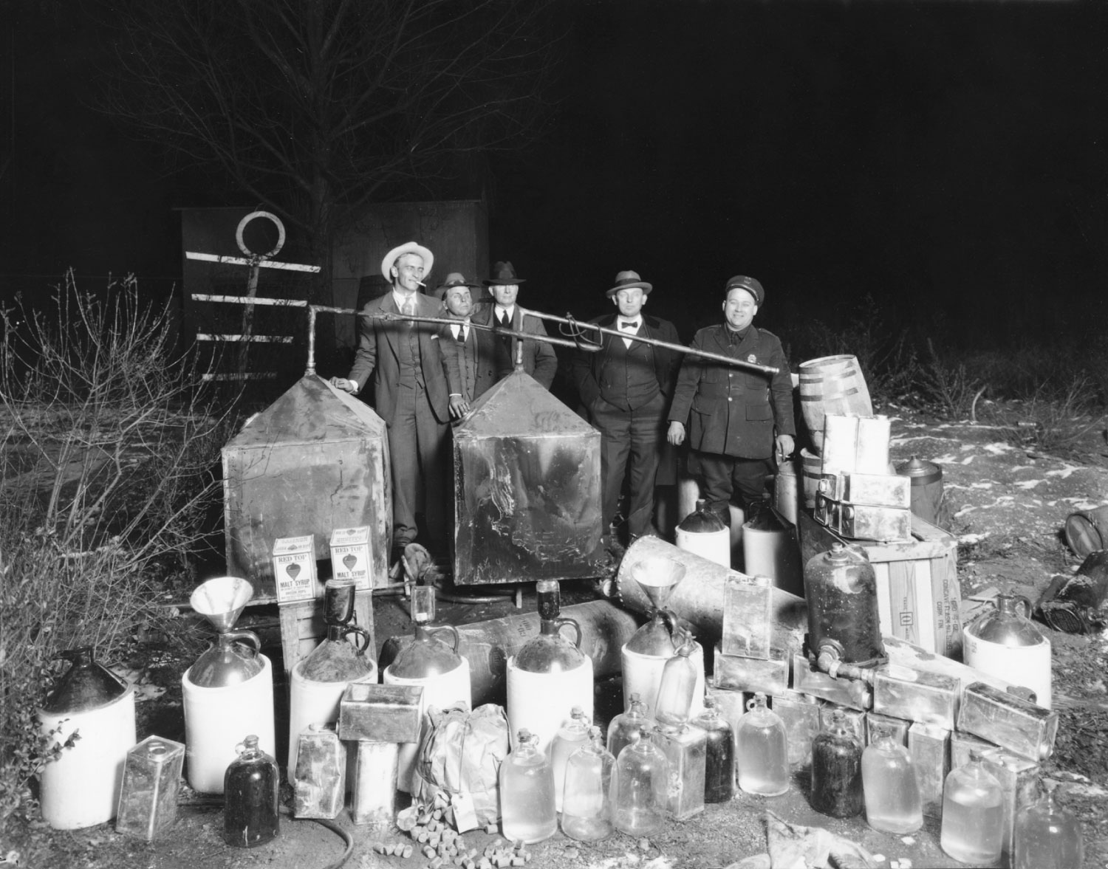
Prohibition of Alcohol
Dry laws
Cities remained “wet”
18th Amendment

Slide 59
American Society in the 1920s

Slide 60
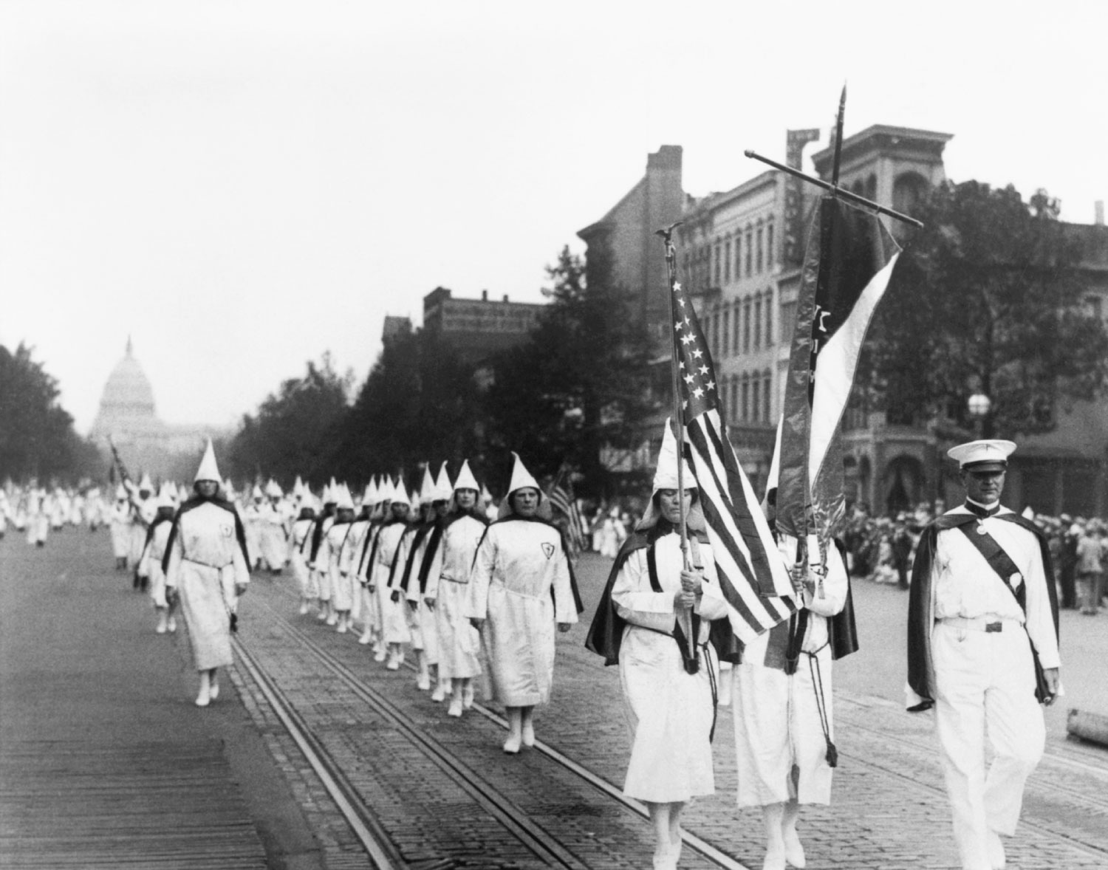
Ku Klux Klan
The rise of the New KKK against open immigration
More like the Know-Nothings party than the original KKK
Demise of the KKK

Slide 61
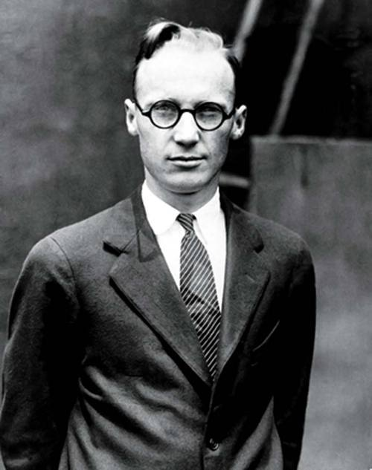
Charles Darwin Disrupts the Churches
Origin of the Species- 1859
Theory that man slowly evolved from lower life forms
Scopes Trial (“Monkey Trial”)- 1929
William Jennings Bryan and Clarence Darrow
John Scopes

Slide 62
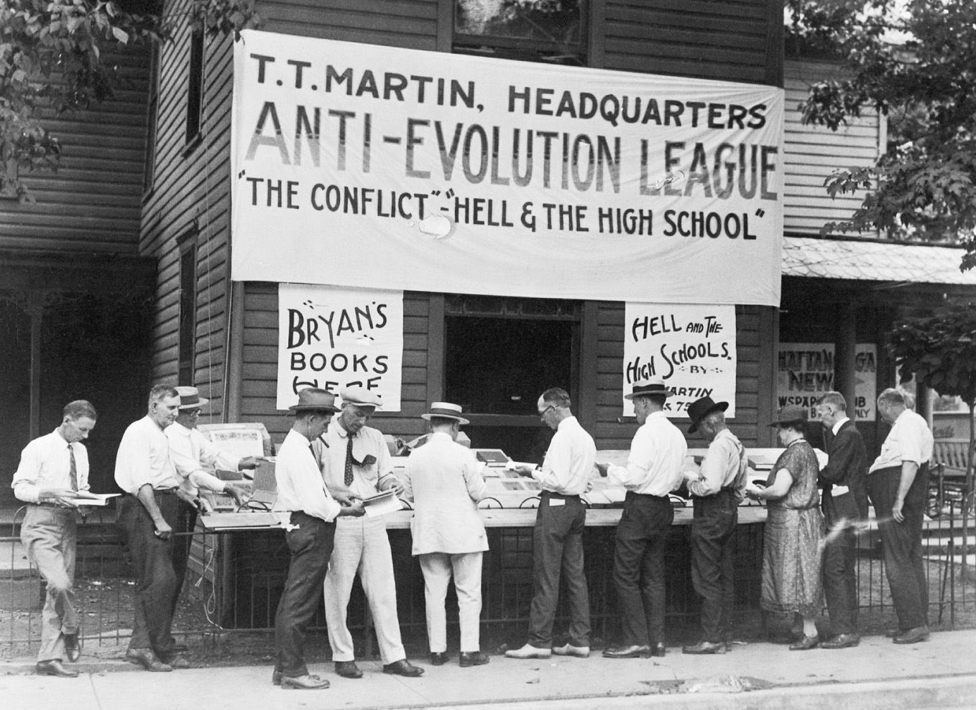
p709
Notes:
The Battle over Evolution
Opponents of Darwin’s
theories set up shop at the
opening of the famed
“Monkey Trial” in Dayton,
Tennessee, in 1925. The trial
was an early battle in an
American “culture war” that
is still being waged more
than seventy-five years
later.

Slide 63
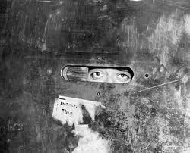
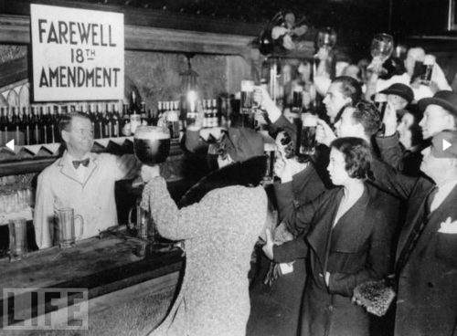
Prohibition- Again
Volstead Act of 1919
Problems with enforcement
Results in a rise of organized crime
  Al Capone
  Bribes
  Gang violence
Speakeasies appear
Repealed in 1933

Slide 64
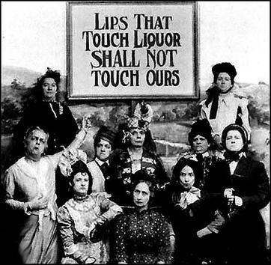

Slide 65
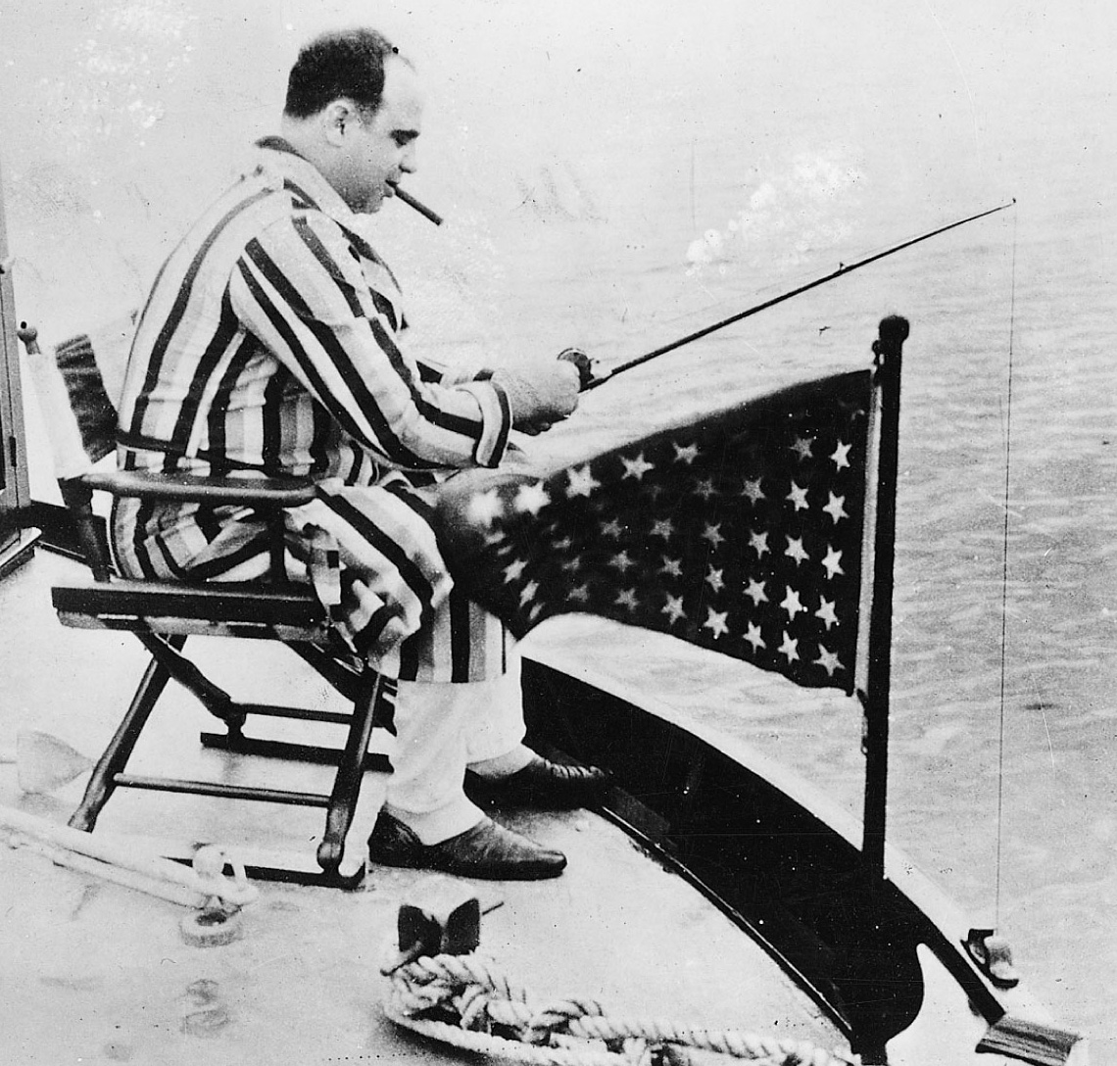
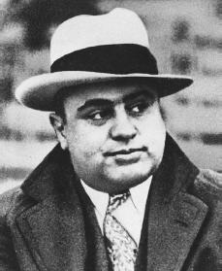
p708
Notes:
Gangster Al Capone Fishing in Florida Capone may
have looked like any Chicago businessman on vacation,
but his business was bigger and nastier than most, as he
often eliminated his competition by murder. He was
reported as saying, “Everybody calls me a racketeer. I call
myself a businessman. When I sell liquor, it’s bootlegging.
When my patrons serve it on a silver tray on Lake Shore
Drive, it’s hospitality.” He was finally jailed in 1932 for
falsifying his income-tax returns.

Slide 66
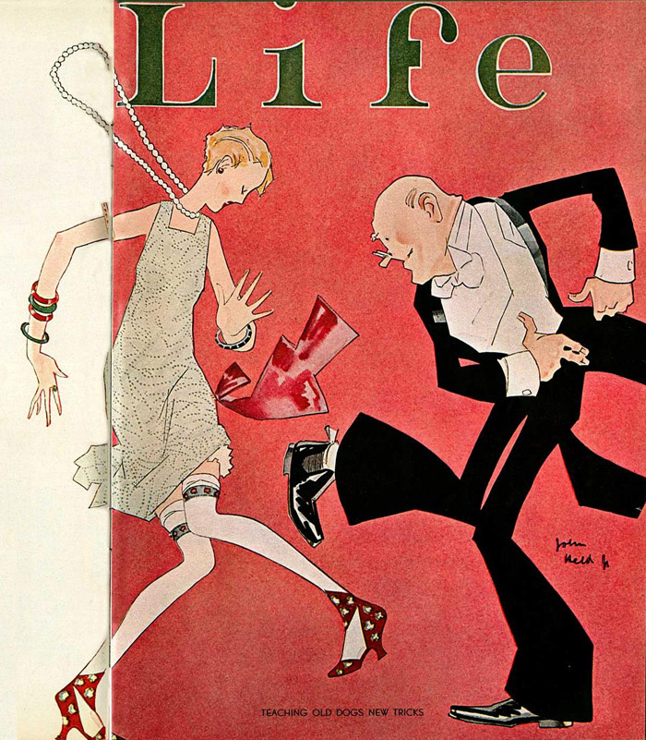
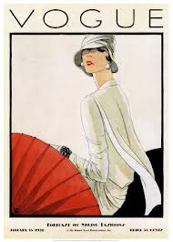
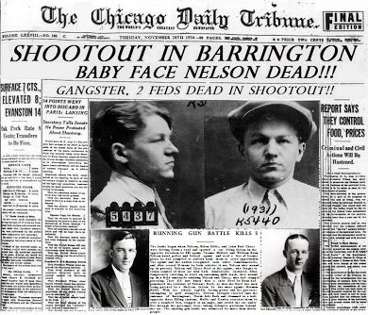
Mass-Consumption Economy
Advertising emerged as a new industry
Newspapers and magazines shaped cultural norms and sparked fads

Slide 67
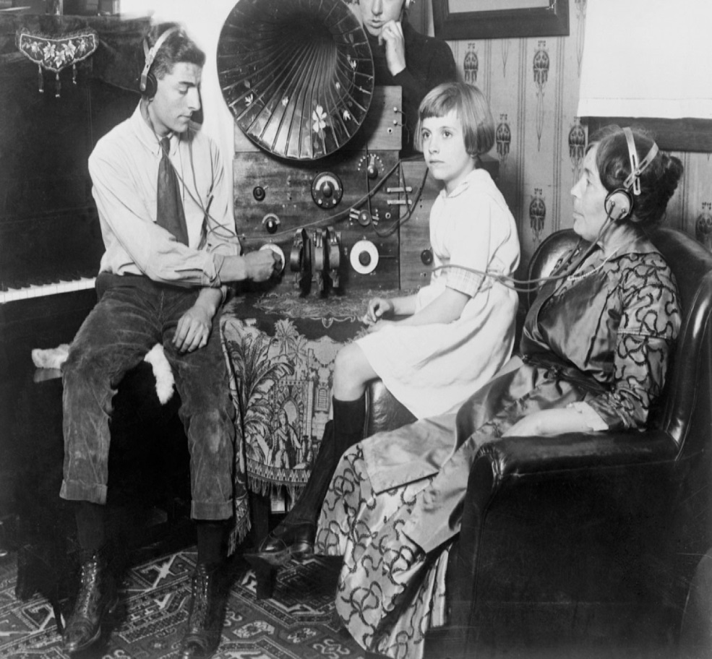
Radio
Marconi- inventor
Radio has huge impact on society
  Jazz is broadcast as a new style of music
  Fireside chats (politicians)

Slide 68
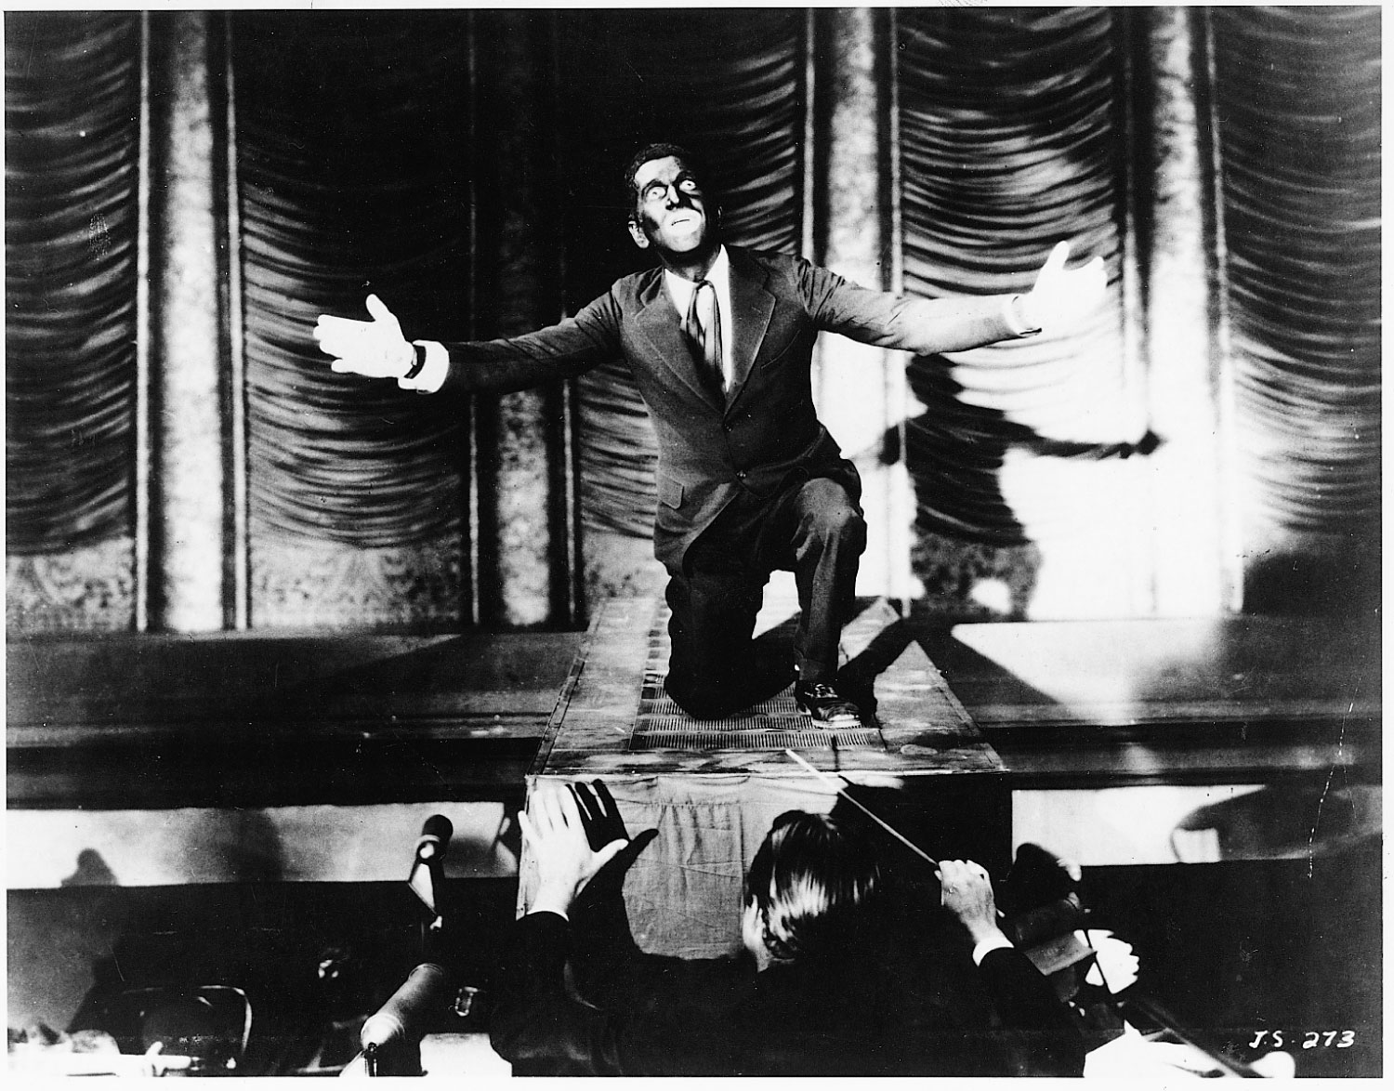
Movies
1903- 1st real moving picture
Provided escape from Depression-era realities
Al Jolson in “The Jazz Singer” (1st talkie)

Slide 69
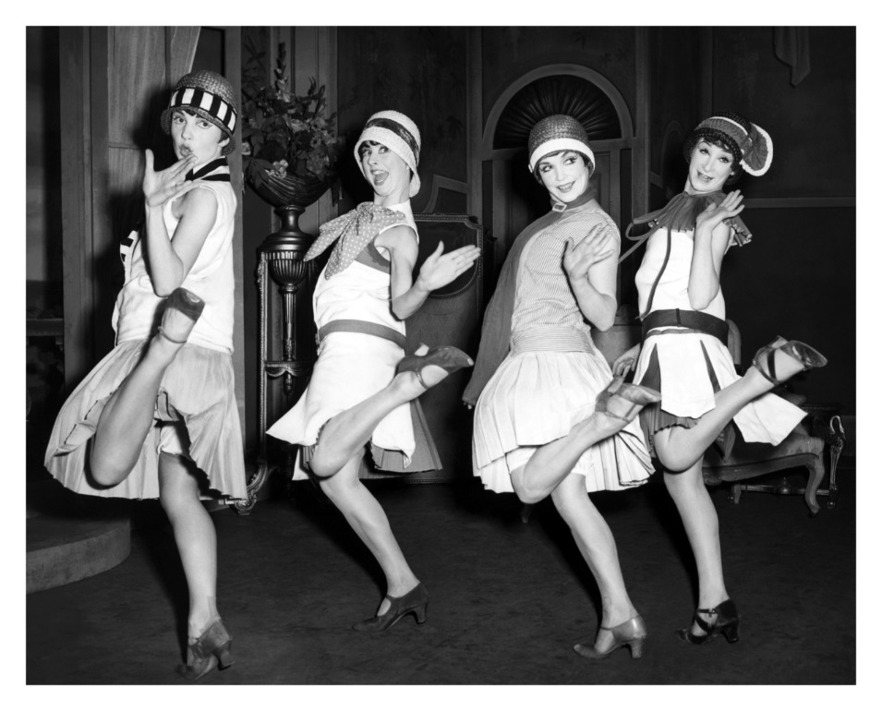

Social Life during the “Roaring 20s”
More people now live in urban areas
Time of sexual revolution
Margaret Sanger and “birth control”
Flapper styles expressed the new freedom of women

Slide 70

Forbidden to speak on the inflammatory topic of birth control, a defiant Sanger covered her mouth and “lectured” in Boston by writing on a blackboard.

Slide 71

“Guardian of Morality” checking to make sure too much leg is not uncovered

Slide 72

Jazz
Term is popularized after WWI
Pre-WWI: Came from African influenced slave spirituals
New Orleans Dixieland Jazz

Slide 73

Election of 1928
Rep. Herbert Hoover vs Dem. Alfred Smith
Radio a big part of campaign
Hoover wins
Herbert Hoover

